Slide 1
Introduction to Thesis Writing
Course Introduction

Slide 2
Prof. W’s Background

Slide 3
Education
Associates of Arts
BA (Linguistics)
Certificate for Teaching ESL Linguistics
(30 Credit courses + 30 hr. practicum)
MA (TEFL/ TESL)
PhD Education

Slide 4
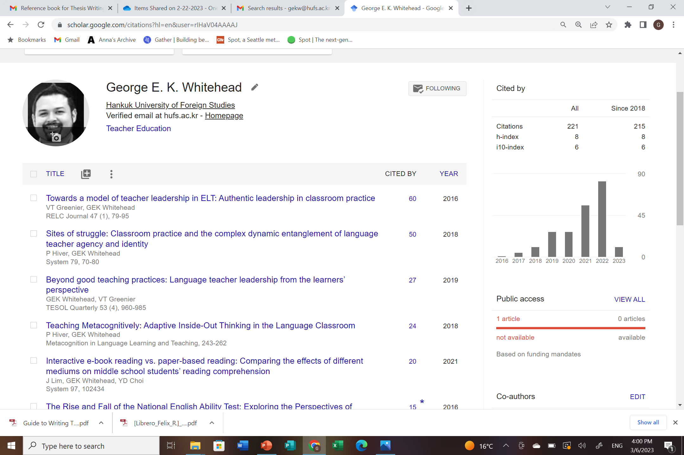
Recent Publications

Slide 5
Peer review & Editing
I volunteer as a peer reviewer for many top journals in our field.
System
TESOL Quarterly
Language Teaching Research

Slide 6
HUFS Thesis Advisor
Specializing in qualitative research design

Slide 8
Introduction to Thesis Writing
with Prof. George E.K. Whitehead

Slide 9
The Introduction to Thesis Writing course aims to…
… help you develop a richer understanding of academic writing.
… increase your understanding and ability to write different sections of a thesis.
…help you increase the quality and clarity of your writing through participation in various task-feedback activities.
…help you develop the ability to knowledgeably review, and critique different sections of a thesis.
… help to boost your confidence in your ability to write a thesis.
But most importantly… Make academic writing and writing your thesis an easier process for you

Slide 10
By the end of this course you will have…
…developed and refined various academic reading & writing skills
….created a variety of documents related to sections of a thesis/ portfolio
…developed a deeper understanding of the topic you write about

Slide 11
Course Overview

Slide 12
1st | Introduction to thesis writing The basics: Key concepts and considerations in thesis writing
2nd | Introduction to useful academic writing tools Finding reputable sources: Knowing what a reputable journal is and how to find studies
3rd | Summarizing and Synthesizing Literature : Creating Literature Cards
4th | Introduction to APA 7th Edition Referencing and practice
5th | Writing the Literature Review Workshop
6th | Writing introductions: Peer-feedback workshop
7th | Writing the Introduction workshop
8th | Introduction writing and feedback workshop
9th | Writing the Methods section workshop
10th | Methods section: Overview of sections and content
11th | Writing Finding/ Results section workshop
12th | Working with data: Presenting and discussing results/ findings
13th | Writing the Discussion section workshop
14th | Writing the Conclusion workshop
15th | Final Review of Key Points & Reference List
6th | Literature review writing and feedback workshop

Slide 13
Course Evaluation
Attendance: 15 points
Participation, Professionalism, Excellence 15 points
Application tasks: 30 points
Writing portfolio: 40 points
Total: 100 points

Slide 14
Application Tasks/ Final Portfolio
Literature card
Introduction
Literature review
Methods
Discussion
Implications
Conclusion
Reference List

Slide 15
Attendance
If you are going to be late or absent please send me a message before class if possible.
*Attendance includes being here on time prepared for class.
Arriving 5 minutes or more after the start of class will be marked as late.
For each late mark you will receive a 1 point deduction in attendance
Arriving 30 minutes or more after the start of class will be marked as absent.
For each absence you will receive a 2 point deduction in attendance
*Absences and lateness may be excused with a valid reason

Slide 16
Participation, Professionalism, Excellence
Participation includes all classroom tasks i.e., projects, performances, discussions etc., as well as attention, attitude.
Professionalism is the way you conduct yourself in class and with your professor.
5 Excellence points are reserved and rewarded for exceptional effort.
Always here on time for class
Outstanding effort during class
Helping others in class
Outstanding classwork or homework
Excellent attitude throughout the semester

Slide 17
Final Portfolio
Final Versions of…
Everything we have done in class
This will vary depending on our progress
Literature card
Introduction
Literature review
Methods
Discussion
Conclusion
Reference List

Slide 18
Contact
Website: profgwhitehead.weebly.com
Email: gekw@hufs.ac.kr

