Slide 1
Introduction to Thesis Writing

Slide 2
Academic research
Introduction

Slide 3
Academic Research is defined as
a systematic investigation into a problem or situation, where the intention is to identify facts and/or opinions that will assist in solving the problem or dealing with the situation.
Professional research focuses on research goals/questions that emerge from business requirements.

Slide 4
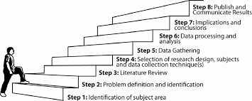
TIP: academic research is A marathon not a sprint
Conducting academic research is more like a marathon than a sprint.
It requires careful attention during multiple steps which can span from months to years.
Don’t put yourself in a position where you need to sprint!

Slide 5
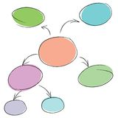
Thesis writing?
When you think of thesis writing what comes to your mind?
What does it involve?

Slide 6
Why is the following text not a good example of academic style?
There are many problems with how English is taught and learned. Lots of students just try to like memorize words in class and at home and teachers focus too much on useless tests. That is why so many people aren’t satisfied with their language ability even after studying for many years. I think it’s like totally better to use English in real situations like chatting on the internet or like speaking with friends in English. One study said that using the language more in real situations helps learners develop faster. I think all researchers are on the same page. So yeah, using language more results in better development, so teachers and learners should change their ways.

Slide 7
Revised Version
Various problems have been noted with how English is taught and learned ( see for example Cook, 2009, Bestos, 2014, Lee, 2009). One of the most prominent problems that has been discussed in the literature is the focus on memorization of language ( Smith, 2005) and focus on invalid tests of proficiency ( Gomina, 2007). These approaches to language learning and teaching have resulted in language learners being frustrated and dissatisfied with their language development after studying for many years (Kim, 2017). Many researchers have argued that using the language in authentic situations consistently and continuously leads to better language development overall ( See for example, Johnson, 2001,Thomas, 2005, Park, 2007, Whitehead, 2018) Thus, it is crucial for learners and teachers of English to reconsider their approaches to English language learning and teaching.

Slide 8
Characteristics of academic writing
It is written in formal language (no slang, idioms, contractions)
Reason over emotions or sensual perception
Facts are accurate and backed by quality resources
Many references are included
Follow specific guidelines (APA 6th edition)
Targeted for a specific audience

Slide 9
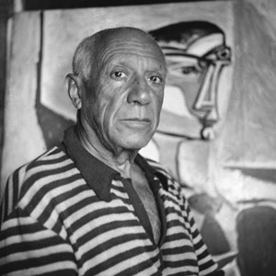
Important Quotes On Writing
If you’re clear in your mind about what you are going to paint, there is no point in painting it
Pablo Picasso
Writing is a process of discovery. Sometimes you don't know what you know. You may know it but have no idea how it fits together
Alice Walker
I have to start to write to have ideas
Françoise Sagan

Slide 10
To be successful in thesis track (or portfolio track)…
What do you need?

Slide 11
You need….
Time
Thesis writing is a slow process.
If you try to write everything in a short amount of time it will be extremely stressful, and the quality of your work will suffer
Background information
You need to read a lot!
You need to know your topic area extremely well
You need to have enough literature and understanding to support your claims
Writing tools to support your writing process

Slide 12
Tips for Thesis Writing
Don’t be worried, afraid, or intimidated
How to succeed:
understand what you are writing about
take your time
break the process into manageable chunks
make a schedule/ set daily tasks to complete
write daily
focus on clarity not perfection
use internet tools to support your writing

Slide 13
Selecting a topic

Slide 14
When selecting a topic…
Choose your topic wisely.
Researchers need to take a non-biased stance ( you can not do research in a deliberate attempt to seek data to support your thoughts and beliefs).
Do not focus your research on a topic that has already been done to death (outdated).
Your research should grow out of reading and studying about certain topics.

Slide 15
Characteristics of a good topic
Interesting – the topic is something that will keep the researchers interest throughout the research process. i.e. they can spend hours joyfully reading about that topic.
Researchable – the topic can be investigated through the collection and analysis of data.
Significant – research on the topic contributes to the improvement and understanding of educational theory and practice
Manageable – the topic is something that fits the researcher’s skill level, needed resources, and time restrictions.
Ethical – research into the topic will not produce harm to those participating in it

Slide 16
Things to ask yourself when considering a topic
Do I know the topic and current literature about the topic well?
What specific issue surrounding this topic is in need of further exploration? Why?
Does the literature point to a need for this research?
Will research into my topic fill a gap in the literature/ contribute to greater understanding of a specific phenomenon?

