Slide 1
Welcome to Communicative English
Prof. George E.K. Whitehead

Slide 2
George E.K Whitehead?

Slide 3
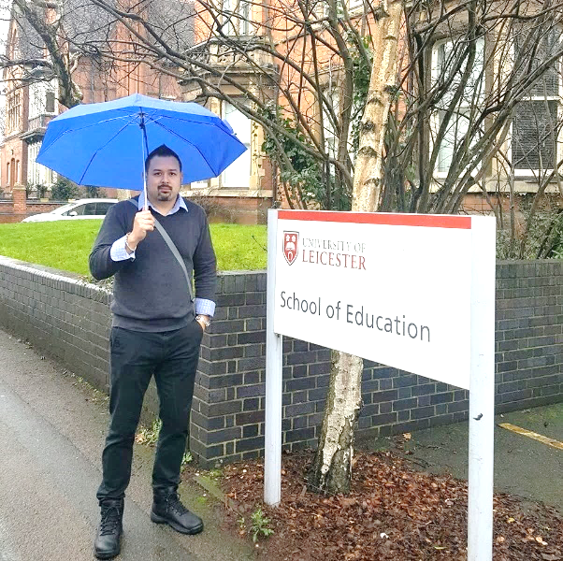
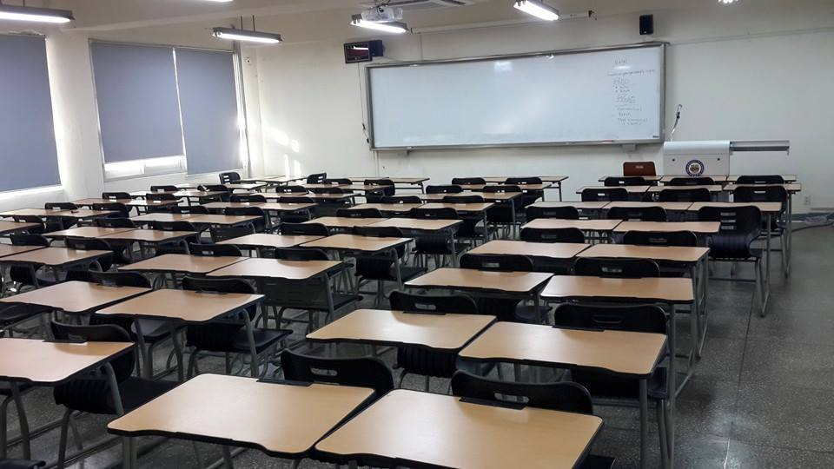
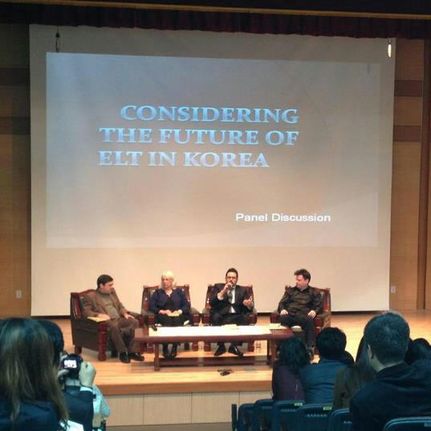
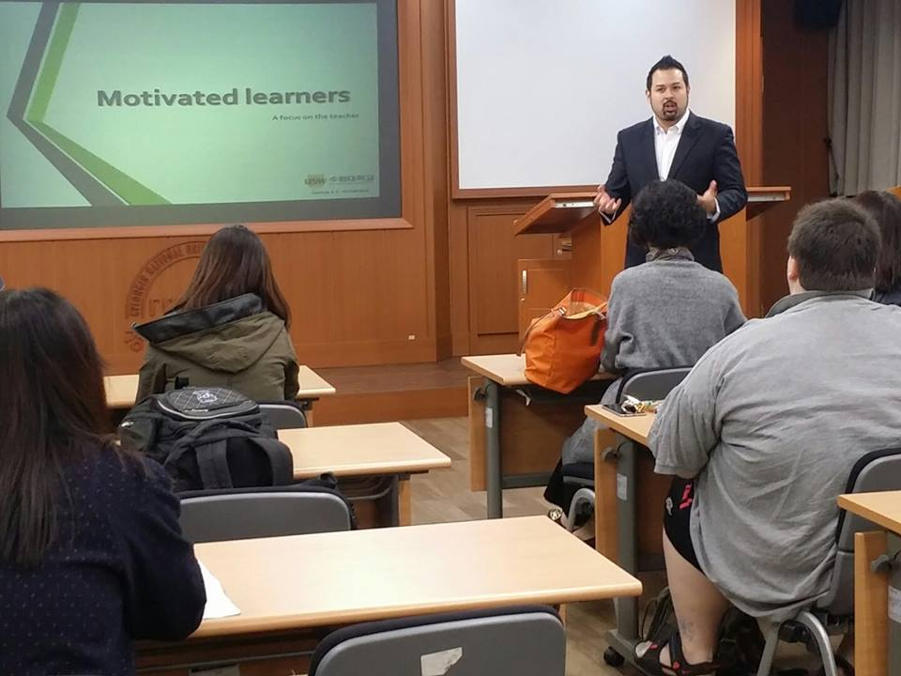
Name: George E.K.Whitehead
Nationality: Canadian
Country of Residence: South Korea
Occupation: Assistant Professor
Non- Academic Hobbies: Muay Thai Kickboxing, Jiu Jitsu

Slide 4
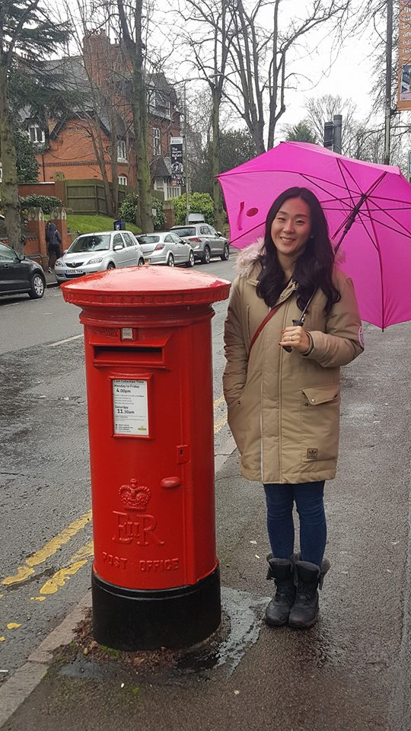
family

Slide 5
Education
Associates of Arts
BA (Linguistics)
Certificate for Teaching ESL Linguistics
(30 Credit courses + 30 hr. practicum)
MA (TEFL/ TESL)
PhD Education (in progress)

Slide 6
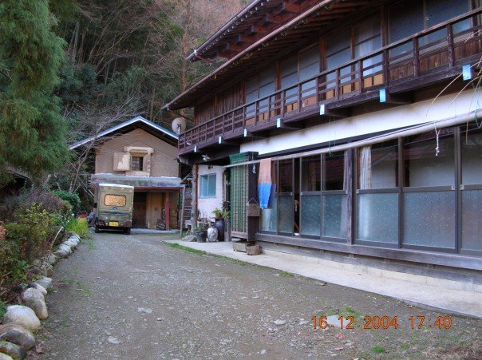
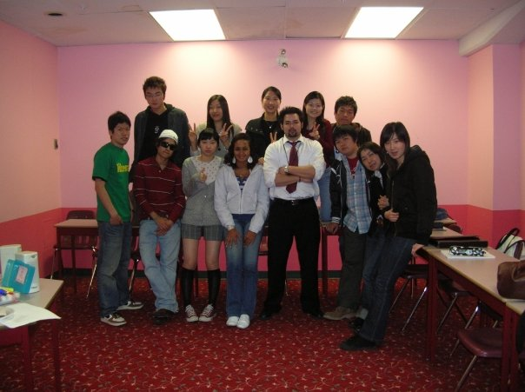
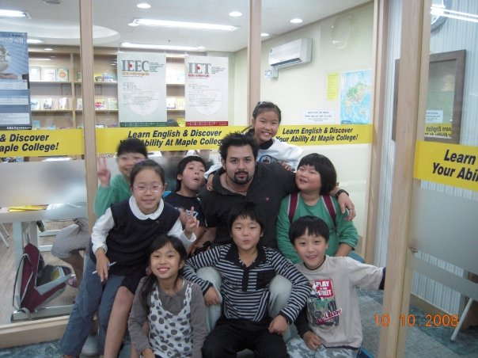
work
1999 & 2003
2006-2009
2007-2008
The beginning…

Slide 7
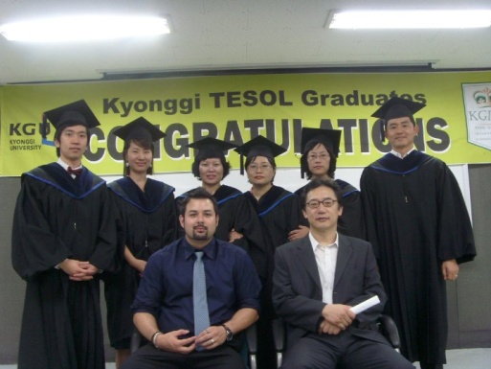
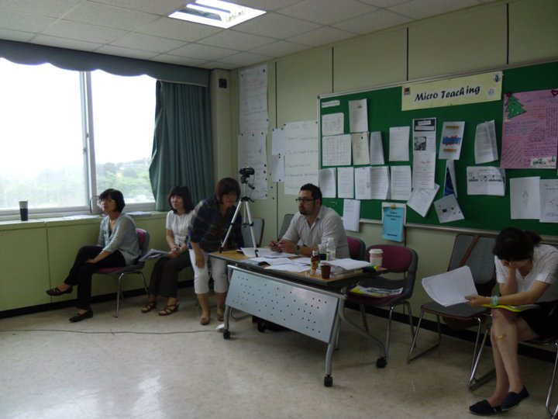
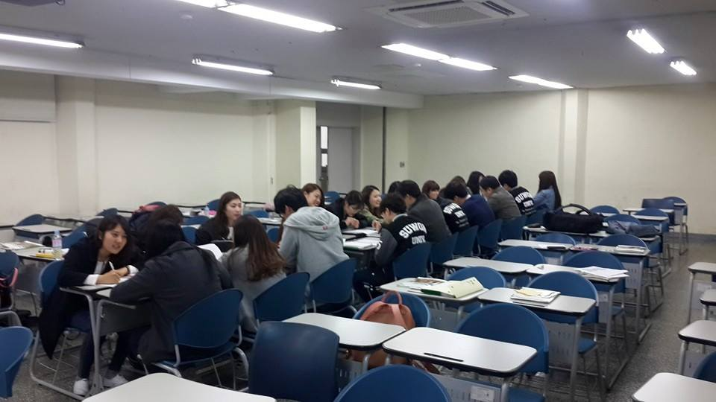
2009-2010
2010-2015
2015-2018

Slide 8
2016-Present
2017-Present

Slide 9
Recent Publications
Whitehead, G. & Greener, V. ( 2019). Beyond good teaching practices: Exploring learners' views of language teacher leadership. TESOL Quarterly.
Whitehead, G. & Ramos, I. (2019). Developing Effective Teacher Talk: A critical self-examination of an ESP syllabus designed for in-service teachers. The Journal of Asia TEFL.
Hiver, P., & Whitehead, G. (2018). Teaching metacognitively: Adaptive inside-out thinking in the L2 classroom. In C. Bjørke, M. Dypedahl, & Å. Haukås (Eds.), Metacognition in Language Learning and Teaching. New York, NY: Routledge.
Hiver, P., & Whitehead, G. (2018). Sites of struggle: The co-construction of language teacher agency and teacher identity through classroom practice. System [Special Issue] Interdisciplinarity in Language Teacher Agency: Theoretical and Analytical Explorations.
Whitehead, G. (2017). Teachers’ voices: Obstacles to communicative language teaching in South Korea. Asian EFL Journal, 18 (4), 5-31.
Whitehead, G. (2016). The rise and fall of the National English Ability Test: Examining Korean high school English teachers’ perspectives. Asian EFL Journal, 19 (4). 124-155.
Greenier, V., & Whitehead, G. (2016). Towards a model of teacher leadership in ELT: Authentic leadership in classroom practice. RELC Journal, 47(1), 79-95 DOI: 10.1177/0033688216631203.

Slide 10
additional publications
Gang, Y.S., Kim, H.D., Whitehead, G., Goo, Y.S., Gwon, H.Y., Han, G., & Hong, G.M. (2018). Middle School English 1. Seoul, South Korea: Darakwon.
Gang, Y.S., Kim, H.D., Whitehead, G., Goo, Y.S., Gwon, H.Y., Han, G., & Hong, G.M. (2019). Middle School English 2. Seoul, South Korea: Darakwon.
Gang, Y.S., Kim, H.D., Whitehead, G., Goo, Y.S., Gwon, H.Y., Han, G., & Hong, G.M. (2020). Middle School English 3. Seoul, South Korea: Darakwon.

Slide 11
Peer review & Editing
Asian EFL Journal - Editor/ Reviewer (https://www.asian-efl-journal.com/)
Asian ESP Journal – Editor/ Reviewer (https://www.asian-esp-journal.com/)
System – Guest reviewer (https://www.journals.elsevier.com/system)

Slide 12
Academic presentations
Whitehead, G. (2018). EMART: Creating Music Videos Through the Integration of English, Music, and Art. Presented at Suwon KOTESOL workshop, Anyang, South Korea. April, 2018.
Whitehead, G. (2017). A Guided Analysis of Effective Language Teaching. Presented at Seoul KOTESOL workshop, Seoul, South Korea. June, 2017.
Whitehead, G. (2016). Analyzing Effective Teaching through Video Analysis. Presented at Yongin KOTESOL workshop, Yongin, South Korea. May, 2016.
Whitehead, G. (2016). Setting the groundwork for student motivation: The role of the teacher. Presented at the Seoul National Conference, Seoul, South Korea. April, 2016.
Whitehead, G. (2015). Motivated Learners: A Focus on the Teacher. Presented at Suwon KOTESOL workshop, Suwon, South Korea. October, 2015.
Whitehead, G. (2015). Connecting with Young Learners: Relevance and Relatability. Presented at Gwangmyeong City elementary language teacher workshop, Gwangmyeong, South Korea. October, 2015.
Whitehead, G. (2015). Sparking Students' Interest and Engagement through Contextual Connections. Presented at Yongin KOTESOL workshop, Yongin, South Korea. September, 2015.
Whitehead, G. (2014). English Today. Presented at Chodang high school student workshop, Yongin, South Korea. October, 2014.
Whitehead, G & Hwang.H. (2014). The ‘Double Iceberg’ model . Presented at Applied Linguistics Association of Korea (ALAK) international conference, Seoul , South Korea. September, 2014.
Invited panel member: Facing the facts: Perspectives on the possibilities for change in Korean English language teaching. Gyeonggi Foreign Language Education Conference (GFLEC), Pyeongtaek, South Korea. November, 2013.
Invited panel member: Considering the future of English language teaching in Korea.Gyeonggi-do International Teachers’ Conference (GITC), Pyeongtaek, South Korea. October, 2012.
Whitehead, G., & Hwang, H. (2012). Examining teacher talk in Korean English classrooms: Advocating the judicious use of L1. Paper presented at Gyeonggi-do International Teachers’ Conference (GITC), Pyeongtaek , South Korea. October, 2012.
Whitehead, G. (2011). Evaluating the use of L1 in Korean English classrooms. Presented at Gyeonggi-do International Teachers’ Conference (GITC), Pyeongtaek, South Korea. November, 2011.
.

Slide 13
Now is your chance!

Slide 14
About the course
English Communication

Slide 15
Course summary
Throughout the course learners will be engaged in various collaborative activities, group projects, and presentations in which students will receive support from peers as well as their professor .
This course specifically aims to foster learners' comprehensible output and negotiation of meaning as well as, 21st century skill development such as collaboration, cooperation, creative thinking, and intercultural communication.
Students can expect a relaxed, low-stakes, and supportive classroom environment where they are able to feel comfortable using the language.
By the end of this course students will not only develop their English communicative abilities , but also their confidence in the language.

Slide 16
Aims
To understand key features of good communicative abilities
To develop your own communicative ability
To develop confidence in your communicative ability

Slide 17
Course Topics
Introduction
Getting to know you
Relationships
Teambuilding
Health
Stress
Happiness
The environment
Travel & Tourism
Crime & Punishment
Technology

Slide 18
Evaluation
1) Class Participation & Professionalism 40 Points
2) In-class Assignments 30 Points
3) Attendance 30 Points
Total 100 Points
Note: This course is graded pass or fail. Students w ho get more than 80 points will receive a pass score. Students who get less than 80 points will receive a fail grade.

Slide 19
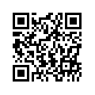
Additional Details & contact Information
Website: profgwhitehead.weebly.com
Email: prof.gwhitehead@gmail.com & gekw@hufs.ac.kr

Slide 20
Thinking about english

Slide 21
What’s really important?
With your group discuss your opinions about the order of importance of the following for English learners today when it comes to communication.
Pronunciation
Grammar
Confidence
A large vocabulary
Comprehensible output
Being familiar with different dialects
Understanding western culture
Idioms and slang

Slide 22
Agree or disagree
The best speakers of English are native speakers
Grammatical accuracy is very important in speaking
Nativelike pronunciation is important
Being able to use high-level vocabulary words when speaking is important
It is important to be able to understand native speaker of English more than non-native speakers of English

Slide 23
What I think…
Comprehensible output
Confidence
Being familiar with different dialects
A large vocabulary
Pronunciation
Grammar
Understanding western culture
Idioms and slang

Slide 24
Things to think about
Good English speakers can be native or non-native speakers
The key is to be as comprehensible to others as possible
The more comprehensible you are the better
Good speakers can make the people they are talking to easily understand what they are trying to say

Slide 25
Think…
What are your biggest difficulties with English?
What are your goals as an English learner?

