Slide 1
Interviews and Focus Groups

Slide 2
Interview Types
Structured, Semi-structured, Unstructured

Slide 3
Structured Interview
A structured interview (also known as a standardized interview or a researcher-administered survey) is a quantitative research method commonly employed in survey research.
The aim of this approach is to ensure that each interview is presented with exactly the same questions in the same order.
This ensures that answers can be reliably aggregated and that comparisons can be made with confidence between sample subgroups or between different survey periods.

Slide 4
Semi-structured Interview
Used often in qualitative research and social sciences
While a structured interview has a rigorous set of questions which does not allow one to divert, a semi-structured interview is open, allowing new ideas to be brought up during the interview as a result of what the interviewee says.
The interviewer in a semi-structured interview generally has a framework of themes to be explored.
Allows the researcher to go beyond the research questions and probe deeper.
Results are richer data sets

Slide 5
Unstructured Interview
They tend to be more informal and free flowing than a structured interview, much like an everyday conversation.
questions are not prearranged but the research may have some general questions in mind that they want to ask.
Designed to be as open as possible; opposite of a structured interview which offers a set amount of standardized questions.
Probing is seen to be the part of the research process that differentiates the in-depth, unstructured interview from an everyday conversation.
This nature of conversation allows for spontaneity and for questions to develop during the course of the interview, which are based on the interviewees' responses.

Slide 6
Creating an Interview Schedule

Slide 7
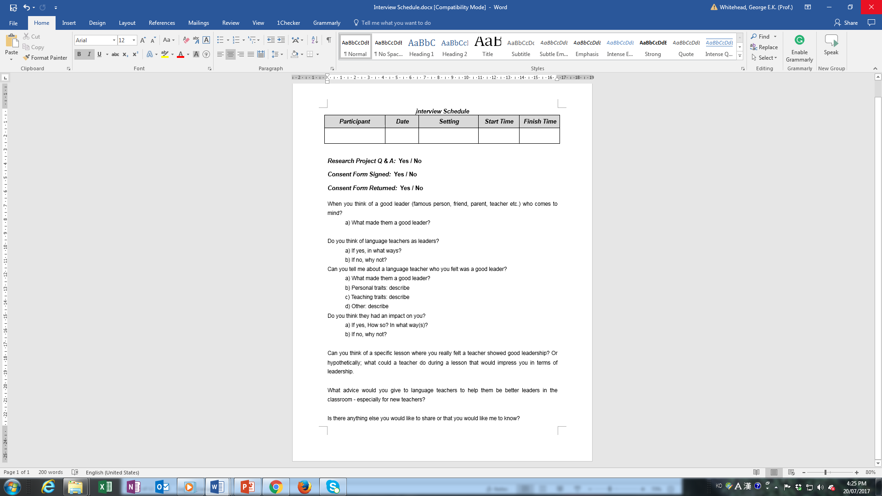
Interview Schedule

Slide 8
Developing Interview Questions
Develop questions that will help you to answer your research questions.
Think about the logical flow of the interview. What topics should come first? What follows more or less “naturally”? This may take some adjustment after several interviews.
Difficult or potentially embarrassing questions should be asked toward the end of the interview, when rapport has been established.
The last question should provide some closure for the interview, and leave the respondent feeling empowered, listened to, or otherwise glad that they talked to you.

Slide 9
Develop probes that will elicit more detailed and elaborate responses to key questions. The more detail, the better!

Slide 10
Adjust the language of the interview according to the respondent (child, professional, etc.).

Slide 11
Begin the interview with a “warm-up” question—something that the respondent can answer easily and at some length (though not too long). It doesn’t have to pertain directly to what you are trying to find out (although it might), but this initial rapport-building will put you more at ease with one another and thus will make the rest of the interview flow more smoothly.

Slide 12
Creating an Interview Schedule
Develop questions that will help you to answer your research questions.
Adjust the language of the interview according to the respondent (child, professional, etc.).
Develop probes that will elicit more detailed and elaborate responses to key questions. The more detail, the better!
Begin the interview with a “warm-up” question—something that the respondent can answer easily and at some length (though not too long). It doesn’t have to pertain directly to what you are trying to find out (although it might), but this initial rapport-building will put you more at ease with one another and thus will make the rest of the interview flow more smoothly.
Think about the logical flow of the interview. What topics should come first? What follows more or less “naturally”? This may take some adjustment after several interviews.
Difficult or potentially embarrassing questions should be asked toward the end of the interview, when rapport has been established.
The last question should provide some closure for the interview, and leave the respondent feeling empowered, listened to, or otherwise glad that they talked to you.

Slide 13

Types of Questions

Slide 14
Direct questions
Indirect questions
Follow-up questions
Probing questions
Specifying questions
Interpreting questions

Slide 15
Direct
How do you feel about this course?
What d you like most about this class?
What are the qualities of a good professor?
Such questions are perhaps best left until towards the end of the interview, in order not to influence the direction of the interview too much.

Slide 16
Indirect
Can you describe a professor who you feel was really good?
Tell me about a time when you felt really happy in this class? What made you happy?
Can you give me an example of things in a course that you do not like?

Slide 17
Follow-up
Getting the interviewee to elaborate his/her answer
Why?
In what ways?
Can you give me an example?
What do you mean by that . . .?

Slide 18
Probing
Can you tell me more about that?
Anything else you can think of?

Slide 19
Specifying
Specifying questions
What exactly do you mean by that?

Slide 20
Interpreting
Do you mean X?
Is it fair to say that what you are suggesting is x?
So what you are saying is X? Is that correct?

Slide 21
Direct questions
Indirect questions
Follow-up questions
Probing questions
Specifying questions
Interpreting questions

Slide 22
Today’s Task
Create your own interview schedule
You can use the template I have provided
  You can download it from profgwhitehead.weebly.com

Slide 23
The Interview

Slide 24
The Interview as an Interpersonal Encounter
The social skills of empathy, warmth, attentiveness, humor (where appropriate), and consideration are essential for good interviewing.
Any judgmental attitudes, shock or discomfort will be immediately detected.
Never answer a question for the respondent.
One must be completely engaged with the respondent, while at the same time keeping track of the questions one needs to ask.
Consider how you dress and a location that is suitable (comfortable, not noisy, not intimidating)

Slide 25
Use every active listening technique at your disposal:
    Repeating back
    “Wow! o Tell me more about that!”
    “That is really interesting.”
Don’t be afraid of silence; you can use it to prod the respondent to reflect and amplify an answer
Semi-structured interviews - Don’t follow the interview guide—follow the respondent. Follow up new information that he or she brings up without losing sense of where you are in the interview.
Try not to think about time—relax into the interview.

Slide 26
Steps in Conducting an Interview

Slide 27
Decide on who your respondents will be and how many you plan to interview.

Slide 28
Prepare an interview schedule that will guide you through the process.

Slide 29
Decide an appropriate location to conduct the interviews.
  Somewhere quiet
  Low distraction

Slide 30
Recruit participants

Slide 31
Conduct the Interview
  Explain the purpose of the study
  Get informed consent
  Proceed with the interview
  Debrief
  Thank them

Slide 32
Transcribe the interview

Slide 33
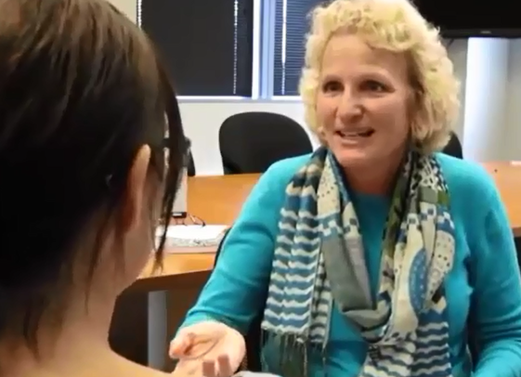
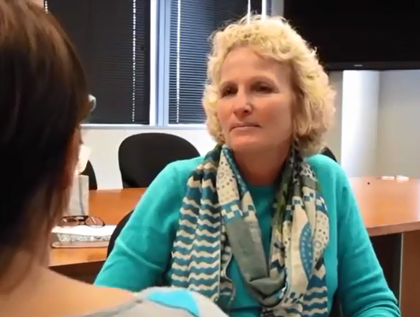
Review: Good and Bad Interviewing

Slide 34
Interviewing Practice
What do you need to do before you interview?

Slide 35
Preparing for the interview
Debriefing about the study
Be sure to prepare an audio recording device and ask the participant if it is ok for you to record the interview
Put the recorder in a non-intrusive place (that does not distract you or the interviewee but can still get a clear audio sample)

Slide 36
TIPS
Make the participant feel relaxed
Go with the flow of the conversation not necessarily the questions
Be sure to ask follow up questions

Slide 37
After the interview
Thank them for their time
Give them time to ask you any other questions they may have

