Slide 1
Interviews and Focus Groups

Slide 2

Interview Formats
Interviews
Focus Groups

Slide 3
What are Qualitative Interviews?
Interviewing is a verbal conversation between two people with the objective of collecting relevant information related to your research question(s).
As method of data collection, it is a technique used to understand the views, beliefs, thoughts, and experiences of others.
Interviews involve two-way interaction between the interviewer and interviewee in which the interviewer poses predominantly open-ended questions, listens to an individual’s response, follows-up on responses by acknowledging and/or probing further.
Interviews allow participants to provide rich, contextual descriptions of the topic under investigation.

Slide 4
What Interviewing Requires
It requires not only the use of various skills, such as intensive listening and note taking, but also careful planning and sufficient preparation.
To collect interview data useful for research purposes, it is necessary for the researchers to develop as much expertise in relevant topic areas as possible so they can ask informed questions.
In terms of the interview design process, there are many decisions that must be carefully considered, such as who to interview, how many interviewees will be required, what type of interview to conduct, and how the interview data will be analyzed.
Interviewing requires “a respect for and curiosity about what people say, and a systematic effort to really hear and understand what people tell you” (Rubin & Rubin, 1995, p. 17).
(Qu & Dumay, 2011)

Slide 5
Qualitative Interview Cycle
1. Research Design
Ethics
Lit. rev.
RQ
research method
Before
Anonymity
Audio recording
Safely stored
3. Interview
During
Interviewee’s point of view
Examples
After
Reflecting
Transcribing
Selecting organisation and interviewee
2. Prepare
Type of Interview
Semi-structured
Unstructured
Interview Schedule & Protocol
Type of research questions
Ethics

Slide 6
What are Focus Groups?
Focus groups are group interviews.
A moderator (usually the primary researcher) guides the interview while a small group discusses the topics that the interviewer raises.
Typically, there are three to ten participants who come from similar backgrounds.
Often there are multiple groups (3-6).
The moderator works from a predetermined set of discussion topics or guiding questions.
(Morgan, 1997)

Slide 7
An Important Consideration
Two to three focus groups are sufficient to capture 80% of themes, including the most prevalent themes, and three to six groups for 90% of themes in a homogenous study population using a semi-structured discussion guide (Guest et al., 2016).

Slide 8

What may be the advantages and disadvantages of each approach?

Slide 9
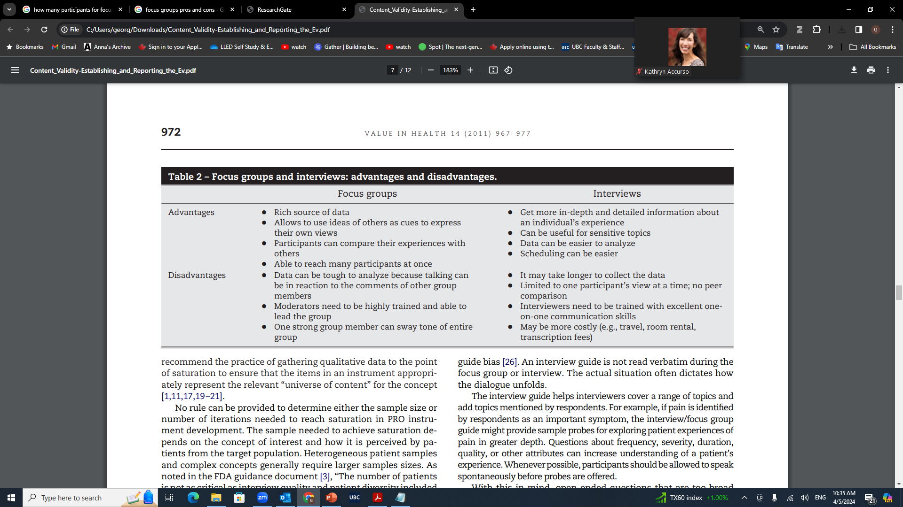
Pros and Cons of Focus Groups and Interviews
(Patrick et al., 2011)

Slide 10
Advantages & Disadvantages of Interviews
Bi-directional
Allows for the researcher to probe deeper
Can allow subjects to open up more if they feel safe and comfortable with the researcher
Replicability difficult
Time consuming
Require familiarity with language and culture
Requires social skills

Slide 11
Advantages & Disadvantages of Focus Groups
  Get a variety of perspectives/reactions to a certain issue
  Allows for participants to build off of one another
  Many perspectives in a short time
Require familiarity with language and culture
Not replicable
Not as in-depth
Requires moderating skills
Specific individuals may dominate the discussion
Difficult to transcribe if speaking overlaps
Not confidential

Slide 12
Approaches to Interviews and Focus groups
Structured, Semi-structured, Unstructured

Slide 13
Structured Interview
A structured interview (also known as a standardized interview or a researcher-administered survey) is a quantitative research method commonly employed in survey research.
The aim of this approach is to ensure that each interview is presented with exactly the same questions in the same order.
This ensures that answers can be reliably aggregated and that comparisons can be made with confidence between sample subgroups or between different survey periods.

Slide 14
Semi-structured Interview
Used often in qualitative research and social sciences
While a structured interview has a rigorous set of questions which does not allow one to divert, a semi-structured interview is open, allowing new ideas to be brought up during the interview as a result of what the interviewee says.
The interviewer in a semi-structured interview generally has a framework of themes to be explored.
Allows the researcher to go beyond the research questions and probe deeper.
Results are richer data sets.

Slide 15
Unstructured Interview
They tend to be more informal and free flowing than a semi-structured interview, much like an everyday conversation.
Questions are not prearranged but the research may have some general questions in mind that they want to ask.
Designed to be as open as possible; opposite of a structured interview which offers a set amount of standardized questions.
Probing is seen to be the part of the research process that differentiates the in-depth, unstructured interview from an everyday conversation.
This nature of conversation allows for spontaneity and for questions to develop during the course of the interview, which are based on the interviewees' responses.

Slide 16
When Should I Use Semi-Structured/ Unstructured?
When you want to get a general idea of or feeling for what participants are feeling, thinking, experiencing etc.
When you have specific themes/ topics you want to focus on.
When you elicit similarly focused information across all of your participants.
When you are very experienced in interviewing.

Slide 17
Creating an Interview Schedule

Slide 18
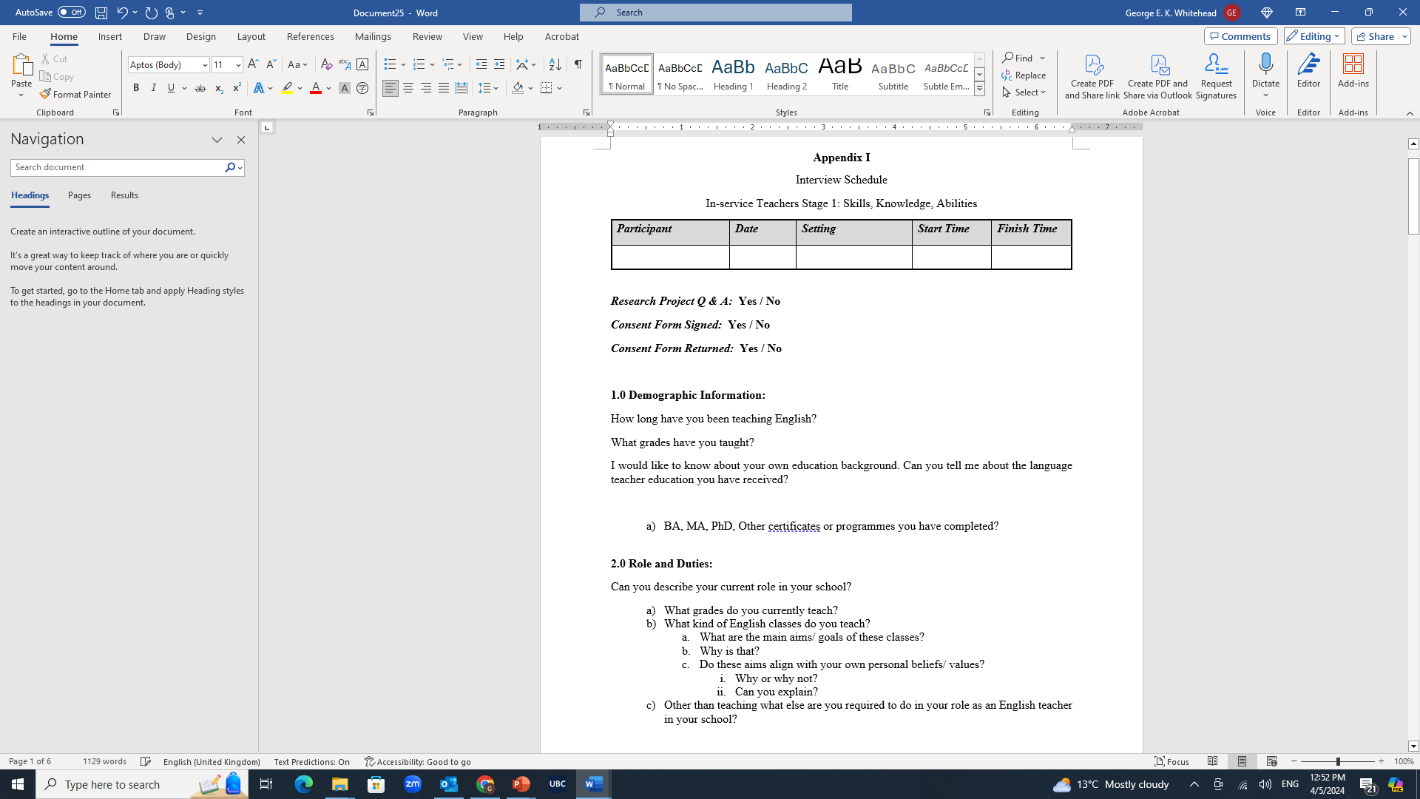
Interview Schedule

Slide 19
Developing Interview Questions
Develop questions that will help you to answer your research questions.
Think about the logical flow of the interview. What topics should come first? What follows more or less “naturally”? This may take some adjustment after several interviews.
Difficult or potentially embarrassing questions should be asked toward the end of the interview, when rapport has been established.
The last question should provide some closure for the interview, and leave the respondent feeling empowered, listened to, or otherwise glad that they talked to you.

Slide 20
Creating an Interview Schedule
Develop questions that will help you to answer your research questions.
Adjust the language of the interview according to the respondent (child, professional, etc.).
Develop probes that will elicit more detailed and elaborate responses to key questions. The more detail, the better!
Begin the interview with a “warm-up” question—something that the respondent can answer easily and at some length (though not too long). It doesn’t have to pertain directly to what you are trying to find out (although it might), but this initial rapport-building will put you more at ease with one another and thus will make the rest of the interview flow more smoothly.
Think about the logical flow of the interview. What topics should come first? What follows more or less “naturally”? This may take some adjustment after several interviews.
Difficult or potentially embarrassing questions should be asked toward the end of the interview, when rapport has been established.
The last question should provide some closure for the interview, and leave the respondent feeling empowered, listened to, or otherwise glad that they talked to you.

Slide 21

Types of Questions

Slide 22
Types of Questions
Direct questions
Indirect questions
Follow-up questions
Probing questions
Specifying questions
Interpreting questions
(see Kvale,1996, pp. 133-5)

Slide 23
Direct
How do you feel about this course?
What do you like most about this class?
What are the qualities of a good professor?
Such questions are perhaps best left until towards the end of the interview, in order not to influence the direction of the interview too much.

Slide 24
Indirect
Can you describe a professor who you feel was really good?
Tell me about a time when you felt really happy in this class? What made you happy?
Can you give me an example of things in a course that you do not like?

Slide 25
Follow-up
Getting the interviewee to elaborate his/her answer
  Why?
  In what ways?
  Can you give me an example?
  How so?

Slide 26
Probing
Can you tell me more about that?
Is there anything else you can think of?

Slide 27
Specifying
What exactly do you mean by that?
Could you be a little more specific?

Slide 28
Interpreting
Do you mean X?
Is it fair to say that what you are suggesting is x?
So, what you are saying is X? Is that correct?
Am I correct in my understanding that …?

Slide 29
Direct questions
Indirect questions
Follow-up questions
Probing questions
Specifying questions
Interpreting questions

Slide 30
Today’s Task
Create your own interview schedule
You can use the template I have provided

Slide 31
The Interview

Slide 32
The Interview as an Interpersonal Encounter
The social skills of empathy, warmth, attentiveness, humor (where appropriate), and consideration are essential for good interviewing.
Any judgmental attitudes, shock or discomfort will be immediately detected.
Never answer a question for the respondent.
One must be completely engaged with the respondent, while at the same time keeping track of the questions one needs to ask.
Consider how you dress and a location that is suitable (comfortable, not noisy, not intimidating)

Slide 33
Use every active listening technique at your disposal:
    Repeating back
    “Wow! Tell me more about that!”
    “That is really interesting.”
Don’t be afraid of silence; you can use it to prod the respondent to reflect and amplify an answer
Semi-structured interviews - Don’t follow the interview guide—follow the respondent. Follow up new information that he or she brings up without losing sense of where you are in the interview.
Try not to think about time—relax into the interview.

Slide 34
Steps in Conducting an Interview

Slide 35
Decide on who your participants will be and how participants you plan to interview.

Slide 36
Decide whether one-on-one interviews or focus groups (or a combination) is most suitable for your study.
Be sure that you can explain the rationale behind your choice.

Slide 37
Decide on the format of your interview (semi-structured, unstructured).
Make sure that you are able to explain the rationale behind your choice.

Slide 38
Prepare an interview schedule that will guide you through the process.

Slide 39
Decide an appropriate location to conduct the interviews.
  Somewhere quiet
  Low distraction

Slide 40


Interview Environments

Slide 41
Benefits and Drawbacks of Face-to-face vs. Online Video
Considerations | Face-to-face | Online Video
Time
Cost
Equipment required
Note taking
Environment
Comfort
Nonverbal language and cues
Common issues/ challenges encountered

Slide 42
Benefits and Drawbacks of Face-to-face vs. Online Video
Considerations | Face-to-face | Online Video
Time | Can be more time consuming to organize and conduct | Easier to schedule
Cost | Can be more costly due to travel and other expenses | Can be costly if hardware and software are required but can be low cost if one already has the necessary tools.
Equipment required | Recording device | Phone/computer/tablet with camera. Software to record.
Note taking | Can be distracting | Can be less distracting
Environment | Less control, can have unexpected noise (e.g., coffee shop). | More control to reduce or minimize background noise
Comfort | Can be less comfortable to both the interviewer and interviewee especially if it is your first time meeting them | Can be more comfortable for both the interviewer and interviewee which can lead to more natural conversations
Nonverbal language and cues | Body language, mannerisms, and other non-verbal clues can be observed | Harder to fully observe due to video only capturing upper body and face.
Common issues/ challenges encountered | Scheduling challenges, location challenges, clarity of recordings, forgetting to record, recorder battery dies. | Hardware and software issues, internet connection, sometimes participants do not want to show themselves on video.

Slide 43
Recruit participants
  Send them the study information sheet

Slide 44
Schedule interview time and location with each participant
  Be sure to cater to their schedule and preferred mode (face-to-face vs. online)

Slide 45
Send participants the informed consent form to be completed and signed before participating in the interview
Send participants the interview schedule(?)
  Why or why not?

Slide 46
Conduct the Interview
  Explain the purpose of the study
  Make sure you have informed consent prior to proceeding
  Ask them for their preferred pseudonym that reflects their identity and background.
  Proceed with the interview
  Debrief
  Thank them

Slide 47
Transcribe the interview

Slide 48
Summary
Decide on who your participants will be and how participants you plan to interview.
Decide whether one-on-one interviews or focus groups (or a combination) is most suitable for your study.
Decide on the format of your interview (semi-structured, unstructured).
Prepare an interview schedule that will guide you through the process.
Decide an appropriate location/ format to conduct the interviews.​
Recruit participants
Schedule interview time and location with each participant
Send participants the informed consent form to be completed and signed before participating in the interview and possibly the interview schedule(?)
Conduct the Interview
Transcribe the interview

Slide 49
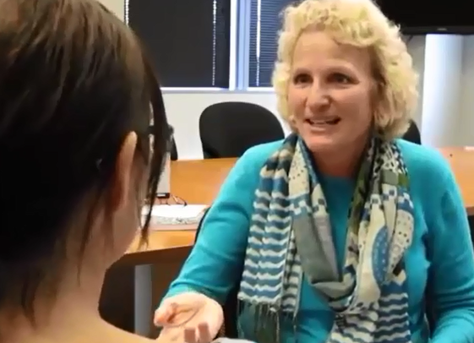
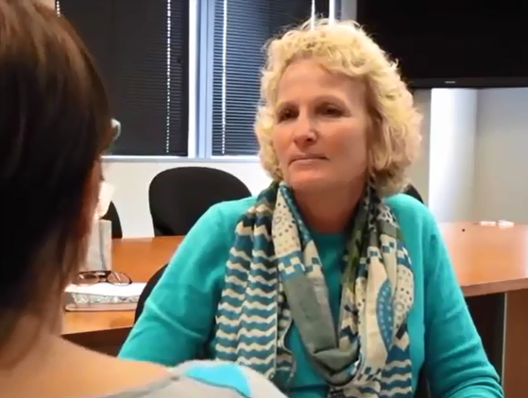
Review: Good and Bad Interviewing

Slide 50
Interviewing Practice
What do you need to do before you interview?

Slide 51
Preparing for the interview
Debriefing about the study
Be sure to prepare an audio recording device and ask the participant if it is ok for you to record the interview
Put the recorder in a non-intrusive place (that does not distract you or the interviewee but can still get a clear audio sample)

Slide 52
TIPS
Make the participant feels relaxed
Go with the flow of the conversation not necessarily the questions
Be sure to ask follow up questions

Slide 53
After the interview
Thank them for their time
Give them time to ask you any other questions they may have

Slide 54
References
Guest G, Namey E, & McKenna K, (2016). How many focus groups are enough? Building an evidence base for non-probability sample sizes. Field Methods, 29(1), 3–22. doi: 10.1177/1525822X16639015.
Kvale, S. (1996). InterViews: An introduction to qualitative research interviewing. Sage.
Patrick, D. L., Burke, L. B., Gwaltney, C. J., Leidy, N. K., Martin, M. L., Molsen, E., & Ring, L. (2011). Content validity—establishing and reporting the evidence in newly developed patient-reported outcomes (PRO) instruments for medical product evaluation: ISPOR PRO good research practices task force report: part 1—eliciting concepts for a new PRO instrument. Value in Health, 14(8), 967-977.
Rubin, H.J. and Rubin, I.S. (2005). Qualitative interviewing: The art of hearing data (2nd ed.). Sage.
Qu, S. Q., & Dumay J. (2011). The qualitative research interview. Qualitative Research in Accounting & Management, 8(3), 238-264.

