Slide 1
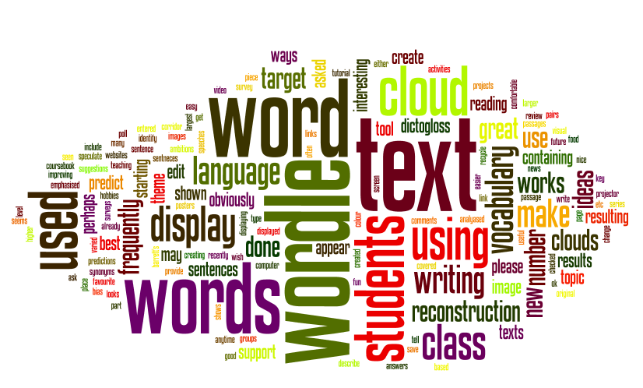
Internet Writing Tools

Slide 2
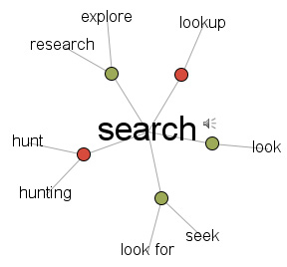
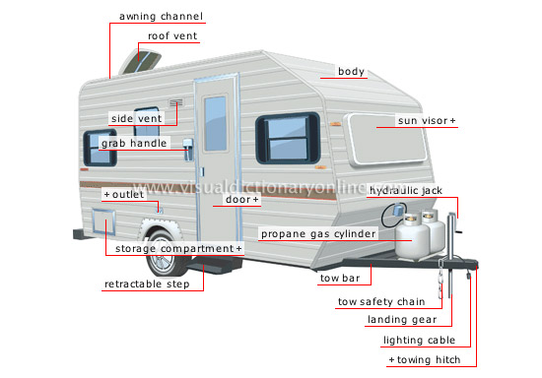
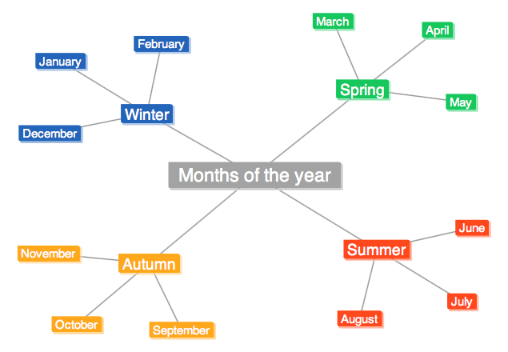
Tools we will explore

Slide 3
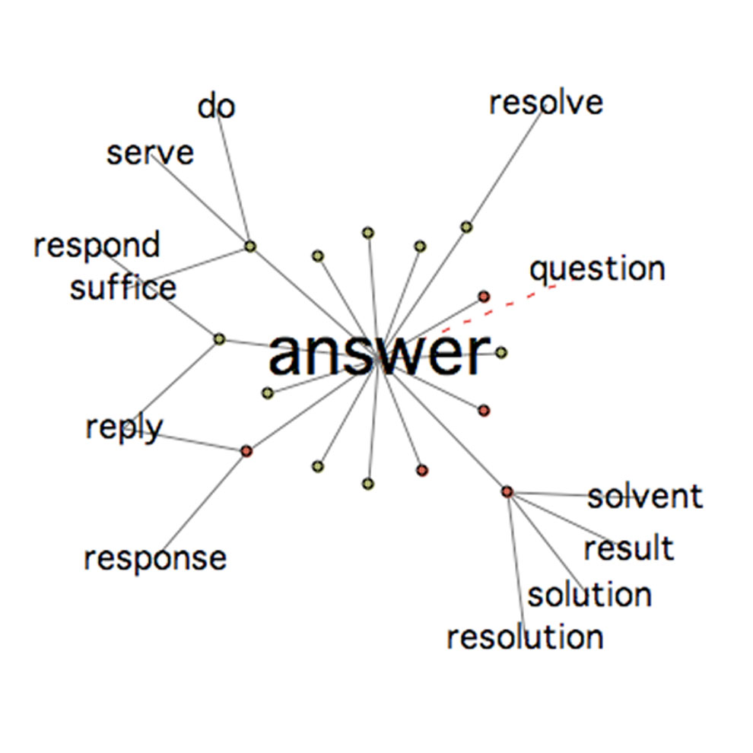
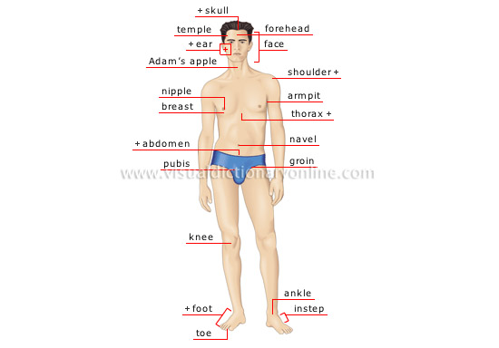
Visual dictionary and thesaurus

Slide 4
Some sites for visual dictionaries and thesaurus
Dictionaries
www.dictionary.com
http://www.visualdictionaryonline.com/
http://www.infovisual.info/
Thesaurus
https://www.visualthesaurus.com/
http://graphwords.com/

Slide 5
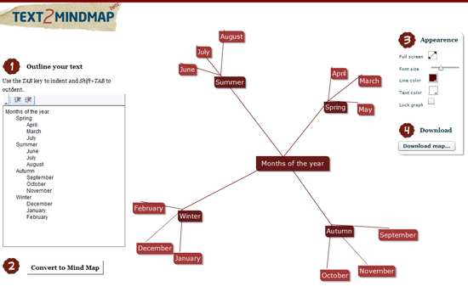
Mind Mapping online

Slide 6
Site for mind mapping
https://www.text2mindmap.com/

Slide 7
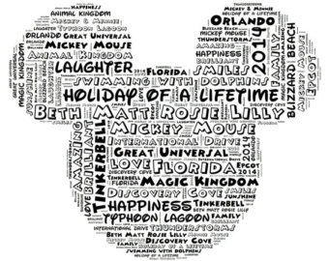
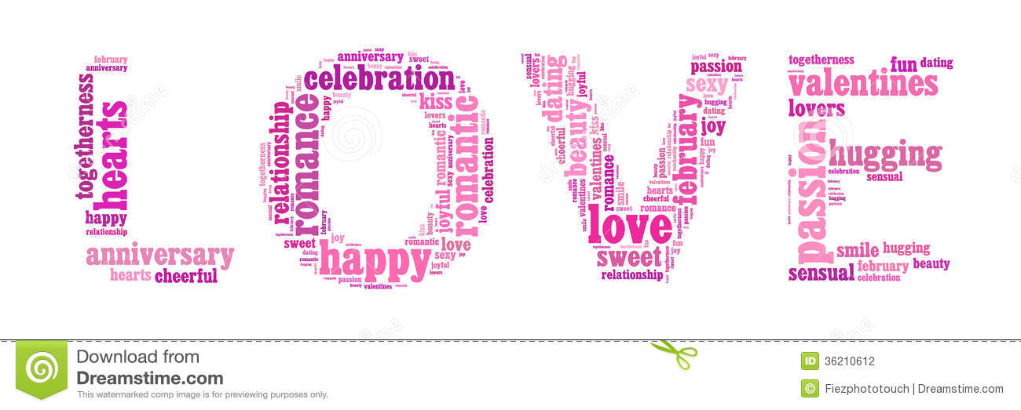
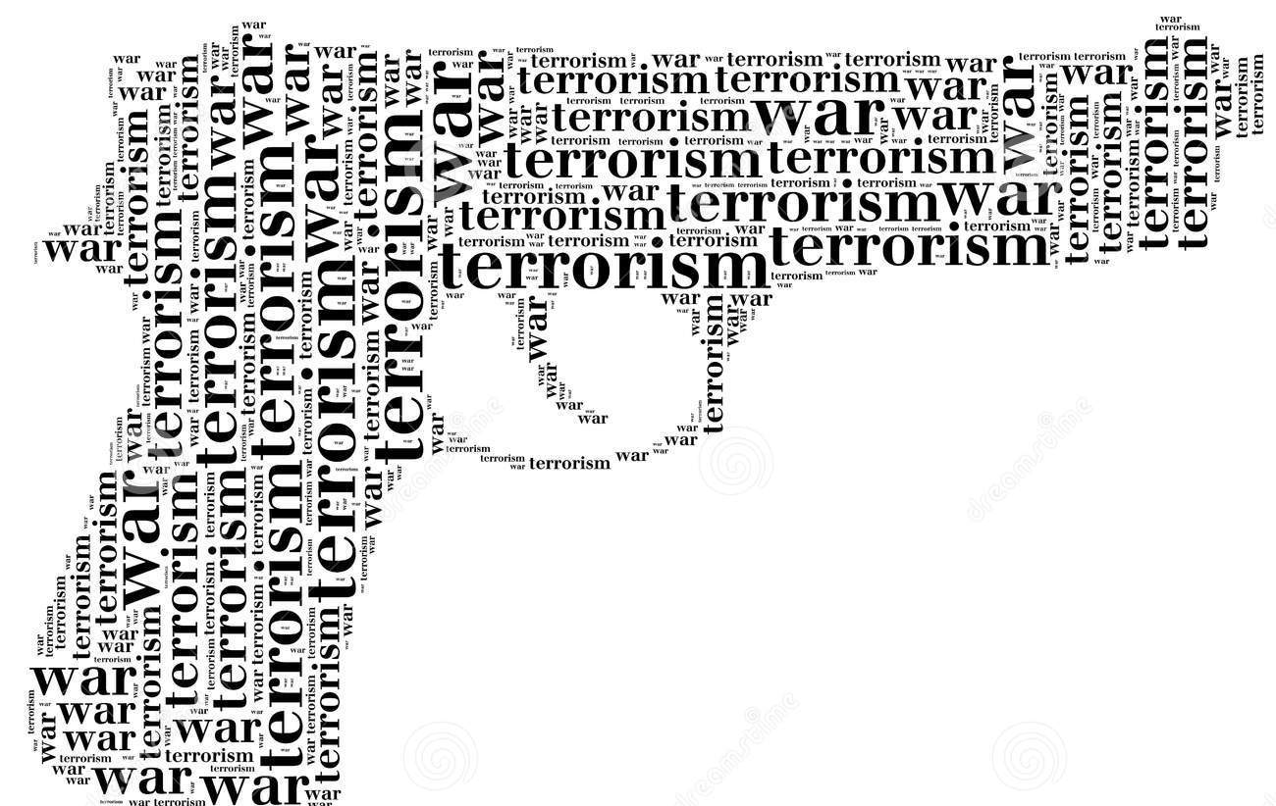
Wordles or Word Clouds

Slide 8
Some websites to create Word Clouds
www.wordle.net
http://worditout.com/
http://www.imagechef.com/ic/word_mosaic/

Slide 9
Memes

Slide 10
Site for creating memes
https://imgflip.com/memegenerator

