Slide 1
Inquiry-based Learning

Slide 2
Definition
Inquiry-based learning is a learning process that engages students by making real-world connections through exploration and high-level questioning. It is an approach to learning that encourages students to engage in problem-solving and experiential learning.

Slide 3
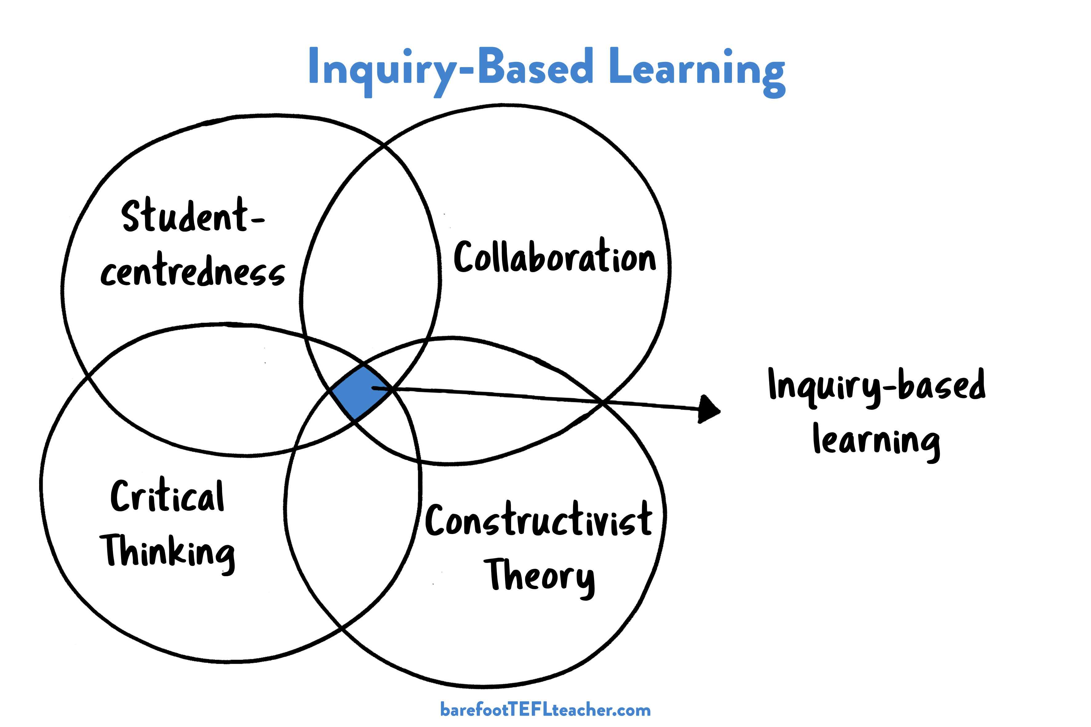

Slide 5
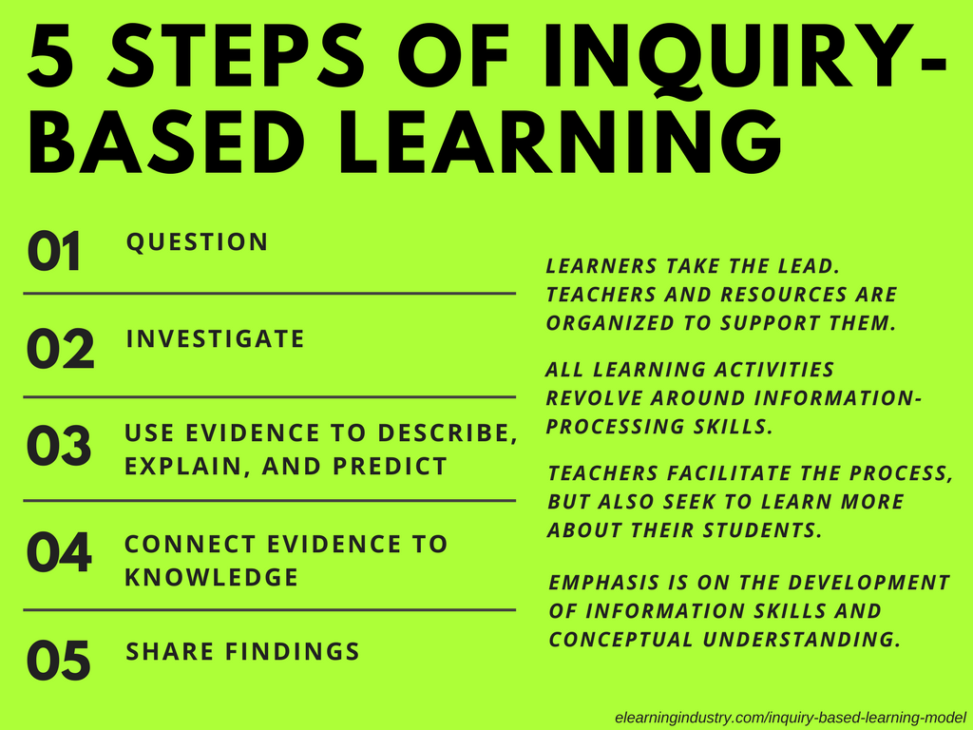

Slide 6
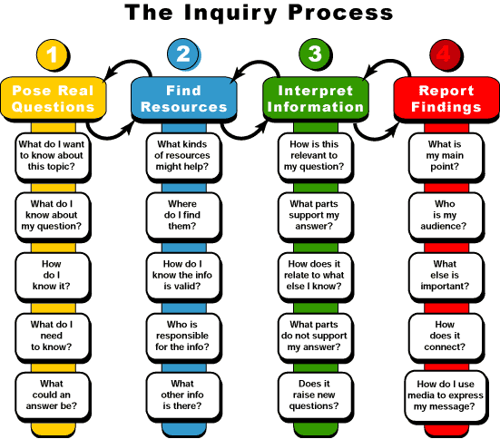

Slide 7
Different types of IBL
Structured inquiry: The question and method of achieving the result is given to learners, but the aim is to provide an explanation which is already based on the evidence collected during the research process.
Guided inquiry: Only questions are given to learners. The main objective is to plan the research method and test the issue itself. This type of investigation is usually not structured as in the previously mentioned form.
Open inquiry: Learners need to develop their own questions, develop investigative methods, then make the same research. At the end of the process, they have to submit their results.

Slide 8
Inquiry-based Questions

Slide 9
Key Points to Good Inquiry Questions
It generates discussion and encourages varied positions.
It demands a critical or careful reading of a variety of text(s).
It moves beyond opinion, into connecting claim, evidence, and reasoning.
It is phrased in such a way that the question doesn’t predetermine the answer.
(e.g., Why is sugar bad for you? Why is fruit good for us?)

Slide 10
Health and Nutrition
What is the importance of a balanced diet in maintaining good health?
How do different nutrients (proteins, carbohydrates, fats, vitamins, and minerals) contribute to our health?
Why is fiber important in our diet and what foods are high in fiber?
What are the potential health risks associated with a diet high in sugar?
How can we ensure we are getting enough vitamins and minerals in our diet?
What is the impact of fast food on our health?
How does portion size affect our health and weight?

Slide 11
Appendices

Slide 12
