Slide 1
Your Future Work

Slide 2
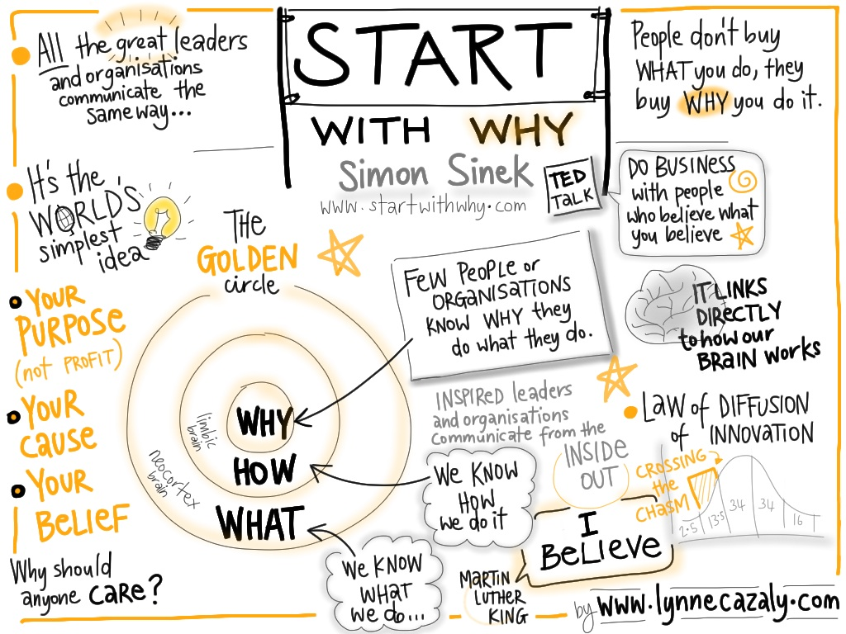

Slide 3
Setting Goals
5 years from now what do you hope your life will be like?
How about 10 years from now?
What will you be doing?
Where will you be doing it?
Will you have a car?
Where will you be living?
Who will you be living with?
What will your residence look like?

