Slide 1

Identify Yourself!

Slide 2

Examining Current Views
Your current views and attitude determines what happens in your classroom.
This reflection is a starting point to help you consider ways in which you may become a more effective teacher.

Slide 3


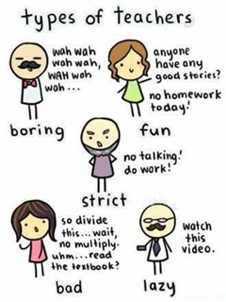

Slide 4


Slide 5
[Part A] Your current outlook

Slide 6
[Part B] Your current attitude

Slide 7
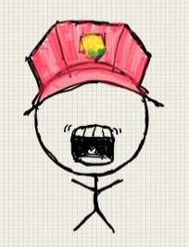
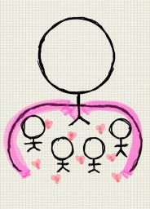
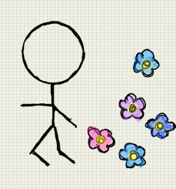
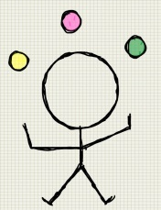
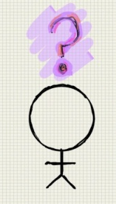
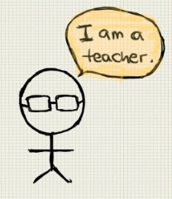

Results
Part A:
  Blue = Future
  Pink = Now
  Green = Past
Part B:
  Purple = Motivated
  Yellow = Complacent
  Orange = Defeated
Part C
  Drill Sergeant
  Mentor
  Free Bird
  Performer
  Lost
  Realistic
  Professor

Slide 8

Time Orientation
Studies have shown that Now/Future orientated individuals are more successful. (Zimbardo and Boyd, 2008; de Posada, 2009)
For a teacher to remain focused and motivated towards professional development, it is important that they have an extended time bubble(Husman, Duggan & Fishman, 2014)
Past oriented teachers have difficulty dealing with change.
Now oriented also have trouble dealing with change.
Future oriented have trouble dealing with now.

Slide 9



Attitude and Motivation
Motivated
Complacent
Defeated
A low level of motivation and satisfaction leads to poor quality work produced (Dörnyei, Evans, 1998, quoted in Foskett & Lumby, 2003)
If you have low motivation to teach, try to find out how you can become more motivated.
Ask yourself:
  Why do you teach?
  What do you like about your job?
  What gives you job satisfaction?

Slide 10
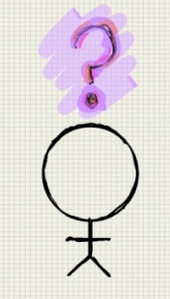


Characteristics
Drill Sergeant | Mentor | Free Bird | Performer | Lost | Realistic | Professor
Set goals to fulfil Demanding Push students to learn and do better | Encourage and inspire students Listen to students Show empathy | Easy going and relaxed Feels no pressure Low passion for students | Having fun in class Lively class Entertain more than teach | Always trying new ideas/activities Low cohesion Distracted easily | Aware and accept the current state Realistic goals Keep to only the necessity | Being receptive, well informed Professional divide Lack proactive skills
Reflect
Why?
What?
How?

