Slide 1
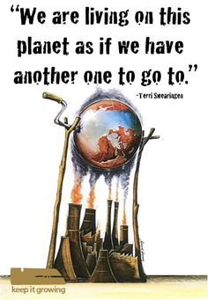
I Don’t Care

Slide 2
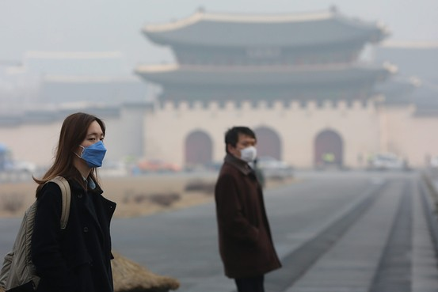
The World We Live in

Slide 3
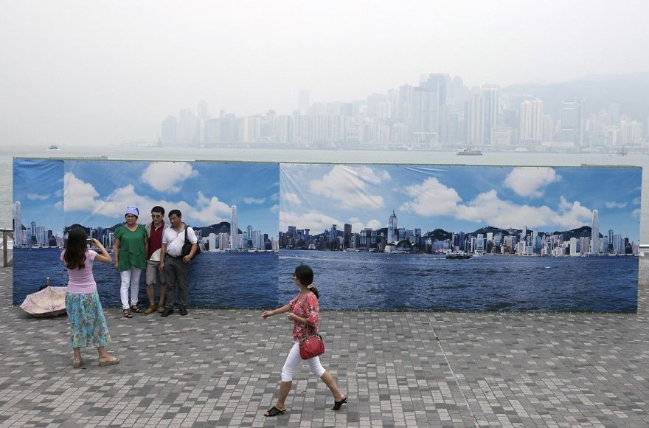

Slide 4
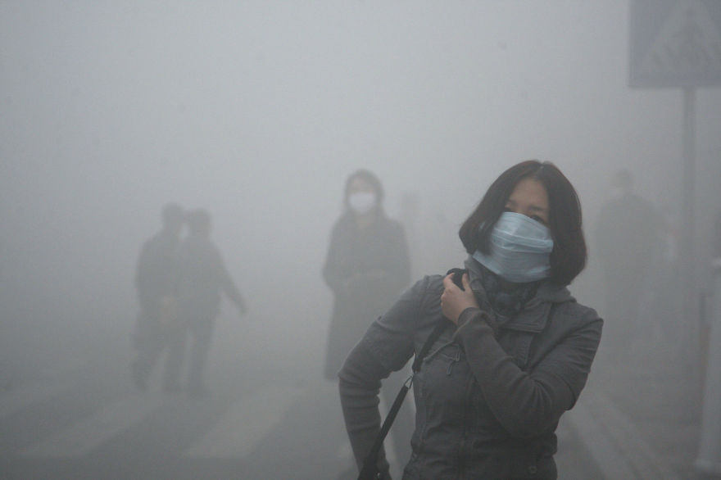

Slide 5
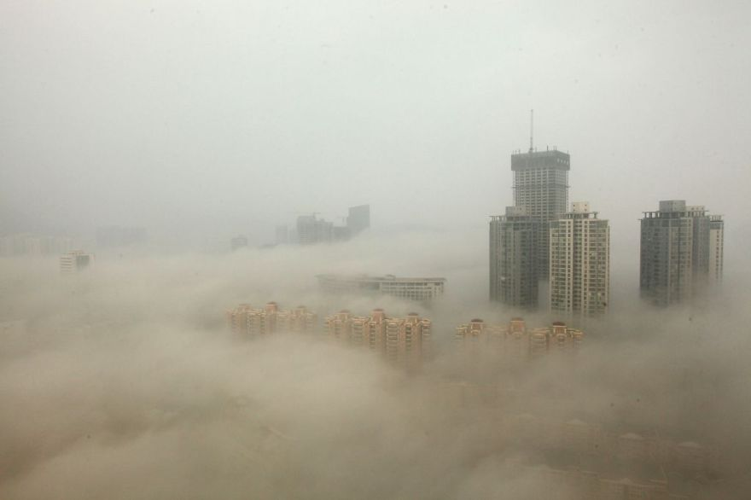

Slide 6
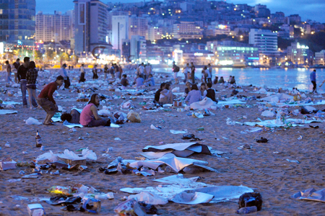

Slide 7
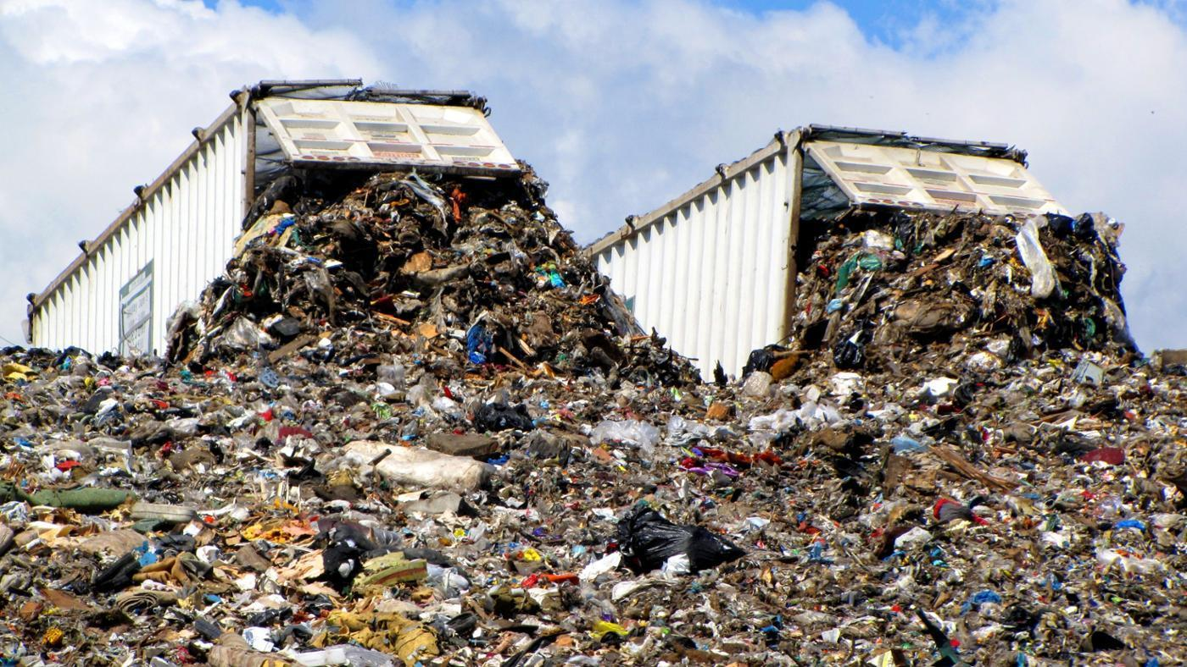

Slide 8
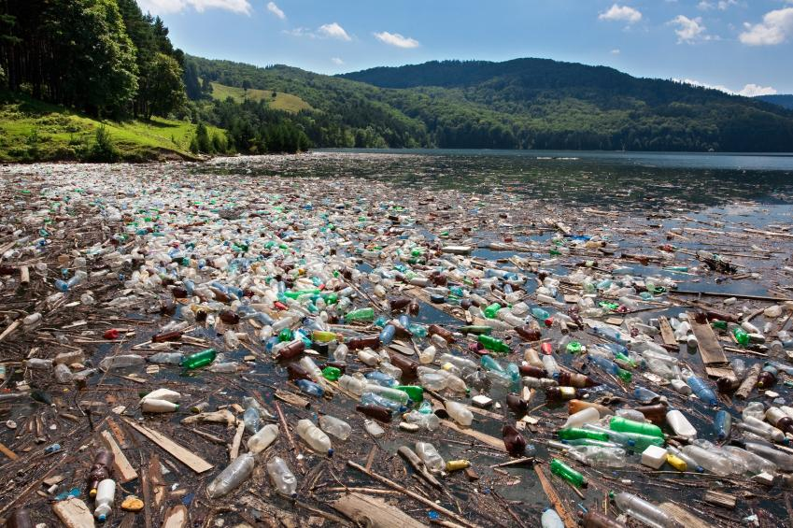

Slide 9
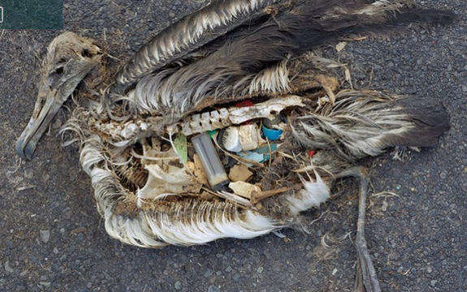

Slide 10
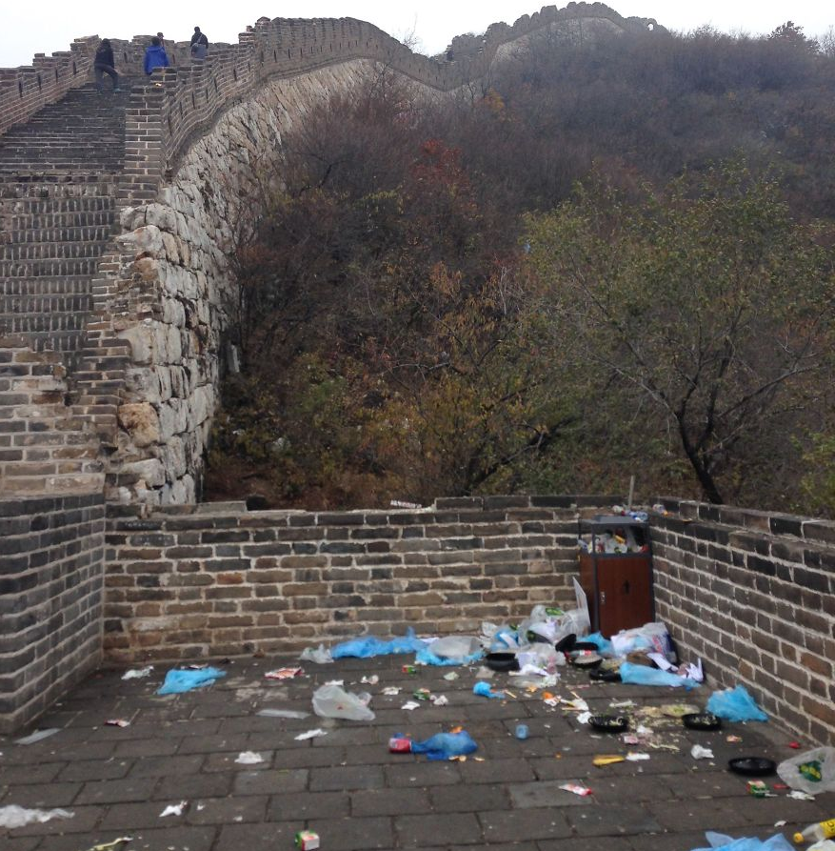

Slide 11
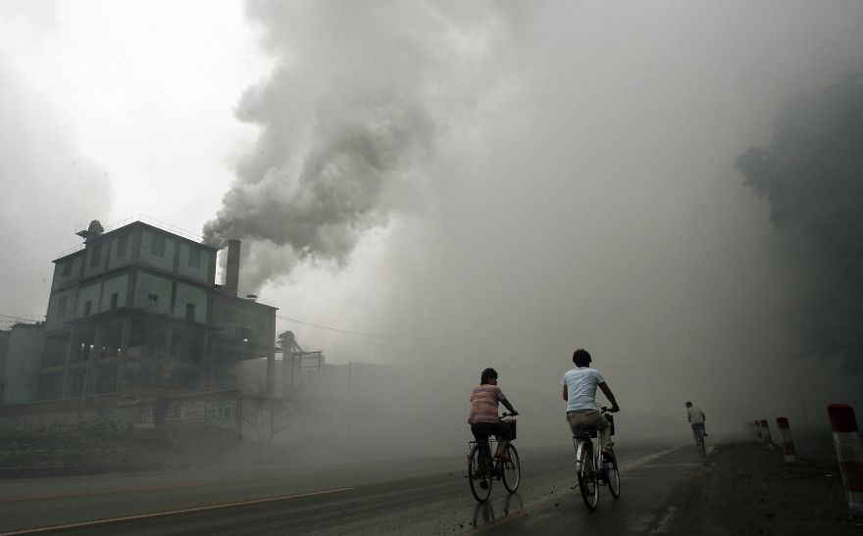

Slide 12
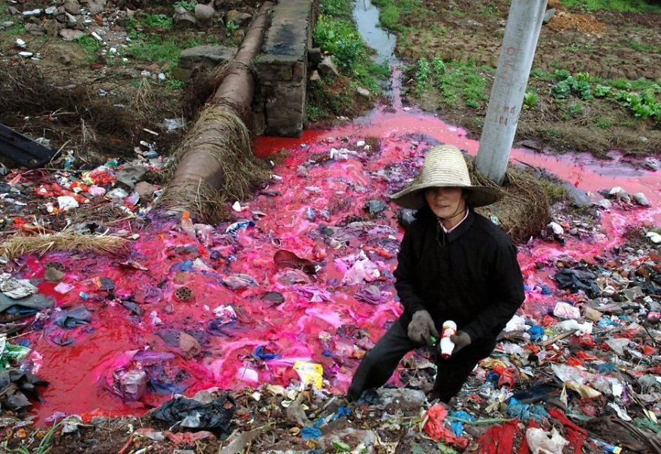

Slide 13
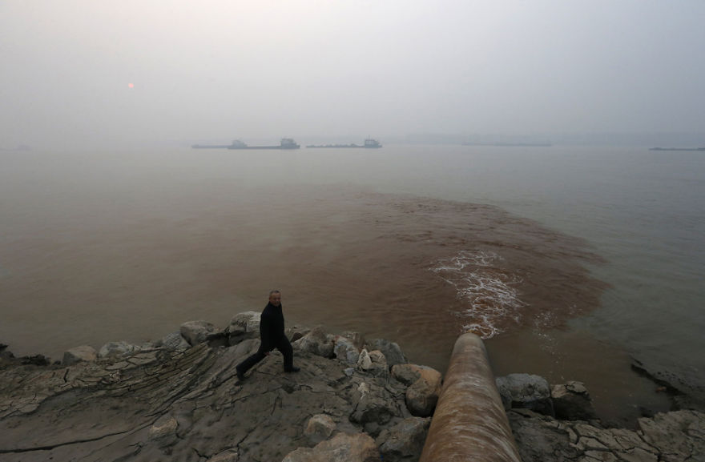

Slide 14
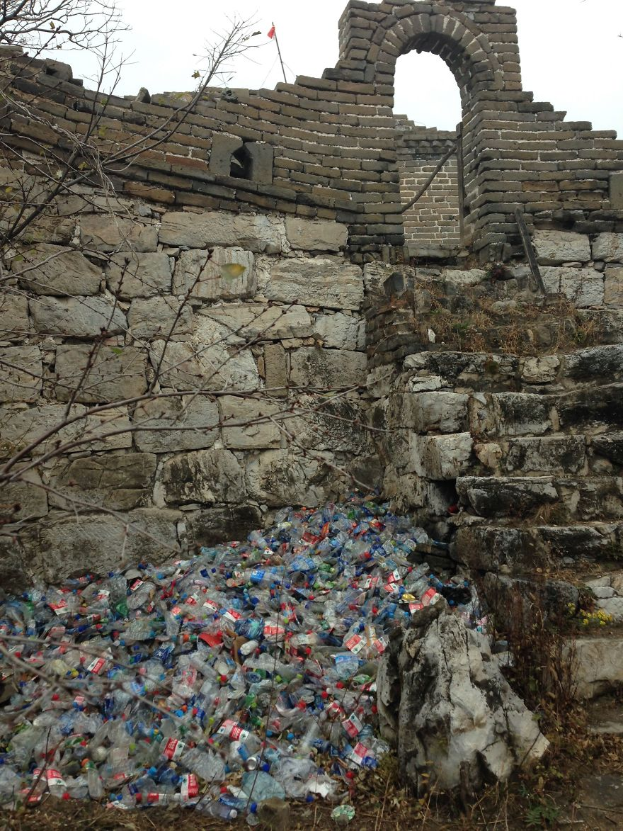

Slide 15
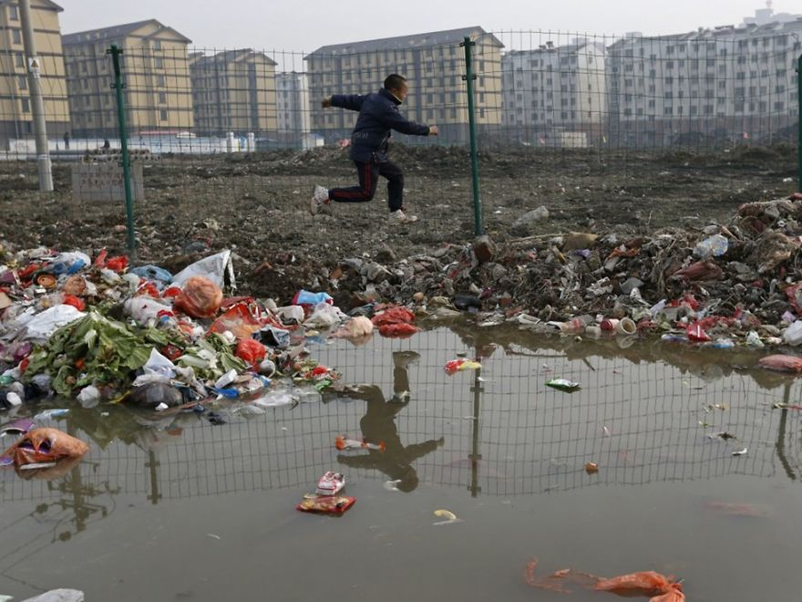

Slide 16
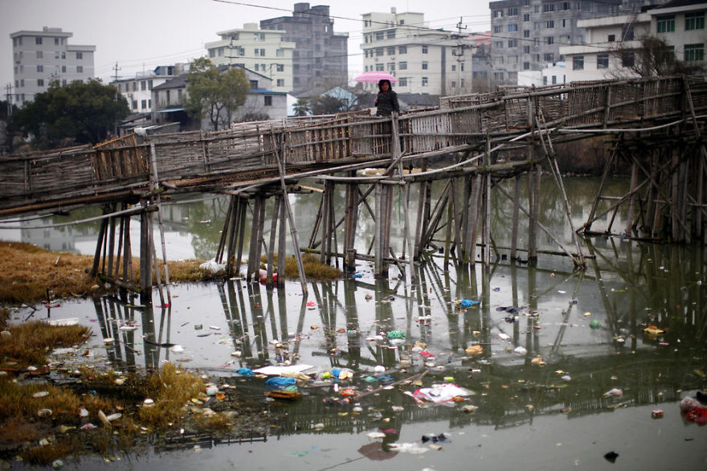

Slide 17
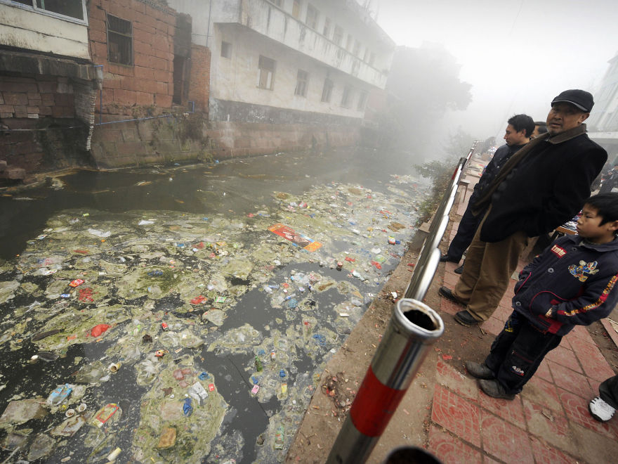

Slide 19
Survey

Slide 20
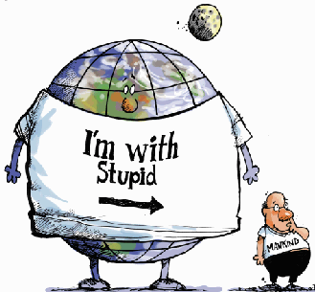
The Issues
What are some of the biggest environmental issues that exist in the world today?
With your group make a list of as many issues as you can think of.

Slide 21
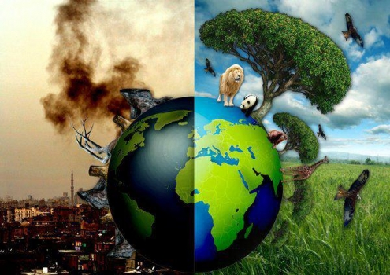
The Death of our Planet

Slide 22
9 Planetary Boundaries
Climate change
Loss of different species
Phosphorus and Nitrogen
Deforestation
Micro-dust (air pollution)
Ozone destruction
Ocean acidification
Freshwater use
Dumping toxic elements into the environment (plastics, nuclear waste, other)

Slide 23
Discussion
What is being done in Korea to protect these boundaries?
Climate change
Loss of different species
Phosphorus and Nitrogen
Deforestation
Micro-dust (air pollution)
Ozone destruction
Ocean acidification
Freshwater use
Dumping toxic elements into the environment (plastics, nuclear waste, other)

Slide 24
How can we increase people’s awareness of how their everyday habits are negatively effecting the earth?

Slide 25
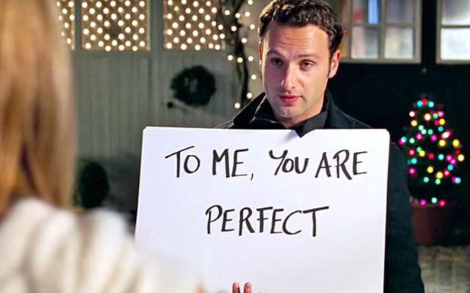
Video
When you brush your teeth, do you let the water run?
With your group
Create a short video to raise people’s awareness of how their daily habits are effecting the earth (think of at least one habit per group member to present)
It can be done by acting/drawing/signs/ or any other creative idea you have
Wevideo

Slide 26
