Slide 1
I Don’t Care

Slide 2
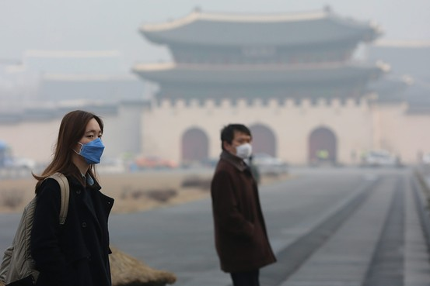
The World We Live in

Slide 3
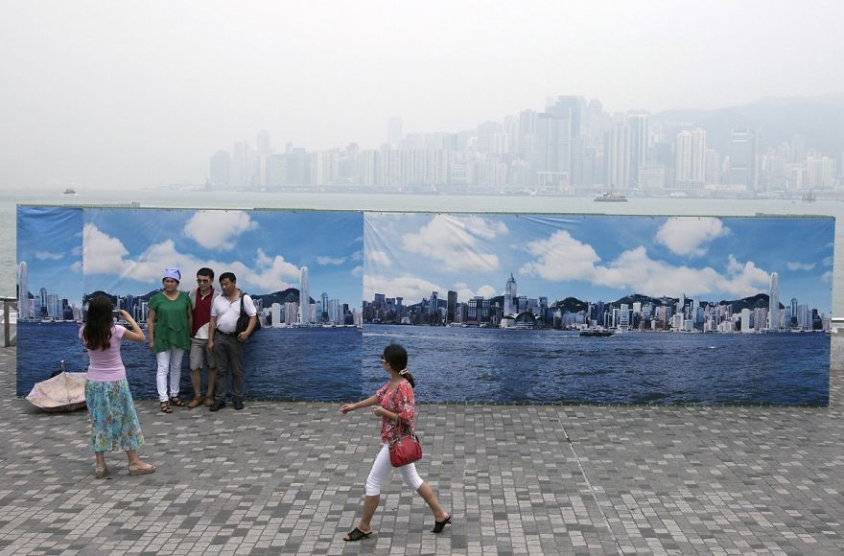

Slide 4
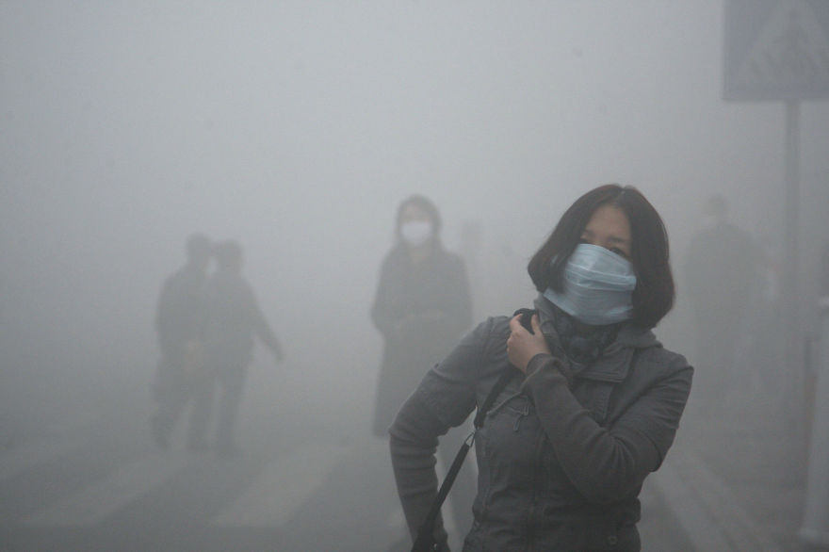

Slide 5
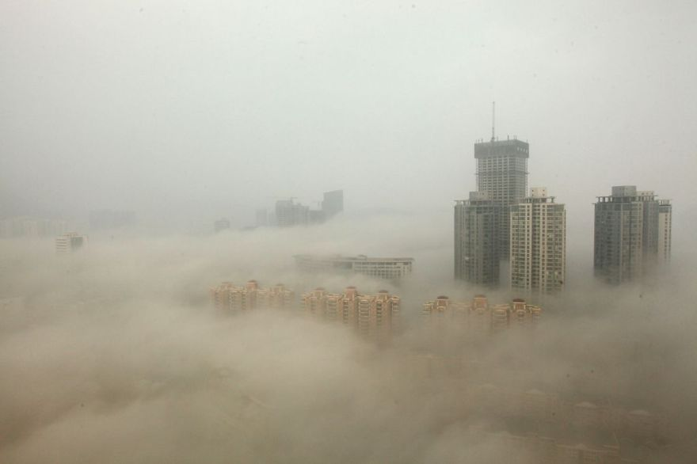

Slide 6
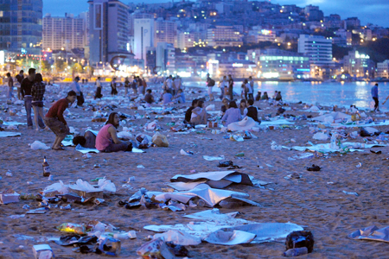

Slide 7
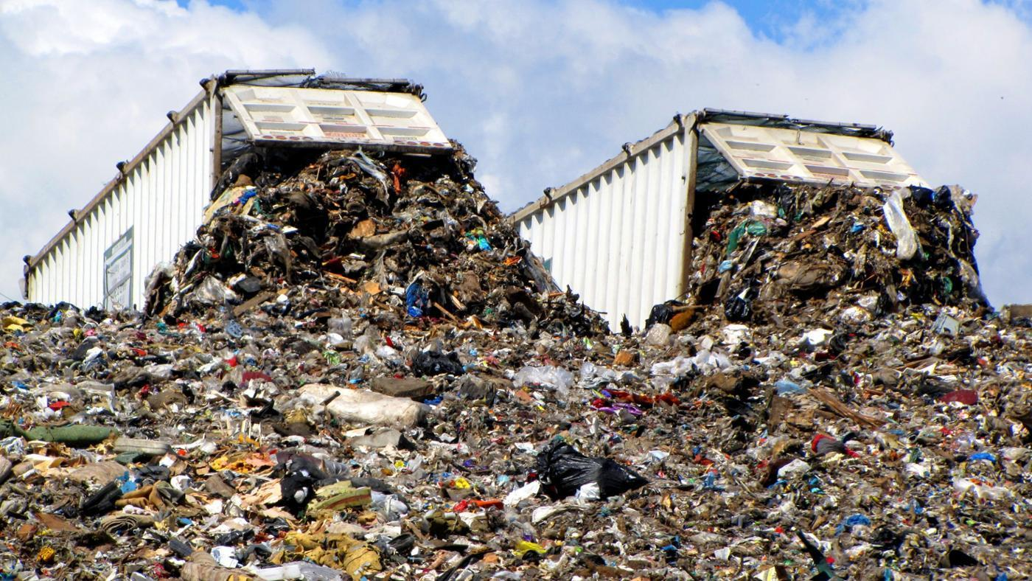

Slide 8
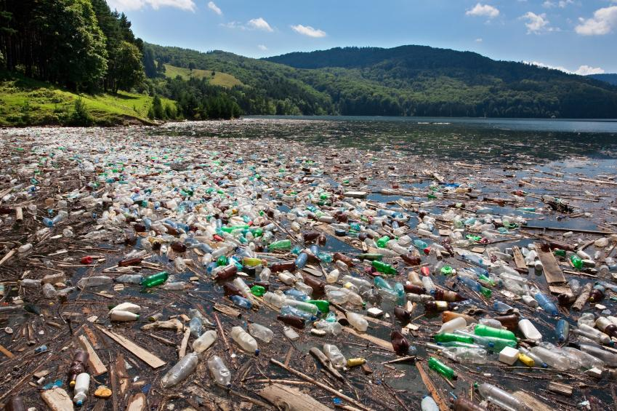

Slide 9
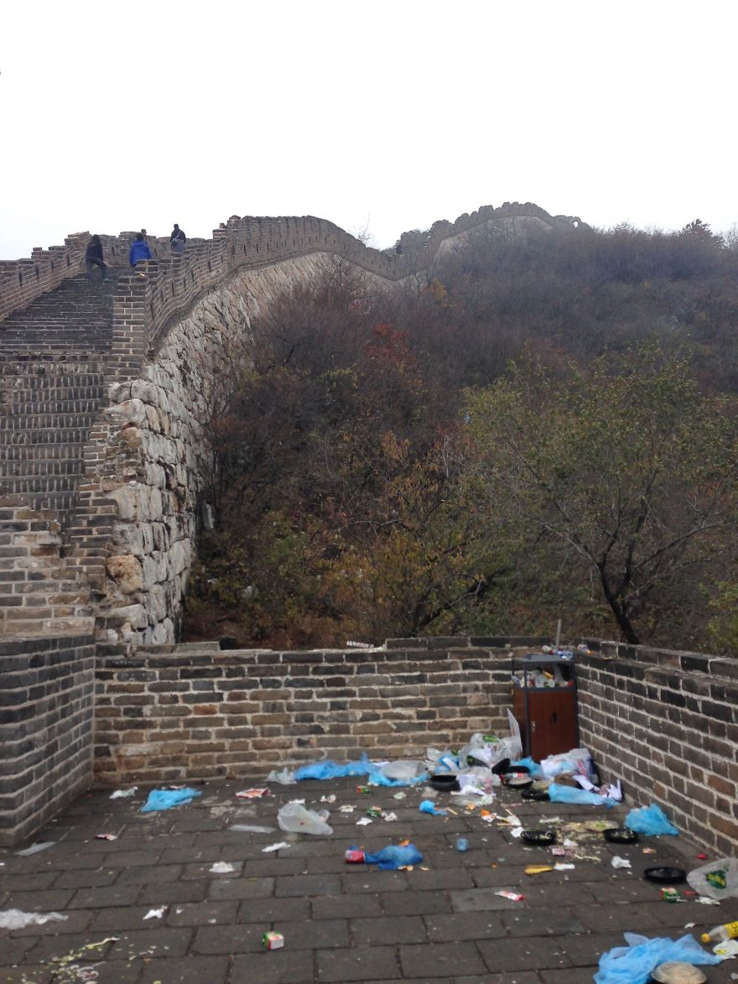

Slide 10
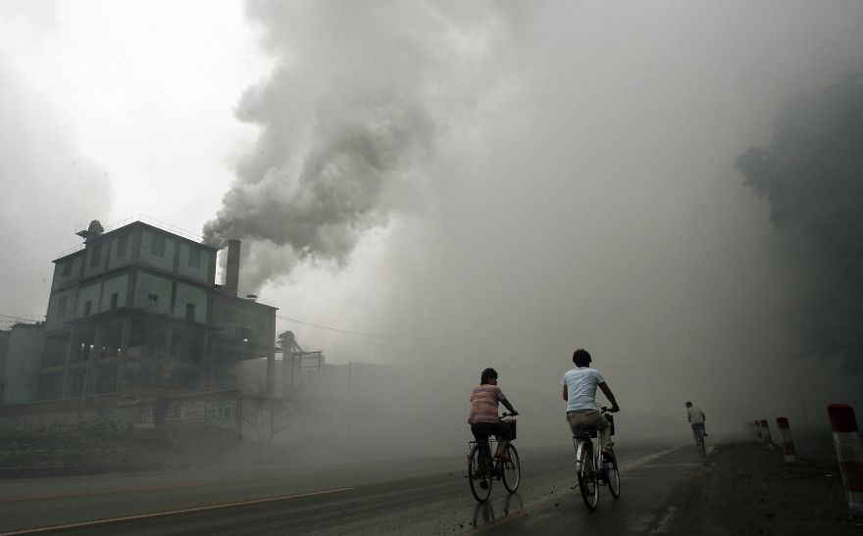

Slide 11
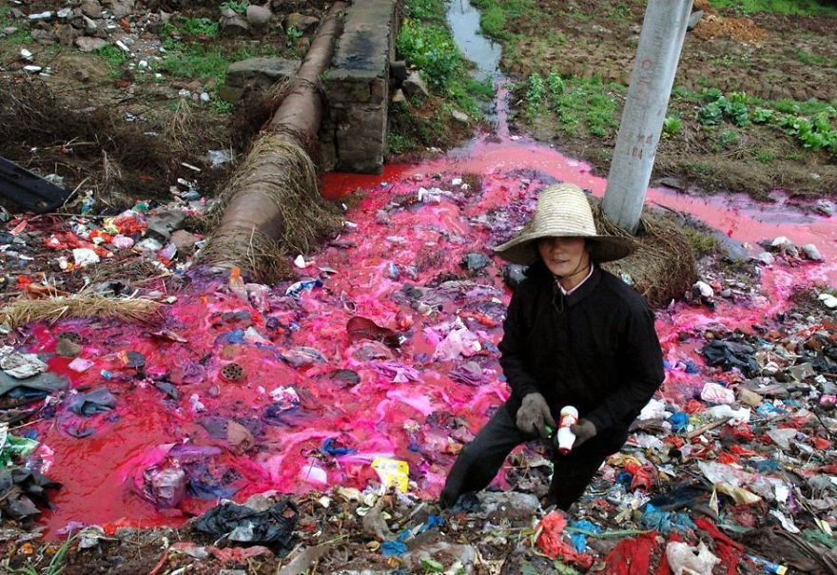

Slide 12
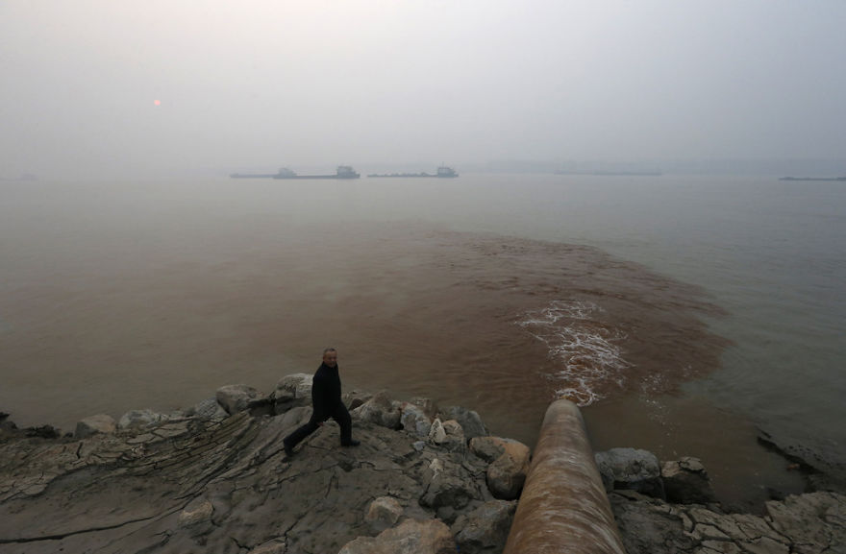

Slide 13
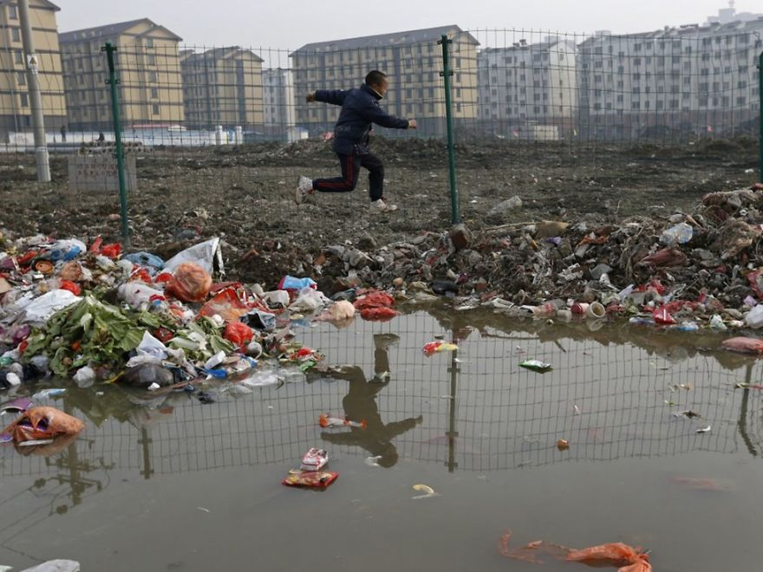

Slide 14
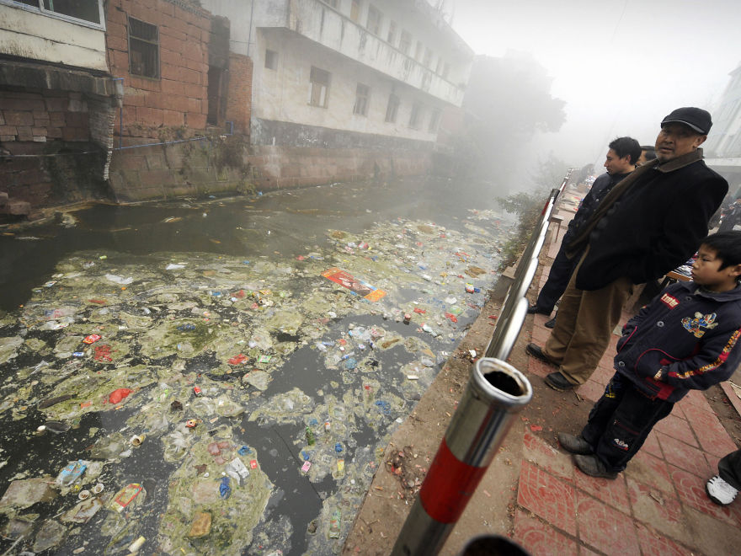

Slide 16
Survey

Slide 17
The Issues
What are some of the biggest environmental issues that exist in the world today?
With your group make a list of as many issues as you can think of.

Slide 18
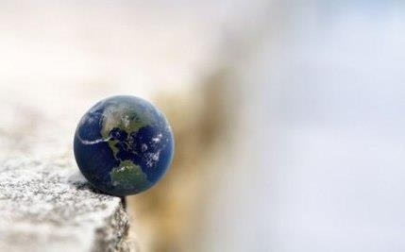
Tipping Point

Slide 19
9 Planetary Boundaries
Climate change
Loss of different species
Phosphorus and Nitrogen
Deforestation
Micro-dust (air pollution)
Ozone destruction
Freshwater use
Ocean acidification
Dumping toxic elements into the environment (plastics, nuclear waste, other)

Slide 20
Discussion
What is being done in Korea to protect these boundaries?
Climate change
Loss of different species
Phosphorus and Nitrogen
Deforestation
Micro-dust (air pollution)
Ozone destruction
Ocean acidification
Freshwater use
Dumping toxic elements into the environment (plastics, nuclear waste, other)

Slide 21
How can we increase people’s awareness of how their everyday habits are negatively effecting the earth?

Slide 22
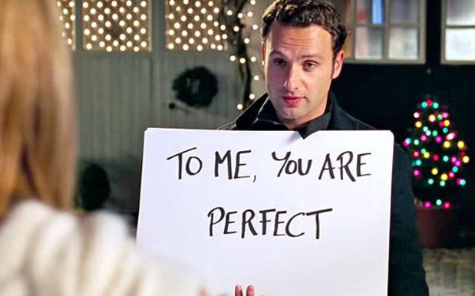
Video project
When you brush your teeth, do you let the water run?
With your group
Create a short video to raise people’s awareness of how their daily habits are effecting the earth (think of at least one habit per group member to present)
It can be done by acting/drawing/signs/ or any other creative idea you have
Wevideo
Vivavideo

Slide 23
Sample Video

Slide 24
Video project
When you brush your teeth, do you let the water run?
With your group
Create a short video to raise people’s awareness of how their daily habits are effecting the earth (think of at least one habit per group member to present)
It can be done by acting/drawing/signs/ or any other creative idea you have
Wevideo
Vivavideo

Slide 25
