Slide 1
How often do you?

Slide 2
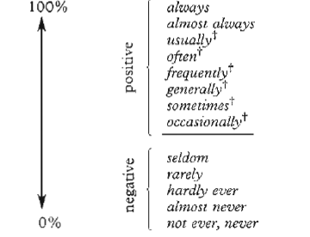

Slide 3
Try these…
(always) I study.
(rarely) I watch a movie.
(almost always) He is late.
(never) She drives.
(occasionally) I am bored in that class.
(frequently) I drink soju.
(sometimes) He is scared to speak.
(always) He is with his girlfriend.

