Slide 1
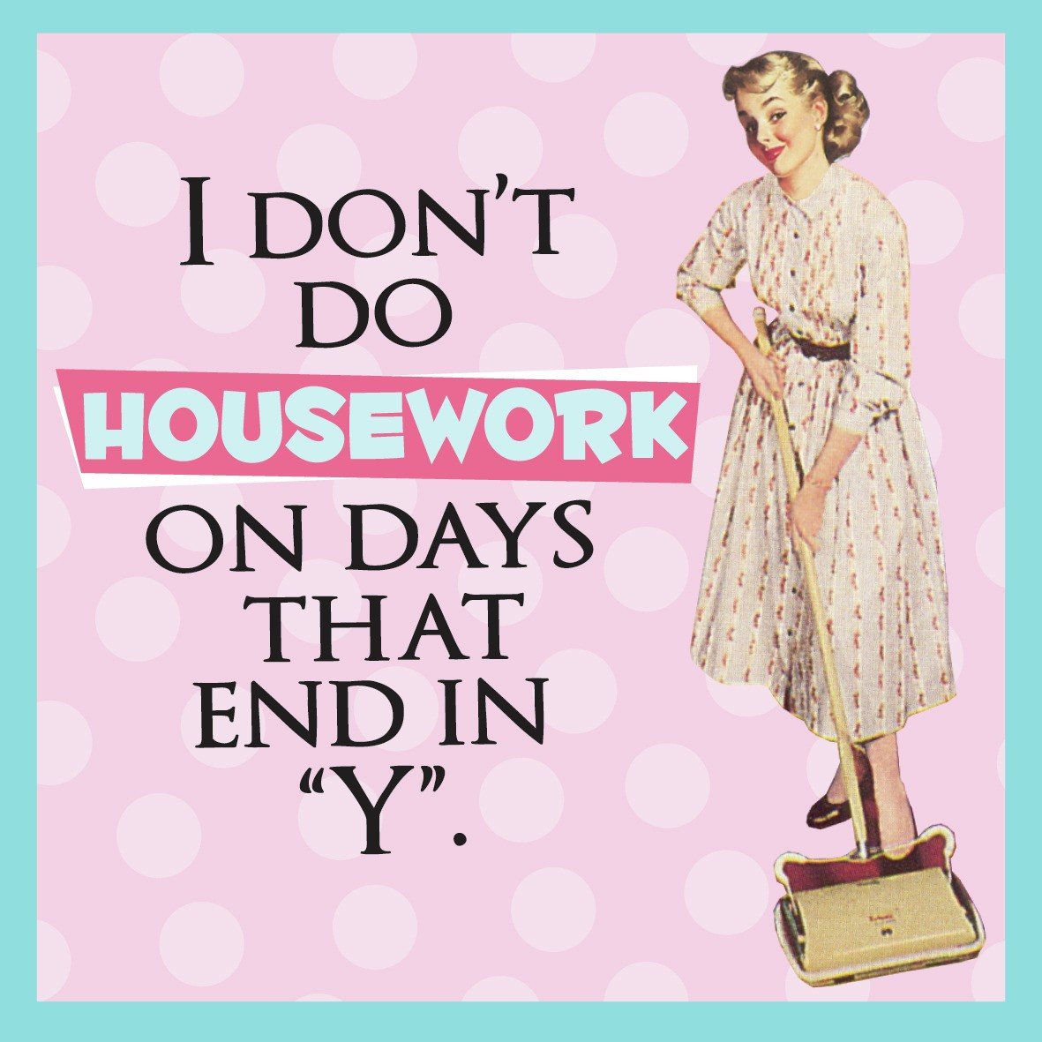
Whose job is it?

Slide 2
What housework chores can you think of?
You have 1 minute to write down as many as possible.
Rank them in order of importance
Why did you order them like that?

Slide 3
SURVEY: Ask 5 people

Slide 4
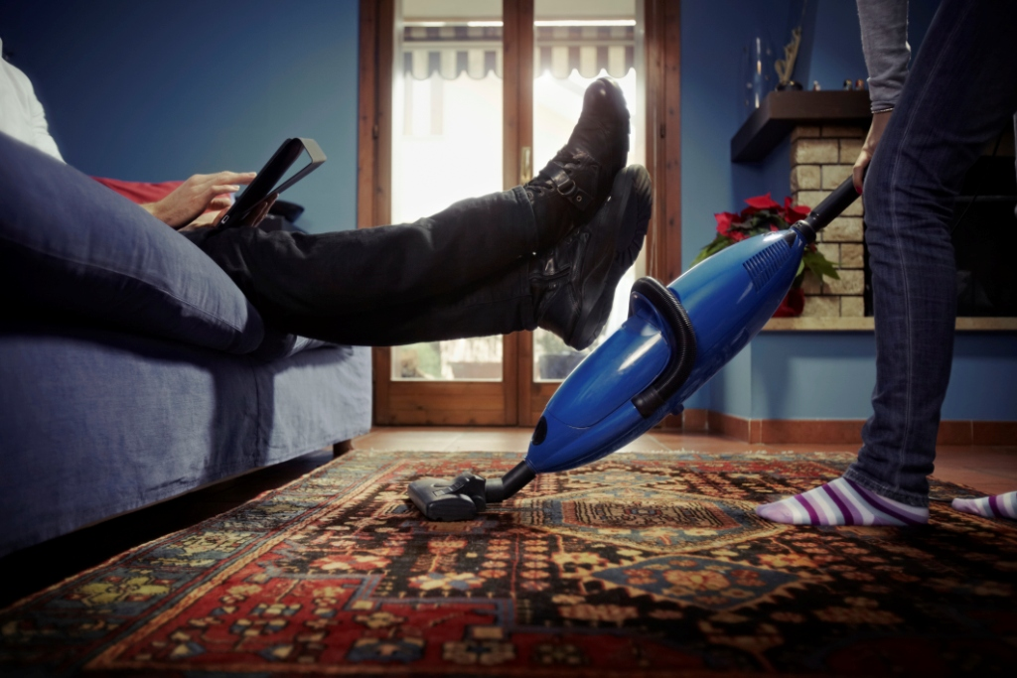
Hye-Jin’s Problem

Slide 5
Opinion
Do you feel that men and women should be equally responsible for housework? Why or why not?
How should the housework be divided in the following situations
The husband is working and the wife is not.
The wife is working and the husband is not.
Both spouses are working.

Slide 6
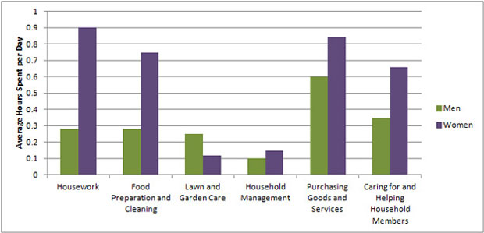
The Statistics

Slide 7
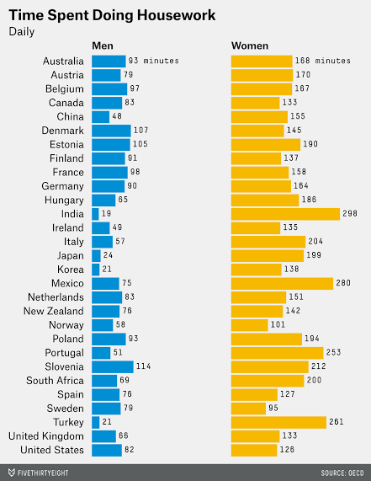
Time Spent Doing Housework
Do you feel that men and women share housework equally in Korea?
Why do you think this is the case?

Slide 8
Dividing up the work
Page 32
Also add the chores you brainstormed at the beginning.

Slide 9
Discuss, write, summarize, share
I think men should do the following household tasks because…
I think women should do the following household tasks because…
I think men and women should share the following tasks because…
I wouldn’t mind doing most of the housework if….

Slide 10
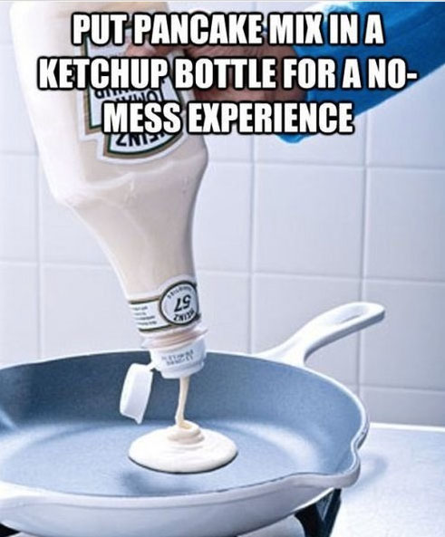
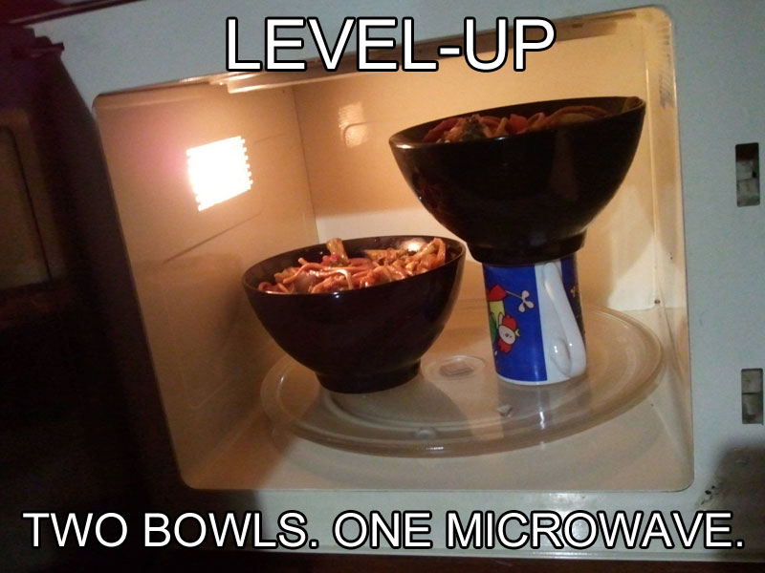
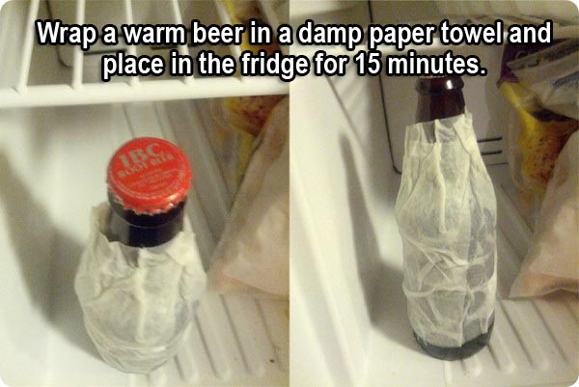
Life Hacks

Slide 11
Life Hacks
Do you know of any life hacks?

Slide 12
Reflection
What are your thoughts about housework? In your opinion, explain how you believe the work should be divided up and under what circumstances that division may change. Consider the following living conditions:
2 friends living in an apartment
A married couple
A married couple with 2 teenage children

Slide 13
