Slide 1
Hedging
Being conscious and cautious in wording

Slide 2
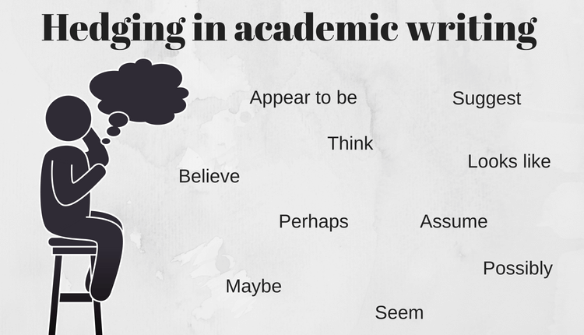
What does it mean to hedge in writing?

Slide 3
Overview of Hedging
Since research and theories are constantly being developed and updated, writers tend to use cautious or tentative language referred to as ‘hedging’.
The language used in academic writing should reflect the strength of evidence to support a topic or claim.

Slide 4
When to hedge and when not to..
Fact or undeniably true: no hedging needed
Speculation: hedging is needed

Slide 5
The strength of evidence to support a topic or claim
Nobody enjoys doing homework.
Everybody in Korea is a fan of BTS.
Foreigners in Korea do not like spicy food.
The sun is hot.

Slide 6
Why is hedging important?
It sounds more professional
It reduces the author’s “degree of liability” (Huebler, 1983:18) and therefore does not leave you as open to attack
It enables writers to “use language with subtlety” and “mean precisely” what they want (Skelton, 1988:107)
It makes writing sound more polite/modest (Hyland, 1995:241)

Slide 7
Compare the following
1. The data in Figure 1 suggest that students tend not to speak English very frequently outside class .
2. It is obvious that students never speak English outside class

Slide 8
Compare the following words
may
might
could
possibly
appears to
seems to
The results indicate/ imply/ suggest
clearly
obviously
without a doubt
certainly
undoubtedly
definitely
there is no doubt that
absolutely (result / evidence) is / shows that / says that / proves

Slide 9
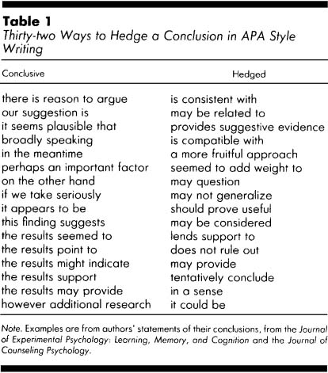

Slide 10
Using cautious language
Language that is not cautious
There is no doubt that Jennings’ (2010) research shows that smoking tobacco causes lung cancer.
Smith’s (2011) evidence proves that greenhouse gases definitely have an effect on the climate.
Cautious language
Jennings’ (2010) research would appear to show that smoking tobacco may cause lung cancer.
Smith’s (2011) evidence suggests that greenhouse gases may have an effect on the climate.

Slide 11
Hedging Language

Slide 12
Identifying hedging
Which sentences have hedging?
Which words or phrases are used to hedge?
Which sentences DON’T use hedging? Why don’t they use hedging?
Help may be at hand for those of us who want to keep the wrinkles and grey hair at bay and slow down the process of aging. New research suggests that eating green vegetables can ward off the signs of aging. Researchers say that broccoli, cabbage and avocado in particular contain a compound that helps slow down the rate at which we age. The key compound, present in green fruit and vegetables, is called NMN. It helps slow down the physical signs of getting old. Scientists say NMN can also rejuvenate the metabolism.

Slide 13
Answer key
Help may be at hand for those of us who want to keep the wrinkles and grey hair at bay and slow down the process of aging. New research suggests that eating green vegetables can ward off the signs of aging. Researchers say that broccoli, cabbage and avocado in particular contain a compound that helps slow down the rate at which we age. The key compound, present in green fruit and vegetables, is called NMN. It helps slow down the physical signs of getting old. Scientists say NMN can also rejuvenate the metabolism.

Slide 14
Hedging Language
http://www.phrasebank.manchester.ac.uk/
http://www.uefap.com/writing/feature/hedge.htm

Slide 15
Type of hedging | Examples
Verbs for observation, opinion, or belief | seem, tend, look like, appear to be, think, believe, indicate, suggest, assume
Modal verbs | may, might, can, could, should, would
Adverbs of frequency | often, usually, sometimes, hardly ever, almost always, almost never
Adverbs showing possibility | possibly, probably, perhaps, potentially
Adjectives showing possibility | probable, possible, likely, unlikely
Nouns showing possibility | possibility, assumption, probability
Quantifiers | most, many, several, almost all, almost none, the majority of, the minority of, few, some

Slide 16
http://www.phrasebank.manchester.ac.uk

Slide 17
Practice
1. There is no doubt that learning English is the most important skill for future success.
2. Research clearly proves that it is much better for your health to drink diet cola than regular cola.
3. Organic food obviously tastes better.
4. Fast food is definitely not a beneficial choice in our lives.
5. As we all know, consuming alcohol always has many negative side effects.

Slide 18
More practice
Everyone agrees that GTM style of teaching is outdated.
The best way to teach language is through authentic activities which engage the learners.
It cannot be argued that the higher a language teacher’s English proficiency the better teacher they are.
From the data we can conclude that younger is always better when it comes to learning a second language.
The results prove that those who start learning a second language after the age of 18 cannot reach the same level of proficiency as those who start before.
It is obvious that children with learning difficulties should be integrated in regular classrooms.

Slide 19
More practice
Everyone agrees that GTM style of teaching is outdated.
Some people feel that GTM may be outdated.
The best way to teach language is through authentic activities which engage the learners.
One possible effective way to teach language is through authentic activities which …
It cannot be argued that the higher a language teacher’s English proficiency the better teacher they are.
Some argue that the higher…
From the data we can conclude that younger is always better when it comes to learning a second language.
Some studies have suggested that younger may be better when it. …
The results prove that those who start learning a second language after the age of 18 cannot reach the same level of proficiency as those who start before.
There have been a few studies that have implied that those who start learning a second language after the age of 18 may not reach….
It is obvious that children with learning difficulties should be integrated in regular classrooms.
It may be beneficial for children with learning difficulties to be integrated into regular classrooms.

Slide 20
Hedging
Review and Warm-up

Slide 21
Hedging Warm-up
The results of this study prove that assigning too much homework to students is bad for their mental health.
Everybody agrees that grammar should be taught inductively to young learners.
There is no doubt that the more you study, the better your test score will be.
It can be said without a doubt that teachers’ greatest difficulty in the classroom is managing students.

Slide 22
Hedging Written Feedback

Slide 23
It is important to hedge written feedback …
So you do not offend
So you do not destroy confidence
So that your students still like you after receiving your feedback ☺

Slide 24
Common mistakes when giving feedback
Reading the piece only once and giving feedback while reading
Criticizing the student, not the writing
Pointing out everything that is wrong, and nothing that is positive
Being overly direct, or overly vague in your comments

Slide 25
Examples of harsh feedback
I don’t understand this.
This sentence doesn’t make any sense.
You have so many grammar and spelling mistakes I cannot even count them.
This is poorly written.
Rewrite.
You suck!
This is a weak effort. You need to try harder.
The only place that will accept this essay is the trash bin.
My 5 year old daughter is better writer than you.

Slide 26
When giving feedback
Focus on constructive criticism
Write the feedback in a way that you would like to receive it if you were the student
Be specific about your suggestions and give examples
You may focus on both things that are positive as well as negative
If you have something negative to say try to explain why you are saying it. Also, it is always nice if you can provide a suggestion on how to improve that negative point.

Slide 27
Useful phrases
X
is well written
contains many useful examples
is well organized
May I suggest…
You may want to consider..
I am sorry but..
I think it would be better if you…
It would be better to..
One way that you could make this stronger is…
Could you please add …

Slide 28
Please provide written feedback for the following
Consider the following
Organization
Clarity
Content
Punctuation/ spelling
Wording
Word choice
Referencing
Hedging
Everyone knows that English is being learned by an increasing number of students each yeer. Also the number of non-native speaking teechers is going up a lot. So like I think it is important to reflect these difference in teaching methods. Like teaching methods need to be updated to kind of you know .. .fit the changing world of Englishs educatin.

Slide 29
Please provide written feedback for the following
Motivating students learners is hard for all the teachers of learners of English in the classrooms. Always students don’t pay their attention when the teacher does the lesson and they bother other students so the teacher has to stop the lesson. Without good skills to motivate the students the problem can gets worse and the teacher get frustrated and angry. So teachers need too learn how to motivate students and different strategies they can use to motivate their students if they have a difficulty like this.
Consider the following
Organization
Clarity
Content
Punctuation/ spelling
Wording
Word choice
Referencing
Hedging

Slide 30
References
Crompton, P. (1997). Hedging in Academic Writing: Some Theoretical Problems, English for Specific Purposes. 16(4), 271-287
Huebler, A. (1983). Pragmatics and beyond: Vol IV, 6. Understatements and hedges in English. Amsterdam, John Benjamins.
Hyland, K. (1995). The author in the text: Hedging scientific writing. Hong Kong Papers in Linguistics and Language Teaching 18, 33-42.
Sketlon, J. (1988). The care and maintenance of hedges. ELT Journal Volume 42, 1, 37-43

