Slide 1
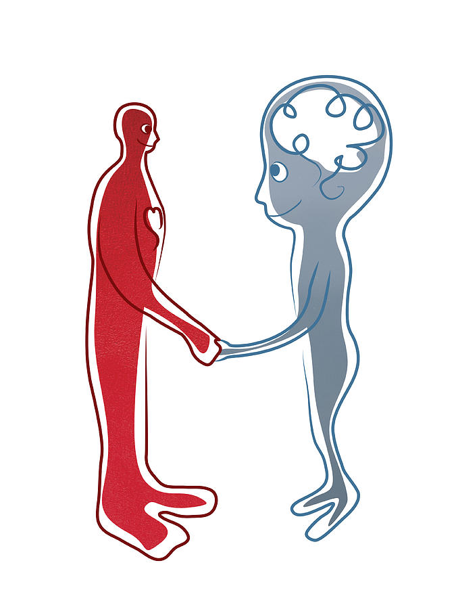
Health
Mind & Body

Slide 2
What is more important?

Slide 3
Survey

Slide 4
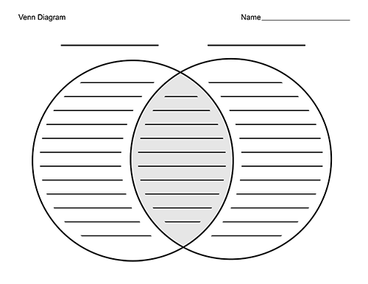
With your group think of things that can make…
Your body unhealthy
Your mind unhealthy
Both your body and your mind unhealthy

Slide 5
Giving advice/ Suggestions
I think you should… (not) eat ….
You should… (not) walk more.
I suggest… (not) taking a vacation.
How about… (not) going for a walk.
Why don’t you… join a yoga class?
It would be a good idea to…. (not) drink more water.

Slide 6
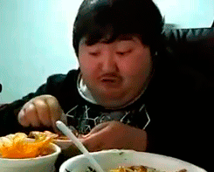
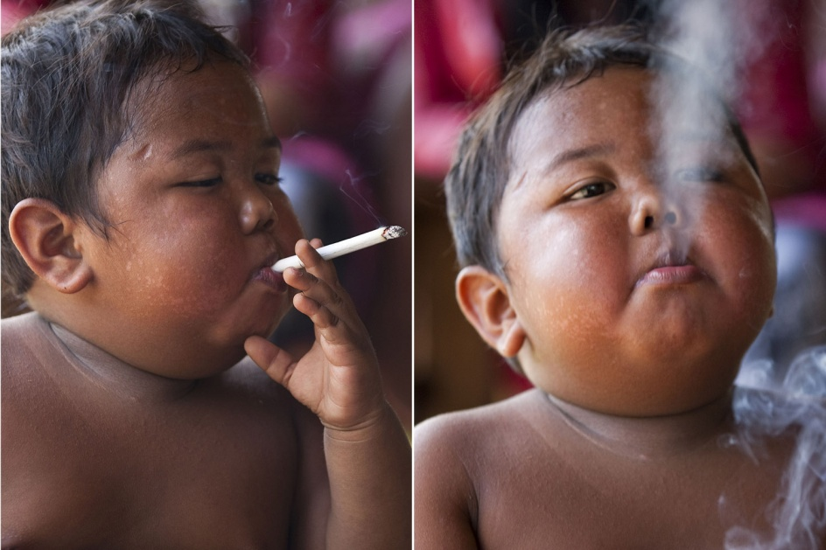
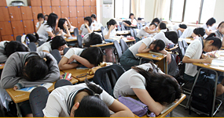
What advice would you give them?

Slide 7
Describe 2 people
Write a description 2 people who are unhealthy.
Ex. Overweight, smoker, alcoholic ect.
You will give you descriptions to another group
The group will then write their advice

Slide 8
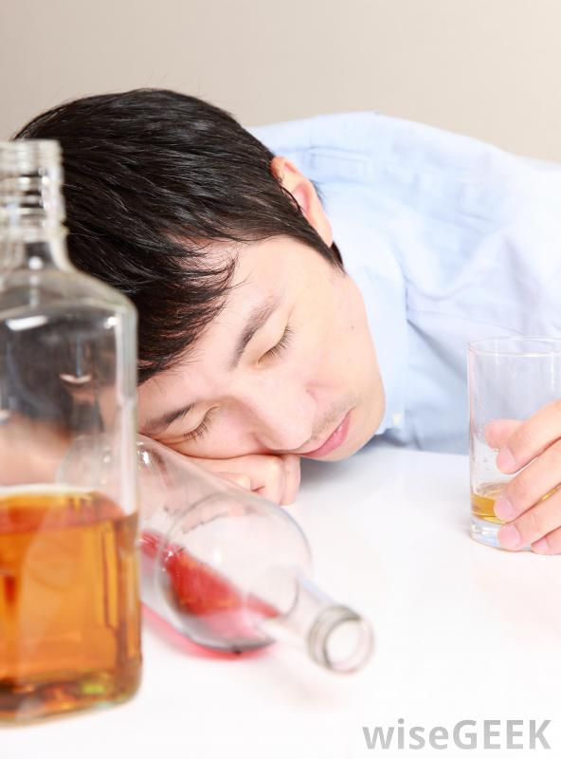
Situation
Name:MinHo
Age:22
Problem: He drinks 1 large bottle of whiskey every night. He always has a headache and his stomach hurts. He always feels tired.

