Slide 1
Happiness
How can we be happy and stay happy?

Slide 2
Happiness

Slide 3
How happy are you?

Slide 4
What makes you happy/unhappy?

Slide 6
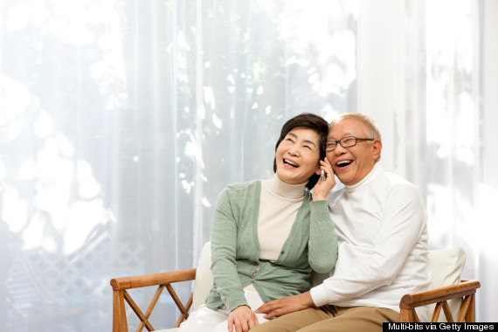
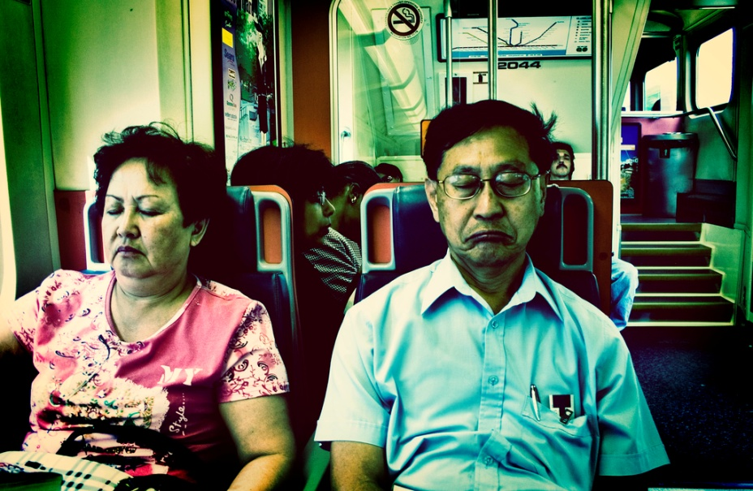
Do you think that people get happier as they get older?

Slide 7
We tend to falsely equate youth with happiness.

Slide 8
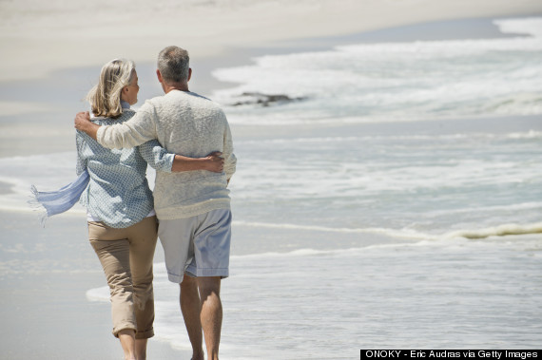
Happiness peaks at 69.
http://www.huffingtonpost.com/2014/04/10/scientific-proof-that-the_n_5110179.html

Slide 9
The older we get, the more we appreciate the little things.

Slide 10
We're happier when we've already accomplished our major goals.

Slide 11
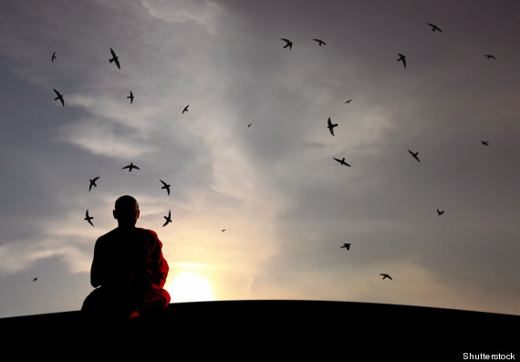
Aging gives us an opportunity for acceptance.

Slide 12
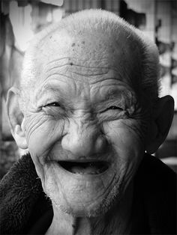
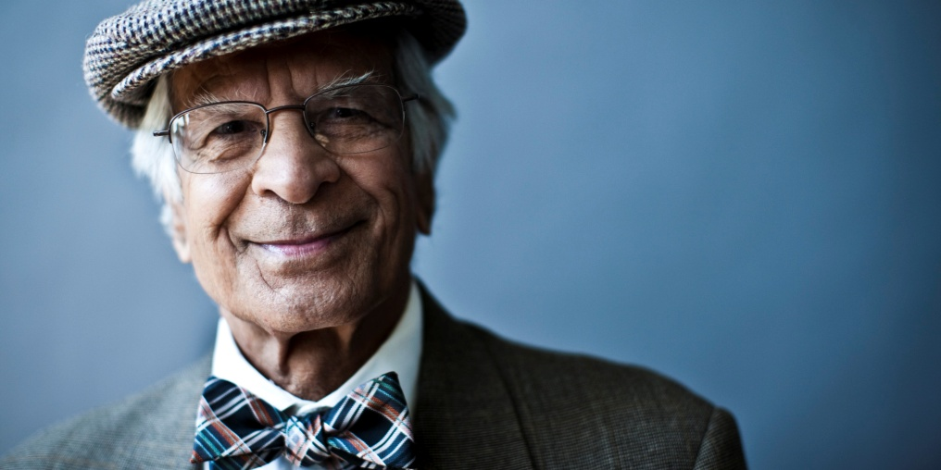
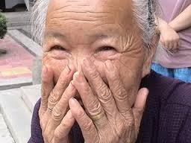
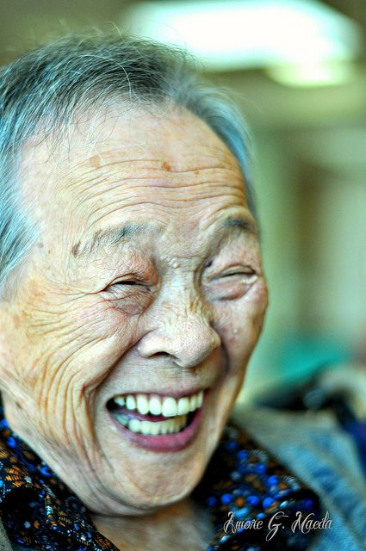
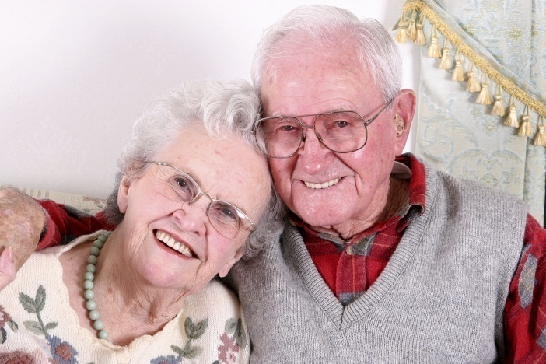
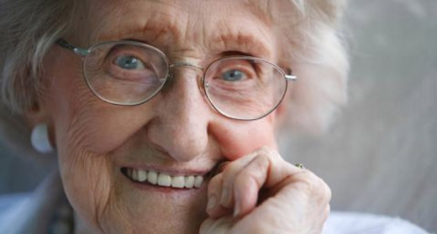
Happiness advice from people over 70

Slide 13
Advice for a Happier Life
Never take the people you love for granted
Believe in yourself
Remember what is important to you
Work hard for what you want
Put your heart and soul into everything you do
Don't hold grudges
Stop worrying and live in the moment
Be the person you want to be, not the person everyone else wants you to be.
Don’t give up things you are passionate about.
Eat good food, Drink good wine

Slide 14
Make your happiness checklist

Slide 15
Photo Essay Project
You are going talk to fellow teachers about happiness at school
You want to help them to increase their happiness at school
What can they do on a daily basis to be happier?
TASK
Take pictures or find pictures on the internet that connect to your advice. (3-5 pictures)
Give your advice one-one

