Slide 1
Getting Started
Basic principles: Students, teacher, classroom environment
Notes:
NOTE:
To change the image on this slide, select the picture and delete it. Then click the Pictures icon in the placeholder to insert your own image.

Slide 2
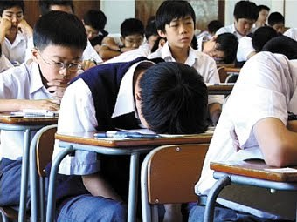
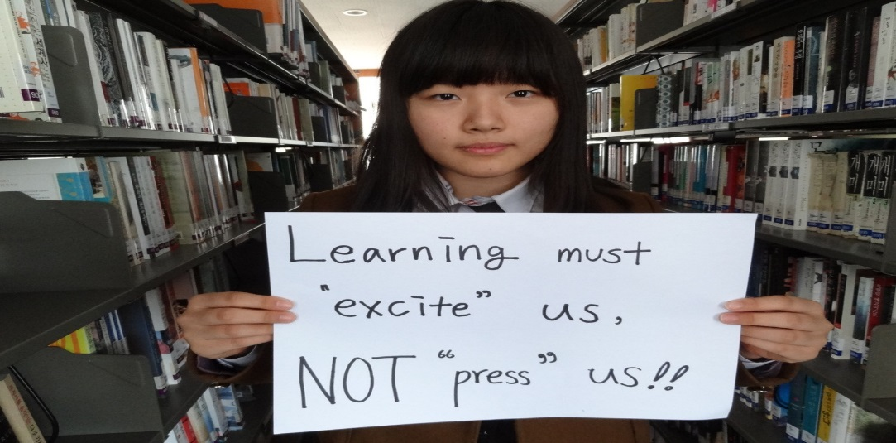
The students

Slide 3
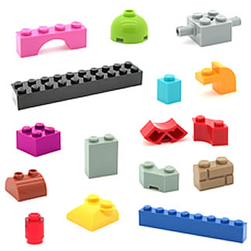
The students
Think about a language learning classroom that you teach or have been part of.
Generally speaking, did your teacher treat the class ( or do you treat your students )as 1 group as a whole, or as a class made up of individual students?

Slide 4
Which one do you think is better? Why?

Slide 5
Think about the following situation
Two or more English learners at the same proficiency level are attending the same English class, having the same instructors and materials, doing the same activities and exercises, proceeding for the same duration of course program.
At the end of the program, these learners undergo an English competency assessment. But they achieve different level of competence.

Slide 6
Thinking time… Same class, different result
Why is it that all students in a class take the same lesson, but do not learn exactly the same thing?
Why may one learner be more successful at something and not another?
What factors may have affected the results of their learning?

Slide 7
Individual differences
In the field of SLA it is acknowledged that individual differences exist in L2 acquisition.

Slide 8
Individual differences in second language learning
Intelligence
Aptitude ( ability to learn/ perform different skills)
Individual learning techniques
Personality (emotion, empathy, confidence, introvert/extrovert etc.)
Motivation
Attitude
Age

Slide 9
Individual differences
It is important for a teacher to be sensitive to learners’ individual differences.
Learning is most effective when a teacher takes into account learners’ differences.
A teacher’s challenge is to acknowledge and celebrate the differences among learners and work to maximize the growth in each learner.

Slide 10
What it means for you
As a teacher, get to know your students.
Understand their individual differences as much as possible.
Whenever possible take these into consideration in your teaching and interaction practices.

Slide 11
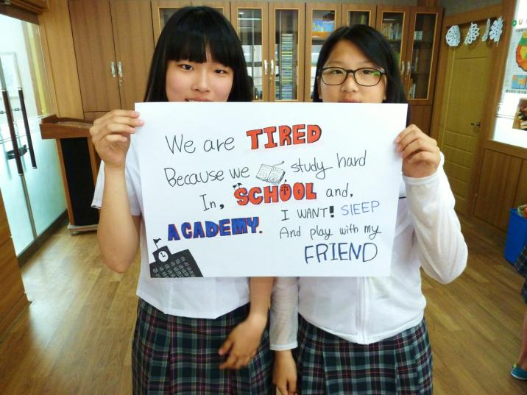
Overall, remember this…

Slide 12
The environment

Slide 13
Creating and environment supportive of language learning
With your group, draw a picture of a language classroom that you feel is supportive of language learning. Think of desk arrangement. Where the whiteboard, TV, or other classroom tools are located. Where the teacher is located.

Slide 14
The importance of a positive learning environment
Classroom environment is one of the most important factors affecting student learning.
Simply put, students learn better when they view the learning environment as positive and supportive (Dorman, Aldridge, & Fraser, 2006).
A positive environment is one in which students feel a sense of belonging, trust others, and feel encouraged to tackle challenges, take risks, and ask questions (Sheffler, 2009)

Slide 15
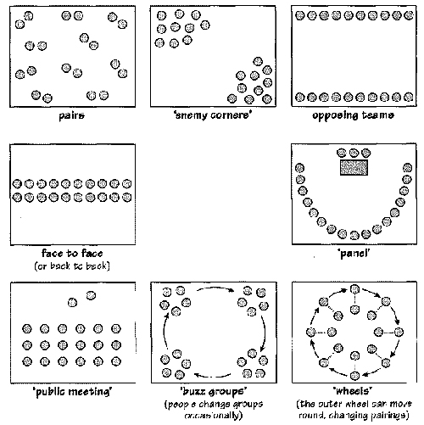
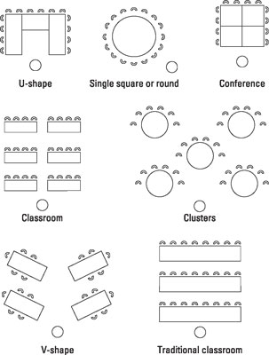
Which set-up is the best for language learning? Worst?

Slide 16
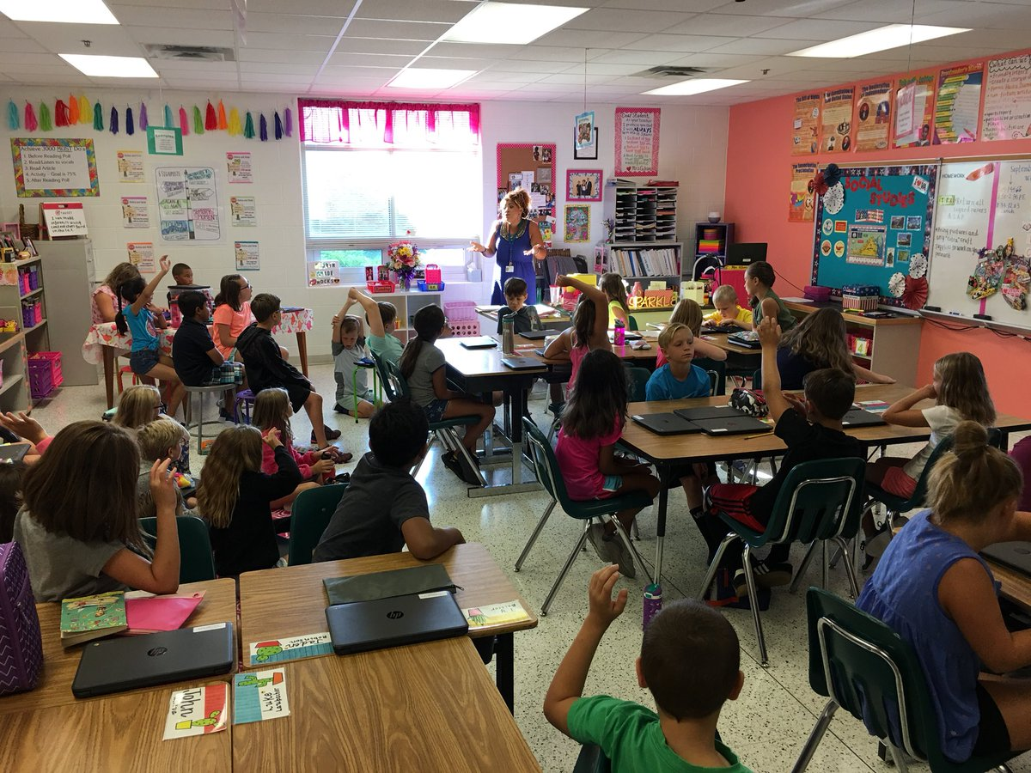

Slide 17
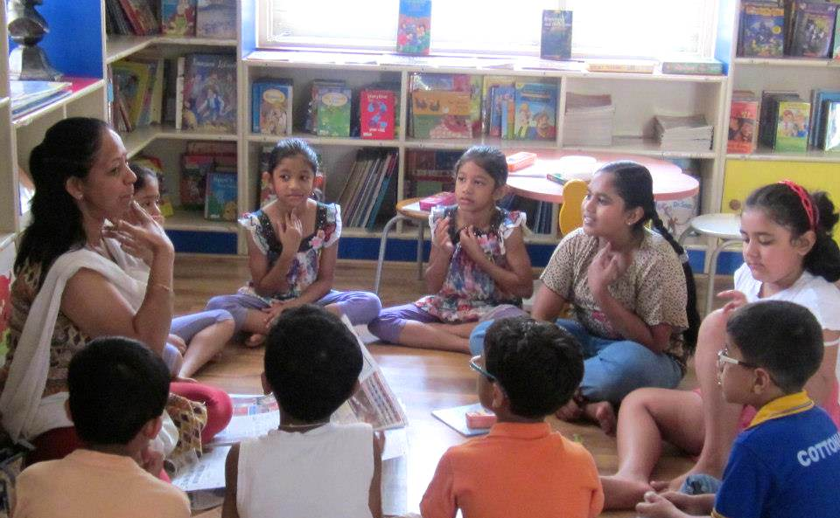

Slide 18
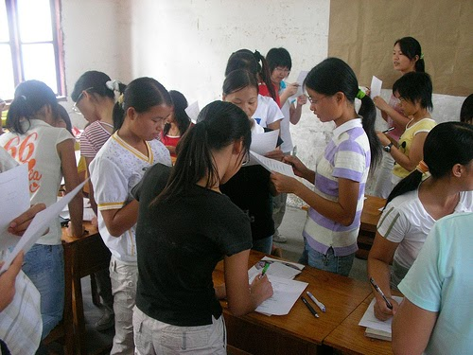

Slide 19
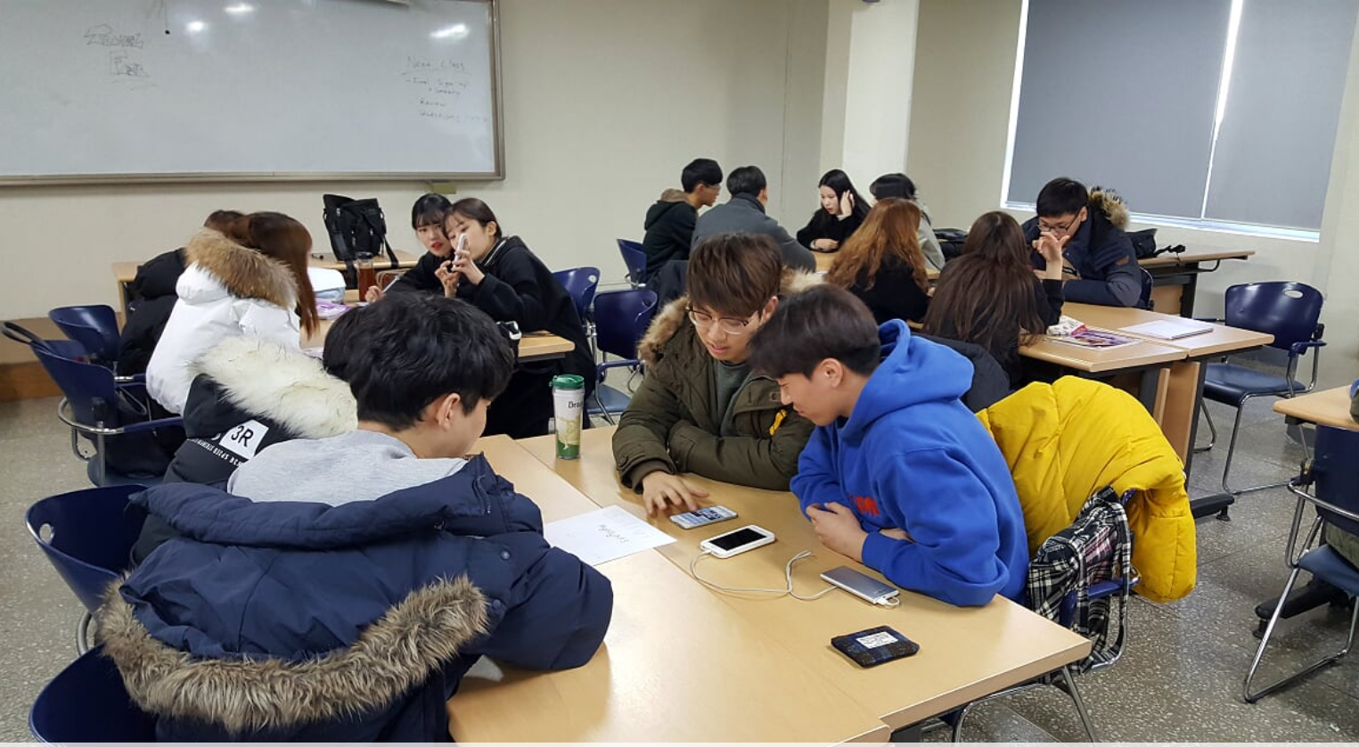

Slide 20
Key points
Positive low-stakes environment ( lower affective filter)
Flexes with the needs of the lesson and learners
Multiple arrangements can be used within a single class
It is not only the set up, but the teachers attitude that affects how comfortable students feel in the classroom.
Just because the environment is comfortable doesn’t mean the students shouldn’t work hard ( actually the opposite)

Slide 21
The language teacher

Slide 22
Think about a language teacher you had in your life
Think about a teacher you really liked
What was it about them that made you like them?
Think about you teacher you really didn’t like
What was it about them that made them less likeable?

Slide 23
The language teacher
What is the job of a language teacher? What is their purpose?

Slide 24
Reflecting on teachers of your past
Think about a language teacher that you have learned a lot from. What did you learn from them?
Think about a language teacher you have had that you would describe as ‘good’. What knowledge, skills, characteristics did they possess that make them ‘good’ in your opinion?

Slide 25
The job of a language teacher
Goes beyond just teaching language.
Building communicative bridges and understanding between people of different languages and cultures.
Fostering global citizens.
Inspiring/motivating students to be autonomous learners.
Building students confidence.

Slide 26
The job of language teacher in South Korea
Often focuses on test scores.
Involves additional work outside of the language classroom i.e. administrative duties, paperwork, counseling parents etc.
In the public setting teachers report 30% of their work is English teaching and 70% is administrative work (i.e. homeroom duties, paperwork, etc.)

Slide 27
Some essential things teachers need to succeed
Language proficiency
Linguistic knowledge
Knowledge of the content they are teaching
Knowledge of stakeholders’ learning aims
Classroom management and motivation skills
Ability to present things in a clear and accurate way to learners
Rapport building skills
Ability to set up and manage a supportive learning environment in line with the aims of the class
Ability to monitor and manage individual students learning and progress
Ability to adapt to different learners and different teaching situations
Ability to deal with the stress of the job

Slide 28
Setting the tone
Get off to a good start

Slide 29
Think about your first day teaching a class
How do you or would you greet the students?
Would you be warm, strict, easy-going ?
How would you act on the first day?
Scary, friendly etc. ?

Slide 30
Welcoming students
Welcome students in a polite, friendly, and approachable manner.
Do not scare them into compliance!
Be clear about your rules and boundaries. You can still do this in a nice way.
The key is to have students respect you for your positive aspects and not out of fear.
Be friendly, but be careful of being ‘friends’
Key point: boundaries, boundaries, boundaries

Slide 31
What boundaries would you set?
What are things you will not tolerate in your class?
Make a list.

Slide 32
Expectations vs. Rules
What classroom expectations would you set?
What rules would you set?

Slide 33
Rapport building
Rapport building starts the first second you meet.
Try to find things in common with your students.
Reduce the gaps that exist between you and them.
Age
Teacher-Student relationship
Other?
Talk about things they like (not things you like).

Slide 34
Additional tips
If you have a certain way you want your class set up. Have the students do this before you come and return it to the way it was previously before you leave.
You should make this clear on the first day ☺

Slide 35
First day of class
Apply what you learned

Slide 36
Teacher Reflection
What kind of language teacher do you want to be? How do you want your students to see you?
What do you think you are good at and what do you think you need to work on?

Slide 37
References
Dorman, J. P., Aldridge, J. M., & Fraser, B. J. (2006). Using Students' Assessment of Classroom Environment to Develop a Typology of Secondary School Classrooms. International Education Journal, 7(7), 906-915.
Sheffler, J. L. (2009). Creating a warm and inclusive classroom environment: Planning for all children to feel welcome. Electronic Journal for Inclusive Education, 2(4), 4.

