Slide 1
Final Tips

Slide 2
Common Feedback
Don’t need to ICQ time unless it is a specific time that you are setting that is going to be kept.
When eliciting don’t just get answers from the most outgoing students. Try to elicit from the shyer ones as well (in a gentle way).
When eliciting make sure you give students enough time to answer or they will wait for your answer.
Break the text up into smaller chunks. Focus on one chunk at a time.
High-school teachers – Test-taking strategies vs. Comprehension of texts
New activities and approaches to teaching take time and practice. Don’t expect things to work right away. Try at least 5 times before throwing it away.

Slide 3
Common feedback
Consider the right activity of method at the right time
  Depends on the text
  Depends on the words you are teaching
  Depends on the topic covered
Example: Ordering of text work better for texts with a timeline

Slide 4
Lesson flow
Vocabulary and Grammar
Present – Practice – Produce
  Controlled – less-controlled – freer

Slide 5
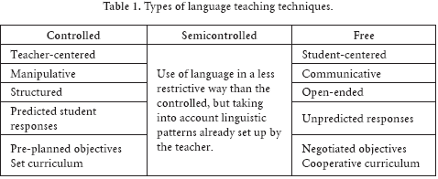
Vocabulary& Grammar: PPP controlled, less-controlled, free
Present/ set the context (situation)
Present the target language
Students drill the target language through repetition activities
Students do a less-controlled activity where they have a language guideline but may also use creatively use the language
Students do a free activity in which they must naturally use the new target language for a specific purpose (without needing to reference it).
Teacher gives feedback to learners highlighting any inaccuracies or issues

Slide 6
Present Practice Produce
Present: Teacher presents the new terms to the learners.
Practice: Students then engage in controlled or semi-controlled activities or worksheets that help them learn, personalize, and use the words in the appropriate context. (more than one activity can and probably should go here)
Production: Students use the words in a productive activity (speaking or writing).

Slide 7
Sample
Present: Teacher presents the Form, Use, Meaning, and Pronunciation or words that students will see in their textbook story today.
Practice: Teacher has students do a worksheet which has them write down their own definitions of the words and then do a fill-in-the-blank worksheet.
Produce: The teacher then has them do a writing activity which they have to make 3 of their own sentences for each word they learned.

Slide 8
Teaching vocabulary
Form
Use
Meaning
Pronunciation
Retrieval and Retention

Slide 9
Teaching Meaning
1:1 translation
dictionary definition
oral/written description
pictures (make sure meaning is clear/ accurate)
body language (gestures, facial expressions)
realia
synonyms/antonyms
examples (lots of them)
media (video, clips, internet)
drawing
eliciting from students
cline
chart

Slide 10
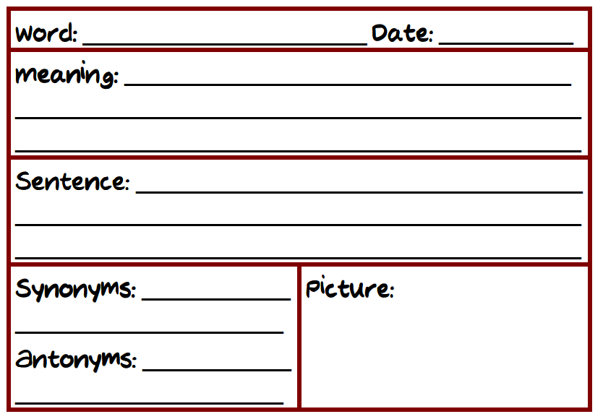

Slide 11
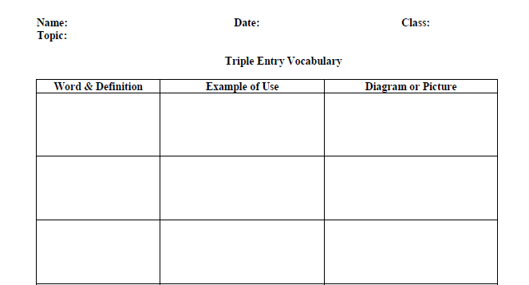

Slide 12
Reading lesson flow
Pre-While/ During - Post

Slide 13
Receptive: Task Feedback Cycle
Lead-in (Setting the context/ background information)
Pre-teach key vocabulary/ grammatical structures
1st Read – focus on general understanding
2nd Read – focus on details
Post-Reading discussion – Addressing problems/ questions
Productive Activity – Speaking or writing activity that personalizes key information/points etc. from what they read.

Slide 14
Jigsaw steps
Give the text to an expert group (AAA)
Give them time to read and understand the text
Take away the text
Have them return to their original group and share their summary of the text with others (ABC).
Have them try to summarize the whole text as a group ( level of detail is up to the teacher)
Then give them the original text to check how accurate they were.
Carry on the lesson with deeper comprehension questions etc.

