Slide 1
Ethical Considerations

Slide 2
What are Ethics?

Slide 3
Ethics
moral principles that govern a person's behavior or the conducting of an activity.
norms for conduct that distinguish between acceptable and unacceptable behavior.

Slide 4
Basic principles of ethics
You don’t want to people to get hurt from your study (physically, emotionally, etc.)
You want to avoid any negative impacts on the participants as a result of your study.
You do not want to break the law with your study.

Slide 5
Why are ethics important
To protect the welfare and wellbeing of subjects/ participants.
Protect the reputation of the researcher.
Protect the reputation of the field you are in.

Slide 6
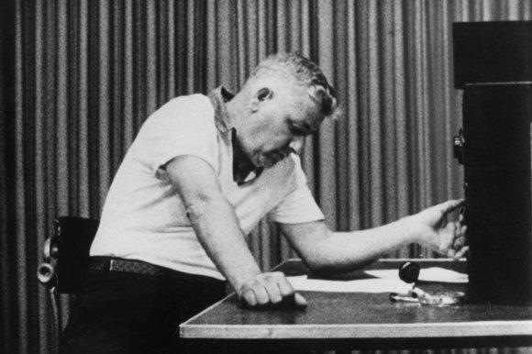
Famous example: Milgram’s Study of Obedience (1961)
The aim of the experiment was to investigate what level of obedience would be shown when participants were told by an authority figure to administer electric shocks to another person. (http://www.simplypsychology.org/milgram.html)

Slide 7
Famous example: Stanford Prison Experiment (1971)
What happens when you put good people in an evil place? Does humanity win over evil, or does evil triumph? In only a few days, guards became sadistic and prisoners became depressed and showed signs of extreme stress. (http://www.prisonexp.org/)

Slide 8
What do researchers need to do?
Researchers must use a systematic process to collect data without interfering or harming your subjects.
Researchers must also consider any topics that may have the potential to emotionally trigger the participants.

Slide 9
Ethical practices

Slide 10
Voluntary participation
Research participation should be voluntary and not forced or bribed.
Participants have the right to withdraw their participation at any time (before, during, or after).

Slide 11
Transparency
Researchers should be clear about the purposes of their study and not mislead subjects about the purpose their research. (except for special circumstances)
Tell the participants as much as you can about your study
Let them ask you questions about your study
Let them know of any potential issues that they may encounter as a result of your study
Researchers should be transparent about the way they are representing the subjects.
Let them know how they are going to be represented in your study
Their views will be presented through interview excerpts
Their behavior will be discussed in relation to the topic of study
They will be represented as a character (narrative)

Slide 12
No Physical or psychological harm
Researchers should never ever put their subjects in a compromising position where there is a potential for danger.
Researchers should not harm or distress (physically or psychologically) their research subjects.
Throughout their research process (before, during, after) they must take all steps necessary to protect the wellbeing of their participants.

Slide 13
Privacy
A researcher should never breach a research subject's privacy.
Anonymity: refers to concealing the identities of participants in all documents resulting from the research.
Using pseudonyms (nicknames)
Confidentiality: is concerned with who has the right of access to the data provided by the participants.

Slide 14
Gatekeeper access
If you are conducting research within a specific institution, you need to be given access by the institution before collecting data.
This means approaching the person in charge, giving them details about your study, and asking for access to the data collection site.

Slide 15
Informed consent

Slide 16
Writing an informed consent sheet
Title of the project
Researcher and affiliation contact information
Purpose of the study
Procedures
Confidentiality
Voluntary participation
Further information about the study
Participant’s agreement statement

Slide 18
If your participants are underage
You need to get consent from their parents

Slide 19
Parental consent
Dear Parents:
My name is ____________ and I am an MA student at _______. I am conducting a study on _________________. I plan on collecting data at ____________ during the period of _________. If your son/daughter chooses to participate in my study, with your permission, she will be _____________. I can assure you that her participation will be completely voluntary, his/her identity will remain anonymous, and the information he/she provides will be confidential. Attached you will find a consent form which is to be, on agreement, signed by your son/daughter and yourself and returned to me at your earliest convenience.
I appreciate the opportunity to work your son/daughter. If you have any questions or concerns, please feel free to call me at home: ______ or work: ________.
Thank you for your time and I look forward to hearing from you soon.
Sincerely,
_____________________

Slide 20
Reflection/ discussion
What are some ethical considerations that are important when interviewing?
What are some ethical considerations that are important when observing?
What about when your write a paper using the data you collected?

Slide 21
Homework Fake Qualitative study plan
What is the topic of your study?
Who will be your research participants?
Research question (s)?
Why is this study important?
What approach will you use?

