Slide 1
English Today

Slide 2
What do you think?
It is important for learners and teachers of English focus primarily on western culture.
To be a fluent speaker of English it is necessary to develop native-like pronunciation.
Teachers should only use native standard English and avoid Konglish.
A trained native English speaking instructor is better than a trained non-native instructor.
Non-native speakers of English have more influence on English internationally than native speakers.
Language teachers should only expose students to native English models.
Knowing a lot of idioms and slang is important in becoming fluent in English.
Native speakers of English often have difficulties communicating in international settings.
It is difficult to communicate without a high standard of grammar.
Comprehensibility and international intelligibility should be the primary goal of English learners.

Slide 3
English Today

Slide 4
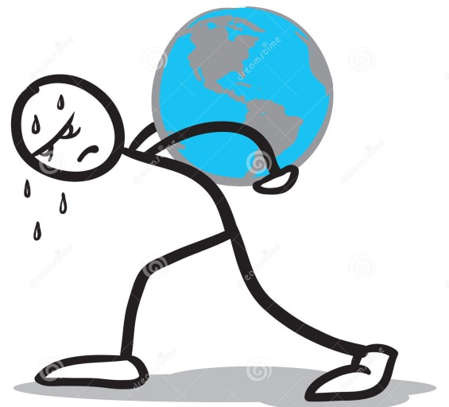
How did this video make you feel?
This video made me feel
Angry
Sad
Upset
This is not the way English should be treated!
“ I want to speak perfect English!”
“I don’t want to let ___ down!

Slide 6
Key Points
In countries like Korea, Korean language and culture needs to come first.
English should not take over Korean culture and identity.
You can be brilliant in your own language. English does not = intelligence!
English is an additional skill.

Slide 7
Which countries have English as a Native Language?

Slide 8
Native English Users
Australia
Canada
Ireland
New Zealand
United Kingdom
United States

Slide 9
Which one is the best?

Slide 10
What does a native speaker look like?
OLD STEREOTYPE

Slide 11
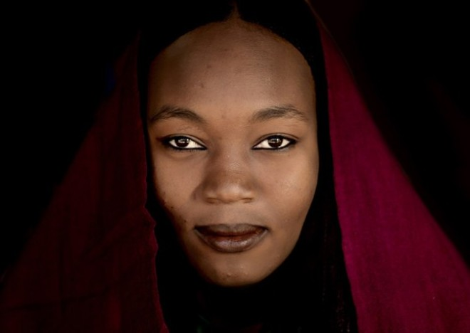
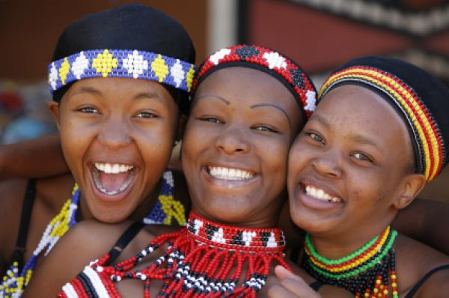
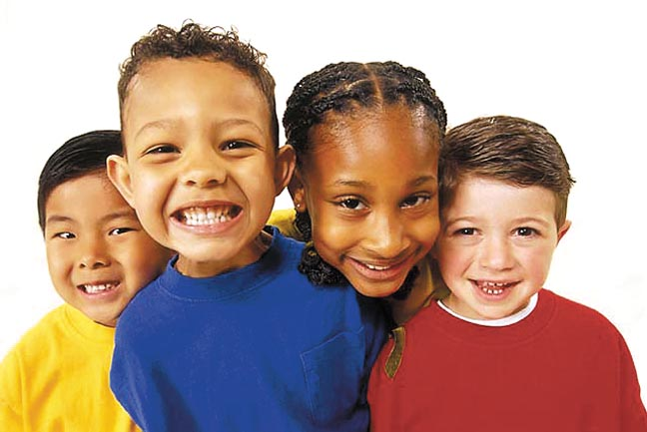
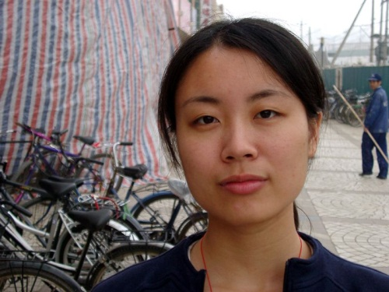
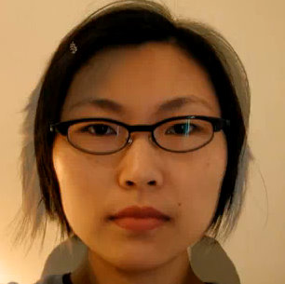
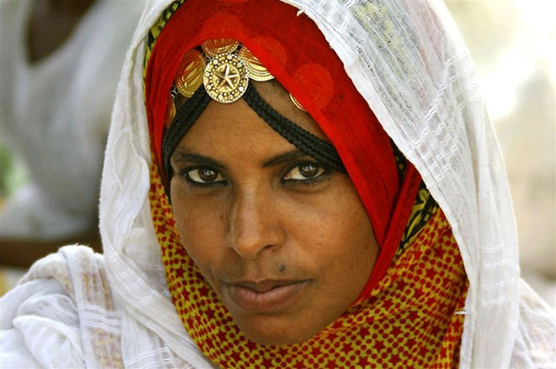
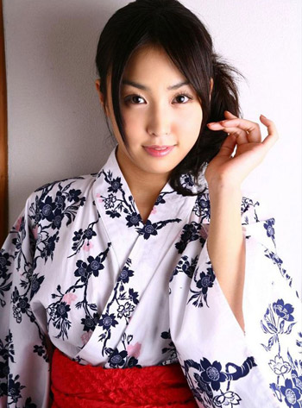
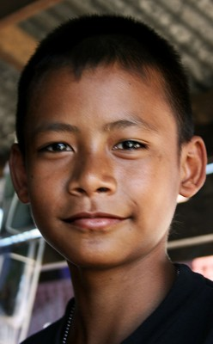
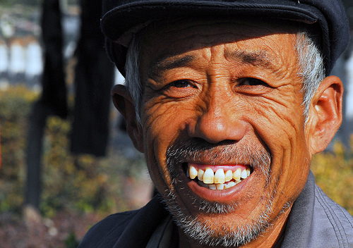
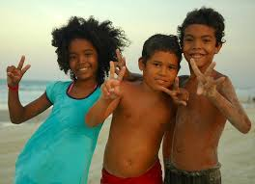
The Faces of English Today

Slide 12
Current Facts
There are now speakers of English all around the world.
There are many fluent non-native speakers.

Slide 13
English as a Native Language
Primary/ Secondary Language
Foreign
Language

Slide 14
English as a Native Language
Second Language
Foreign
Language

Slide 15
Regional Varieties
Konglish
Chinglish
Turklish
Finglish
Poglish
Norweglish
Dunglish
Czenglish
Porglish
Hinglish
Spanglish
Greeklish
Tinglish

Slide 16
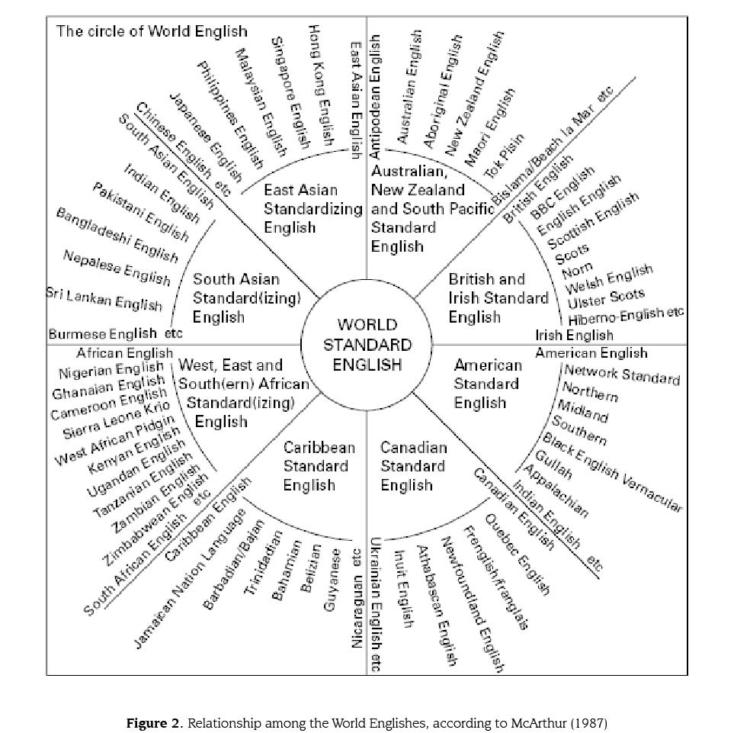

Slide 17
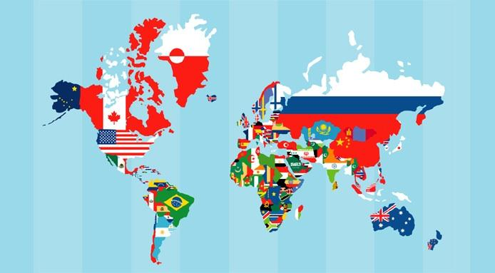
English is now an international language

Slide 18
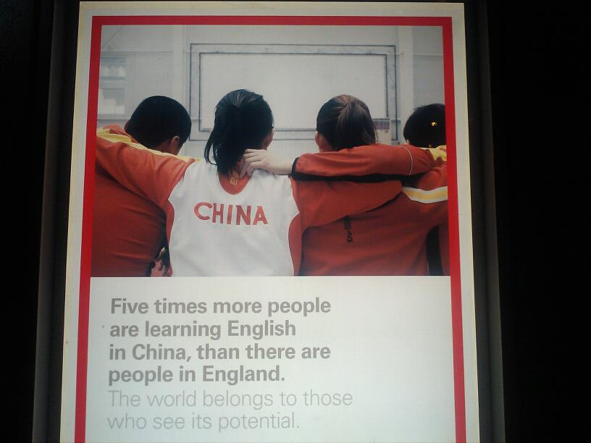
Current Facts
Currently, non-native speakers outnumber native speakers
5 to 1
Who are you most likely to interact in English with?

Slide 19
What does it mean?
No country owns English.
English is not the language of native speakers.
English does not have to be linked to western culture.
English should be used in your own culture.
There are many different varieties of English.

Slide 20
What does English sound like?

Slide 21
Activity
Write down the score you would give these speakers of English from 1-10.
1 = very very bad
10 = perfect!

Slide 24
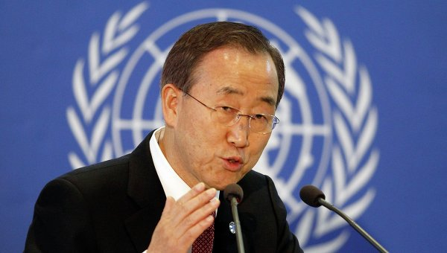

Slide 25
Today
All English speakers (native or non-native), need to understand multiple varieties of English.
The focus is on international communication and understanding.
Native speakers can have troubles in international settings.

Slide 26
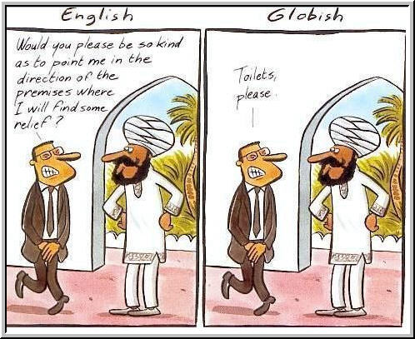
Fluency can be dangerous in International settings

Slide 27
English Speakers Today

Slide 28
Goals of English
English is more than just a test score, It is a life skill.
The primary goal of learning English should be to understand others and be understood (native and non-native).
Accuracy in grammar, pronunciation are not as important if they do not affect comprehensibility.

Slide 29
What does it mean?
Native speakers should try to understand your English just as much as you try to understand theirs.
Talk about Korean things in English!
Keep your identity, use Konglish, spread understanding of Korea through English!
Accept different varieties of English, try to understand other non-native speakers.
Ban Ki-moon can be a great role model for Korean English learners.

Slide 30
What do you think?
It is important for learners and teachers of English focus primarily on western culture.
To be a fluent speaker of English it is necessary to develop native-like pronunciation.
Teachers should only use native standard English and avoid Konglish.
A trained native English speaking instructor is better than a trained non-native instructor.
Non-native speakers of English have more influence on English internationally than native speakers.
Language teachers should only expose students to native English models.
Knowing a lot of idioms and slang is important in becoming fluent in English.
Native speakers of English often have difficulties communicating in international settings.
It is difficult to communicate without a high standard of grammar.
Comprehensibility and international intelligibility should be the primary goal of English learners.

Slide 31
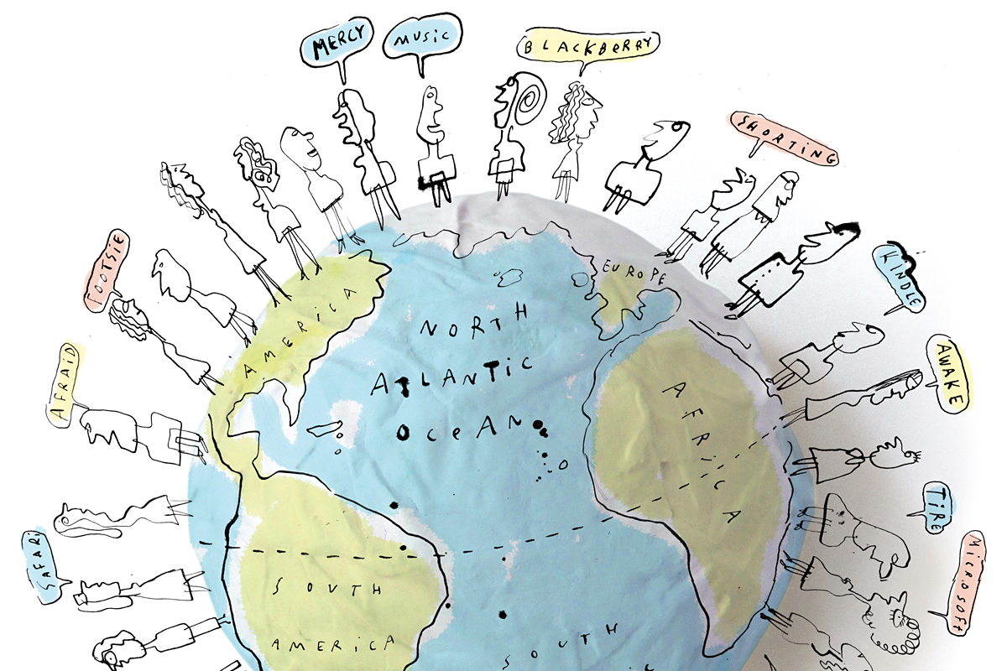
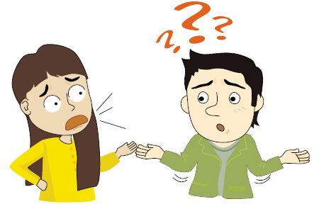
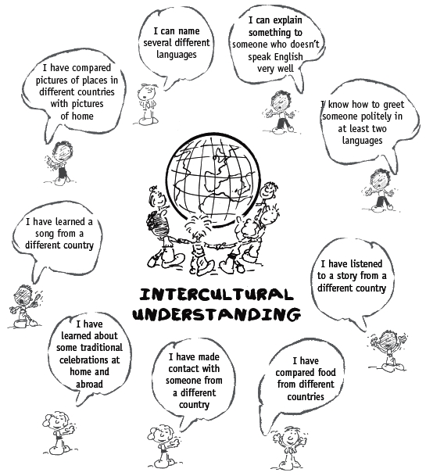
Intercultural Communication

Slide 32
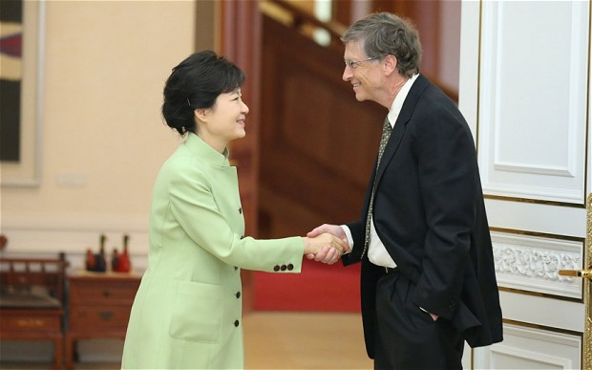
Body and Words
Shut up!
I’m going to the EXO concert tomorrow!

Slide 33
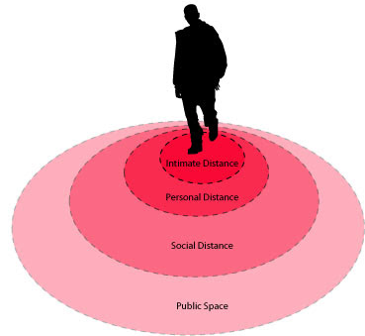
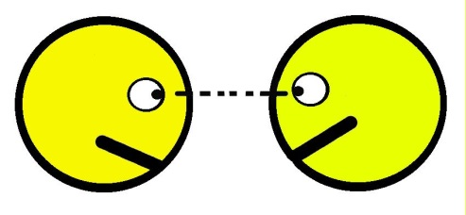
Body
Eye Contact
Personal Space
Gestures
Physical contact

Slide 34
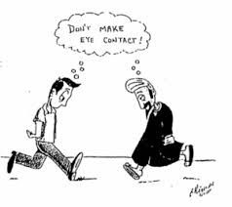
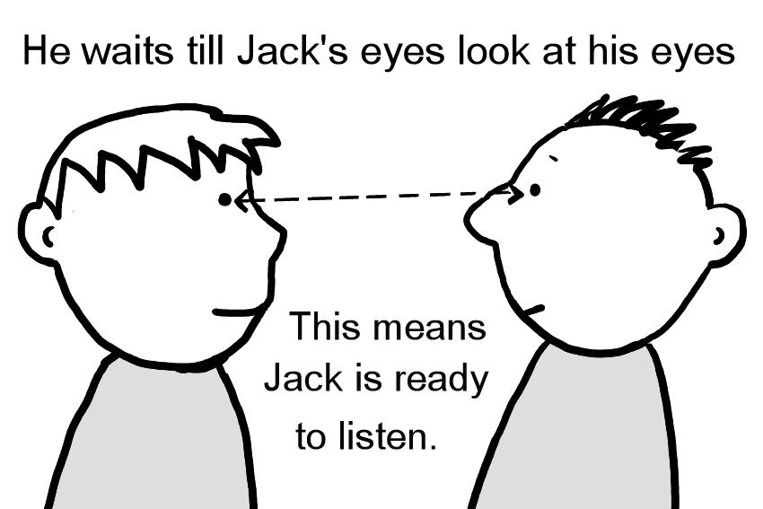
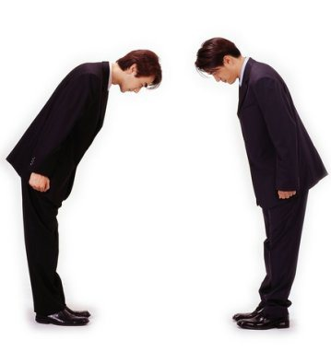
Eye Contact

Slide 35
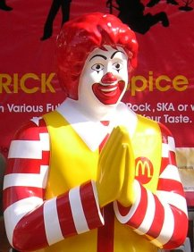
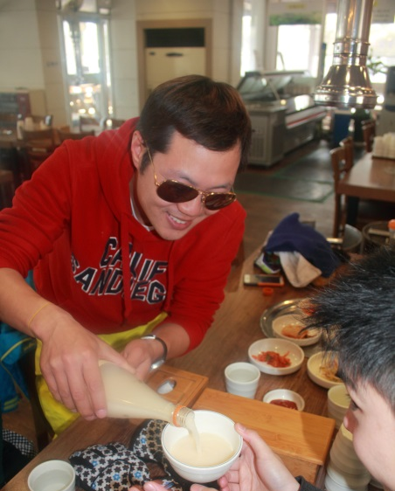
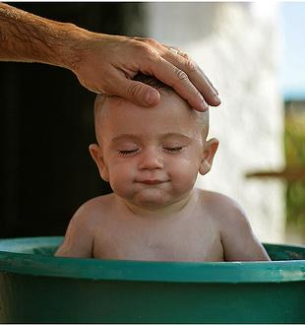
Gestures

Slide 36
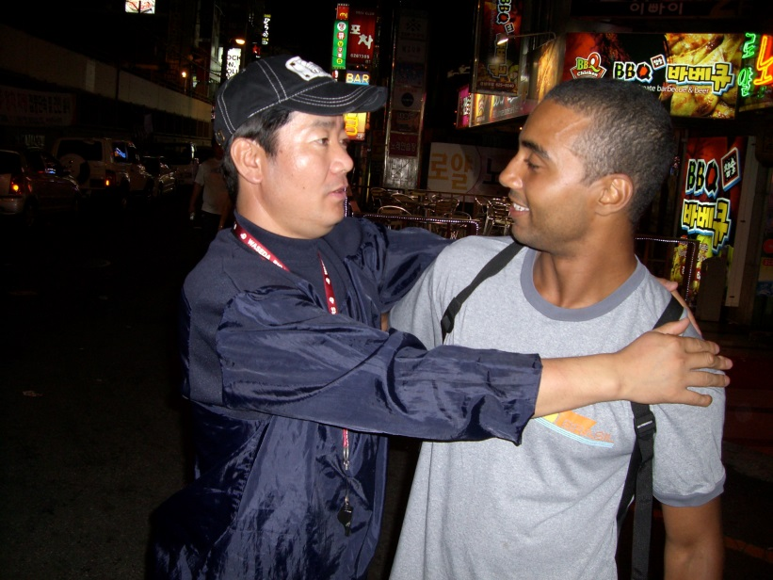
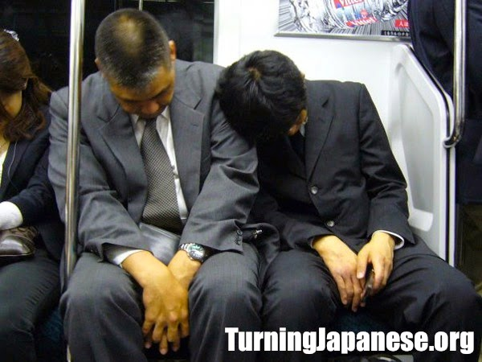
Personal Space

Slide 37
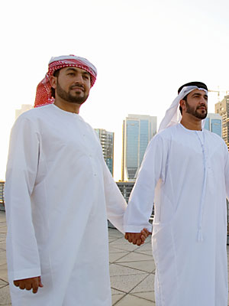
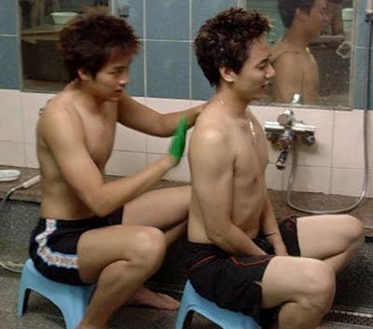
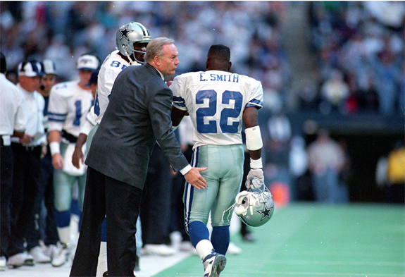
Physical Contact

Slide 38
Words

Slide 39
What people say and what they mean may differ depending on who you are talking to.
누구와 대화하는 것에 따라 우리가 말하는 뜻이 다를 수 있다

Slide 40
Wow!
Be quiet!
Your kidding
Shut your mouth!
닥쳐
Shut up!
Shut up!

Slide 41
What people understand may differ depending on who you are talking to.
누구와 대화하는 것에 따라 알아 듣는 것도 다를 수 있다

Slide 42
Wow!
닥쳐?
I am getting married!
Shut up!

Slide 43
Cultures and languages that are more similar will tend to have similar meanings.
문화와 언어가 유사하면 비슷한 의미가 있는 경향이 있다

Slide 44
Wow!
닥쳐
How was your date?
Crazy!

Slide 45
Many things happened…
닥쳐
How was your date?
Crazy!

Slide 46
Individual Differences
Speed
Grammar
Pronunciation
Meaning
Directness
Intonation
Word choice

Slide 47
How to avoid misunderstandings
SPEAKING | LISTENING
Keep it short and simple | Ask for clarity (Don’t jump to your own conclusions)
Be as direct in your words as possible | Ask people to repeat
Don’t use idioms, slang or abstract language | Ask “ What do you mean?”
Show and demonstrate by using examples ,illustrations, gestures etc. | Ask them to slow down
Watch their face and body language | Don’t pretend you understand if you don’t.
Pause a lot and check if they understand
Repeat and rephrase when necessary
Notes:
M. Kovyazina Comparative Culturology Lectures, Tyumen State University, 2004-2009

Slide 48
How can we bring intercultural communication into our classrooms?

Slide 49
ICC in the Classroom
Change the model of a good English speaker being a native speaker to a glocal model.
Characters (use international characters who promote intercultural communications)
Flash culture points during lessons (did you know that in…. they … ?)
Exposure to native and non-native varieties of English
Explain differences between what words mean in different cultures.
Foster understanding and acceptance of different world values and beliefs (Not only ‘Inner Circle’ countries!)
Set an intercultural Korean role model (You!,Ban Ki Moon)
Treat English as an International language (focus on comprehensibility ex. pronunciation) http://www.forvo.com/word/macaroni/

Slide 50
Quiz Time

Slide 51
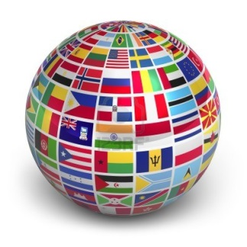
What 3 countries have the most Native speakers of English?
USA, UK, Canada
b. USA, India, UK
c. USA, India, Pakistan
d. USA, Australia, Canada
1. USA 291,524,091 | 6.Phillippines 43,994,000
2.India 125,344,736 | 7.Canada 25,246,220
3.Pakistan 88,690,000 | 8.Australia 18,172,989
4.Nigeria 79,000,000 | 9.South Africa 19,424,417
5.UK 59,600,000 | 10.Ireland 4,450,252

Slide 52
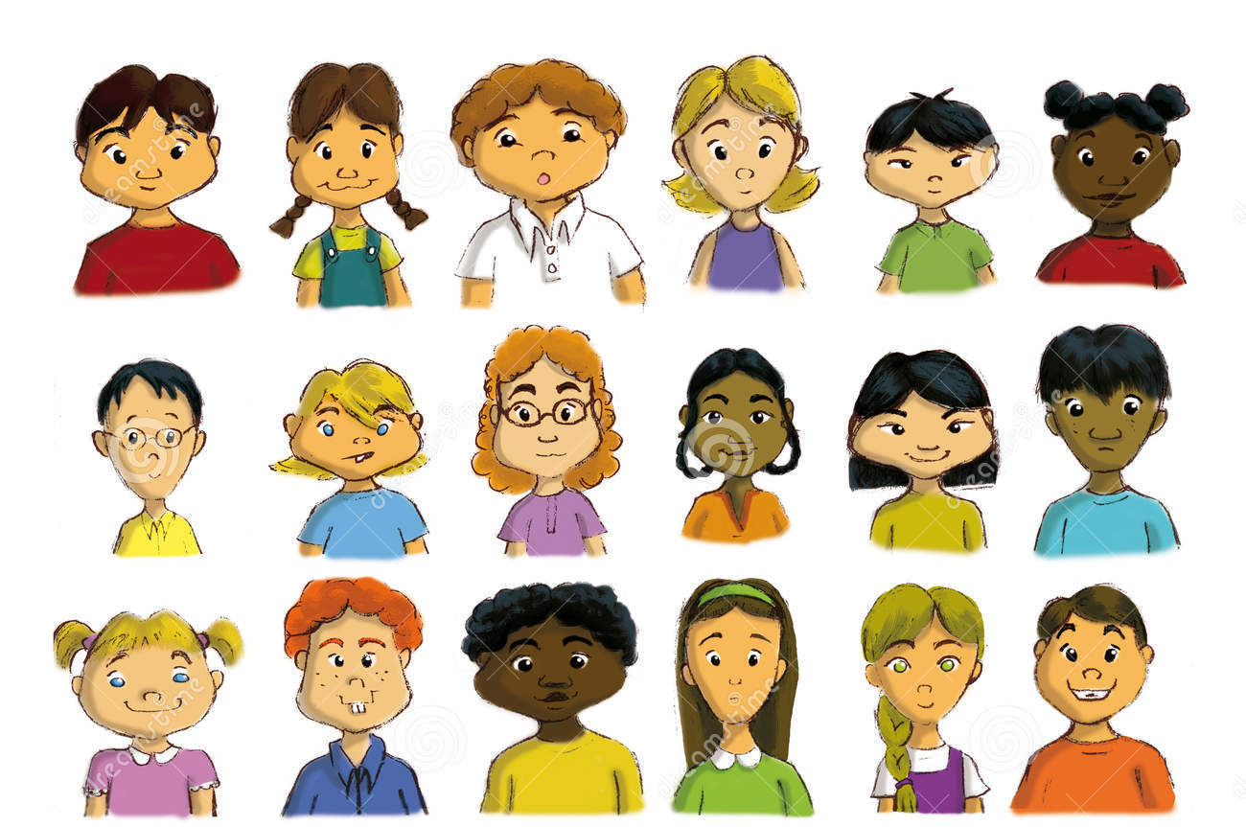
Which of these people are native speakers of English?

Slide 53
In Thailand…
a. Men holding hands is considered a sign of friendship.
a. it is common to see men walking along holding
hands.
b. it is common to see a man and a woman holding
hands in public.
c. it is rude for men and women to walk together.
d. men and women traditionally kiss each other on meeting in the street.
Public displays of affection between men and women, however, are unacceptable.

Slide 54
What does the color yellow mean in China? Ex. yellow book
a. Good luck
b. Bad Luck
c. Adult Content (18+)
d. Happiness
C. The word yellow often refers to adult content in China .

Slide 55
When a taxi driver shakes his head from side to side, it probably means..
c. This is the Indian way of saying “yes.”
a. he thinks your price is too high.
b. he isn’t going in your direction.
c. he will take you where you want to go.
d. he doesn’t understand what you’re asking.
It can also express general agreement with what you’re saying or suggest that an individual is interested in what you have to say.

Slide 56
Which is NOT banned in Singapore?
a. Spitting
b. Littering
c. Gum
d. Lighters
D. Lighters are not banned in Singapore unless they look like a weapon.

Slide 57
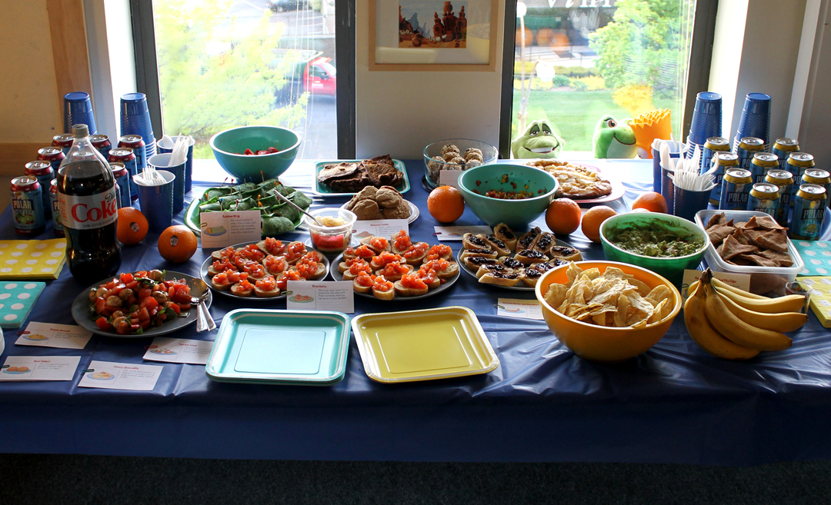
In Canada, a potluck party is..
C.
a . a party where everyone sings.
b. a party where everyone bangs on pots.
c. a party where everyone brings some food to share.

Slide 58
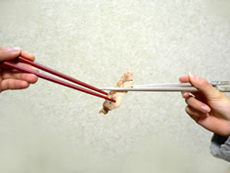
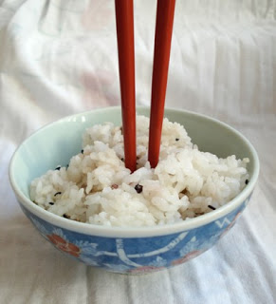
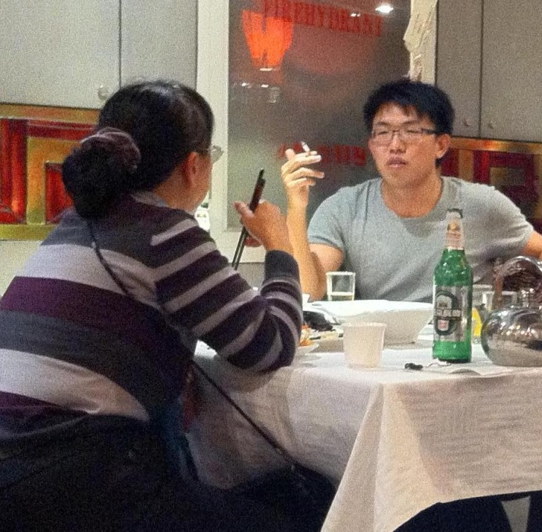
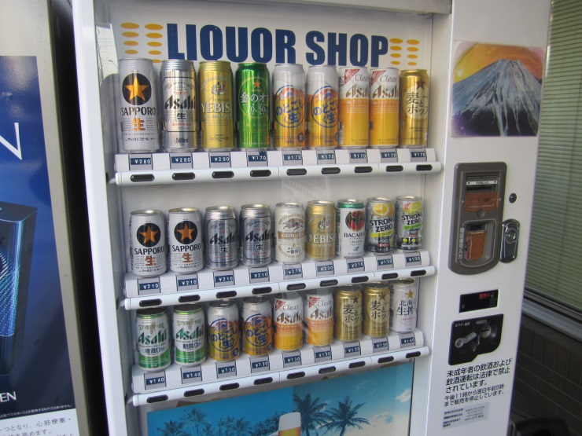
Which is OK in Japan?

Slide 59
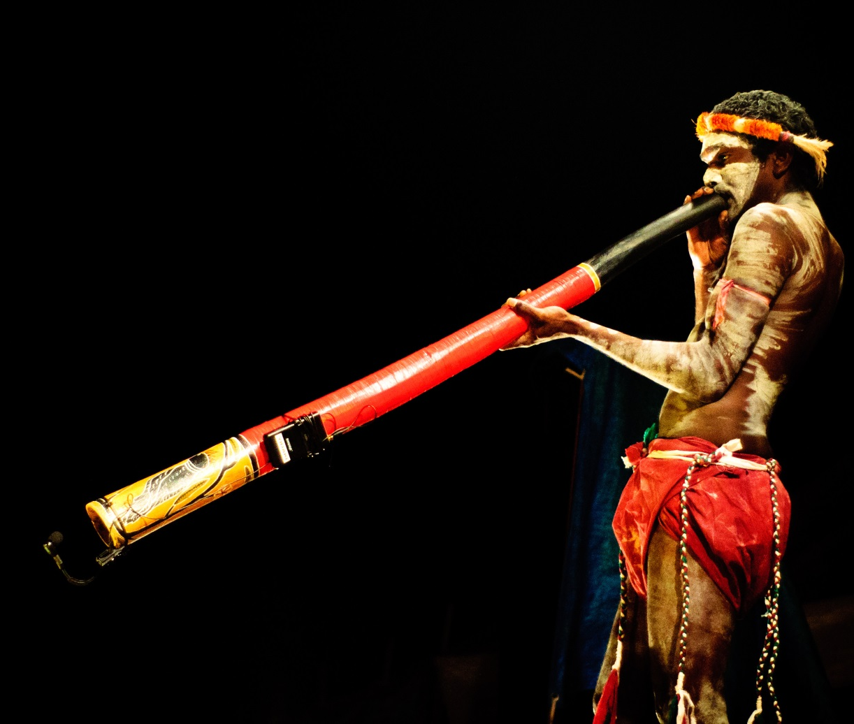
What country does this intrument come from?
a. Kenya
b. New Zealand
c. Nigeria
d. Australia
C. The didgeridoo was developed over 1500 years ago in Australia!

Slide 60
Which country has the most lakes in the world?
a. USA
b. Russia
c. Canada
d. China
C. With over 3 million lakes,60% of all the lakes in the world are found in Canada.

Slide 61
Keep in Mind
Native English varieties represent a minority amongst the many ‘Englishes’ that are spoken around the world.
The more you know about the world, the better you will be able to use English.

