Slide 1
English language teaching and vocabulary
Key Considerations

Slide 2
Reflective Discussion
How did you learn new English vocabulary when you were in school? Do you feel that it was a good method? Why or why not?
How did/do you learn English vocabulary out of class?
What is the most difficult or challenging thing for you when learning new words?
In your opinion what method or technique is most effective to learn the meaning of new words?
In your opinion what method or technique is most effective to remember?

Slide 3
What are your views of vocabulary teaching? (consider age/proficiency level)
Vocabulary learning can happen naturally in the right context.
Learners need to be explicitly taught words.
It the teacher’s job to help students learn new words.
It is the learner’s job to find to learn words and build their own vocabulary.

Slide 4
No one right way…
“Research has provided much useful information about vocabulary learning and instruction. What it has not provided is a simple formula for optimal instruction, because no such formula can exist.”
(Beck, McKeown and Omanson, 1987, p.150)

Slide 5
ELT & Vocabulary Hot Issues
1. In learning another language, vocabulary is not as important as grammar or other areas.
2. Using words lists to learn second language vocabulary in unproductive.
3. Presenting new vocabulary in semantic sets facilitates learning.
4. The use of translations to learn new vocabulary should be discouraged.
5. Guessing words from context is an excellent strategy for learning second language vocabulary.
6. The best vocabulary learners make use of one or two really good specific vocabulary learning strategies.
7. The best dictionary for second language learners is a monolingual dictionary.
8. Teachers, textbook, and curricula cover second language vocabulary adequately.
9. The more words you know the better.
10. How many words are appropriate for students to learn in a day?

Slide 6
Vocabulary or Grammar?
Arguably, vocabulary is perhaps the most important component in L2 ability. (Folse, 2004)
English learners know that vocabulary is important than grammar. This is why they carry dictionaries and not grammar books! (Krashen, 1989)
David Wilkins (1972) summed up the importance of vocabulary learning by saying “Without grammar very little can be conveyed, without vocabulary nothing be conveyed.”
Without words we are only left with body language and “sense”.
Wilkins also gives the following advice to students “ If you spend most of your time studying grammar, your English will not improve very much. You will see most improvement if you learn more words and expressions.”

Slide 7
Word lists
…no particular method or approach seems to have been that much more successful than another. Using lists appears to be neither detrimental nor miraculous. (Folse, 2004)
Translation pairs can be very useful, however it is crucial that the translation is accurate.
It also may not be beneficial to present multiple meanings of the word out of context. It is better to stick to the meaning of the word in the context it is being used in the lesson.
While advanced learners may benefit from learning vocabulary in context, beginning learners probably benefit the most from words that are presented in lists of translation pairs (Carter, 1987).

Slide 8
For a detailed description of each of these words lists please refer to Folse (2004, p. 43-44)
For a copy of each of the lists please visit my website.

Slide 9

Semantic Sets (categories, synonyms, antonyms)
The easiest way to organize the words—and seemingly the most logical way—is to group the vocabulary by kind, that is, by semantic sets (Folse, 2004, p. 47).
i.e. colors, people adjectives, family members, weather words, days of the week, months of the year, rooms in a house, kitchen words, living room words, sports etc.
There has not been a great deal of research on the use of semantic sets, but the research results are clear and, I think, very conclusive; semantic sets are not only unhelpful, they actually hinder vocabulary retention. (see Folse, 2004, p. 53)
'Interference Theory’ - states that when words are being learned at the same time, but are too 'similar' or share too many common elements, then these words will interfere with each other thus impairing retention of them.
Better to teach words in thematic units than in semantic sets.

Slide 10
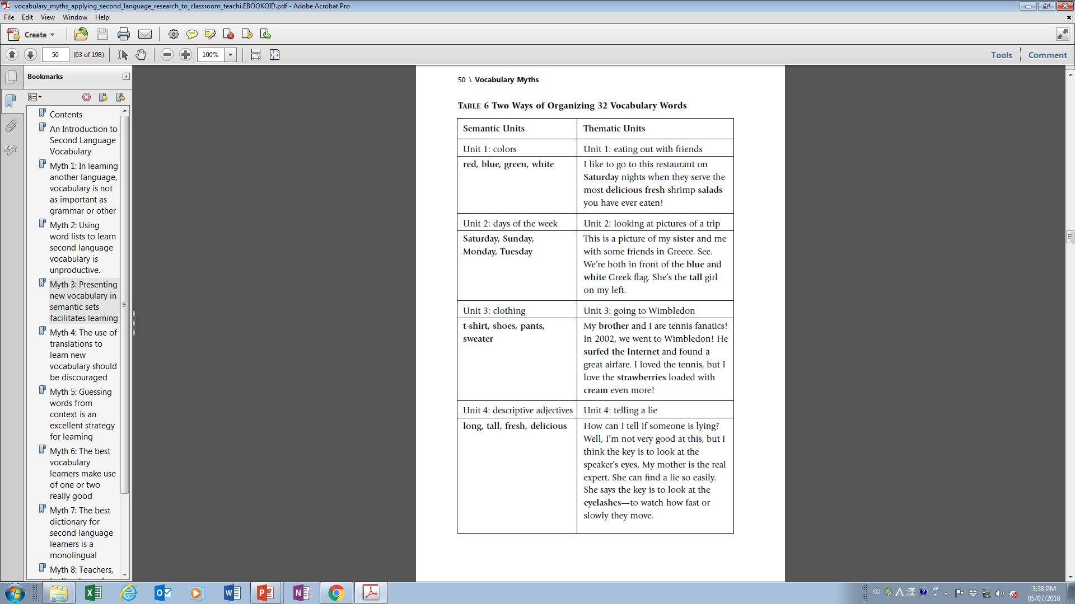
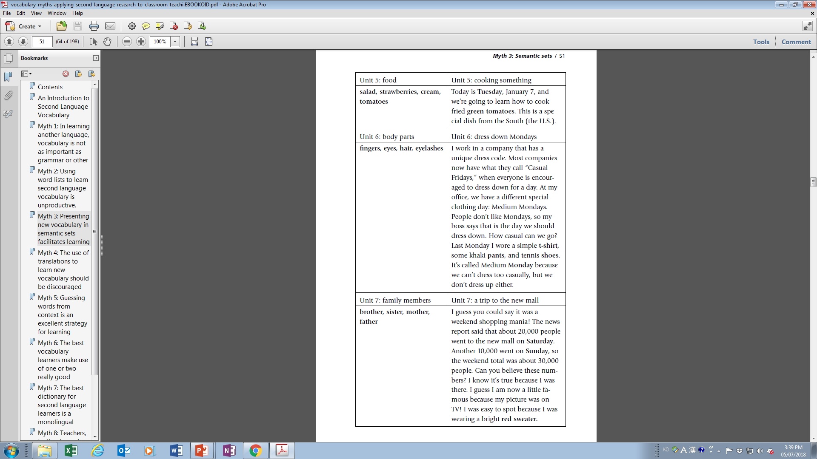

Slide 11
Use of translation
Translations can be helpful, but it is more helpful if the students do it by themselves (individually or through scaffolding).
Some words (like nouns) can be directly translated, while others may require an explanation.
Teacher can then check up that the translations are accurate.
Careful, because some words when translated directly result in slightly different meanings. It is important to consider connotative meaning (what is implied )rather than denotative meaning (dictionary definition).
It is also important to focus on the correct meaning in context.
Example:
  He went to the Big Apple.
  She is paranoid about her test.

Slide 12
Guessing words from context
Guessing vocabulary from context is how native speakers most frequently learn the meaning of new L1 words.
Some vocabulary items were learned intentionally, but far fewer than the number learned incidentally (through reading and listening).
However, it should be kept in mind that this statement refers to native speakers learning their own native language.
It is not the same for L2 learners.

Slide 13
Guessing words from context
The use of context clues is without a doubt a good strategy to improve reading in L1 and L2, but it is a reading-improvement strategy, not a vocabulary-improvement strategy.
Reading can definitely aid vocabulary growth, especially when done with vocabulary exercises.
Students need to pay focused attention on the meanings of words (looking up the meanings rather than simply guessing)
In class and for homework, give your students exercises and activities that focus on vocabulary.

Slide 14
Use of learning strategies
The myth of the existence of one specific magical strategy for foreign language vocabulary is false.
There are numerous good vocabulary learning strategies (VLSs), and there are bad
ones, too.
What research has shown us is that good learners use a wide variety of VLSs; however, the good students have developed an individualized set of strategies that works best for their needs and personalities.
Encourage learners to find out what works best for them and develop their own learning strategies that best fit their personal preferences and needs.

Slide 15
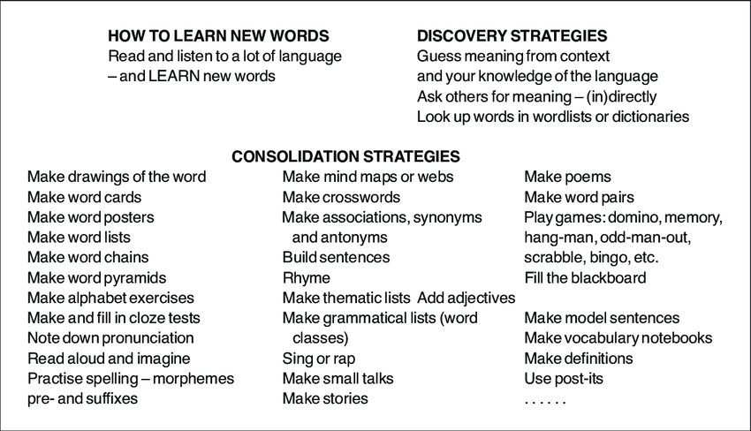

Slide 16
Dictionaries
Students need to be taught that some words, in fact many words, are polysemous and that care should be taken in selecting the proper meaning—i.e., translation from those listed.
Look up the word ‘set’ for a good example ^^
There is absolutely no empirical evidence—quantitative or qualitative—to support the familiar notion that monolingual dictionaries are better than bilingual dictionaries for understanding and learning L2 vocabulary.
Lower level learners may be more comfortable with bilingual dictionaries. More advanced learners may be guided towards the use of monolingual dictionaries.
Learners must also be made aware of possible differences in word to word translations, and learn to select the most common/ appropriate word from those listed in a bilingual dictionary.

Slide 17
Textbook coverage of vocabulary
Generally speaking, vocabulary is not covered well enough in curricula, materials, and courses.
Some teachers cover some vocabulary, but this is hardly ever done very systematically. Vocabulary is something that everyone assumes that learners will somehow pick up…
There are not enough practice activities which foster vocabulary growth such as noticing, retrieval, and creative or generative use of the words (Nation, 2001).
For examples of possible exercise types (other than fill in the blank, matching, multiple choice etc.) see Folse (2004, p. 146-149)

Slide 18
The more the better?
For receptive vocabulary, the more words you know the greater you will be able to comprehend a wide range of texts.
However, productive vocabulary is different. More is not always better when speaking since comprehensibility involves speaking at a level that is comprehensible to those you are interacting with.
More is also not necessarily better in writing since using abstract or high-level words may take away from the overall comprehensibility of the writing ( i.e. Academic writers who search for difficult ways to say simple things).
Learning to be efficient and effective with the words you know is sometimes more important than learning more words (see Meaning Focused Output)

Slide 19
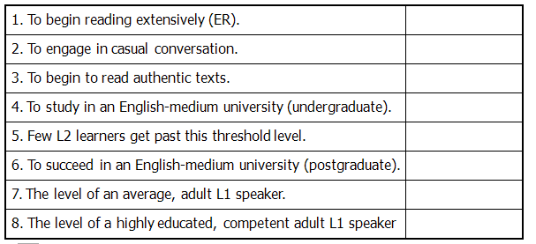
How much vocabulary is needed?
Depending on your definition of “word” the English language has
Between 600,000 and 1 million words
1,000 words
2 – 3,000
5,000
8 – 10,000
12,000
15 – 20,000
20 – 22,000
35,000

Slide 20
How many new words in a day?
This question does not have a straightforward answer as it depends on the difficulty and abstractness of the words.
If they are simple verbs or nouns 5-7 would seem appropriate.
For more difficult words 3-5 may be more than enough.
Miller (1956) found that adults, when given a list of items to attempt to memorize, have the ability to recall seven of the items—plus or minus two—without any special training. (but these were just words in a list that these people already knew)

Slide 21
Word learnability
The learnability of the target word places constraints on the number of words one decides to teach.
‘Learnability’ refers to the level of challenge a word poses to the learner. For instance: long polysyllabic words with unfamiliar phonemes will be harder for beginners to retain; abstract words are usually more difficult to acquire than concrete words etc.
When deciding how many words to teach, the learnability factor is crucial.
Pneumonoultramicroscopicsilicovolcanoconiosis vs. brush

Slide 22
Depth of knowledge
Knowing a word entails knowing many things about the word: its literal meaning, its various connotations, its spelling, its derivations, collocations (knowing the words that usually co-occur with the target word),frequency, pronunciation, the syntactic constructions it is used in, the morphological options it offers and a rich variety of semantic associates such as synonyms, antonyms, homonyms (Nagy and Scott, 2000).
How deep one intends to go will entail spending more time hence teaching fewer words.

Slide 23
Receptive vs. Productive
Receptive vs Productive knowledge – as Nation (1990) notes vocabulary items in the learners’ receptive vocabulary might not be readily available for productive purposes, since vocabulary reception does not guarantee production.
In other words, students may learn to recognize words whilst not being able to use them in speech or in writing. This difference is often overlooked whilst is crucial in planning a vocabulary lesson.
You may be able to teach more words if your aim is receptive understanding and less words if your aim is production (in speaking or writing).

Slide 24
Depth of processing
Shallow vs Deep processing – The deeper the degree of semantic processing involved the more likely the students are to recall them in the future.
Deep processing includes activities such as: establishing association within new and old words, categorizing them; finding opposites and synonyms; writing the definition; inferencing their meanings from context; creating mnemonics to enhance future recall); odd one out; etc.
Shallow processing involves little cognitive effort (e.g. learning by repeating aloud; memorization of lists).

Slide 25
Reflection
What are some of the key things you learned from today’s lesson?
  What are some key things you have to remember as a vocabulary learner?
  What are some key things you have to remember as a vocabulary teacher?
In what ways can you practically apply the key principles covered today to your everyday life?
What questions do you have after taking this lesson?

Slide 26
References
Beck, I.L., McKeown, M.G., and Omanson, R.C. (1987). The effects and uses of diverse vocabulary instructional techniques. In M.G. McKeown & M.E. Curtis (Eds.), The Nature of Vocabulary Acquisition (pp. 147-163). Hillsdale, NJ: Erlbaum.
Folse, K.S. (2004). Vocabulary myths: Applying second language research to classroom teaching. Ann Arbor: University of Michigan Press.
Krashen, S. (1989). We acquire vocabulary and spelling by reading: Additional evidence for the input hypothesis. The Modern Language Journal 73(4), 440–464.
Nagy, W.E., & Scott, J.A. (2000). Vocabulary processes. In M.L. Kamil, P.B. Mosenthal, P.D. Pearson, & R. Barr (Eds.), Handbook of reading research (Vol. III, pp. 269-284). Mahwah, NJ: Erlbaum
Nation, I. S. P. (1990). Teaching and Learning Vocabulary. Teaching Methods. United States: Cengage Learning.
Nation, P. (2001). Learning vocabulary in another language. New York: Cambridge University Press.
Wilkins, D. (1972).Linguistics in language teaching. Edward Arnold, London.

