Slide 1
English Education
with Professor George E.K. Whitehead

Slide 2
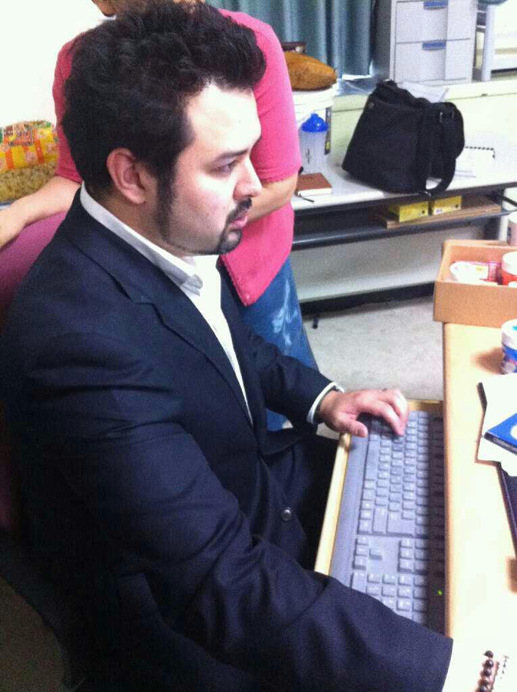
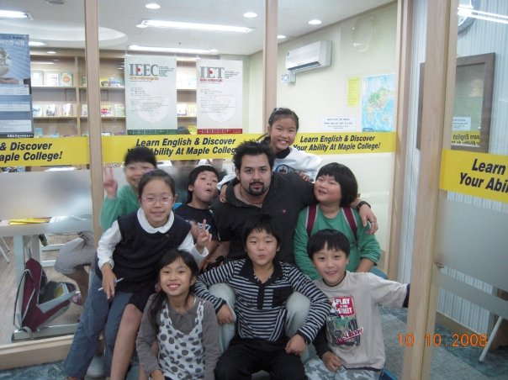
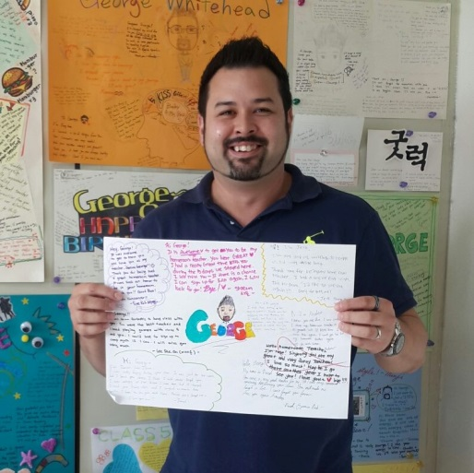
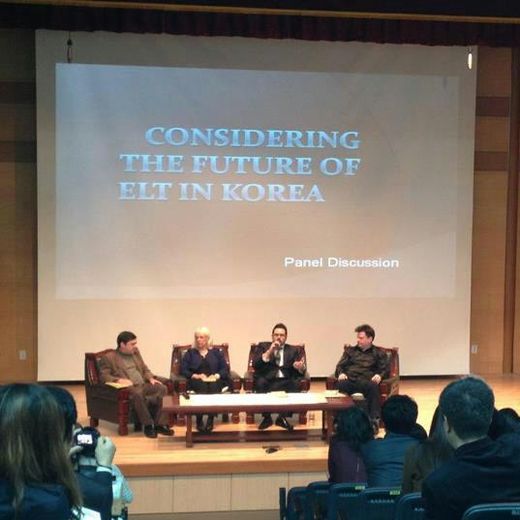
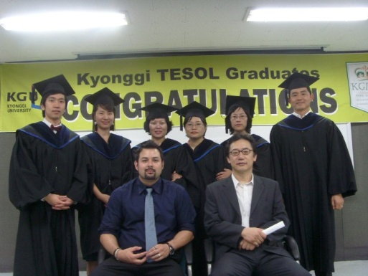
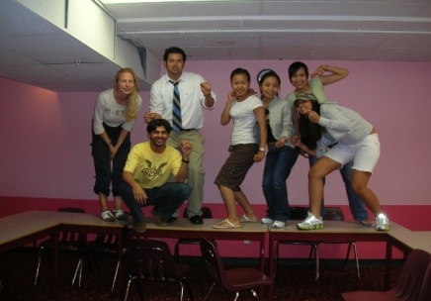
About me
George E.K Whitehead
경일
Prof. G

Slide 3
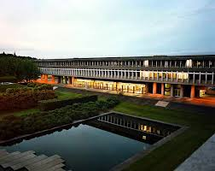
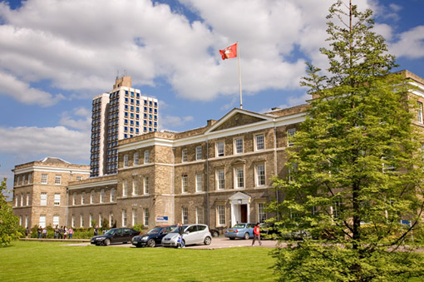
Associates of Arts
BA Linguistics
Certificate for Teaching ESL Linguistics
MA TEFL/ TESL
PhD Education (in progress)

Slide 4
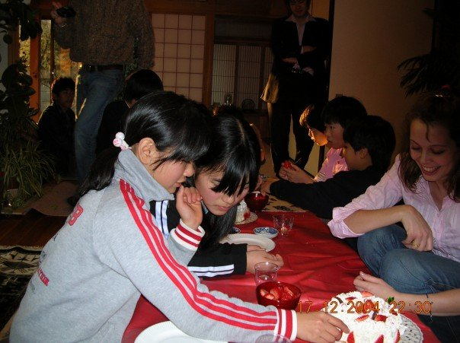
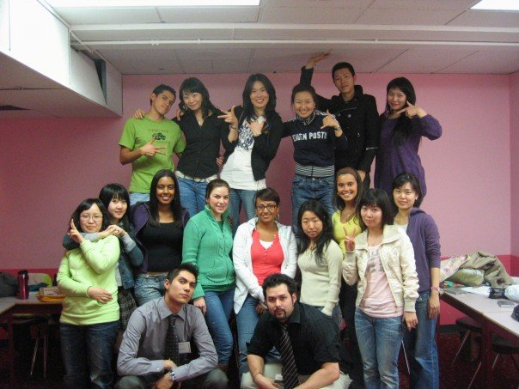
My 16 Year Career
The beginning…

Slide 5
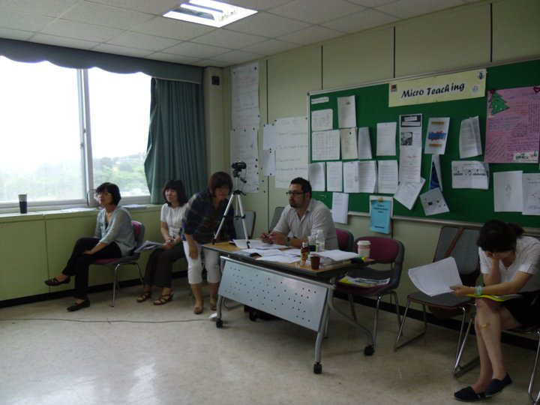
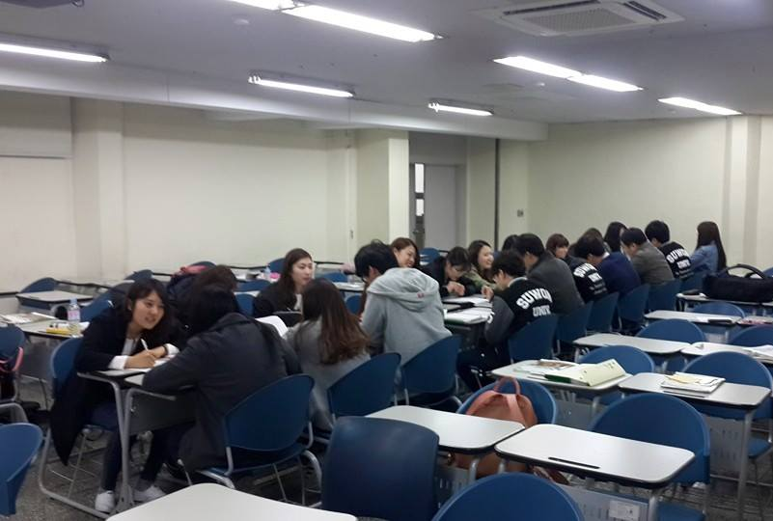
My 14 Year Career continued..

Slide 6
Additional Work
Darakwon Publishing (Author, Editor, Advisor)
대학수학능력시험
International Graduate School of English
Editor at Asian EFL Journal & Asian ESP Journal

Slide 7
Publications
Hiver, P., & Whitehead, G. (under contract). Teaching metacognitively: Adaptive inside-out thinking in the L2 classroom. In C. Bjørke, M. Dypedahl, & Å. Haukås (Eds.), Metacognition in Language Learning and Teaching. New York, NY: Routledge.
Hiver, P., & Whitehead, G. (under contract). Sites of struggle: The co-construction of language teacher agency and teacher identity through classroom practice. In H. Kayi-Aydar, X. Gao, E. Miller, M. Varghese, & G. Vitanova (Eds.), Theorizing and Analyzing Language Teacher Agency. Bristol, England: Multilingual Matters.
Whitehead, G. & Greenier, V. (under review). Investigating learners’ perceptions of language teacher leadership. TBA.
Gang, Y.S., Kim, H.D., Whitehead, G., Goo, Y.S., Gwon, H.Y., Han, G., & Hong, G.M. (in-press). Middle School English 1. Seoul, South Korea: Darakwon.
Whitehead, G. (2017). Teachers’ voices: Obstacles to Communicative Language Teaching in South Korea. Asian EFL Journal. 19(4).
Whitehead, G. (2016). The rise and fall of the National English Ability Test: Examining Korean high school English teachers’ perspectives. Asian EFL Journal., 18(4), 124-155.
Greenier, V. & Whitehead, G. (2016). Towards a Model of Teacher Leadership in ELT: Authentic Leadership in Classroom Practice. RELC Journal, 47(1), 79-95 DOI: 10.1177/0033688216631203.

Slide 8
Ask George!

Slide 9
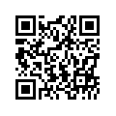
Contact
Website: profgwhitehead.weebly.com
Email: prof.gwhitehead@gmail.com

Slide 10
English Education
Course Information

Slide 11
The course
1. developed a deeper understanding English education
2. developed a critical eye for how language is learned, taught, and acquired
3. develop and refine learners’ metacognition
4. reflect on the goals of learning English and appropriate approaches to English education in South Korea.

Slide 12
Course Topics
YELLs (Young English Language Learners)
Teaching YELLs vs. Teaching adults
English as International Language
Contextualizing teaching and learning

Slide 13
Course Evaluation
Participation & Professionalism 20 Points
Attendance 20 Points Midterm 30 Points Final Exam 30 Points Total 100 Points

Slide 14
Attendance
*Attendance includes being here on time prepared for class.
LATENESS
*5 mins. after the start of class = late
*Late = 1 point deduction in attendance
Absence
*More than 30 mins. = absent
* Absence = 2 point deduction in attendance
**Absence and tardiness will only be excused if a valid reason and/or a doctors note is provided.

Slide 15
Participation
*Participation includes all classroom tasks i.e. projects, performances, discussions etc., as well as attention, attitude and professionalism
*5 excellence points are reserved and rewarded for exceptional effort.
Some ways to get excellence points:
Always here on time for class
Outstanding effort during class
Helping others in class
Outstanding classwork or homework

Slide 16
Additional Details and Information
Homepage: profgwhitehead.weebly.com

