Slide 1
Welcome to

Slide 2
What is EMART?
Learning English through making music videos which involve illustrating lyrics!

Slide 3
What are we going to do
Listen to music
Illustrate lyrics
Take pictures of the lyrics and illustrations
Make a music video using screen capture software
Watch it

Slide 4
The pedagogy
Involves lots of repetition.
Relaxed atmosphere.
Students focus on meaningful input and personalize the meaning.
Creating something personal that you can keep forever ☺

Slide 5
An Example

Slide 6
Lesson Flow

Slide 7
Teacher Preparation
Select a song
Get the song audio (.mp3, youtube)
www.offliberty.com
www.listentoyoutube.com/
Get the lyrics (www.azlyrics.com)
Check that the lyrics are accurate
Create a gap fill worksheet/ ordering worksheet
Put lyrics into .PPT breaking it up into comprehensible chunks on each slide.
Print off the .PPT slides (make sure they are numbered!)
Make sure your phone has battery and space to take pictures of all of the slides
Get screen capture software
https://monosnap.com/en/page/download/windows
https://thundersoft-free-screen-recorder.en.softonic.com/

Slide 8
Lesson Flow
Set the context – background
So students know what the song is generally about
Pre-teach
Key vocabulary
Phrases
Grammar
Listen to song
Ordering activity
Gap fill activity
Task-feedback cycle ( repeat until complete)
Hand out Lyric slides
Get students to illustrate the slide they receive
Continue illustrating until all slides have been completed

Slide 9
Making the video
Take pictures of the illustrated slides in order
Transfer the files to your computer
Make sure the slides are in order and properly rotated
Open the screen recorder software
Get the song audio ready
Open up the first title picture
Get ready to click in-line with the music and PPT slides.

Slide 11
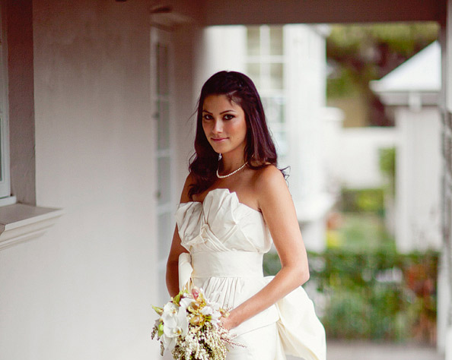
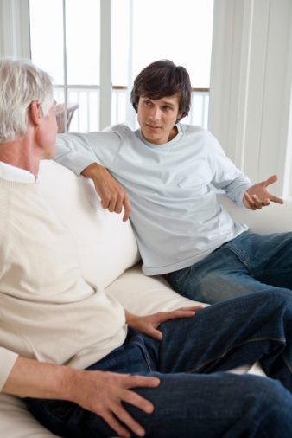

Slide 12
Words
race like a jet
get your blessing
old-fashioned man
we will be boys
heart in my hand
tough luck
altar

Slide 13
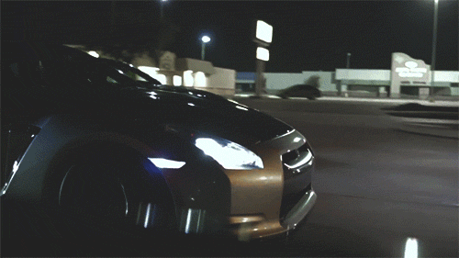
I raced like a jet to get to work on time!

Slide 14
You have to get my father’s blessing before I say “Yes!”….
I would like to marry your daughter…
You have my blessing, but if you hurt her, I will kill you!!

Slide 15
My dad is an old-fashioned man, he follows old traditions.
He had better ask for my blessing before proposing…

Slide 16
We will be boys after our trip to India!

Slide 17
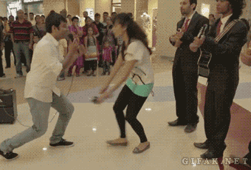
I came to you with my heart in my hand to propose to you.

Slide 18
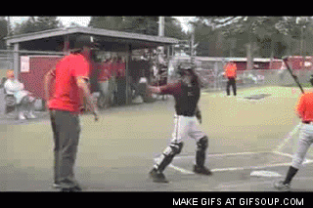
Tough luck, maybe next time.

Slide 19
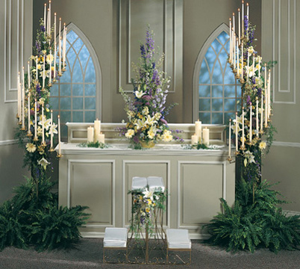
The altar was decorated beautifully.

