Slide 1
ELT materials development
Getting Started

Slide 2
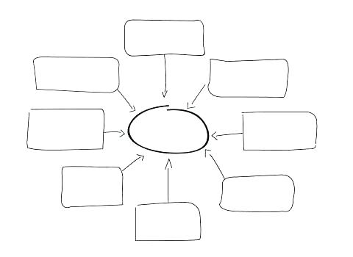
Getting started
List as many English language teaching materials as you can think of!
ELT Materials

Slide 3
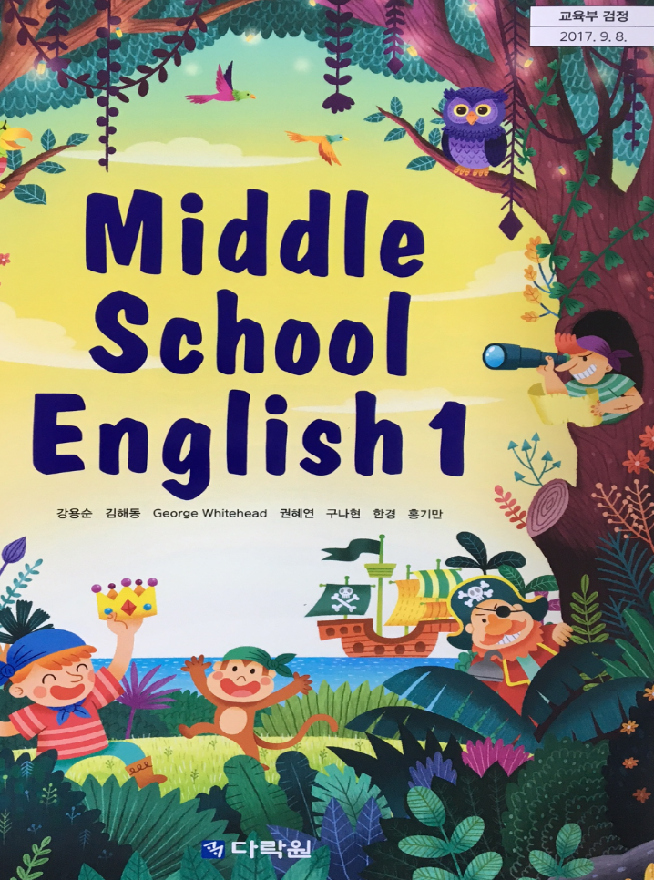
materials
The term materials can apply to virtually anything that a teacher uses to help the teaching process in the classroom.

Slide 4
Types of materials
Print Materials
  books, workbooks, worksheets , or readers
Non-print Materials
  materials needed to do activities (i.e. dice, personal whiteboards, construction paper, glue, tape, colored pens etc.)
Digital materials
  Online quizzes, games, worksheets, audio materials, videos, computer-based presentation materials (PPT, Prezi).

Slide 5
What is materials development
Materials development is both a field of research and a hands on task
  Field of Research:
    Involves the critical examination of the principles and procedures of the design, implementation and evaluation of language teaching material. Understanding what works and what doesn’t and why.
  Hand on Task:
    Involves production, evaluation and adaptation of language teaching materials. Application of what we know works and doesn’t work (research based materials).
  For more informant see Tomlinson (2008, 2011, 2013 )

Slide 6
Your experience
Research Experience | Hands-on Experience
  Examining how materials are developed
  Examining how materials are used
  Examining the design of materials
  Examining students’ perception of the materials that are being used
Creating your own materials
Working on a materials development team
Making your own PPTs for class

Slide 7
Authentic vs non authentic

Slide 8
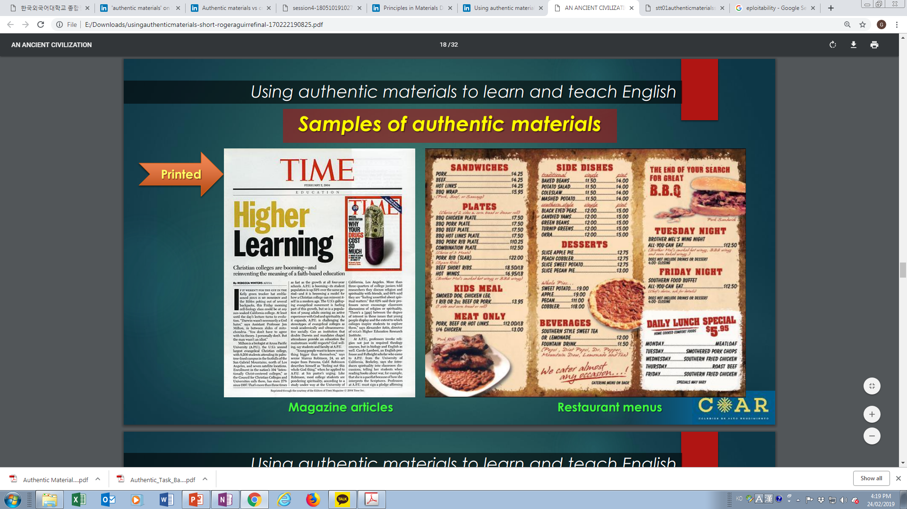
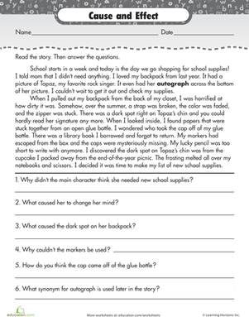

Slide 9
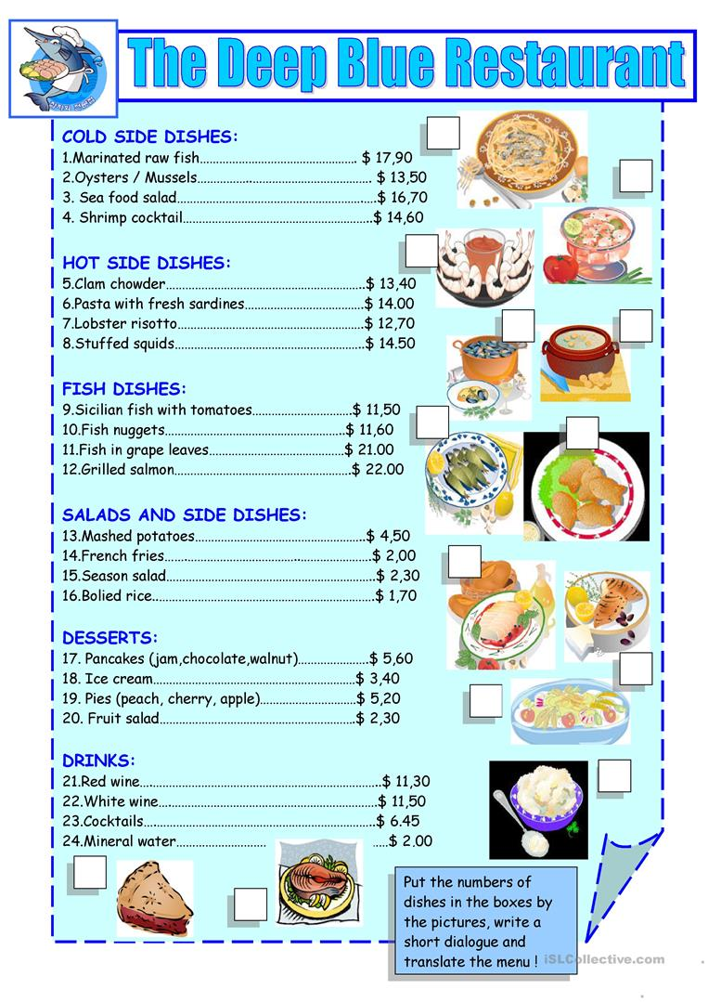

Slide 10
Authentic vs Non authentic
Authentic materials refer to materials that have not been designed or adapted for use in an English language classroom such as magazines, newspapers, video clips and song lyrics.
Non authentic material refers to anything that has been designed specifically to aid the teaching process such as worksheets, text books and instructional CD’s or DVD’S.

Slide 11
Task: sort the following into authentic and non authentic materials
Graded reader
TED Talks
Arianna Grande song
Harry Potter books
Newspaper article from BBC
Newspaper article from www.breakingnewsenglish.com
Clips from an Avengers movie
Grammar in Use series
McDonald’s menu from Singapore https://www.mcdonalds.com.sg/
Language taken from Facebook or Instagram comments
Vocabulary worksheet
A speech given in English by Ban Gi Moon
A BTS/ Blackpink interview conducted in English

Slide 12
Experience of language in use
‘Authentic materials are ‘designed not to transmit declarative knowledge about the target language but rather to provide an experience of the language in use.’
(Tomlinson & Masuhara, 2010: 400)

Slide 13

Benefits and drawbacks
Can you think of the benefits and drawbacks of using authentic materials?

Slide 14
Advantages of using authentic material
According to Brinton (1991), authentic materials connect the language classroom and the outside world.
Students are exposed to language they are likely to encounter.
Gebhard (1996) sees authentic materials as a way to contextualize language learning. When lessons are centered on comprehending a menu or a TV weather report, students tend to focus more on content and meaning rather than the language itself.
Another advantage is that it increases the motivation to learn in students and it increases the interest in the subject matter.
Students become more confident when they work with authentic materials, and they increase their understanding in the practical side of this use in the real world.

Slide 15
Disadvantages of using authentic material
Sometimes difficult to find authentic texts in a country where English is a foreign language.
Difficult to choose what authentic material to choose ( Materials from many different countries)
Difficult language structure and vocabulary items can pose difficulties for lower level students
Teachers have to creative in how to use them

Slide 16
Tips for using Authentic materials
Choose your material carefully considering learners’ age, level, purpose
Select engaging topics according to learners’ interests
Plan activities that provide necessary pedagogical support
Grade the task based on learners’ level
Consider including different types of tasks or varying difficulty
Choose materials that reflect English varieties they are likely to encounter

Slide 17
It’s not all or nothing….
Regular classroom instructions with a course book should be accompanied by using authentic materials.

Slide 18
Assessing the usefulness and appropriateness of authentic materials
Difficulty :
  Is the material too easy/difficult for the students?
  Is it structurally too demanding/complex?
  How much new vocabulary does it contain?
Presentation:
  Is it “attractive”?
  Is it non-intimidating?
  Does it grab the student’s attention?
Suitability of Content:
  Does the content interest the students?
  Is it relevant to the students’ needs?
  Does it represent the type of material that the students will use outside of the classroom?
Usefulness:
  Can the content be used for my teaching purposes/objectives?
  Will the material be useful to my students?

Slide 19
Authentic Materials
Printed materials: newspapers, magazines, fliers, books, restaurant menus, recipes, manuals, food labels, TV guides, comics
Auditory materials: radio news, songs, phone messages, podcasts
Visual materials: posters, street signs, postcards
Audio visual materials: films, commercial advertisements, documentaries, music video clips, television programs, video tutorials
Online materials: websites, blogs, social networking sites, games, etc.

Slide 20
The job of developing materials

Slide 21
Legal Matters
Copyright, Creative Commons, Fair Use
https://practicaledtech.com/2020/05/26/updated-a-guide-to-finding-media-for-classroom-projects/
https://www.copyright.gov/fair-use/more-info.html
https://www.photosforclass.com/

Slide 22
Creative Commons
is voluntary licensing that artists, musicians, photographers, videographers, and writers can apply to their works

Slide 23
Fair Use
Fair use is a legal doctrine that promotes freedom of expression by permitting the unlicensed use of copyright-protected works in certain circumstances.
criticism, comment, news reporting, teaching, scholarship, and research are activities that may qualify as fair use.

Slide 24
references
Brinton, D.M. (1991). The use of media in language teaching. In M. Celce-Murcia (ed.), Teaching English as a Second or Foreign Language, Boston: Heinle and Heinle Publishers.
Gebhard, J.G. (1996). Teaching English as a Foreign Language: A Teacher Self-Development and Methodology Guide. Ann Arbor: The University of Michigan Press.
Tomlinson, B. (Ed.) (2008). English language learning materials: A critical review. London: Continuum.
Tomlinson, B. (Ed.) (2011). Materials development in language teaching. Cambridge: Cambridge University Press.
Tomlinson, B. (Ed.) (2013). Developing materials for language teaching (2nd ed.). London: Bloomsbury.

