Slide 1
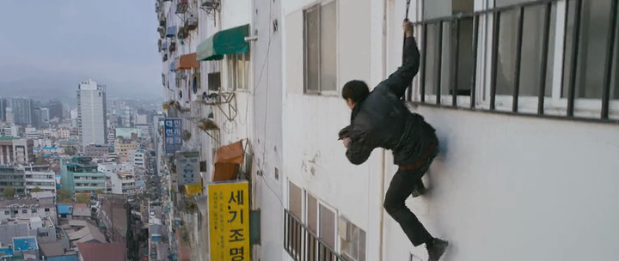
Did You Hear that Noise Downstairs?

Slide 2
Warm up
Have you ever had something stolen from you?
Are you ever worried about someone breaking into where you live?

Slide 3
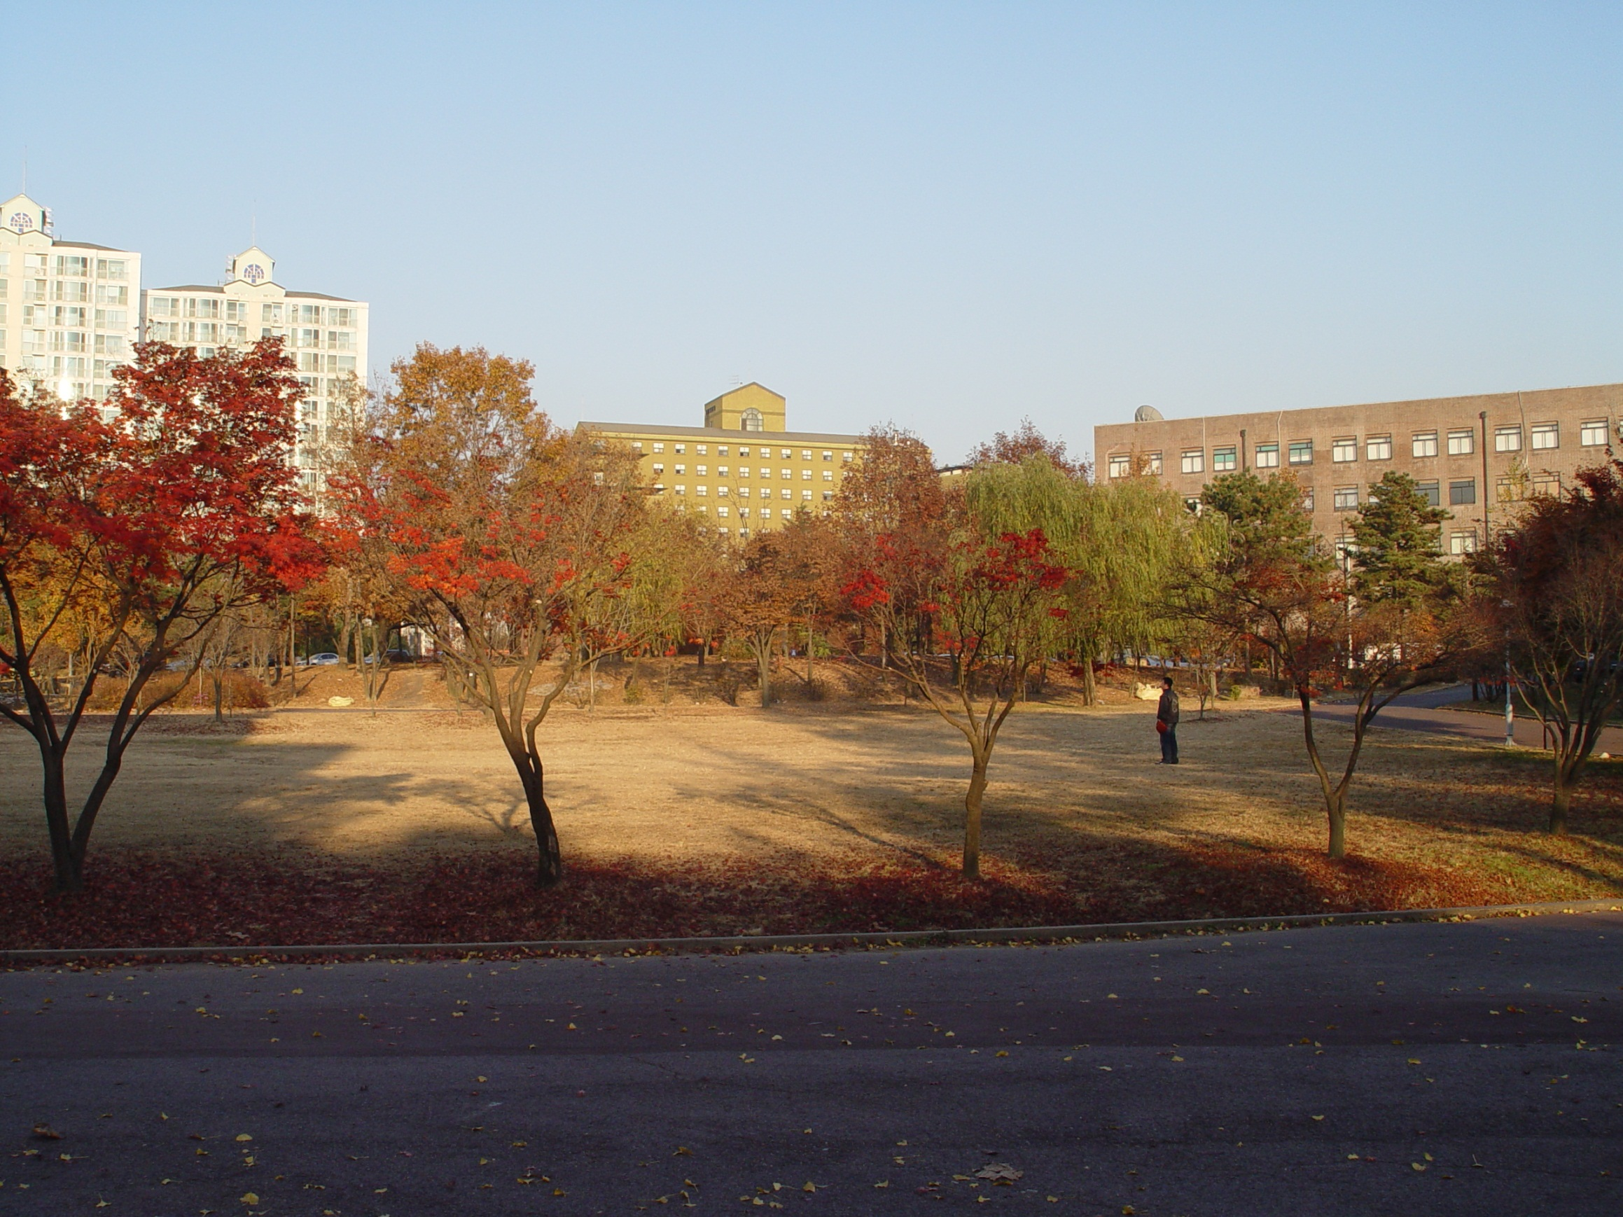
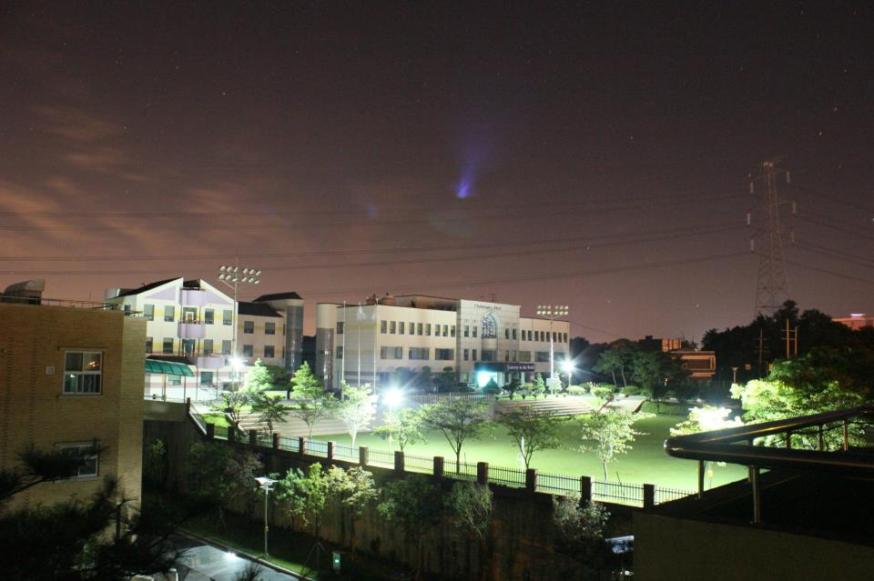

Slide 4
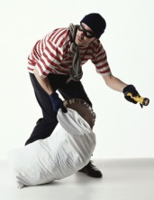
Last night a thief came to the University!!

Slide 5
I have your wallet.

Slide 6
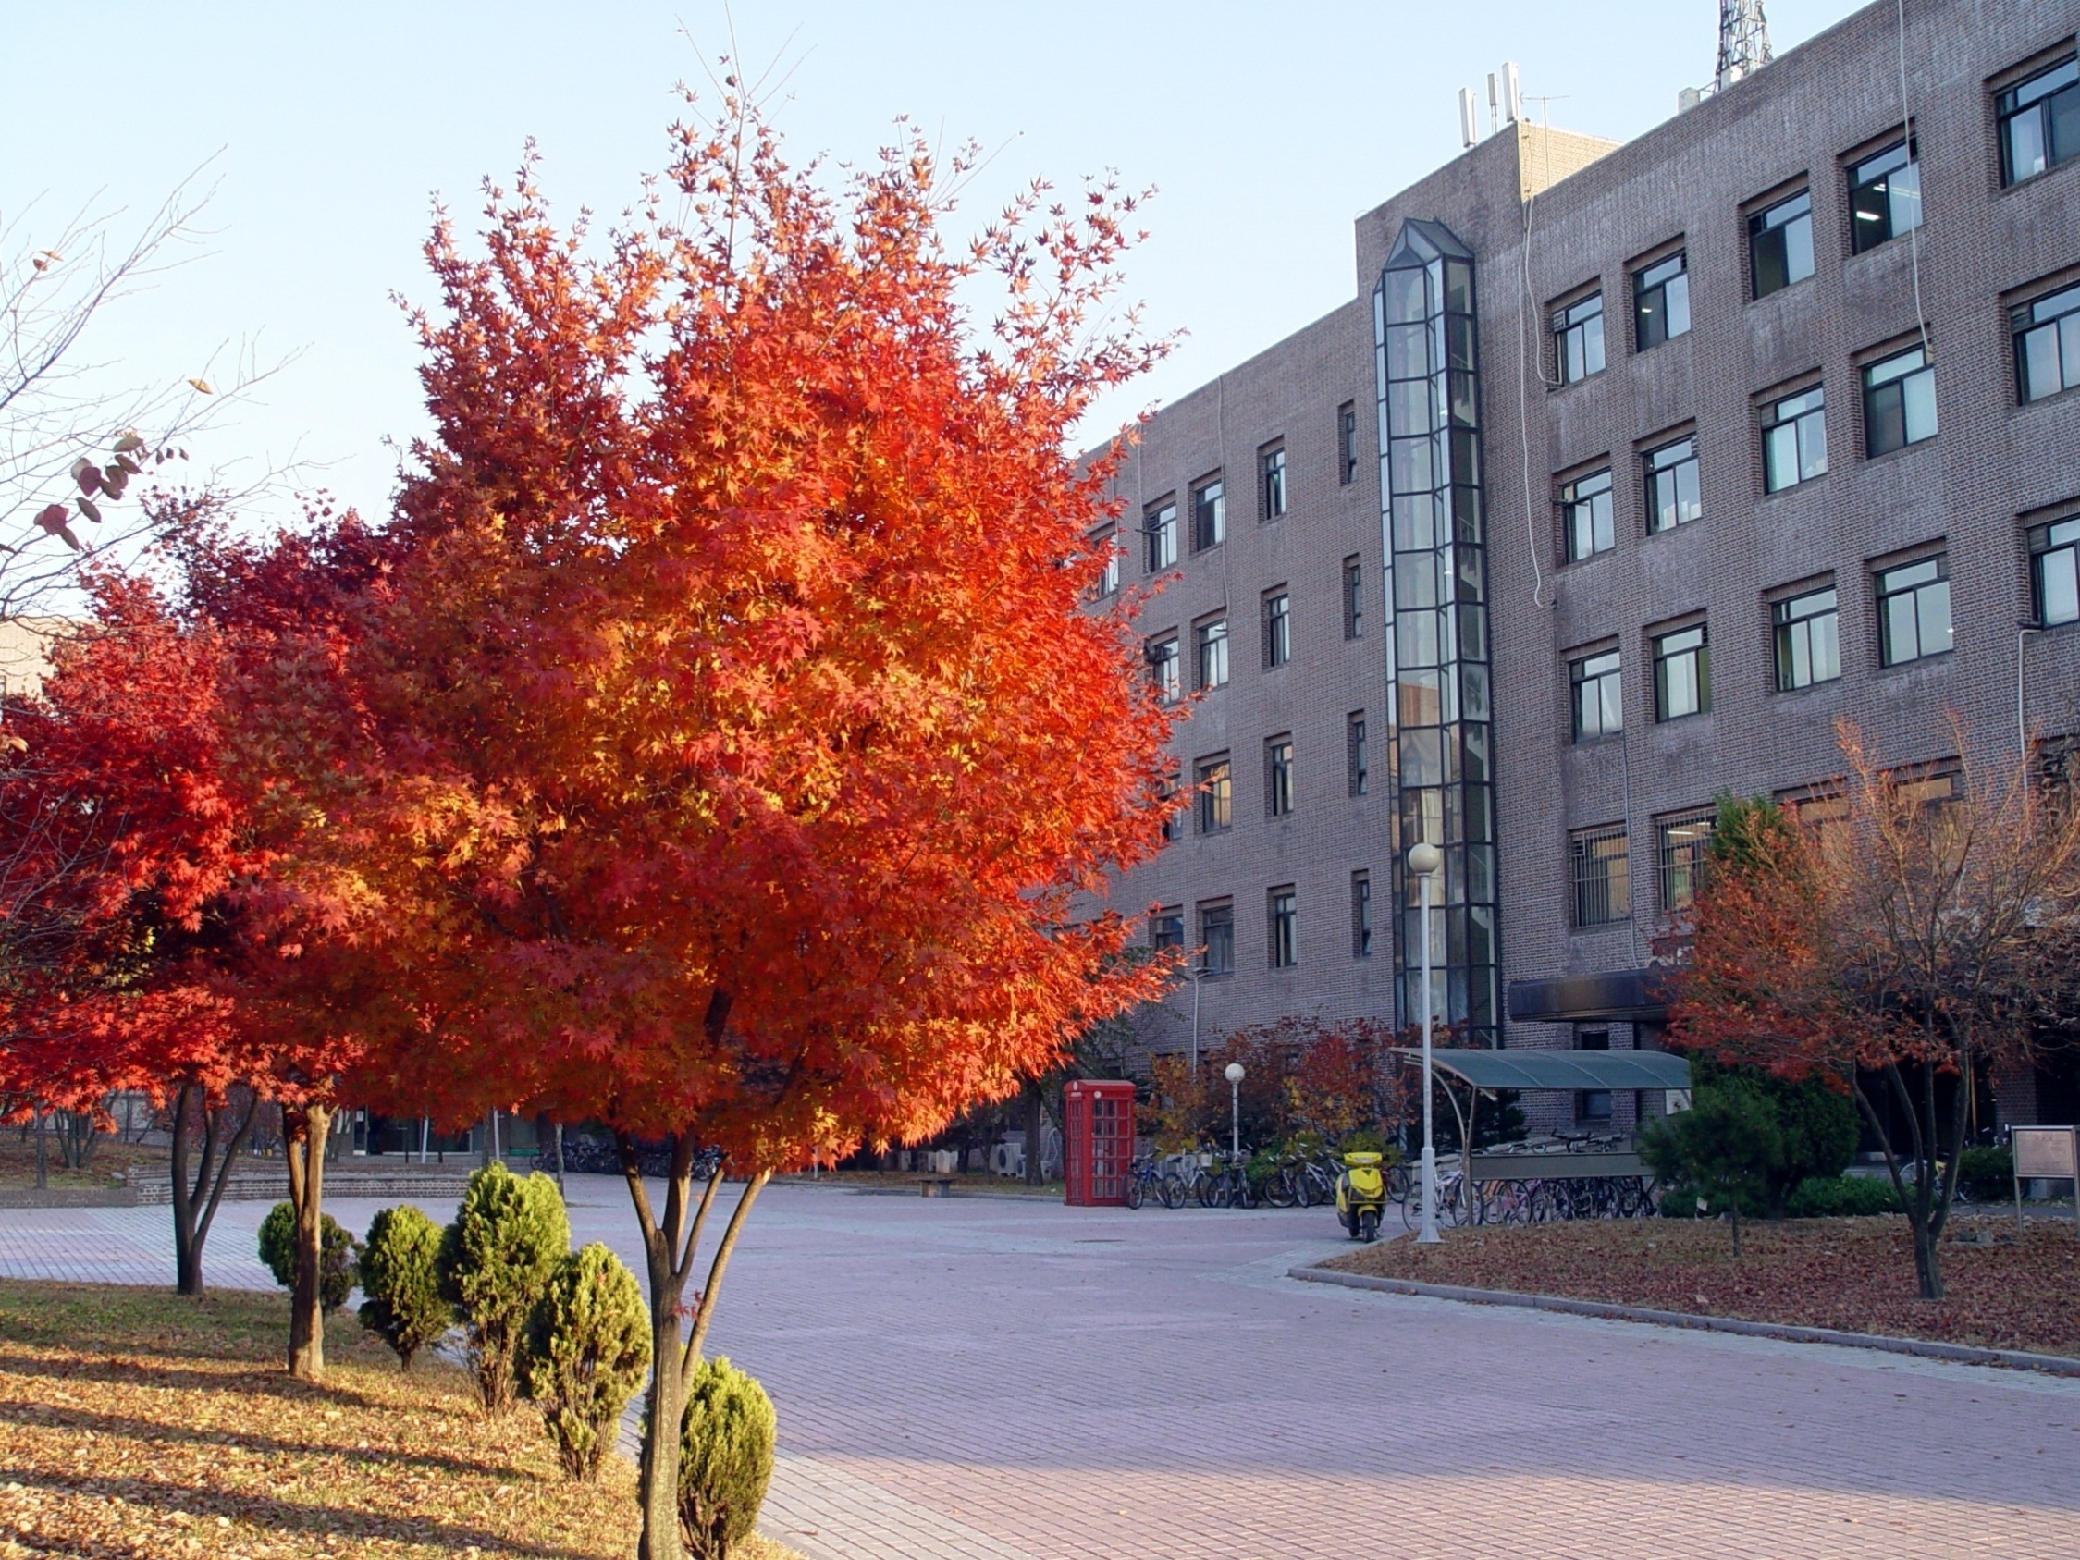
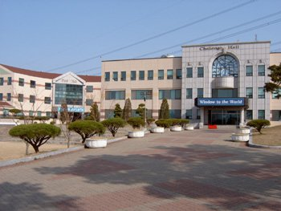
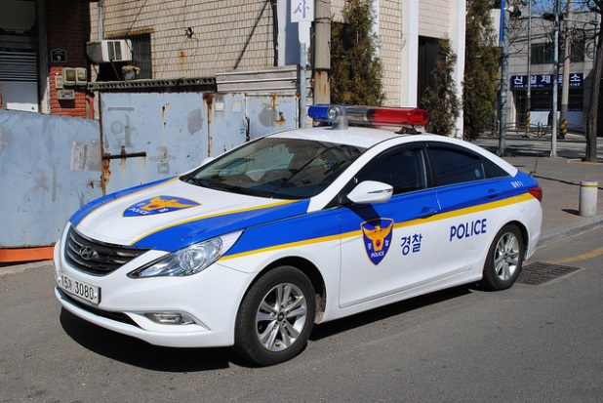
The police came this morning…

Slide 7
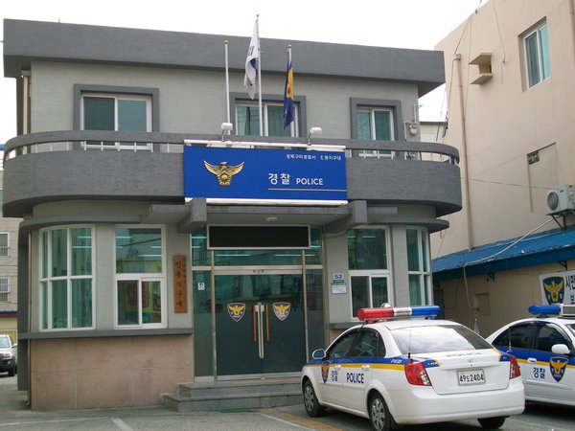
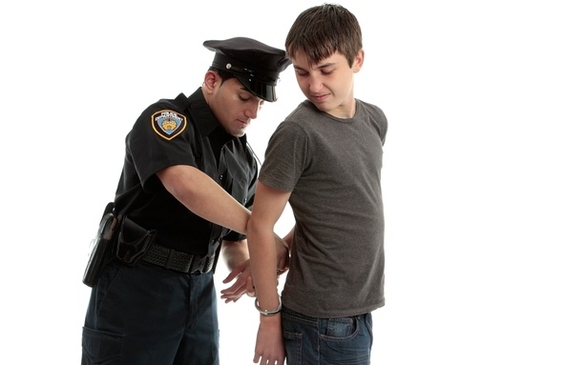
They took the suspects to the police station….

Slide 8
The police know that the crime happened between 5pm and 10pm
The suspects have an alibi…
They say …
5-6pm they were eating dinner together.
6-8pm they were watching a movie.
8-10pm they were at the norebang

Slide 9
The police know that the crime happened between 5pm and 10pm
The suspects have an alibi…
They say …
5-6pm they were bowling.
6-8pm they were in a PC room.
8-10pm they were in the library studying.

Slide 10
Wrap-up
You just got back from your honeymoon in Indonesia and as you get to your apartment door you see that the door is slightly open. When you look down there are muddy footprints leading inside your apartment. You slowly and quietly open the door and see a thief in your kitchen. What would you do?

Slide 11
TIPS
What are 5 tips that you would give people to keep their home safe while they are travelling?

