Slide 2
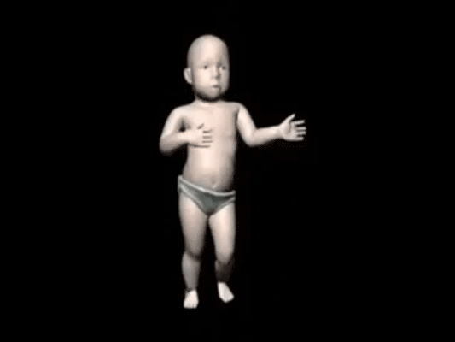
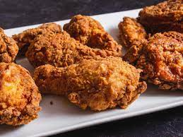
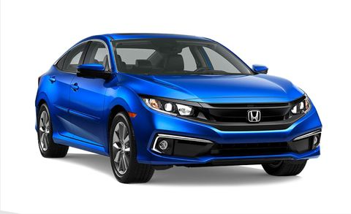
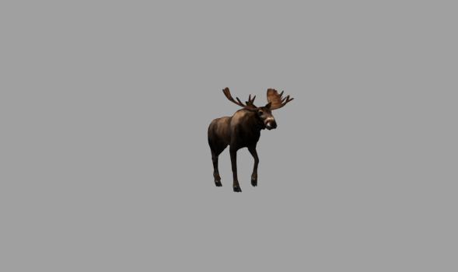
A

Slide 3
$100
Question 1 here
$100
Question 2 here

Slide 4
$100
$100

Slide 5
Question 1
Answer this

Slide 6
Question 2
Answer this

