Slide 1
Data Collection Strategies
An Overview

Slide 2
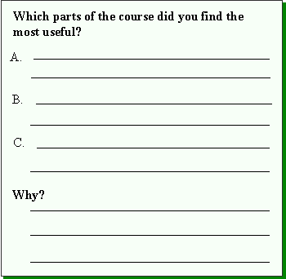
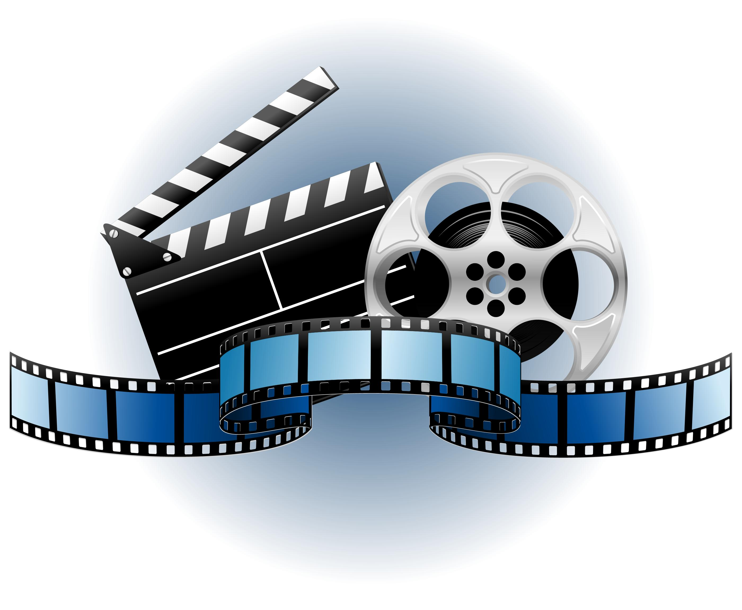
Different ways to collect qualitative data

Slide 3
Collecting Data
Observation
Interviews
Focus groups
Open-ended surveys
Participants writings
Visual methods

Slide 4
Observation

Slide 5
Observation
Researchers gather data either by observing or by both observing and participating, to varying degrees, in the study-community’s daily activities.
Can be done both in person, as video observations, or both

Slide 6
Types Of Observers: Participant vs Non-participant
Complete observer
Behind one-way mirror, invisible role
Observer as participant
Known, unhidden observer
Participant as observer
Hidden observer

Slide 7
Advantages & Disadvantages of Observation
It allows the researcher to see what actually goes on at the ground level. (what people say and what they do is quite different)
It allows the researcher to be able to feel and experience how the participants feel
Gives researchers and inside perspective
It is Time- consuming
Subjective
May need to be followed up with interviews or debriefing to clarify the observations

Slide 8
Interviews

Slide 9
Interviews
A qualitative research method in which a researcher/interviewer gathers data about an individual’s perspectives on a specific topic(s)
The researcher/interviewer engages with the individual by posing questions in a neutral manner, listening attentively to responses, and asking follow-up questions and probes based on those responses.

Slide 10
Interview techniques
Structured
Impose fixed structure on ordering & wording of question & categories for coding response
Semi-structured
Less rigid than structured
Respondents asked a series of open ended questions and answers are recorded in full.
Interviewer is free to probe to amplify & clarify responses and follow up any interesting idea or to delete any question
Unstructured
Minimal influence on the structure of schedule(In-depth interview)

Slide 11
Purpose Of Interviews
It help us to Elicit:
Feelings
Thoughts
Opinions
Previous experiences
The meaning people give to certain events

Slide 12
Advantages & Disadvantages of Interviews
Bi-directional
Allows for the researcher to probe deeper
Can allow subjects to open up more if they feel safe and comfortable with the researcher
Replicability difficult
Time consuming
Require familiarity with language and culture
Requires social skills

Slide 13
Focus Groups

Slide 14
Focus Groups
a group interview with 3 to 12 participants
group discussion guided by the researcher but open to participants to discuss, questions, answer, and interact.

Slide 15
Advantages & Disadvantages of Focus Groups
Not replicable
Not as in-depth
Specific individuals may dominate the discussion
Difficult to transcribe if speaking overlaps
Not confidential
Get a variety of perspectives/reactions to a certain issue
Allows for participants to build off of one another
Many perspectives in a short time

Slide 16
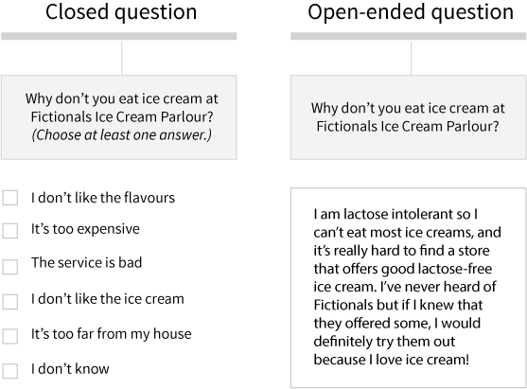
Open-ended Survey

Slide 17
Open-ended Surveys
Collection of data through written responses to open ended questions.

Slide 18
Advantages & Disadvantages of Open-ended Surveys
Easy to administer
Low cost
Can get a large number or participants from a wide range of settings
Automatic data sorting
One directional
People don’t like to do surveys
People may troll the survey

Slide 19
Online Tools
https://www.limesurvey.org/
www.surveymonkey.com/

Slide 20
Participant’s Writings

Slide 21
Participant’s writings
Collection of data through participant writing on a given topic.
Can be in the form of a journal, reflection, essay, or additional writing task.

Slide 22
Advantages & Disadvantages of Participant Writing
Easy to administer
Low cost
Non-intrusive
Easily anonymized
One-directional
Participants can feel burdened by being asked to write (especially if it is in their L2)
Participants may not write to the quality and quantity that you expect

Slide 23
Visual Methods
Collection of data through pictures, videos, drawings, etc. (online or offline)
Researcher filming or photographing activities and/or interactions
Participants filming their own activities and interactions in the learning environment as a means of providing insight into their perspective. This could include the use of video diaries.

Slide 24
Advantages & Disadvantages of Visual Methods
Goes beyond words
Gives a fresh perspective
Can be followed up with interviews to bring out issues that are meaningful to the participants
Relatively new
Can be overly interpretive
Can break ethical codes
Intrusive

Slide 25
Reflection
Which method or methods are most suitable for your intended project?
Why are they the most suitable?

Slide 26
References
Creswell, J. W., & Poth, C. N. (2017). Qualitative inquiry and research design: Choosing among five approaches. Thousand Oaks, CA: Sage publications.
Dörnyei, Z. (2007) Research Methods in Applied Linguistics. Oxford, UK: Oxford University Press.
Tracy, S. J. (2013). Qualitative research methods. Oxford, UK: Wiley-Blackwell.

