Slide 1
Data Analysis
Coding Qualitative Data

Slide 2
Analysing Qualitative Data
Identify similarities
Create generalisations
Extract themes
Highlight differences
Identify relationships

Slide 3
Objectives of Qualitative Analysis
To draw inferences
To draw conclusions
To develop theories

Slide 4
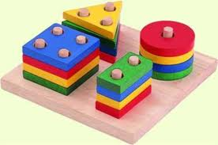
What is coding?
Coding is closely examining qualitative data and organizing it in a way that captures important features/ relationships/ concepts/ ideas/ phenomena.

Slide 5
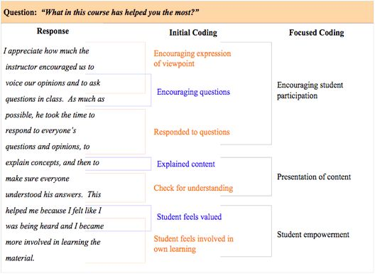

Slide 6
The Coding Process
Initially read
through text
data Divide the text Label the segments
into segments of information Reduce overlap
of information with codes and redundancy Collapse codes
into themes

Slide 7
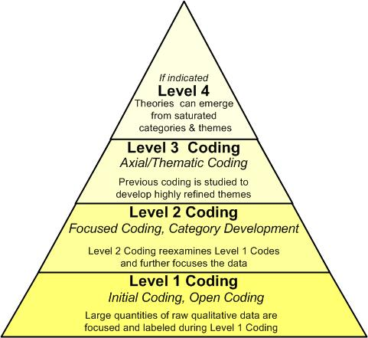

Slide 8
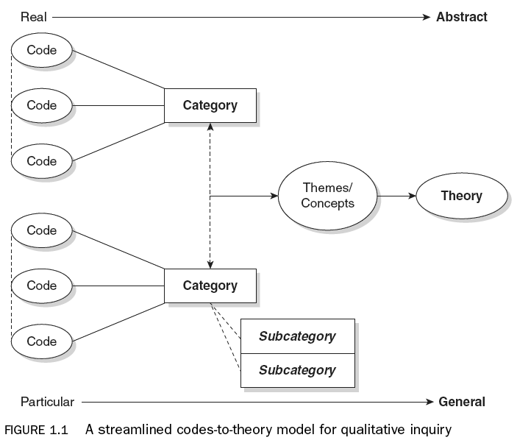
Saldaña, 2013: 12

Slide 9
Data-driven vs. Theory-driven
Codes can be either ‘data-driven’ or ‘theory-driven’
Data-driven – codes emerge from the data itself
Theory-driven – there are pre-determined codes that have been developed prior to examining the data

Slide 10
1st cycle coding
2nd cycle coding
Refer back to your research questions
How does the data relate to answering your RQs?
Identify key words/ phrases/ concepts within the data and assign a code
Use the same code for the data that fits the same concept
During first level coding do not be overly interpretive, report only what is actually there.
Refer back to your research questions
How does the data relate to answering your RQs?
Identify similarities in codes and combining them
Categorizing codes under thematic subheadings/ categories

Slide 11
First cycle coding practice
“What major factors lead you into teaching?”
Work with a partner and code the data
Compare your coding with another group

Slide 12
Methods of Coding
In Vivo Coding: codes terms and phrases used by the participants themselves. The objective is to attempt to give the participants a voice in the research.
Process Coding: this method uses gerunds ("-ing" words) only to describe and display actions throughout the document. It is useful for examining processes, emotional phases and rituals.
Versus Coding: uses binary terms to describe groups and processes. The goal is to see which processes and organizations are in conflict with each other throughout the document. These can be both conceptual and grounded objects.
Values Coding: codes that attempt to exhibit the inferred values, attitudes and beliefs of participants. In doing so, the research may discern patterns in world views.

