Slide 1
Creative Writing
Comic strips, Stories, Poems

Slide 2
Comic Strips
http://bitstrips.com/pageone
http://chogger.com/creator
http://stripgenerator.com/
http://www.toondoo.com/

Slide 4
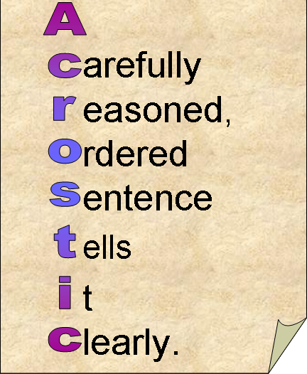
Acrostic

Slide 5
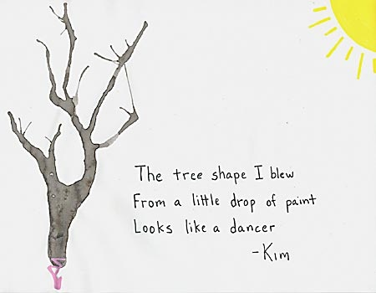
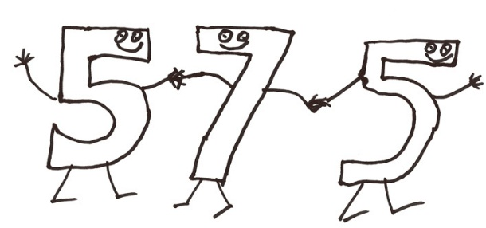
5-7-5

Slide 6
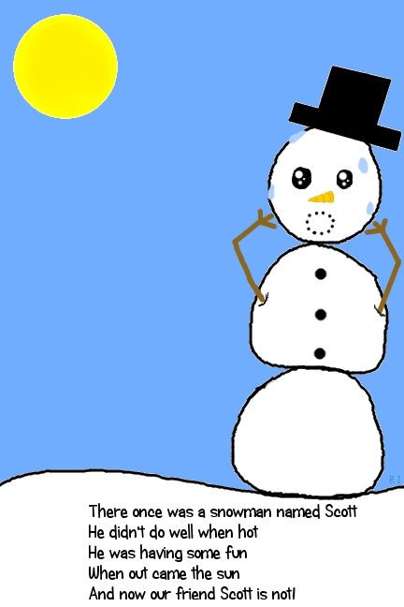
Limerick

Slide 7
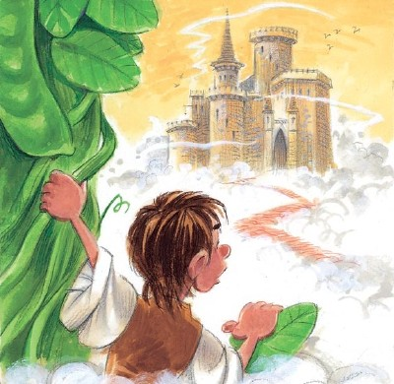
Storytelling

Slide 8
Write a poem or story
https://storybird.com/

