Slide 1
Creating Compelling Lessons through Contextual Awareness
George E.K. Whitehead

Slide 2
Background
“I hypothesize that for most people, motivation to acquire a language plays no role in successful language acquisition.
Rather, language acquisition is the result of doing something else: It is the result of obtaining truly interesting, or "compelling" comprehensible input.”

Slide 3
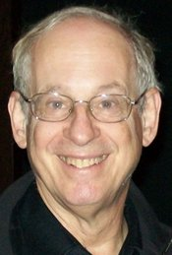
Compelling Input
“Compelling means that the input is so interesting, you forget it is in another language.”
(Krashen, 2011, 2015)

Slide 4
Contextual Awareness
Students
Individuals
People
Age
Wants
Interests
Values
Needs
Interests
Life experiences
Culture & Customs

Slide 5
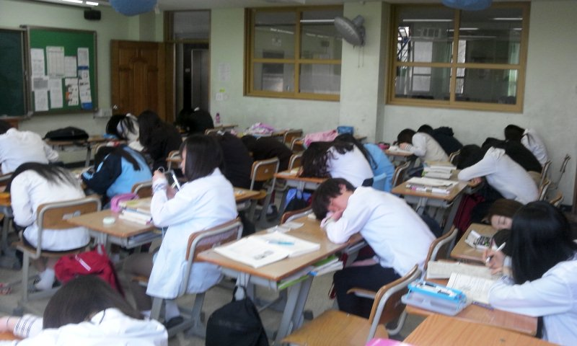
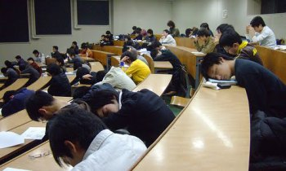
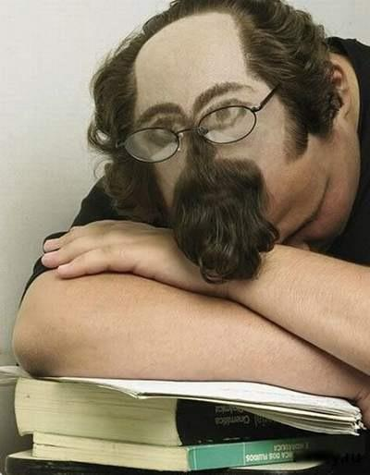
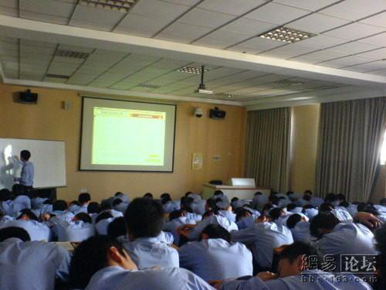
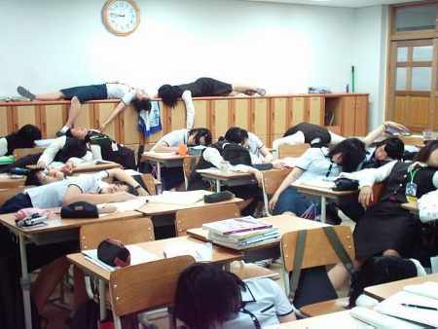
The Issues at Hand

Slide 6
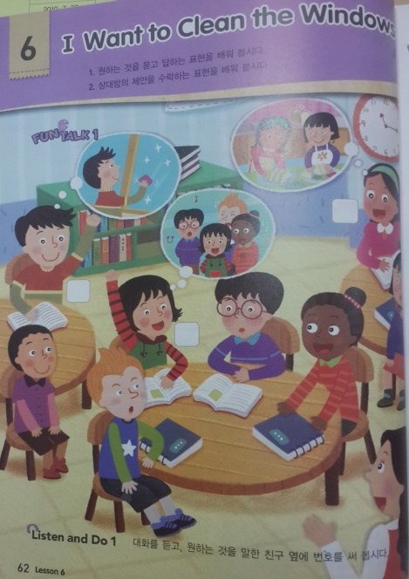
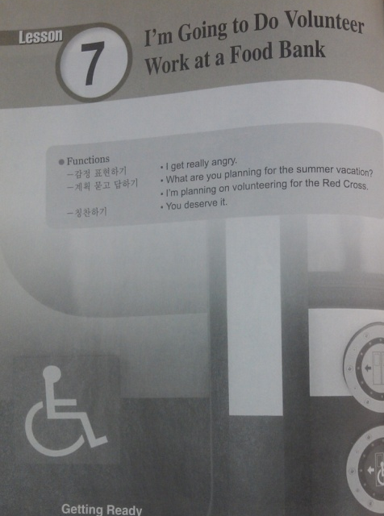
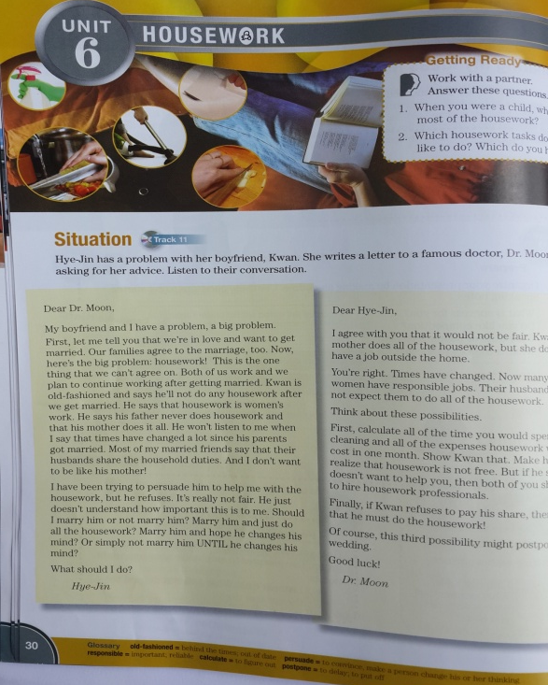
Contributing Reason A: Content

Slide 7
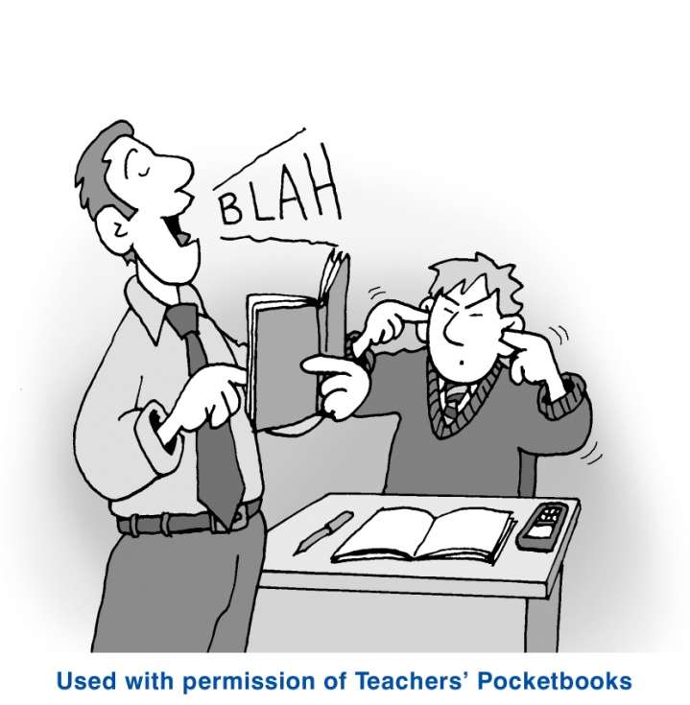
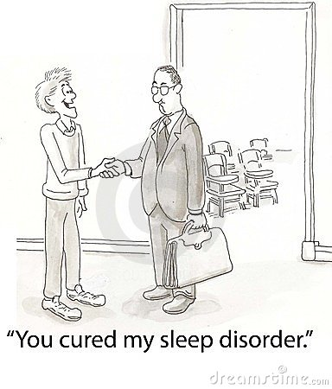
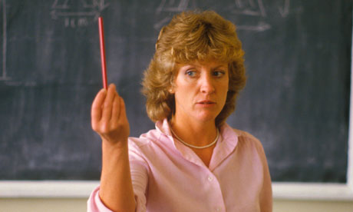
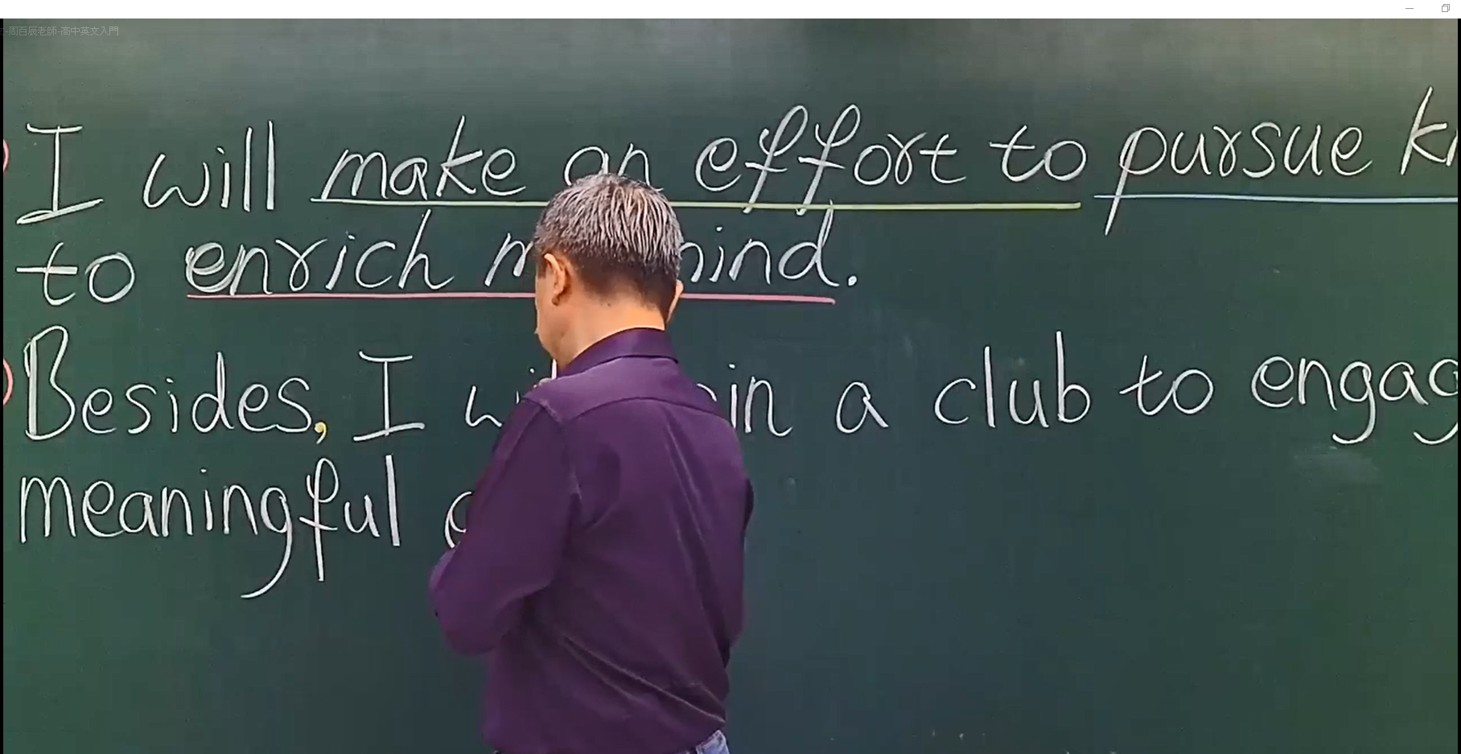
Contributing Reason B: The Teacher

Slide 8
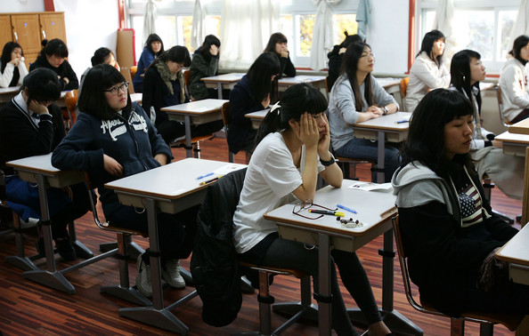
Check-up
2
4
6
g

Slide 9
Creating Compelling Lessons

Slide 10
How can you make your lessons more compelling?
30% is the content you are working with.
70% is how the content is delivered.

Slide 11
Delivery

Slide 12
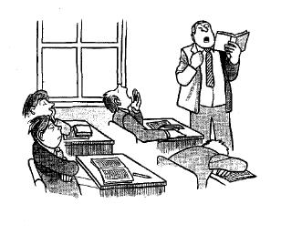
How to be a boring teacher…
(Prodromou ,1999)
Let students do nothing
Teach the book
Be right all the time
Assume students know nothing
Sit still
Be predictable
Speak in monotone
Make sure students are idle
Lose your students
Keep talking

Slide 13
DELIVERY

Slide 14
1. Compel them from the start!
Shock (unusual fact, strange examples)
Fishing
Confusion and uncertainty
Presenting a situation or problem
Making students want to find a solution or answer
RULE: Grasp their attention from the beginning!

Slide 15
2. Connect with students
Good rapport can go a long way!
RULE: If they are connected to you as a teacher, they will be more compelled in your classes.

Slide 16
3. Be a good role model
Come to class compelled to teach… or at least fake it…
RULE: If you seem bored to teach it, students will be bored to learn it.

Slide 17
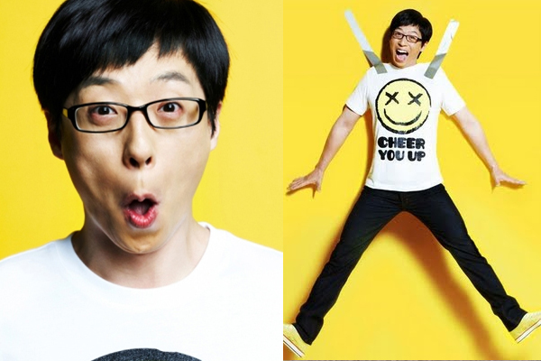
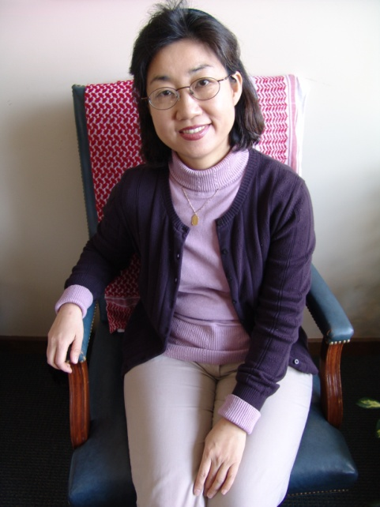
4. Use your compelling qualities
Develop your own compelling style!
RULE: Know your compelling points and use them in your delivery!

Slide 18
5. Interaction, Interaction, Interaction
Interact with students and let them interact with each other as much as possible!
RULE: The longer you are talking, the more bored they will become. Ask lots of questions to break up your speaking!

Slide 19
6. Make it easy to understand
Great teachers can make difficult things easy to understand.
RULE: If students can’t understand it, they can get bored.

Slide 20
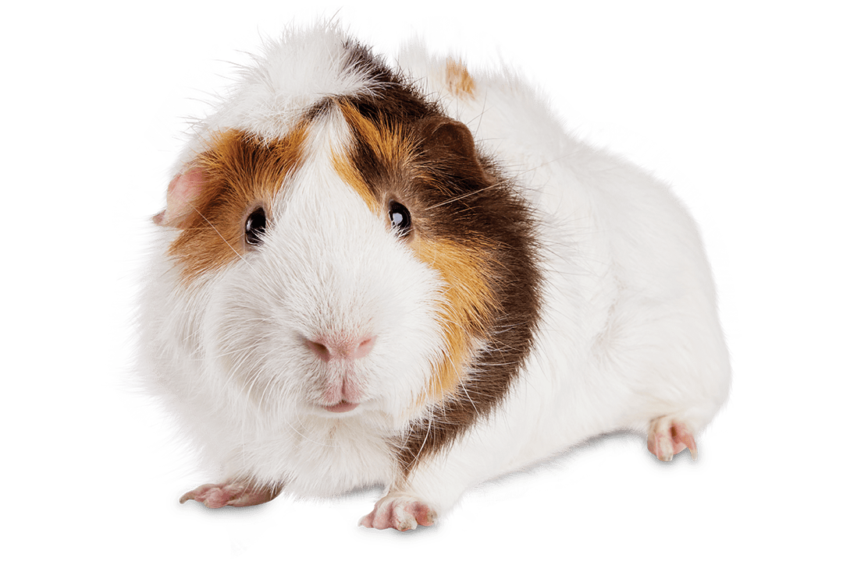
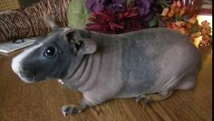
7. Spice it up with multimodality
A hairless guinea pig looks like a small hippo.
Multimodal lessons are much more compelling!
RULE: Seeing it is much more interesting than hearing about it!

Slide 21
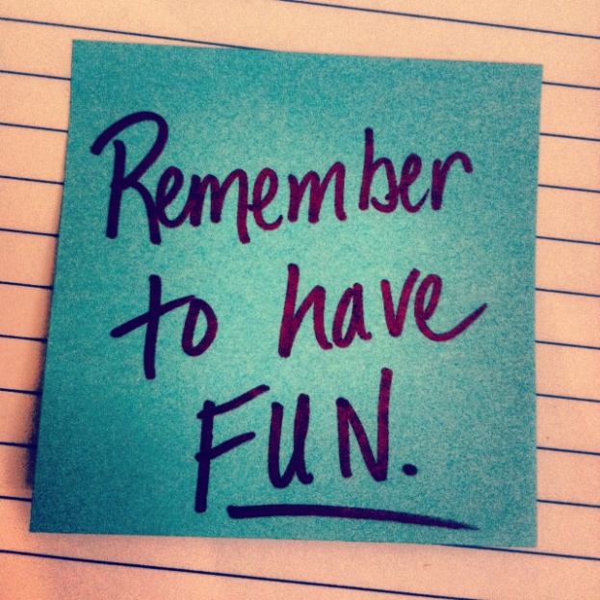
8. Have Fun
Fun is contagious and compelling!
RULE: If you are having fun, you just might trick your students into having fun too…

Slide 23
Compelling or Not

Slide 24
Who is compelling?

Slide 25
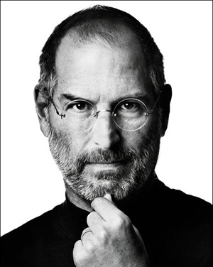
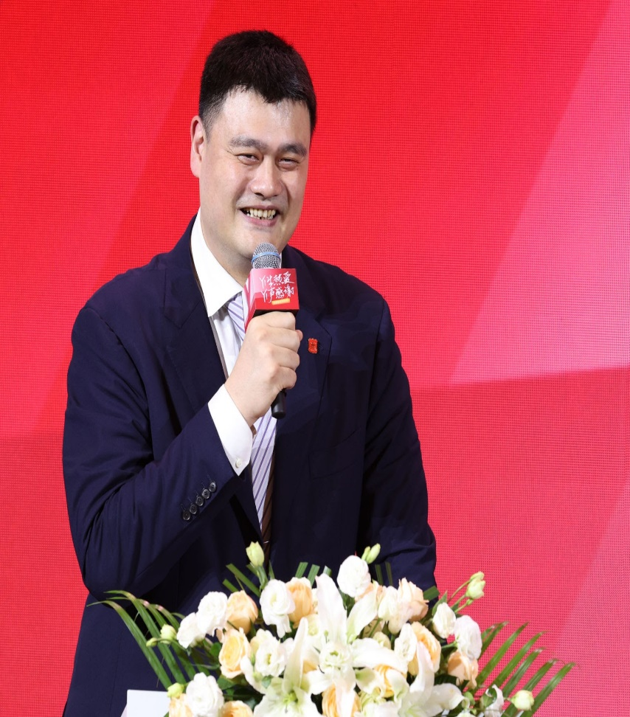
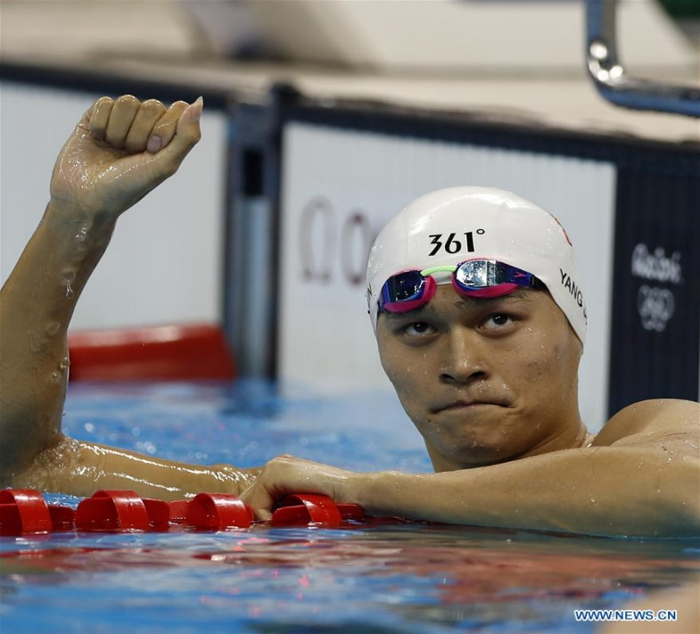
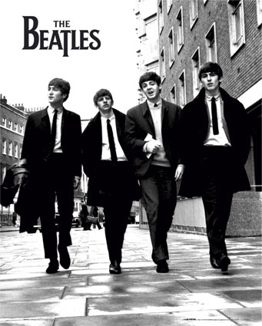
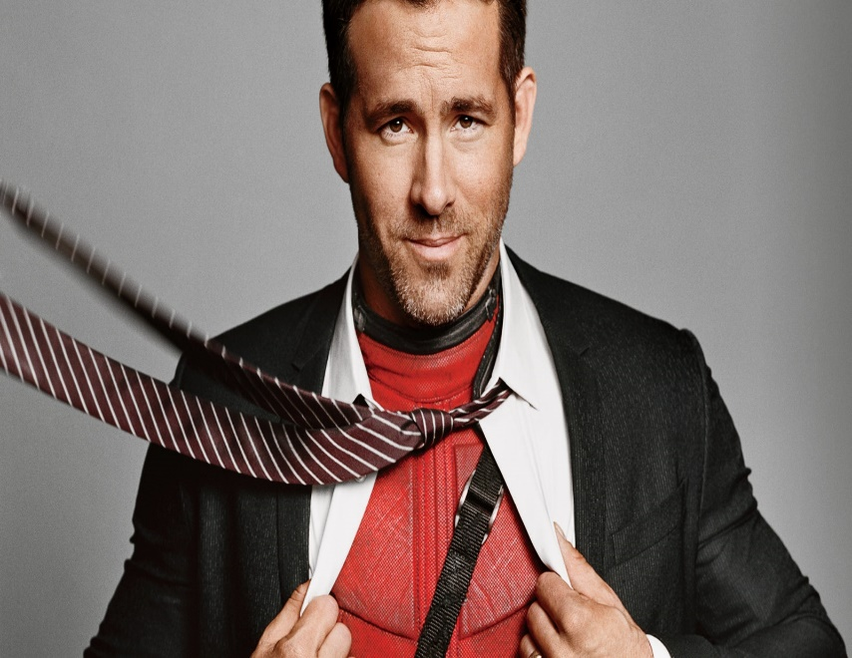
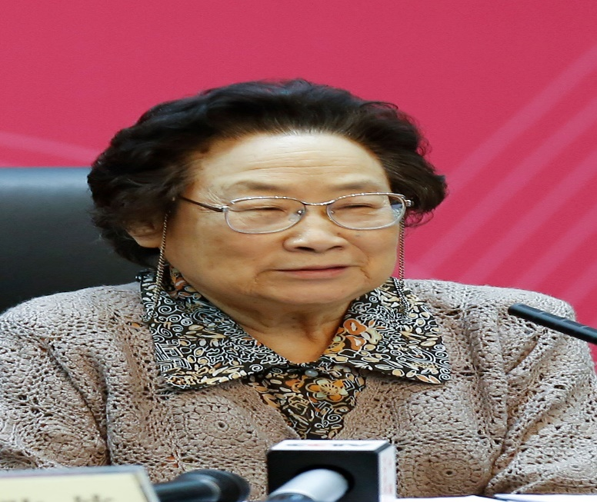
Notes:
Yao Ming (Chinese: 姚明; born September 12, 1980)
Sun Yang (Chinese: 孙杨; Mandarin pronunciation: [swə́n.jǎŋ]; born 1 December 1991) is a Chinese Olympic and world-record-holding competitive swimmer. In 2012, Sun became the first Chinese athlete to win an Olympic gold medal in men's swimming.
Tu Youyou is a Chinese malariologist and pharmaceutical chemist. She discovered artemisinin and dihydroartemisinin, used to treat malaria, a breakthrough in twentieth-century tropical medicine, saving millions of lives in South China, Southeast Asia, Africa, and South America.

Slide 26
Who/ What is compelling?

Slide 27
Topics
Family
Relationships
Environmental issues
Food
Homework

Slide 28
TASK
Make a list of “Who” or “What” would be compelling to your students right now.
Think of at least 5 for each.

Slide 29
Compelling Examples

Slide 30
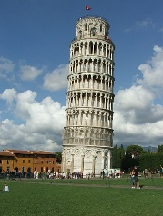
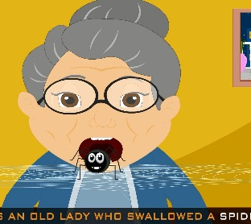
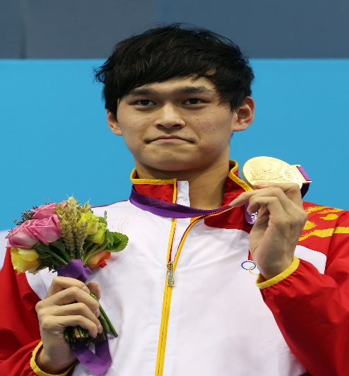
Which of the following sentences is the most compelling?
a)I have been to Italy.
b) She has eaten a spider.
c) Sun Yang has won a gold medal.
d) 赵丽颖 has studied at UBC.
Notes:
Sun Yang (su̯ən yáng)
Zhao Liying (Chinese: 赵丽颖, born 16 October 1987), also known as Zanilia Zhao, is a Chinese actress and singer.

Slide 31
Task
Create 3 compelling examples for the past tense
Create 3 compelling examples for the future tense

Slide 32
Delivery time
Deliver your sentences in your compelling style ☺

Slide 33
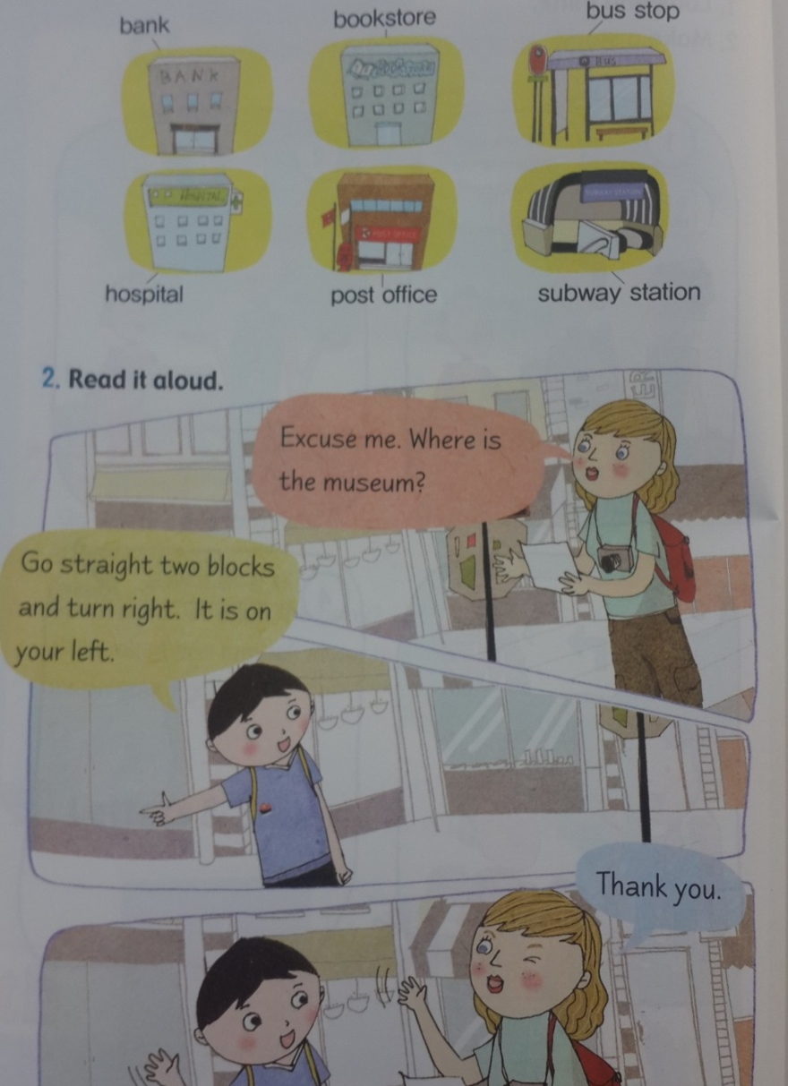
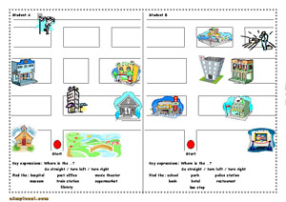
Practice Application

Slide 34
Application Task
How would you make this more compelling for your students?

Slide 35
References
Krashen, S. (2015). The end of motivation. New Routes, 55, 25-29.
Krashen, S. (2011). The compelling ( not just interesting) input hypothesis. The English Connection (KOTESOL), 15 (3), 1.
Prodromou, L. (1999). How to be a boring teacher. English Teaching professional, 12, 16-18.

Slide 36
