Slide 1
Creating CLIL Lessons from Meaningful Input
Drawing From a Text-Driven Approach
Notes:
And unlike CBI, CLIL not only aims at stimulating multilingualism of all citizens in the European community but also strives to “preserve the independence and health of local languages” (EURYDICE 2013).

Slide 2
Revisiting the Key Features in CLIL Lessons
What are the aims of CLIL lessons?
What are the 4 Cs that are incorporated into CLIL lessons?
What is language of, language for, and language through learning?

Slide 3
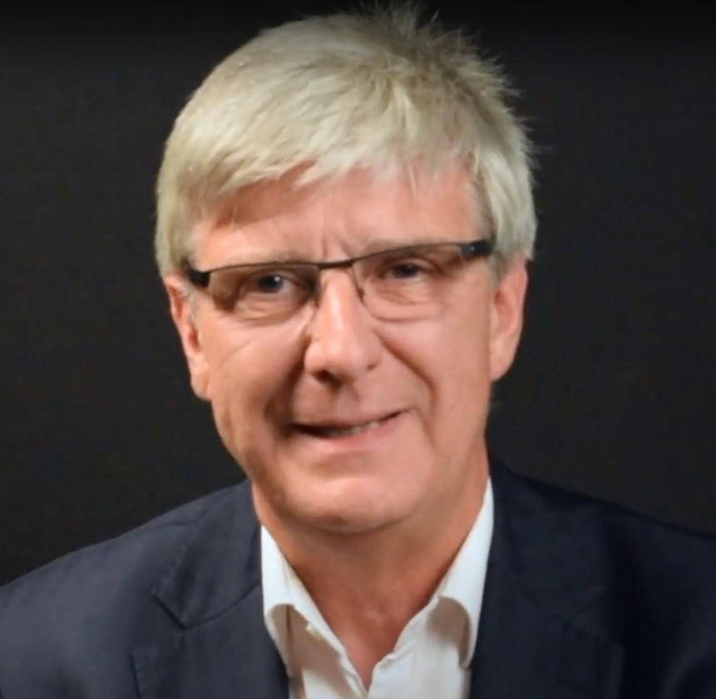
CLIL Defined
CLIL refers to “situations where subjects, or parts of subjects, are taught through a foreign language with dual-focused aims, namely the learning of content and the simultaneous learning of a foreign language” (Marsh, 1994, p. 2).
Notes:
David Marsh from the University of Jyvalskyla, Finland coined the term CLIL in 1994

Slide 4
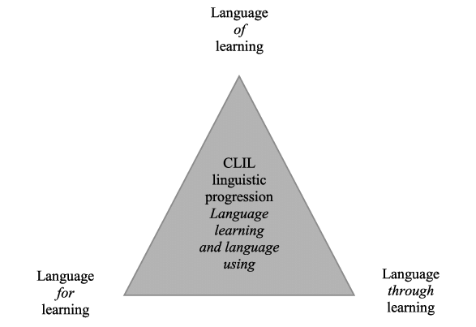
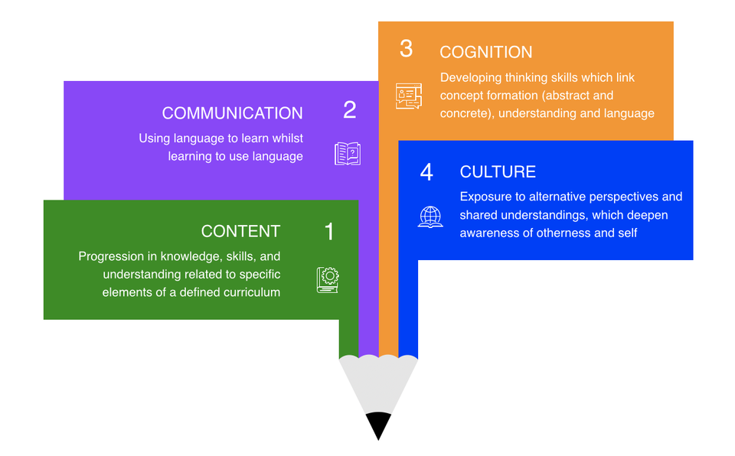
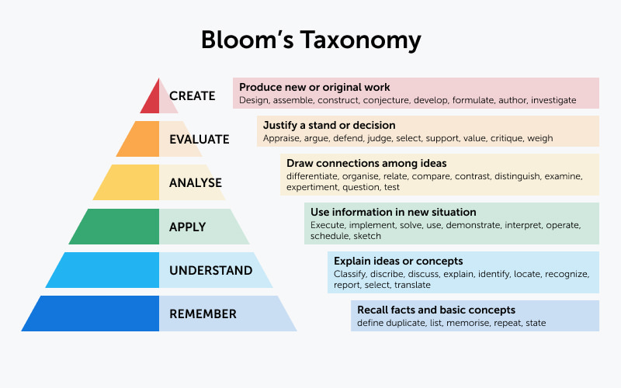
Review

Slide 5
Creating CLIL Lessons from Meaningful Input
Drawing From a Text-Driven Approach
Notes:
And unlike CBI, CLIL not only aims at stimulating multilingualism of all citizens in the European community but also strives to “preserve the independence and health of local languages” (EURYDICE 2013).

Slide 6
CLIL Flexibility
There is neither one preferred CLIL model, nor one CLIL methodology.
CLIL approach is flexible in order to take account of a wide range of contexts.
Individual contexts have to define how integrated learning can be realized.
(Coyle et al., 2010)
Notes:
Coyle, D., Hood, P., & Marsh, D. (2010). CLIL Content and language integrated learning. Cambridge University Press.

Slide 7
Today’s Lesson
You are going to be introduced to a meaningful-input based approach to CLIL.
You are going to practice applying what you have been introduced to through various application tasks.
Overall, we are going to work on developing your ability to create a meaningful-input based CLIL lesson plan that is contextually suitable in your teaching context.

Slide 8
What is a Text-Driven Approach?

Slide 9

Background
Brian Tomlinson
Introduced the text-driven approach to materials development in 2003 in the book Developing Materials for Language Teaching.
He argues against tasks without context, and texts in coursebooks that are not engaging for students.
The lesson materials and activities (tasks) are driven by potentially engaging written, spoken, or visual texts rather than by pre-selected teaching points.
(Tomlinson, 2003)

Slide 10
Text-Driven Approach Key Principles
The importance of text selection: a potentially engaging text, a text, which you think is likely to move the learners emotionally to make them laugh, to make them cry to make them excited, and is likely to stimulate them to think.
The underlying principles of a text-driven approach include:
  exposure to authentic language in use
  affective and cognitive engagement
  use of language for communication
  opportunities for learner discovery
(Tomlinson, 2003)

Slide 11
From Text-Driven to Meaningful-Input Driven

Slide 12
Meaningful-Input Based Approach
A meaningful-input based approach to lesson design is when lessons are driven by meaningful written, spoken, or visual input.
The lesson is built around selected input/content (CLIL) rather than by pre-selected teaching points.
There is a focus on students’ gaining knowledge of the content and developing their L2 through natural usage of the language to engage with the content.
Notes:
Whitehead, G. (2022). Constructing lessons from meaningful input: Taking a text-driven approach to lesson planning. Presented at Seoul public elementary school English teachers’ professional development workshop, online. October 2022.

Slide 13
Lesson Planning Preparation
Select suitable meaningful input.
Consider key language needed to comprehend and discuss the content (language of and language for learning).
Consider appropriate communicative activities for students to utilize different L2 skills (R,W,L,S) connected to the content and cognitive skills focused on the development of content (LOTS → HOTS).
Consider how you can connect your lesson to other countries and cultures.

Slide 14
Possible Lesson Flow
Pre
(readiness activities)
During
(cognitive engagement with and comprehension of content)
Post
(personalization & extension)
  Activate background knowledge.
  Personally connect learners to the content to be covered.
  Pre-teach language for learning right before learners engage with the lesson content.
  *remember to teach language for learning prior to activities which are interactive.
  Teacher presents the content to the students.
  Reading/ listening activities to engage with the content (general to specific comprehension focus).
  Students engage in activities in which they are focused on understanding/comprehension of the content (LOTS →HOTS).
  Follow-up whole class discussion to address any problems or questions students have relating to language and/or content.
  Students do an activity/ activities focused on applying what they learned and further personalizes the content that they have engaged with (HOTS). (apply, analyze evaluate, create).

Slide 15
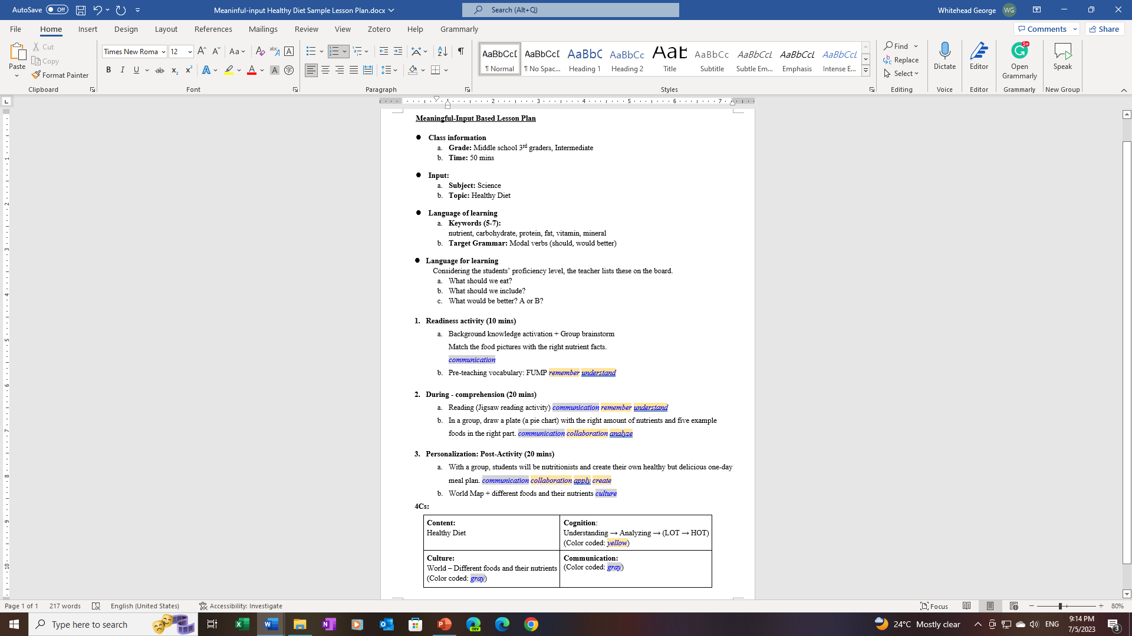
Sample Lesson Plan

Slide 16
Selecting Suitable Input

Slide 17
Key Considerations
The input must be meaningful; something that students will be personally connected to.
The more personally connected they are to the input the more meaningful will be to them.
The input must be at the appropriate level for students.

Slide 18
Meaningful Input

Slide 19
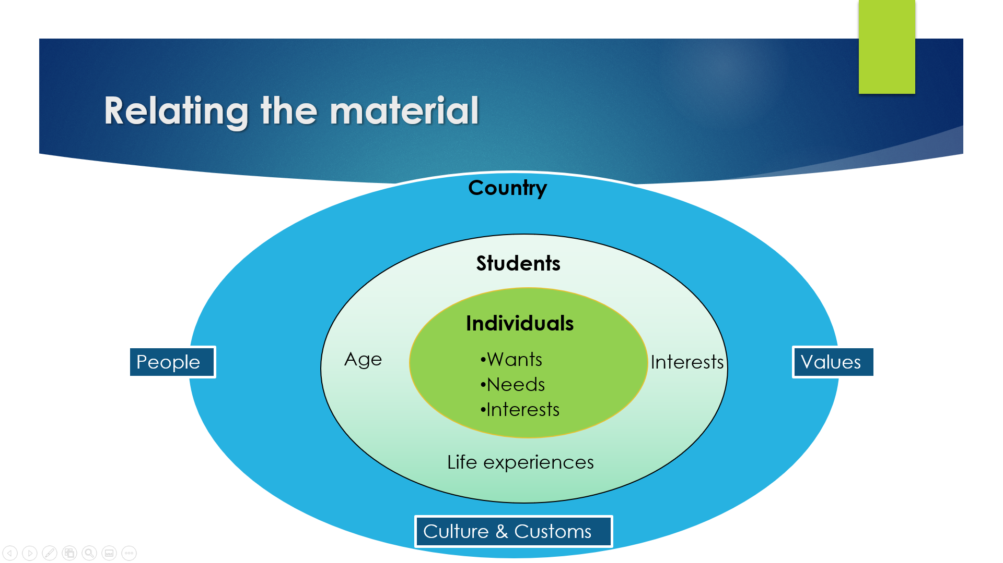
Key Points
Input must be connected to the learners age, interests, and experiences.
If it is not directly connected it is the teachers' job to find ways to connect it.

Slide 20

Thinking & Discussion Time
In your group, please discuss what topics/content may be of interest to the following students in your teaching context.
*Be sure to consider learners specific age and grade.
  Elementary school
  Secondary school (middle/ high)
  Adult learners (university level +)
Consider what main subject the topic/ content relates to:
Science
Technology
History
Geography
Health
Math
Art
Music
Business
Social Studies
Other?

Slide 21
Finding Input: Useful Resources

Slide 22


Possible Input Sources
Reading Sources
Listening Sources
  Books
  Reputable websites
  News
  Infographics
  Posters
  Brochures
  Magazines
  Audiobooks
  Reputable websites
  News
  T.V.
  Movies
  YouTube
  TED talks
  Teacher
  Students
  Podcasts
*Handout of useful websites provided separately

Slide 23
Level Appropriateness

Slide 24
Levels of Difficulty
Independent - Easy
  Can read alone without assistance and can comprehend 90% or more of the content and language.
Instructional - Challenging
  The learner understands most of the content but feels the needs help with new words they do not know and comprehension.
  They should be able to comprehend at least 75%.
  The material should be challenging but not too difficult.
Frustration – Too difficult
  This level should be avoided for CLIL lessons.
  Word recognition presents such difficulty that adequate comprehension is impossible.
  Can comprehend 50% or less.
  Warning signs: looks of confusion, anger, heavy breathing, crying
Notes:
https://www.mheducation.com/unitas/school/program/corrective-reading-2008/corrective-reading-independent-instructional-frustrational-reading-levels.pdf
Katz, C. A., Polkoff, L., & Gurvitz, D. (2005). Shhh... I’m reading”: Scaffolded independent level reading. School Talk, 10(2), 1-3.
Osborn, J., Lehr, F., & Hiebert, E. H. (2003). A focus on fluency. Honolulu, HI: Pacific Resources for Education and Learning.
Emmett Betts first presented the framework in his 1946 book Foundations of Reading Instruction, in which he described four levels of text difficulty: (1) the basal, or independent, level; (2) the instructional level; (3) the frustration level; and (4) the probable capacity level, which is “the highest reading level at which the individual can comprehend... material read to him” (p. 439).

Slide 25
Sample content – What age/ level is the following content suitable for?
Precipitation is a vital component of how water moves through Earth’s water cycle, connecting the ocean, land, and atmosphere. Knowing where it rains, how much it rains and the character of the falling rain, snow or hail allows scientists to better understand precipitation’s impact on streams, rivers, surface runoff and groundwater. Frequent and detailed measurements help scientists make models of and determine changes in Earth’s water cycle. The water cycle describes how water evaporates from the surface of the earth, rises into the atmosphere, cools and condenses into rain or snow in clouds, and falls again to the surface as precipitation. The water falling on land collects in rivers and lakes, soil, and porous layers of rock, and much of it flows back into the oceans, where it will once more evaporate. The cycling of water in and out of the atmosphere is a significant aspect of the weather patterns on Earth.
Whether an object sinks or floats depends on its density. Everything is made of molecules. Molecules are tiny particles that can only be seen with a microscope. Some objects have molecules that are packed closely together. Others have molecules that are packed more loosely. This is density. Objects with tightly packed molecules are denser and sink. A paper clip or a penny is dense. Objects with more loosely packed molecules are less dense and float. Wood, cork or sponges float.

Slide 26
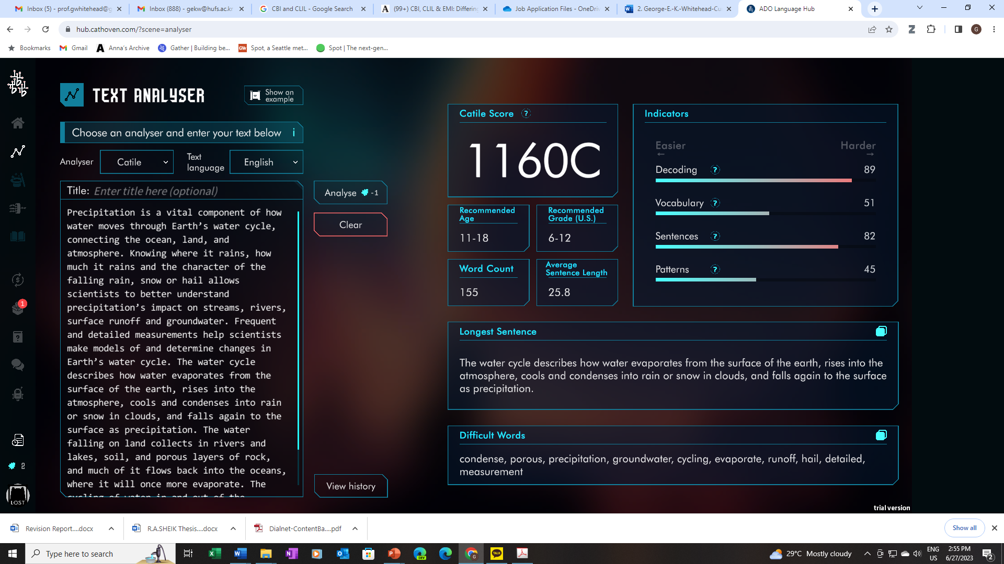
Notes:
https://hub.cathoven.com/?scene=analyser

Slide 27
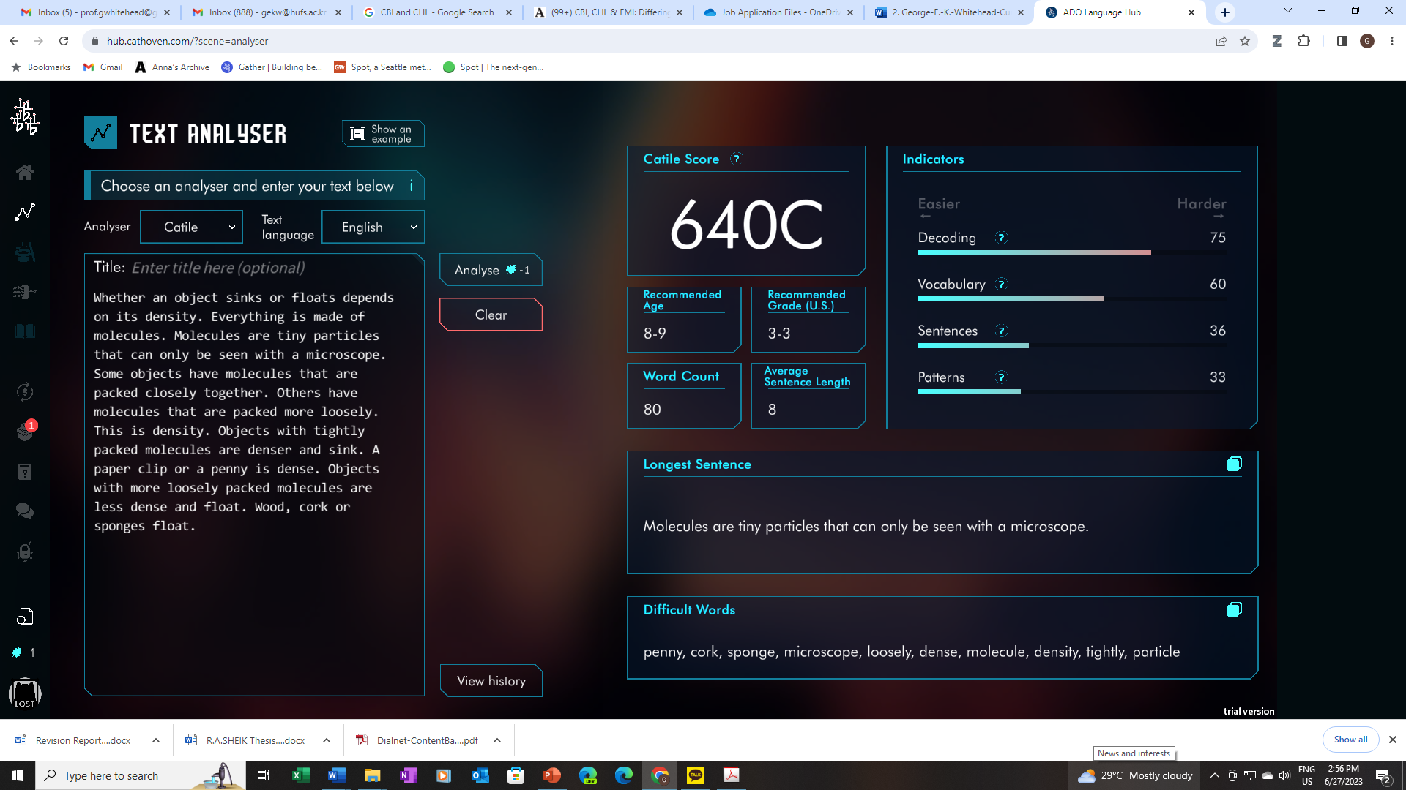

Slide 28
Planning Activities

Slide 29
Readiness Activities
Connecting the content to the learners and preparing them to engage with it

Slide 30
Readiness Activities
Class discussion eliciting students’ experiences in relation to the topic (Have you ever?).
  Teacher writes questions or statements on the board and asks students to discuss what they think.
Teacher shows pictures or video clips and discusses the topic with students in order to connect it to them and their experiences.
KWL – Know, Want to Know, (at the end of the lesson fill out what they learned).
Quiz connected to the topic (to activate/check students’ background knowledge).
Mind mapping – what they know about the topic.
Prediction activities.
  True or false
  What will happen
  Which is correct/ incorrect

Slide 31
Language of Learning required to comprehend the lesson content
Pre-teach language of learning (lexis, lexical chunks, grammar structures).
Check comprehension of language of learning.

Slide 32
Language for Learning helpful for communication during interactive activities
Before interactive activities provide students with language for learning.
  Spoken/ written phrases depending on how students are interacting.
  Go over each phrase, the meaning, when to use it, and model the pronunciation.

Slide 33
Reading & Listening Activities
Comprehension Focus

Slide 34
Reminder
CLIL promotes cognitive or thinking skills which challenge learners.
Engaging in a variety of low and high-order thinking skills can lead to deeper learning and retention of the content.
LOTS → HOTS

Slide 35
Reading/ Listening Activities
Comprehension questions
  General
  Specific
  Factual
  Inferential
  Sequencing
Listen/ Read & Draw
Follow the directions/ instructions.
Ordering (Pictures, paragraphs, words etc.)
Summarize
Translate
Predict and check
Graphic organizers

Slide 36
Use of Graphic Organizers
Comprehension Focus

Slide 37
Notes:
Bouchard, M. (2005). Comprehension Strategies for English Language Learners. New York, NY: Scholastic.
Margaret Bouchard

Slide 38
Speaking Activities
Application & Personalization

Slide 39
Speaking Activity Ideas
Surveying other Ss about their opinions
Interviewing other Ss about their opinions
Discussion about what they learned
Role-play/ Drama in relation to the content they learned
Debate about the topic
Explain to other Ss what they learned (Jigsaw)
Developing a group plan in response to what they learned
Presentation of their thoughts and ideas in relation to what they learned
Speeches in relation to their views on a topic
Teach others what they learned
Make a video practically applying what they learned
Solve a problem together in groups
Create and present an experiment

Slide 40
Writing Activities
Application & Personalization

Slide 41
Writing Activity Ideas
A personal summary of what they learned.
Drafting a letter/ email/ social media post expressing their opinion.
Story/ comic in relation to the content they learned.
A reflective journal entry on their thoughts about what they learned.
Essay
Narrative frames
Poetry

Slide 42
Meaningful-Input Based Approach: Application Tasks

Slide 43
Review
A meaningful-input based approach to CLIL lesson design is when lessons are driven by meaningful written, spoken, or visual input rather than by pre-selected teaching points.

Slide 44
Lesson Planning Preparation
Select suitable meaningful input.
Consider key language needed to comprehend and discuss the content (language of and language for learning).
Consider appropriate communicative activities for students to utilize different L2 skills (R,W,L,S) connected to the content and cognitive skills focused on the development of content (LOTS → HOTS).
Consider how you can connect your lesson to other countries and cultures.

Slide 45
Possible Lesson Flow
Pre
(readiness activities)
During
(cognitive engagement with and comprehension of content)
Post
(personalization & extension)
  Activate background knowledge.
  Personally connect learners to the content to be covered.
  Pre-teach language for learning right before learners engage with the lesson content.
  *remember to teach language for learning prior to activities which are interactive.
  Teacher presents the content to the students.
  Reading/ listening activities to engage with the content (general to specific comprehension focus).
  Students engage in activities in which they are focused on understanding/comprehension of the content (LOTS →HOTS).
  Follow-up whole class discussion to address any problems or questions students have relating to language and/or content.
  Students do an activity/ activities focused on applying what they learned and further personalizes the content that they have engaged with (HOTS). (apply, analyze evaluate, create).

Slide 46
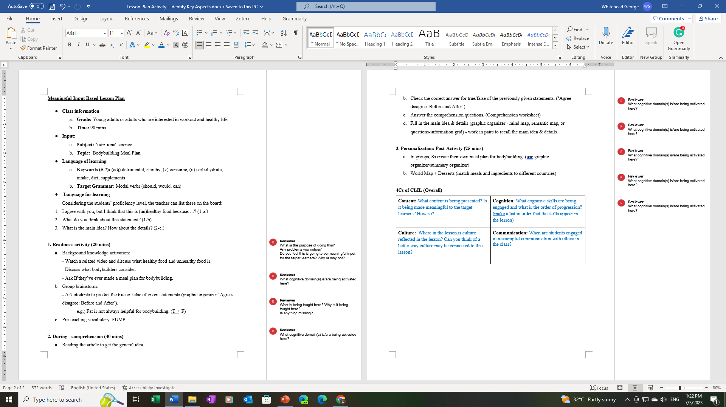
Group Activity

Slide 47
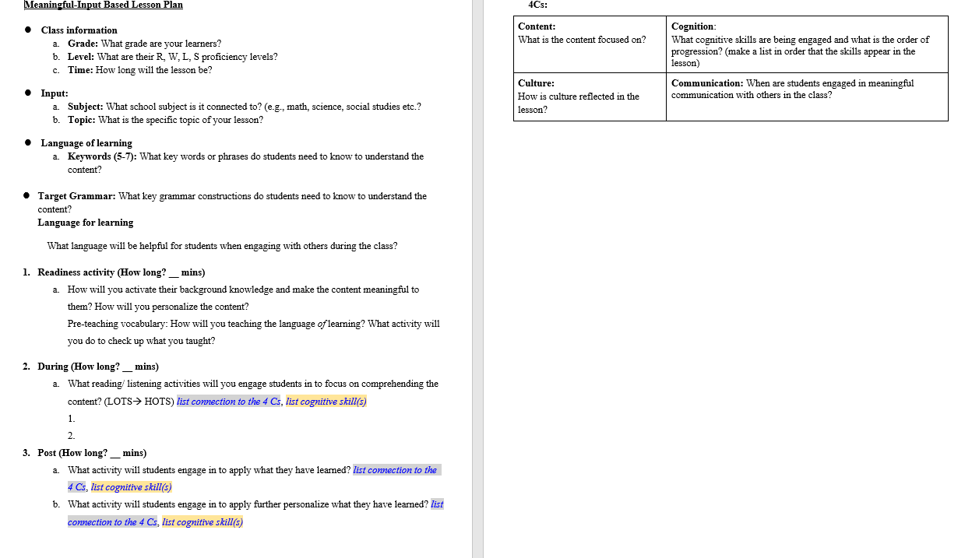
Lesson Plan Guide

Slide 48

Application Task
In your groups, work together to design a meaningful-input based lesson on the topic/content of your choice that would be suitable for you and your learners in your teaching context (you can select a topic that was mentioned in your group discussion at the beginning of the lesson).
Use the sample lesson plan for reference.
Enter the lesson plan into the meaningful-input based lesson plan template.

Slide 49
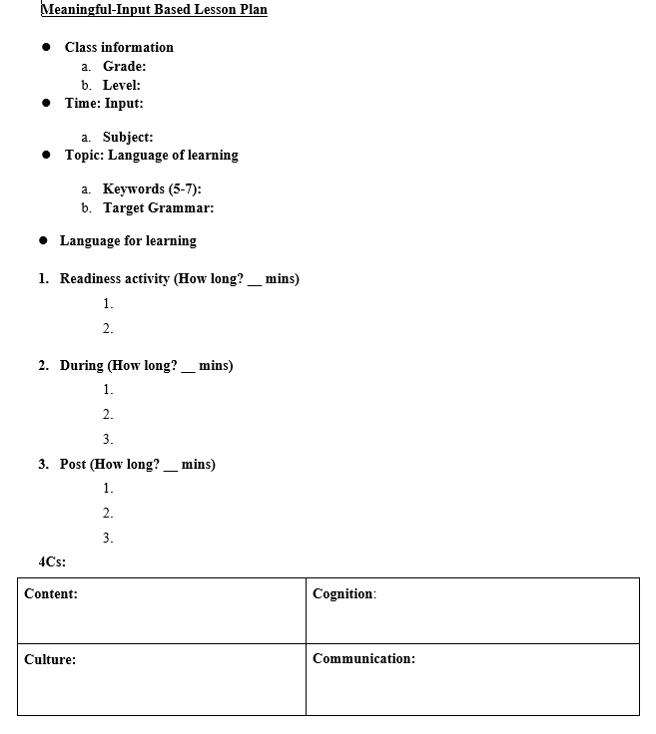
Lesson Plan Template

Slide 50
Readings
Coyle, D., Hood, P., & Marsh, D. (2010). CLIL Content and language integrated learning. Cambridge University Press. Chapter 4
Tomlinson, B. (2003). Developing materials for language teaching . Bloomsbury. Chapter 6
Tomlinson, B. (2018). Text-driven approaches to task-based language teaching. Folio, 18(2), 04-07.

Slide 51
References
Arslan, S., & Whitehead, G. E. (2022). Fostering pre-service teachers’ perceived ability to implement dialogic teaching in Turkey: Examining the contributing factors of an intensive short-term teacher education program from the teacher-learners’ vantage point. Language Teaching Research, 13621688221093755.
Bouchard, M. (2005). Comprehension strategies for English language learners. Scholastic.
Marsh, D. (1994). Bilingual education & content and language integrated learning. In International Association for Cross-cultural Communication (Ed.), Language teaching in the member states of the European Union (lingua). University of Sorbonne.
Rannikmäe, M., Holbrook, J., & Soobard, R. (2020). Social constructivism—Jerome Bruner. In B. Akpan & T. J. Kennedy (Eds.), Science education in theory and practice: An introductory guide to learning theory (pp. 259–275). Springer Nature.
Tomlinson, B. (2003). Developing materials for language teaching . Bloomsbury.
Tomlinson, B. (2013a). Second language acquisition and materials development. In B. Tomlinson (Ed.), Applied linguistics and materials development (pp. 11-29). Bloomsbury.
Ur, P. (1981). Discussions that work: Task-centred fluency practice. Cambridge University Press.
Ur, P. (1984). Teaching listening comprehension. Cambridge University Press.

Slide 52
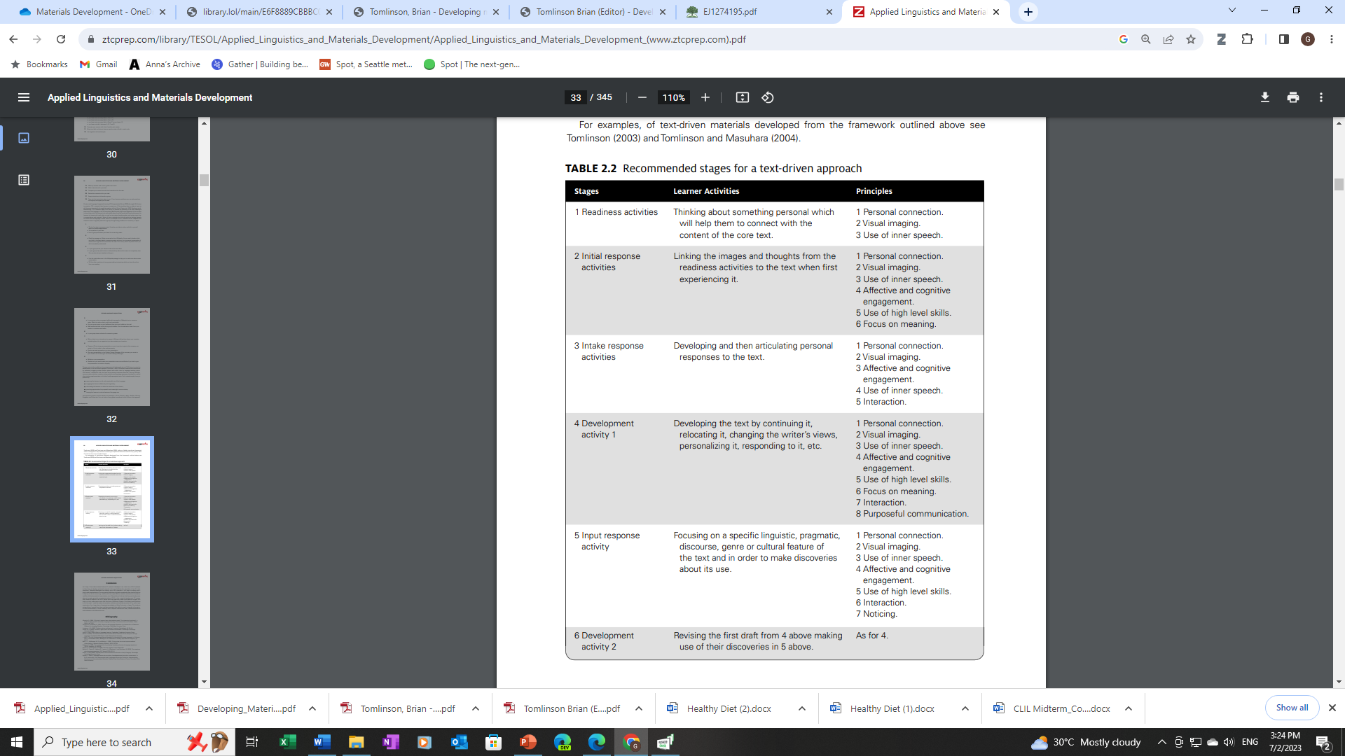
Stages/ Activities/ Principles
(Tomlinson, 2013)

