Slide 1
Academic Profiles
Creating and Managing

Slide 2
Have you heard of these?
Academia.edu
Researchgate.net
Google scholar profile

Slide 3
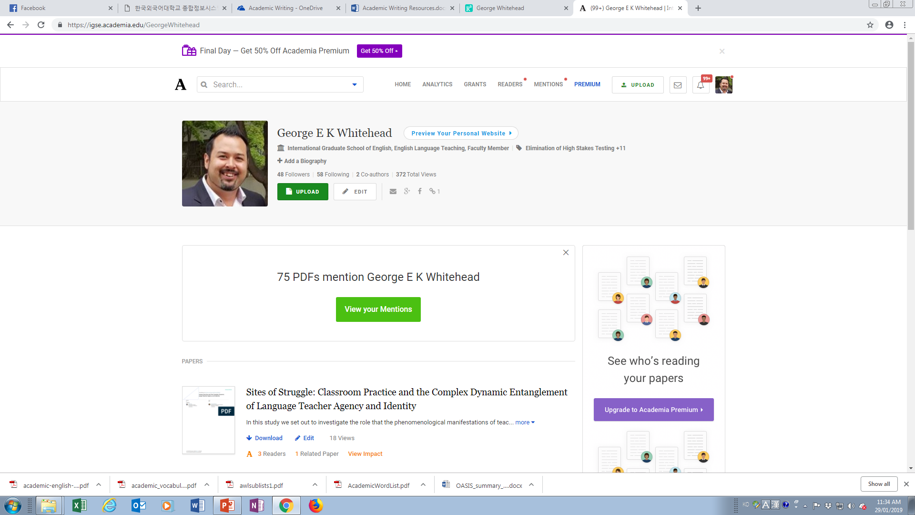
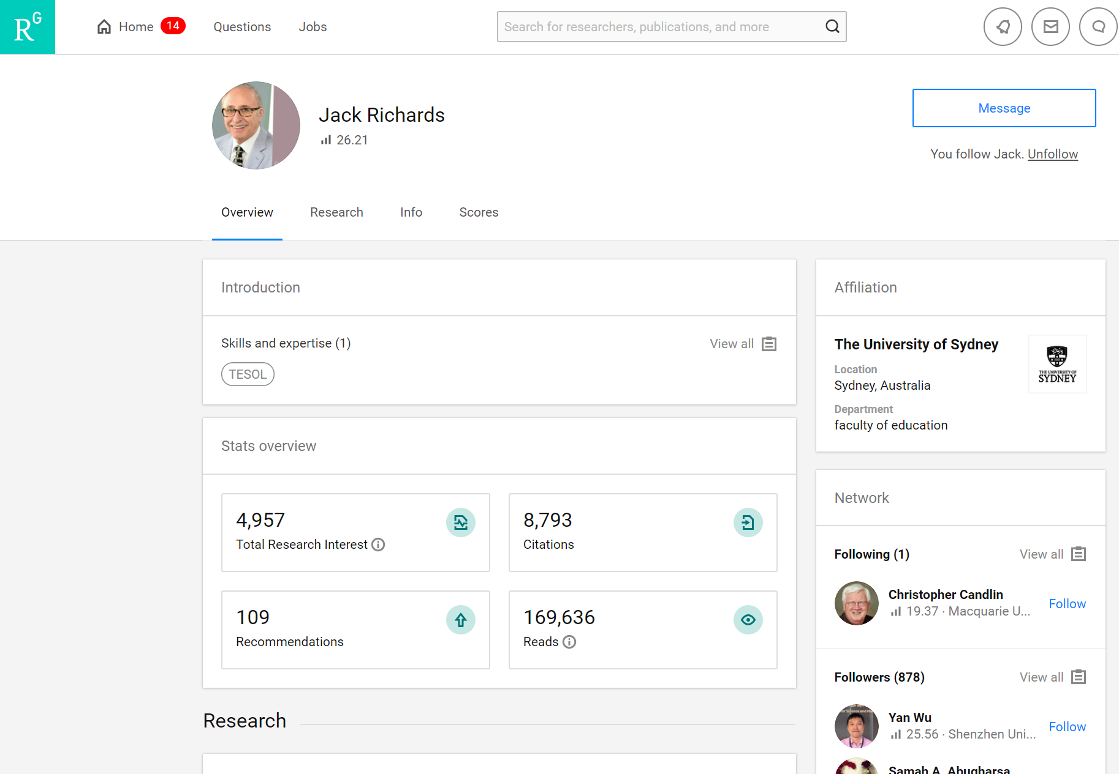
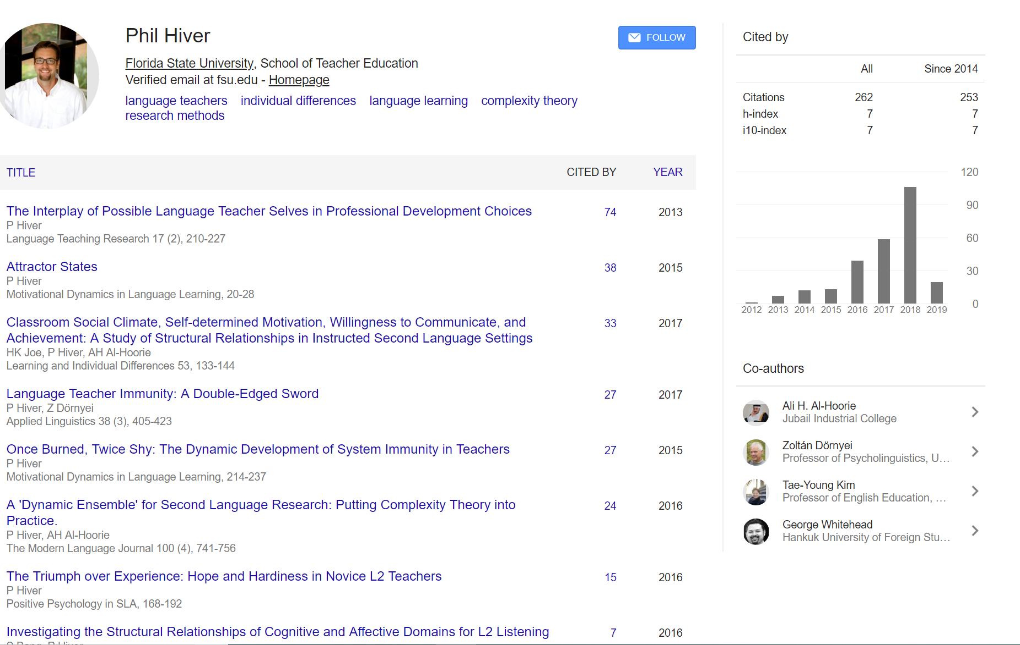
Academic Profiles

Slide 4
Brainstorming
What are the benefits of having an academic profile?

Slide 5
TIPS: Finding and Contacting Authors
Academia.edu
Researchgate.net
Google scholar profile

Slide 6
Suggestion
Create an academic profile on Researchgate, Academia, or both

