Slide 1
Academic Profiles
Creating and Managing

Slide 2
Have you heard of these?
Academia.edu
Researchgate.net
Google scholar profile

Slide 3
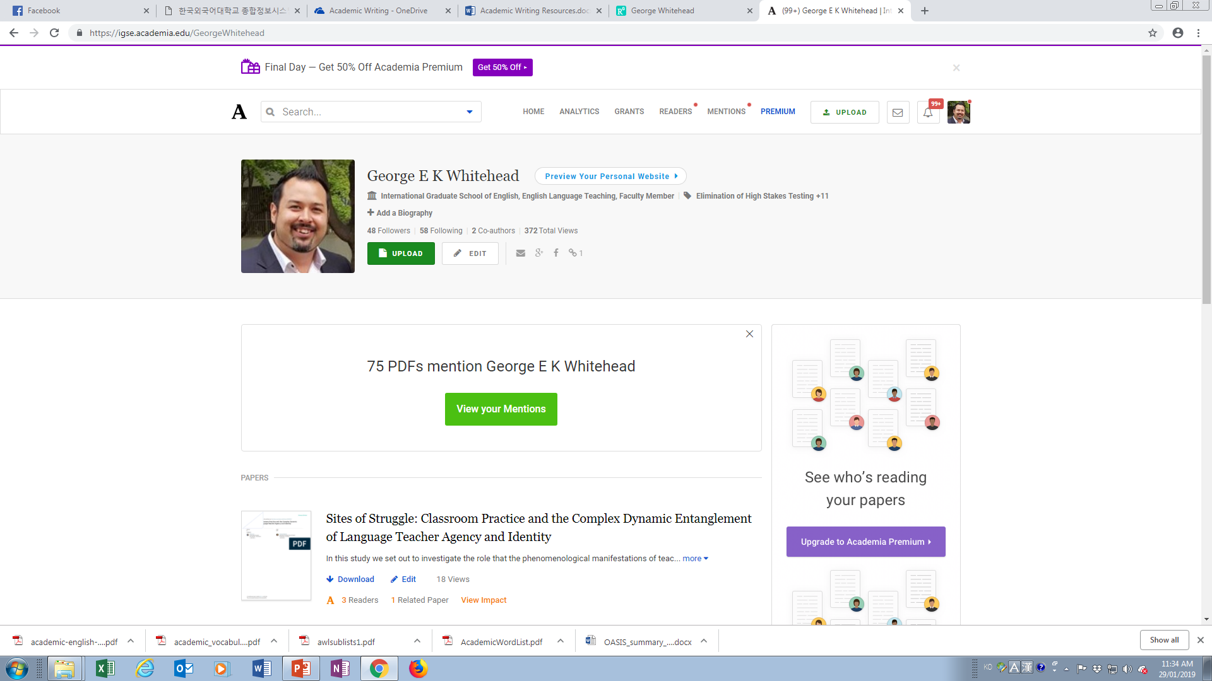
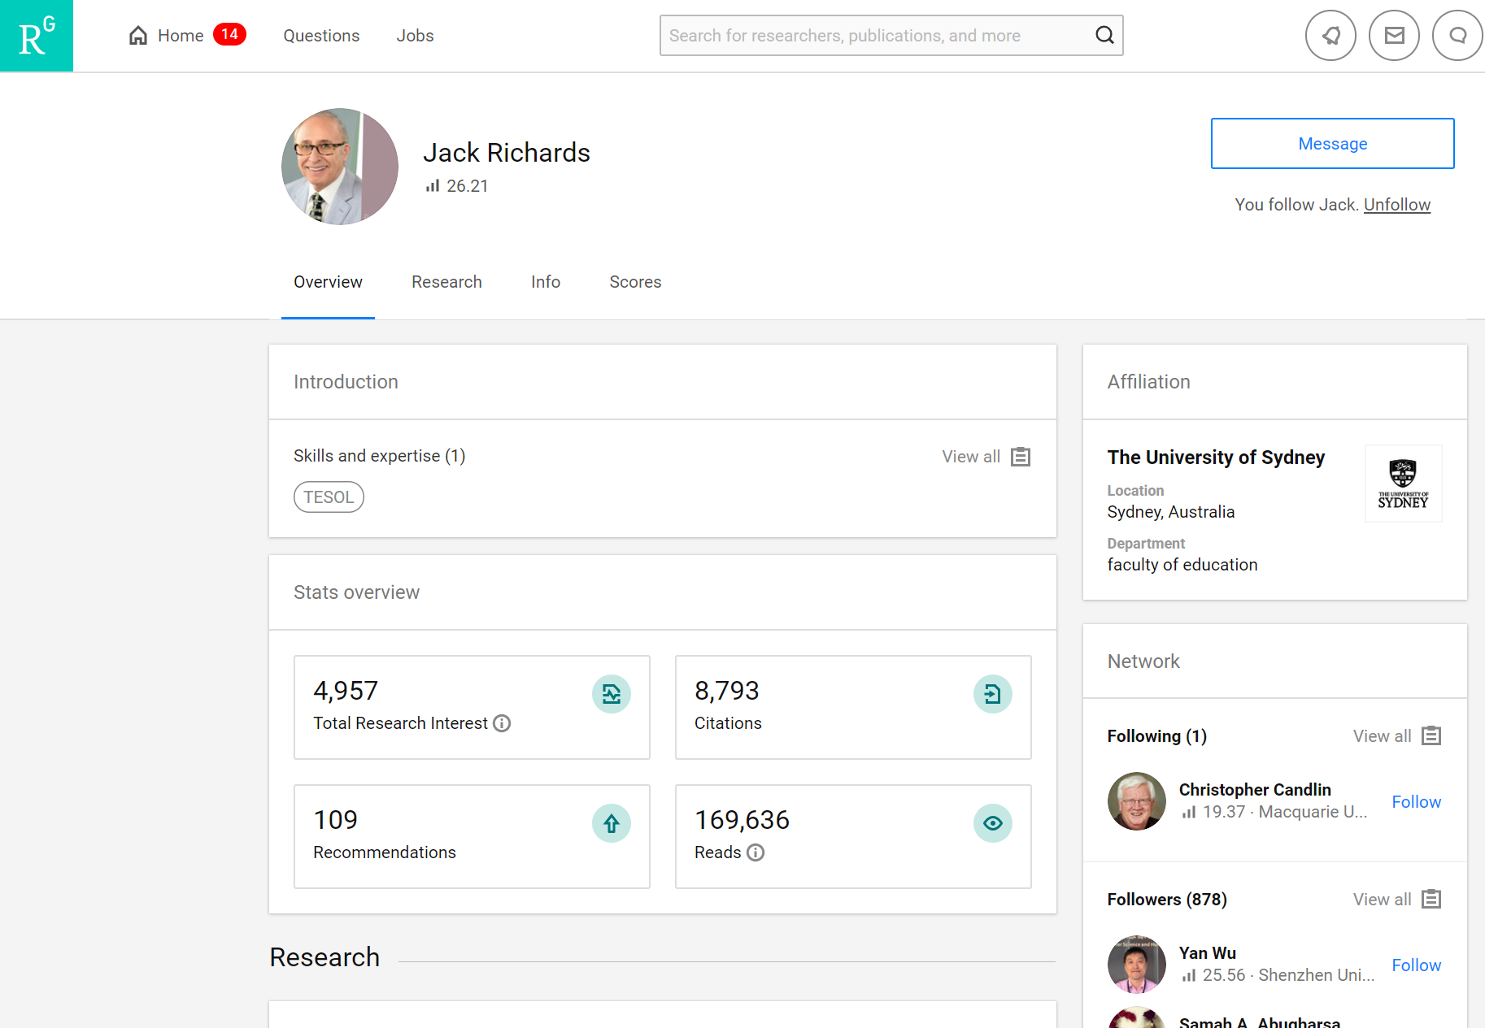
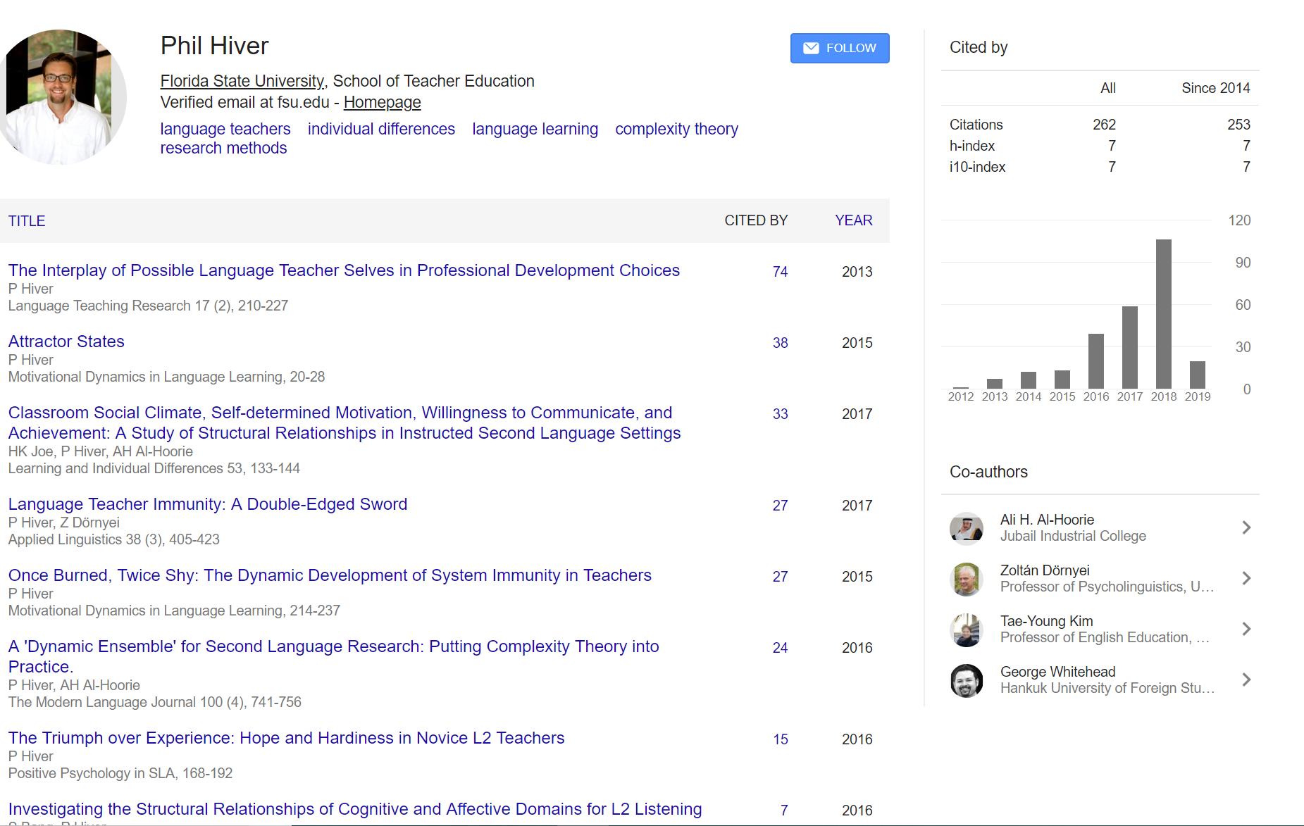
Academic Profiles

Slide 4
Brainstorming
What are the benefits of having an academic profile?

Slide 5
TIPS: Finding and Contacting Authors
Academia.edu
Researchgate.net
Google scholar profile

Slide 6
Suggestion
Create an academic profile on Researchgate, Academia, or both

Slide 7
Personal website
Creating & Managing for Academic Purposes

Slide 8
Personal Websites
www.sdkrashen.com/
www.finchpark.com/
http://www.scottthornbury.com/

Slide 9
Thinking…
What are the benefits of having a professional website?

Slide 10
What we are going to do today
Visit some sample sites
Sign-up and sign-in
Select a theme and layout that suits your tastes and needs
Learn how to create and maintain pages
Learn how to add and delete files, videos, pictures etc.
Learn how to add and use a blog page

Slide 11
Sample sites
http://suwonunivenglishian.weebly.com/
http://philhiver.com
http://profgwhitehead.weebly.com

Slide 12
Key points to a good website
Make sure it attractive to visitors
Make it look clean & Keep it that way
Keep a consistent layout
Use pictures to make it visually appealing
Choose a nice, easy to read font
Use color (but not too much)
Interesting/ useful content
Make sure it is user friendly
Easy for visitors to navigate and find what they are looking for
Make sure the content you are presenting is accurate
Spelling and grammar
Lesson content
Additional content

Slide 13
Important!
Also consider your own privacy
Do not post things that you do not wish to be shared
There are a lot of people out there who may steal things from your site if you let them
Be very careful of personal information

Slide 14
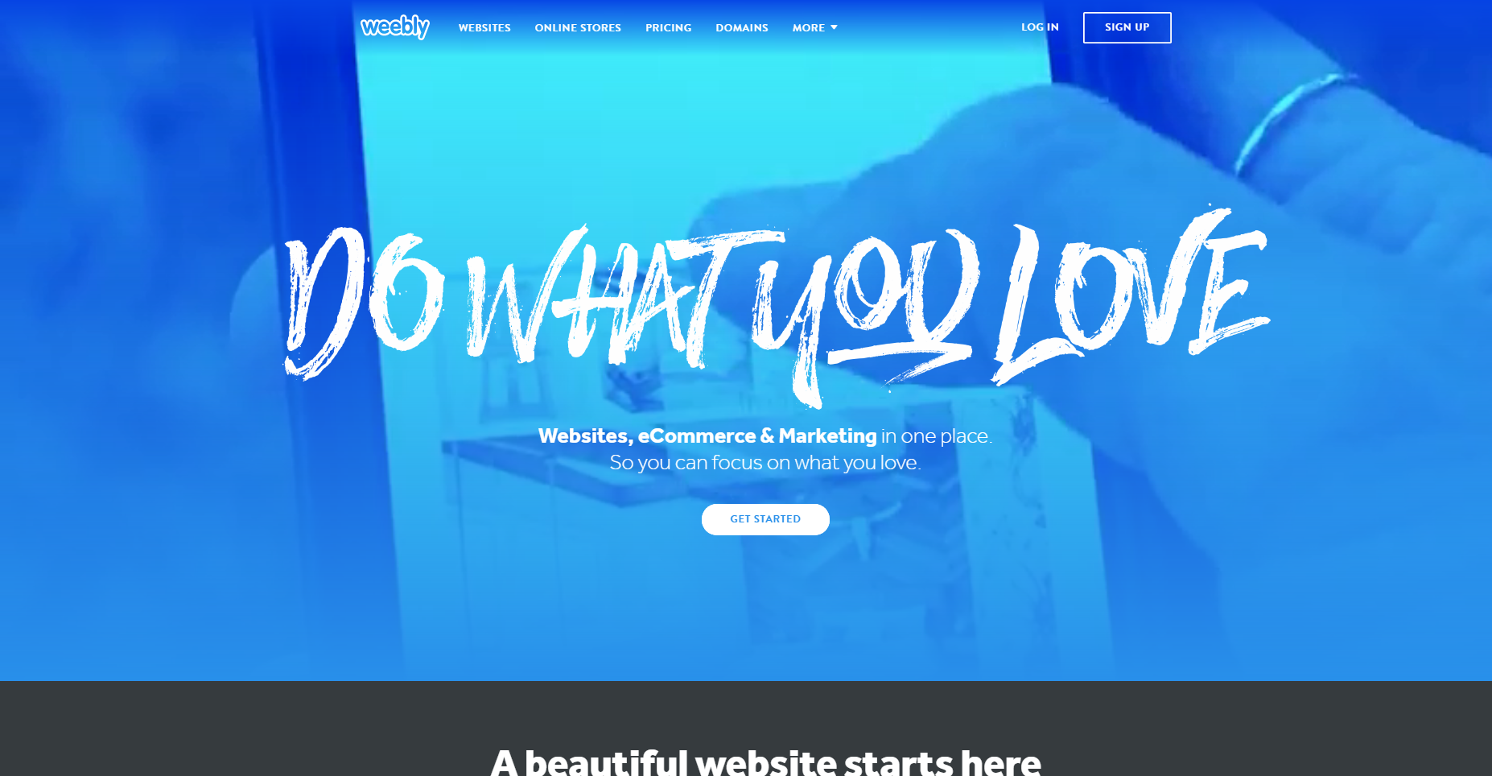
www.weebly.com

Slide 15
Today’s Task
Create a new page
Call it practice
Add a youtube video of your choice
Add a file of your choice
Add an image
Add a title and text box with content of your choice
Add a button that links to hufs.ac.kr
Create a Blog page
Enter 1 blog post
Add an image
Add some text
Share your site
Browse others sites

