Slide 1
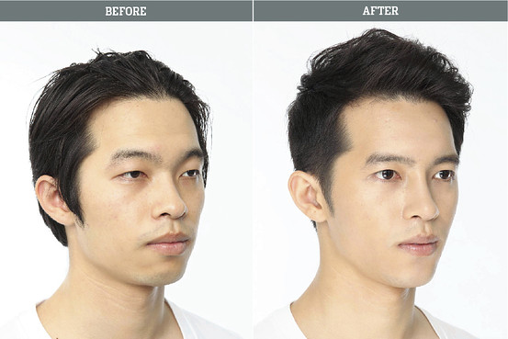
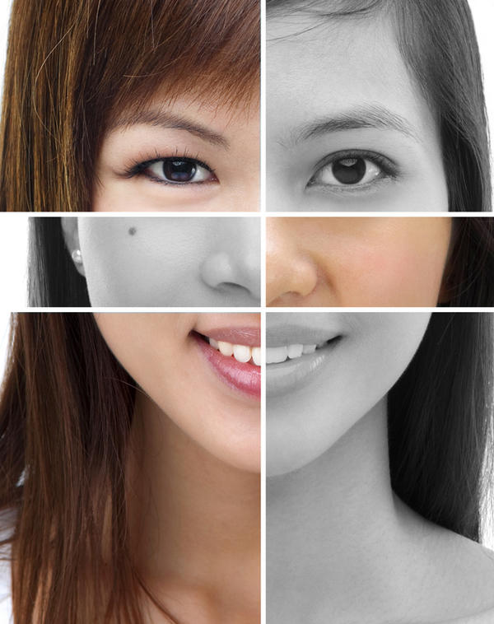
Cosmetic Surgery
Is it worth it?

Slide 2
Getting Ready
What is cosmetic surgery?
Do you know the difference between cosmetic surgery and plastic surgery?

Slide 3
The Differences
Cosmetic Surgery: a type of plastic surgery specifically focused on enhancing appearance

Slide 4
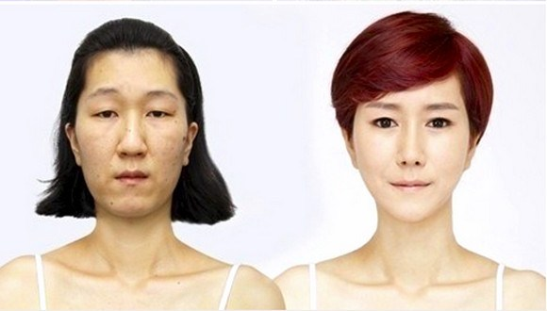
Cosmetic Surgery
What are some of the most common cosmetic surgery procedures in your country?

Slide 5
Question
How important are your looks to you?
How important are the looks of others to you?

Slide 6
Survey
Talk with your group
Think of 5 questions about cosmetic surgery that you want to ask your classmates
Write them down in the empty boxes

Slide 7
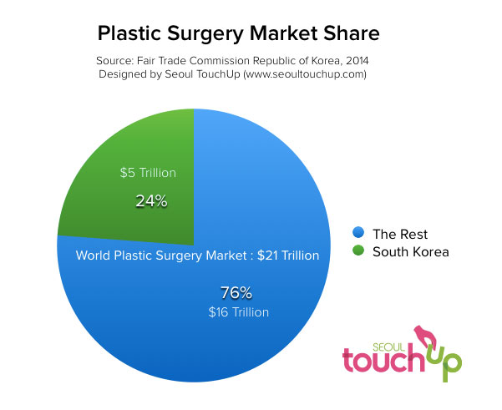
Fun Facts
https://www.seoultouchup.com/korean-plastic-surgery-statistics/

Slide 8
Human Form

Slide 9
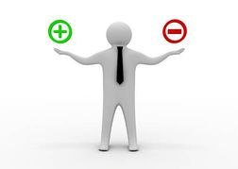
Class Discussion
With your group make a list of the Pros and Cons of cosmetic surgery.

Slide 10
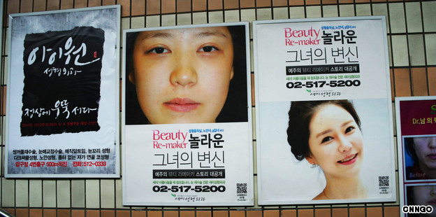
Ayu’s Situation

Slide 11
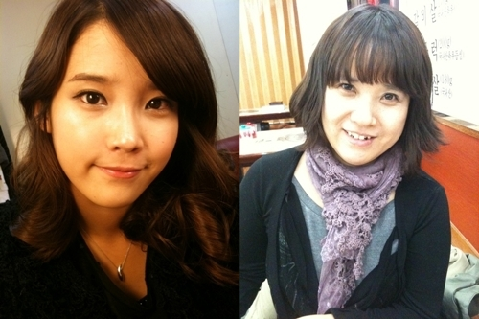
Listen to Ayu ‘s Situation…
While listening keep in mind the questions on page 11.
What type of surgery does she want?
Why?
What is her mother’s idea of beauty? Is Ayu’s the same?
How will she pay for it?
What does she think about her mom’s advice?

Slide 12
Your Opinions
How would you feel if your future children want cosmetic surgery?
What if you have a lot of cosmetic surgery and then have children?

Slide 13
Consider the statements
Page 12
Activity A
Agree/ Disagree/ Depends

Slide 14
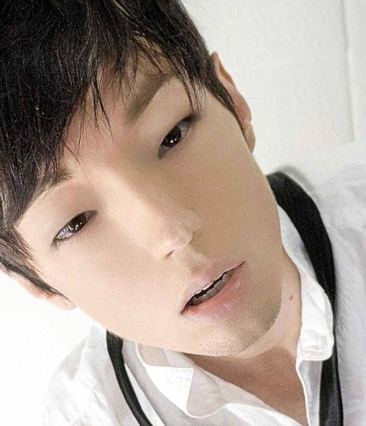
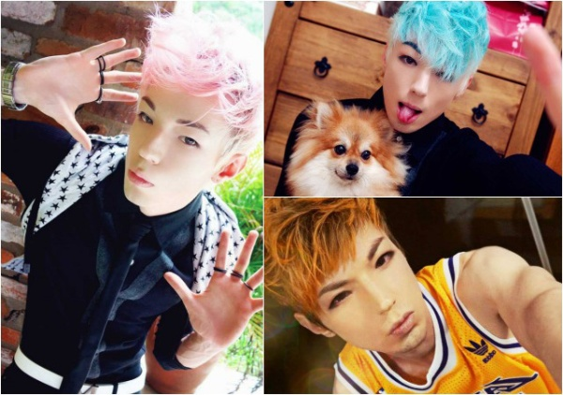
What do these pictures have in common?

Slide 15
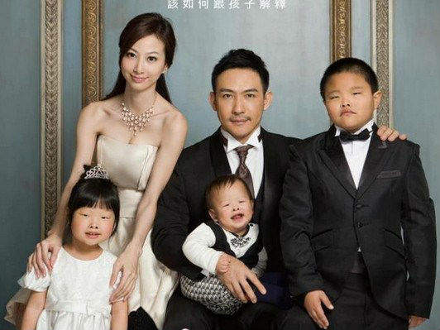
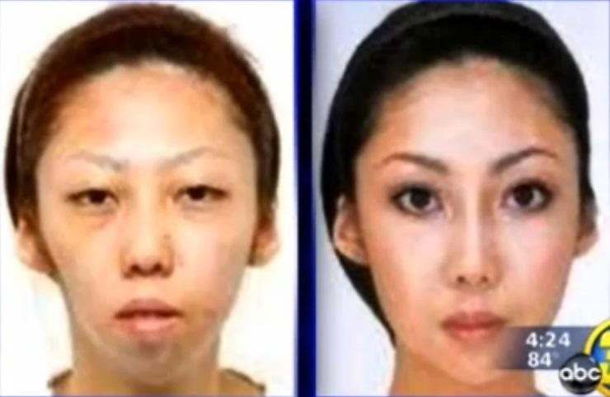
A famous internet story…

Slide 16
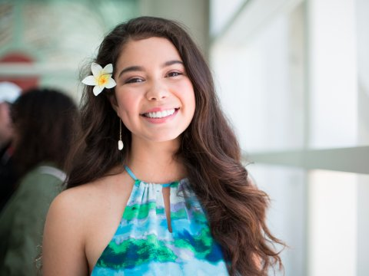
Cosmetic Surgery Role Play
Choose a famous person
Decide what kind of cosmetic surgery you want
Get advice
From a friend
From a cosmetic surgeon
From a parent

Slide 17
Language
I want to ______.
get double eyelid surgery
get liposuction
a higher nose
make my ____ smaller/bigger/longer/shorter
Why do you want to ________?
You should consider the positive and negative consequences.
For example…
What if you regret doing it?
What if you look worse?
It is dangerous?

Slide 18
Check-up
What are your opinions about plastic surgery?
Are you for it? Against it? Mixed opinions?
Why?

Slide 19
Thinking further
What is your definition of beauty?
Do you think that physical beauty is important for your whole life?
Why/ why not?
How would you order the following in order of importance for you? Why?
Physical beauty
Beautiful personality
Smart
Popular
Successful

