Slide 1
Compelling or NOT?

Slide 2
Compelling Input
Krashen, 2011

Slide 6
How can we make boring textbook content compelling?
30% is the content
70% is how the content is delivered

Slide 7
Activities in textbooks are dead.
As English teachers, it is our job
to bring the textbook to life!!
Your Microteaching Instructors (sometime not long ago..)

Slide 8
Think like a student!!
The first step to compelling input is to make the content
relevant, relatable and interesting to students

Slide 9
Content Think in the mind our your students! Use examples that are currently interesting in Korea! Think glocalization!
Try to link content, examples and activities to your students interests.
Think about their age think about what is popular right now!
Make the content relevant to their life experience
Ask your students what they like, cater your lessons to them

Slide 10
EXAMPLES

Slide 11
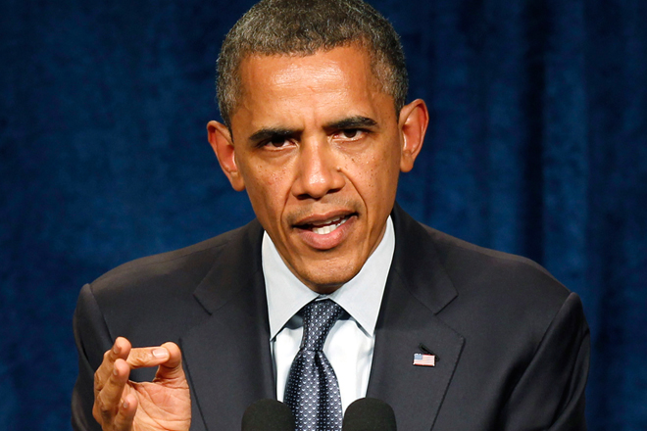

Slide 12
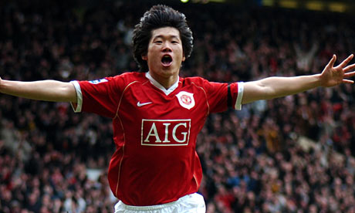

Slide 14
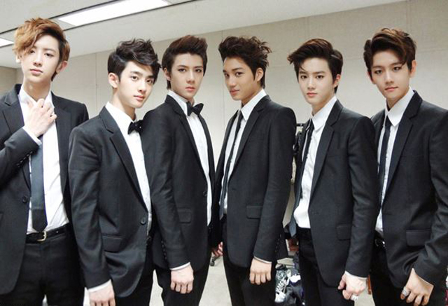

Slide 15
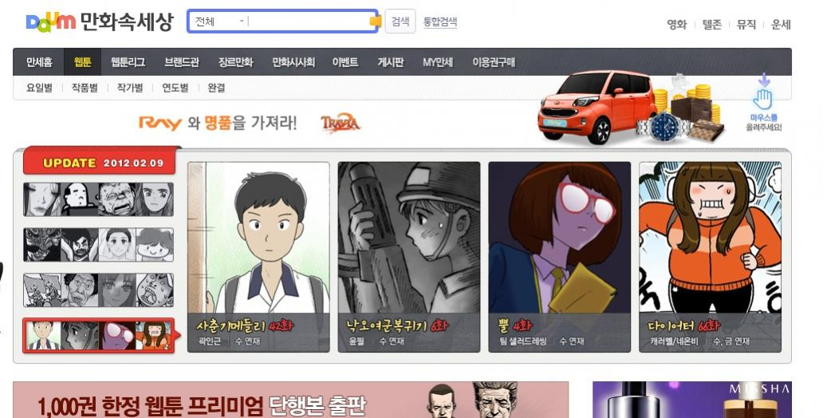

Slide 17
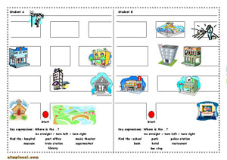

Slide 18
A lesson is like a story… If you create a good storyline/ context it can make the lesson more compelling!
Ex. Yesterday night George’s wallet was stolen from his room! All of his credit cards, I.D. and money were in it! We must help George find out who stole his wallet!
You are now detectives and must help the police find the thief. You must go to the bank, hospital, pc room to get clues!

Slide 19
DELIVERY

Slide 20
Delivery 70% of good teaching is the delivery
Use interesting examples and visuals
Use your personal strengths ☺
(humor, cuteness, beauty, etc. )
Make it easy to understand
Teacher talk
Using visuals to support lesson
Make it fun and enjoyable!
Be a role model

Slide 21
DELIVERY

Slide 22
Application

Slide 23
Start Compelling Lessons by…
Shock (unusual fact, strange examples)
Fishing
Confusion and uncertainty
Presenting a situation or problem
Making students want to find a solution or answer
Being a role model ☺

Slide 24
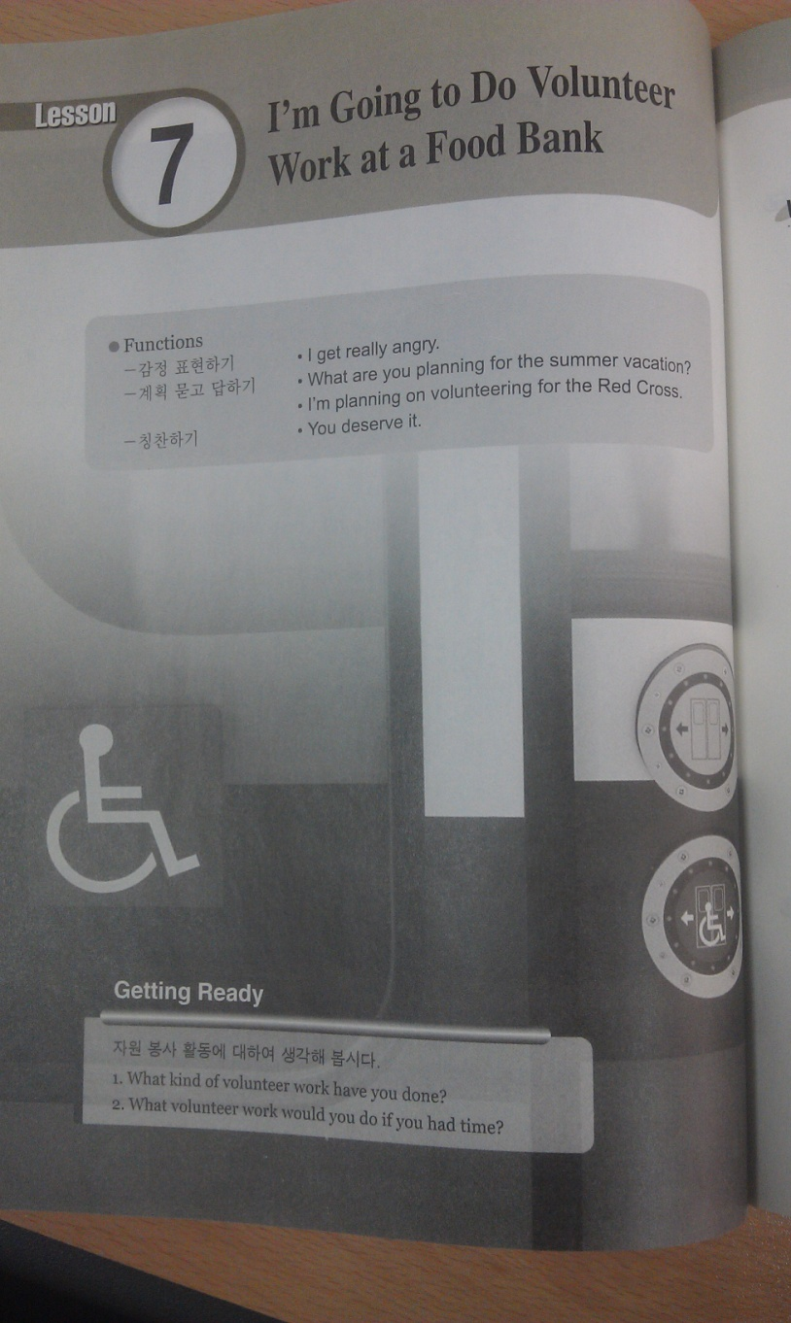
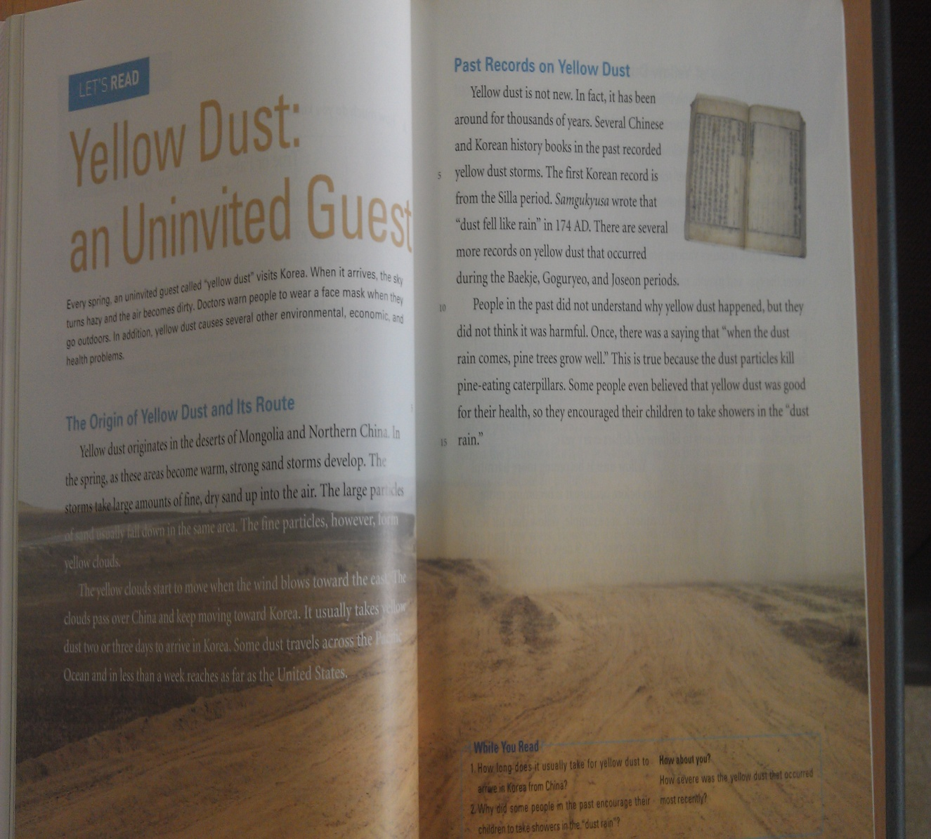
How would you make these compelling?

Slide 25
