Slide 1
Creative Writing
comics, storybooks, brochures, posters, and more!

Slide 2
Comic/ Storyboard
https://www.makebeliefscomix.com/Comix/
https://www.storyboardthat.com/

Slide 3
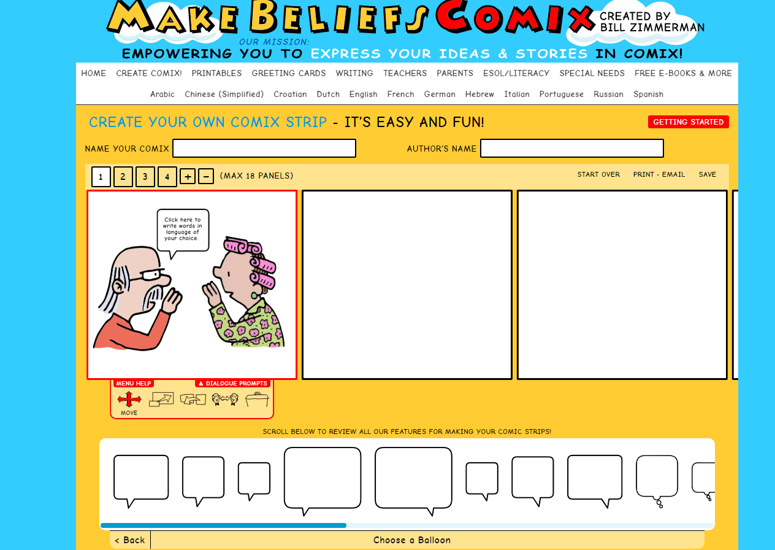
Making a quick comic strip

Slide 4
A more advanced website

Slide 5
Your Task
Play around with the two sites I introduced.
Create 2 comics / storyboards of 3 or more slides.
Try to relate the content to real English lessons you would teach.

Slide 6
What activities can you do with these comics?
Ordering activities
Read and order
Prediction
Guess the order of the story
Guess what they are saying
Create their own story
Create their own dialogue
Role-play
Create an ending/ alternate ending/ extension of the story
Information gap
Picture dictation
What they are saying vs. what they are thinking
Grammar ( what is he/she doing? Where is the X? What can she/he do?

Slide 7
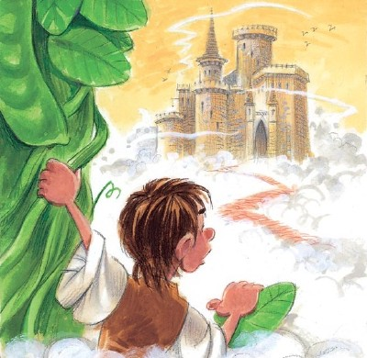
Storytelling

Slide 8
Write a short story
mystorybook.com
storyjumper.com

Slide 9
Your Tasks
Create 2 short stories ( 5 pages each)
Or 1 Long story 8-10 pages

Slide 10
Sharing your work
You will share the story you wrote in a small group of your choice. Your job is to read aloud the story to your group of peers.

