Slide 1
Course Introduction

Slide 2
Course Overview
You will be introduced to the background and key features of CLIL while being pushed to critically reflect on the practicality of implementation in your teaching context.
In this section of the course, you will be engaged in informative lectures, class discussions, activities, and practical application tasks to help you build the base knowledge and skills to utilize CLIL in your teaching.
You will experience CLIL from both the learner’s perspective as well as the teacher’s perspective to provide you with real-life experiences with the teaching approach from different vantage points.

Slide 3
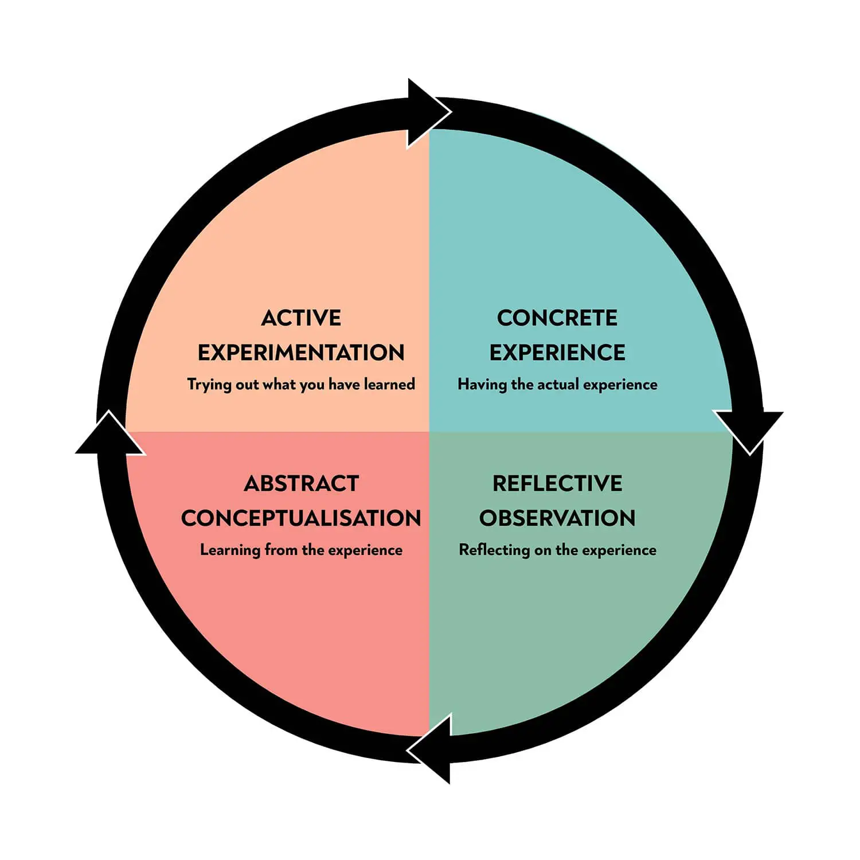
“Learning is the process whereby knowledge is created through the transformation of experience” (Kolb, 1984, p. 38).
Arslan, S., & Whitehead, G. E. (2022). Fostering pre-service teachers’ perceived ability to implement dialogic teaching in Turkey: Examining the contributing factors of an intensive short-term teacher education program from the teacher-learners’ vantage point. Language Teaching Research, 13621688221093755.

Slide 4
Course Aims
This course is designed to help you:
Become familiar with the key principles of CLIL and what it looks like in action.
Become comfortable and confident planning a CLIL lesson and materials.
Develop your ability to implement CLIL lessons In your classroom.

Slide 5
Part 2 – CLIL

Slide 6
Course Readings & Supplementary Materials
A reading list has been uploaded to my website to supplement what you are learning in class. It is your job to complete the readings for a deeper understanding.
I have also posted various supplementary videos to assist your understanding. It is up to you to watch them if you feel you require further clarification of concepts covered in class.
Respecting your individual differences, it is my policy that if you require more readings or content out of personal interest or to support your deeper understanding it is your job to come and ask me.

Slide 7
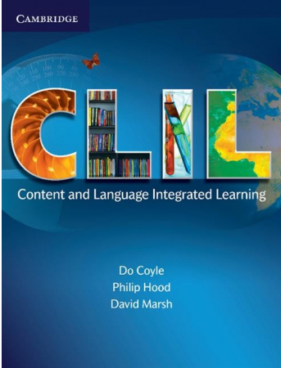
Course Readings
The readings for this course are drawn from the following books:

Slide 8
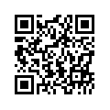
Contact
Website: profgwhitehead.weebly.com
Email: g.whitehead@ubc.ca

