Slide 1
Breaking the Law

Slide 2
Group Thinking
Think of as many crimes as you can in the next 5 minutes.
Crime = anything that you would consider breaking the law.

Slide 3
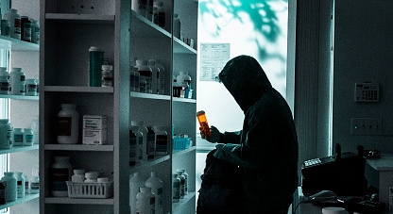
Description
Make a description of a person and the crime that they have committed.
Lee Jihoon
24 years old
Works at GS 25
Did not graduate high-school
Lives with his mother and father
His mother and father have been very sick for many years
He was caught stealing medicine for his sick parents from a pharmacy.

Slide 4
Punishment
What punishment would you give them?

