Slide 1
Getting Started
Basic principles: Students, teacher, classroom environment
Notes:
NOTE:
To change the image on this slide, select the picture and delete it. Then click the Pictures icon in the placeholder to insert your own image.

Slide 2
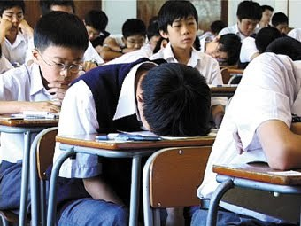
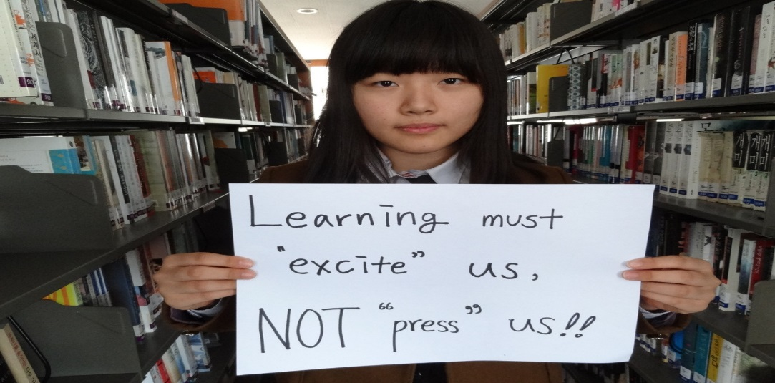
The students and Teacher

Slide 3
Your thoughts…
Is it good to compare students work when grading them?
Should students all be expected to produce the same quality of work?
Why or why not?
Do all students progress at the same rate?
Do all students develop in the same way?

Slide 4
Thinking task
With your group come up with a list of at least five statements that you believe are true about a good language learner.
Notes:
Willing to communicate, not afraid to make mistakes, confidence
Motivation – self motivation, willingness to learn
Diligent
Autonomous – self directed
Curiosity
Aptitude – natural abilities
Language learners know their own proficiency
Young learners whose age is 7-9, who go abroad to learn English as a second language context
Knows their intelligences or learning style

Slide 5
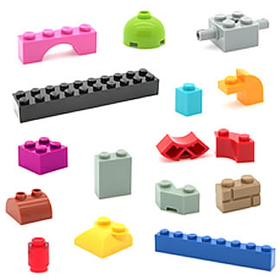
The students
Think about a language learning classroom that you teach or have been part of.
Generally speaking, did your teacher treat the class ( or do you treat your students )as 1 group as a whole, or as a class made up of individual students?

Slide 6
Which one do you think is better? Why?

Slide 7
Think about the following situation
Two or more English learners at the same proficiency level are attending the same English class, having the same instructors and materials, doing the same activities and exercises, proceeding for the same duration of course program.
At the end of the program, these learners undergo an English competency assessment. But they achieve different level of competence.

Slide 8
Thinking time… Same class, different result
Why is it that all students in a class take the same lesson, but do not learn exactly the same thing?
Why may one learner be more successful at something and not another?
What factors may have affected the results of their learning?

Slide 9
Individual differences
In the field of SLA it is acknowledged that individual differences exist in L2 acquisition.

Slide 10
Thinking time…
What kind of individual differences can you think of that may affect students’ learning and development?

Slide 11
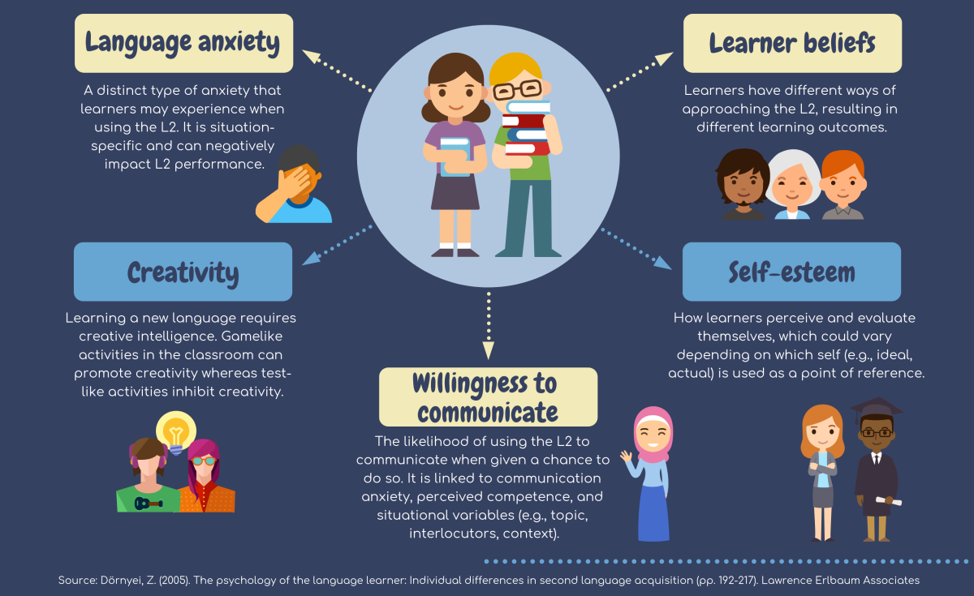

Slide 12
Individual differences in second language learning
Intelligence
Aptitude ( ability to learn/ perform different skills)
Individual learning techniques and preferences (*caution: learning styles)
Personality (emotion, empathy, confidence, introvert/extrovert etc.)
Motivation
Attitude
Age (Critical period? Periods?)
Social factors
Notes:
Lethaby, C. and Harries, P. (2016). ‘Learning styles and teacher training: are we perpetuating neuromyths’? ELT Journal. 70/1. 16-27.
https://www.youtube.com/watch?v=4bfMXKGhcSQ
Derived from biology, the cp concept was famously introduced into the field of language acquisition by Penfield and Roberts in 1959 [1] and was refined by Lenneberg eight years later [2]. Lenneberg argued that language acquisition needed to take place between age two and puberty – a period which he believed to coincide with the lateralisation process of the brain. (More recent neurological research suggests that different time frames exist for the lateralisation process of different language functions. Most, however, close before puberty [3].) However, Lenneberg mostly drew on findings pertaining to first language development in deaf children, feral children or children with serious cognitive impairments in order to back up his claims. For him, the critical period concept was concerned with the implicit “automatic acquisition” [2, p. 176] in immersion contexts and does not preclude the possibility of learning a foreign language after puberty, albeit with much conscious effort and typically less success.
https://www.ncbi.nlm.nih.gov/pmc/articles/PMC3723803/#:~:text=In%20second%20language%20acquisition%20research,language%20input%20is%20non%2Dlinear.

Slide 13
Individual differences
It is important for a teacher to be aware of and sensitive to learners’ individual differences.
Learning is most effective when a teacher takes into account learners’ differences.
A teacher’s challenge is to acknowledge and celebrate the differences among learners and work to maximize the growth in each learner.

Slide 14
What it means for you
As a teacher, get to know your students.
Understand their individual differences as much as possible.
Whenever possible take these into consideration in your teaching and interaction practices.
Remember the teaching and learning relationship is non-linear. Just because you teach it does not mean students will learn it and students may learn things from your lessons that you did not expect.

Slide 15
Overall, remember this…

Slide 16
Also remember teachers also have individual differences
There is no recipe that works for every teacher
Different teachers have different strengths and weaknesses
Being a great teacher requires great understanding of yourself
Develop what works best for you rather than copying what other people do

Slide 17
Reflection
Think about what we have discussed so far regarding students’ individual differences.
What are some of the key points you have learned?
How can what you learned be applied in your own teaching?
What obstacles stand in your way?
How might you overcome such obstacles?

Slide 18
The environment

Slide 19
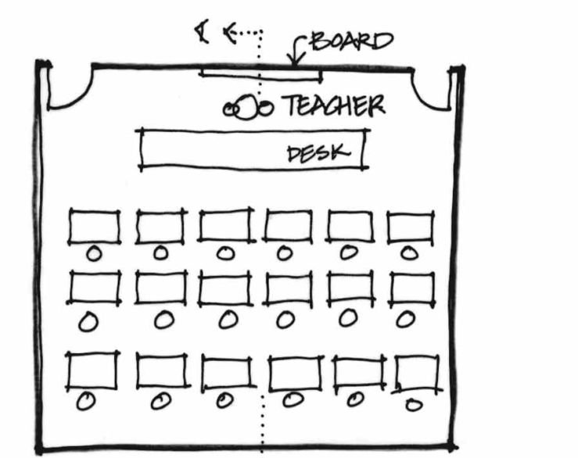
Creating and environment supportive of language learning
Take a moment and draw a picture of a language classroom that you feel is supportive of language learning. Think of desk arrangement. Where the whiteboard or other classroom tools are located (e.g., screen, TV, shelves). Also, identify where the teacher is located.

Slide 20
Compare and Discuss
Compare and discuss your pictures
Explain the different aspects of a supportive learning environment that you have included in your drawing. Why is this setup good for language learning? Are there any drawbacks to this arrangement?
After comparing, make a list of key things that your group feels are crucial in setting up and running a supportive language learning environment.

Slide 21
The importance of a positive learning environment
Classroom environment is one of the most important factors affecting student learning.
Simply put, students learn better when they view the learning environment as positive and supportive (Dorman, Aldridge, & Fraser, 2006).
A positive environment is one in which students feel a sense of belonging, trust others, and feel encouraged to tackle challenges, take risks, and ask questions (Sheffler, 2009)
Related to Krashen’s (1987) ‘Affective Filter Hypothesis
Notes:
The Affective Filter hypothesis embodies Krashen's view that a number of 'affective variables' play a facilitative, but non-causal, role in second language acquisition. These variables include: motivation, self-confidence, anxiety and personality traits. Krashen claims that learners with high motivation, self-confidence, a good self-image, a low level of anxiety and extroversion are better equipped for success in second language acquisition. Low motivation, low self-esteem, anxiety, introversion and inhibition can raise the affective filter and form a 'mental block' that prevents comprehensible input from being used for acquisition. In other words, when the filter is 'up' it impedes language acquisition. On the other hand, positive affect is necessary, but not sufficient on its own, for acquisition to take place.

Slide 22
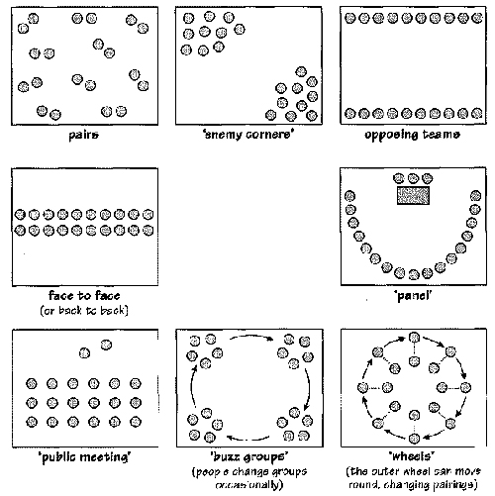
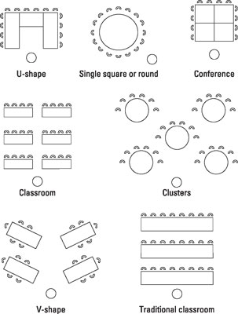
Which of these classroom arrangements are the most supportive of language learning? Worst? Why?
A
B
C
D
E
F

Slide 23
Dynamic Arrangements to Fit the Needs/ Aims of the Class

Slide 24
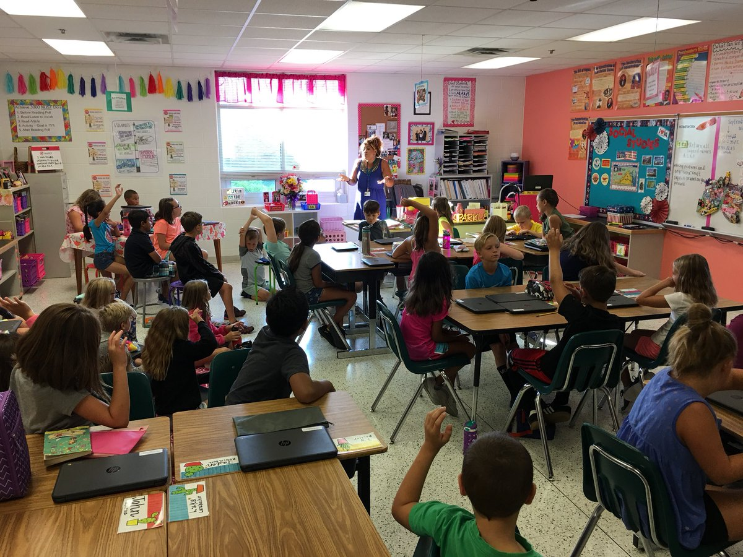

Slide 25
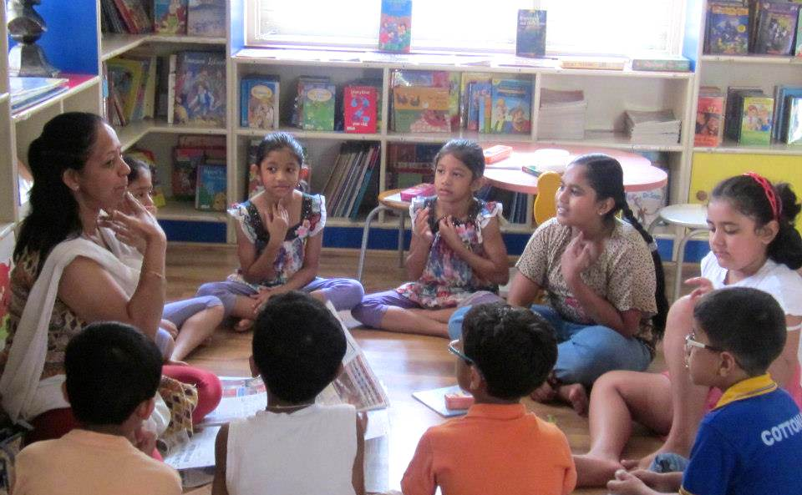

Slide 26
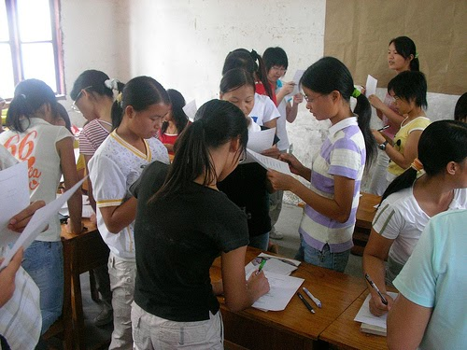

Slide 27
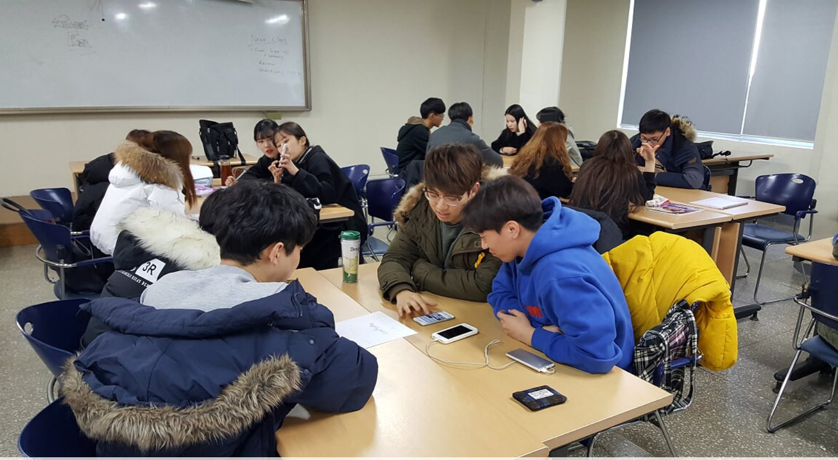

Slide 28
Key points
Positive low-stakes environment (lower affective filter)
Flexes with the needs of the lesson and learners
Multiple arrangements can be used within a single class
It is not only the arrangement but the teacher's attitude that affects how comfortable students feel in the classroom
Just because the environment is comfortable doesn’t mean the students shouldn’t work hard (actually the opposite)

Slide 29
Reflection
Think about what we have discussed so far regarding the language learning environment/ classroom?
What are some of the key points you have learned?
How can what you learned be applied in your own teaching? How can you improve the teaching environment you provide to your students?
What obstacles stand in your way?
How might you overcome such obstacles?

Slide 30
The language teacher

Slide 31
What are your natural characteristics?
Write down your most positive traits/characteristics
How would you describe your personality?

Slide 32
Good and Bad language teachers
Describe a good language teacher. What characteristics and skills should they have?
Describe a bad language teacher. How would you describe them?

Slide 33
Also remember teachers also have individual differences
There is no recipe that works for every teacher
Different teachers have different strengths and weaknesses
Being a great teacher requires great understanding of yourself
Develop what works best for you rather than copying what other people do

Slide 34
The language teacher
What is the job of a language teacher? What is their purpose?

Slide 35
The job of a language teacher
Goes beyond just teaching language.
Building communicative bridges and understanding between people of different languages and cultures.
Fostering global citizens.
Inspiring/motivating students to be autonomous learners.
Building students confidence.

Slide 36
The reality of a language teacher
Often focuses on test scores.
Involves additional work outside of the language classroom i.e., administrative duties, paperwork, counseling parents etc.
In the public setting teachers report 30% of their work is English teaching and 70% is administrative work (i.e., homeroom duties, paperwork, etc.)

Slide 37
Some essential things teachers need to succeed
Language proficiency
Linguistic knowledge
Knowledge of the content they are teaching
Knowledge of stakeholders’ learning aims
Classroom management and motivation skills
Ability to present things in a clear and accurate way to learners
Rapport building skills
Ability to set up and manage a supportive learning environment in line with the aims of the class
Ability to monitor and manage individual students learning and progress
Ability to adapt to different learners and different teaching situations
Ability to deal with the stress of the job

Slide 38
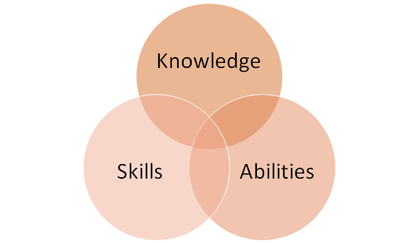
Interrelated components

Slide 40
 | Pedagogic |  | Self | Administrative
 | General pedagogic | Pedagogic content
Knowledge | Contextual | Linguistic Theoretical Practical activity University entrance test | Personal language teaching philosophy What works best for oneself Coping strategies | Administrative policies and procedures
Skills | Behavioral management Interpersonal Positive classroom learning environment set-up and management Lesson delivery and learning management Technology | Lesson planning Lesson delivery | Self-study Critical thinking | Computer system skills
Abilities | Leadership Situationally adaptive | Language Implementation of research-informed practices Learner assessment and test development Agentic | Deal with the stress of the job Collaboration/ cooperation | Managing homeroom duties Organization and management of daily duties Accurately complete official documents

Slide 41
Group discussion
What would you add or delete from the following table?

Slide 42
Effective language teachers
Knowledgeable about what they teach
Adapt to the context of where they are teaching
Methods
Language
Culture
Create a positive/ likeable learning environment
Interesting/ engaging atmosphere
Low-risk environment
Compelling lessons
Interactive
Easy to understand
Are mindful of students’ needs and opinions (individual differences)
Sympathetic towards students’ L2 learning problems and needs
Push students a little (to their potential)
Positive role model
Likeable
( Renandya, 2014, Whitehead & Greenier, 2019)

Slide 43
Key points
Every teacher is different and has different strengths and weaknesses.
Don’t compare yourself to others or copy others teaching without criticism.
Find out what works best for you.
Understanding yourself better can lead to becoming a better teacher.
What core competencies do you need to develop or further refine?
What can you do to develop them?
The job of teaching requires much more than just in-class duties. It is important to have a balanced set of competencies to be able to fulfil all aspects of your job while maintaining your health and wellbeing.

Slide 44
Reflection
What core competencies do you need to develop or further refine?
What can you do to develop them?

Slide 45
References
Dorman, J. P., Aldridge, J. M., & Fraser, B. J. (2006). Using Students' Assessment of Classroom Environment to Develop a Typology of Secondary School Classrooms. International Education Journal, 7(7), 906-915.
Greenier, V. & Whitehead, G. (2016). Towards a Model of Teacher Leadership in ELT: Authentic Leadership in Classroom Practice. RELC Journal, 1-17. DOI: 10.1177/0033688216631203.
Renandya, W. (2014). Effective strategies for motivating L2 learners. Paper presented at KAPEE International conference Chuncheon National Univeristy of Education, Chuncheon, South Korea.
Sheffler, J. L. (2009). Creating a warm and inclusive classroom environment: Planning for all children to feel welcome. Electronic Journal for Inclusive Education, 2(4), 4.
Whitehead, G., & Greenier, V. (2019). Beyond good teaching practices: Exploring learners' views of teacher leadership in English language classrooms. TESOL Quarterly. doi: https://doi.org/10.1002/tesq.526

