Slide 1
Approaches to Qualitative Inquiry
Narrative, phenomenological, ethnographic, case study, Action research, grounded theory

Slide 2
Research paradigms
Qualitative researchers generally see human behavior as something that is influenced by both internal and external factors. Thus, human behavior is variable, and can change from person to person, time to time, and situation to situation
Qualitative researchers seek to examine/explore reality through participant’s views, their own background and experiences.
Qualitative researchers seek to describe things in as much detail as possible
By understanding other’s views, backgrounds, and experiences, (and factors that affect) each we can better understand people as well as ourselves.

Slide 3
Different ways to approach qualitative research
Narrative
Phenomenological
Ethnographic
Case Study
Action research
Grounded Theory
What is a narrative study, a phenomenological study, a grounded theory study, an ethnographic study, an action research study, and a case study?
How do the five approaches differ?
How does a researcher choose from among the five approaches?

Slide 4
Differences Among the Approaches
Narrative – focuses on presenting an issue through individuals’ stories.
Phenomenology – focuses on understanding people’s experiences, perspectives or feelings on an issue.
Ethnography – focuses on studying people in their own environment or natural setting.
Case Study – focuses on an in-depth understanding of a specific case over a period of time.
Action Research –focuses on fixing or addressing an issue or problem.
Grounded Theory – focuses on developing a theory about a process.

Slide 5
Different approaches to qualitative inquiry

Slide 6
Narrative Research

Slide 7
Narrative Research – Telling their story
Narrative method provides a means to understand and analyze the stories people give.
Narrative method begins with collecting stories about the lives of individuals.
Narrative researchers often describe the context in which the participant is having the experience under investigation in detail. (i.e. studying teachers, describing their school and working context in detail)
Narrative researchers present the stories of individuals (often first person)
The researcher adds their interpretations of the story focusing on detailed themes that arise from the story

Slide 8
Narrative Research procedure
Identify a problem or phenomenon to explore
Select one or more participants
Collect the story from participants
Retell the story in as much detail as possible (setting, characters, problems, actions, and resolution)
While telling the story highlight specific themes of points of interest that connect to answering your research question.
Before submitting or publishing the story re-check with participants that the story you are telling is accurate. ( protects the story’s credibility)

Slide 9
Example of narrative research
Kim, Jeng-Hee (2006,). For whom the school bell tolls: Conflicting voices inside an alternative high school. International Journal of Education & the Arts, 7(6), 1-21.
Purpose of the study: Provide readers with and inside perspective of the tensions that exist in an alternative school, so that they may engage in questioning the nature and purpose of these types of schools.
Participants: A principal, teacher, male student, female student and school security guard.

Slide 10
Phenomenological research
Study of people’s perceptions of the world
Multiple ways of interpreting the same experience

Slide 11
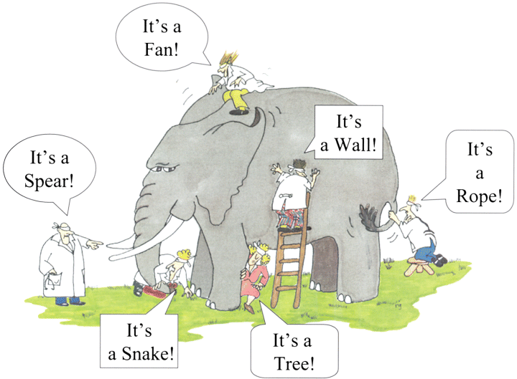

Slide 12
Phenomenological research
Whereas a narrative study reports the stories of individuals, a phenomenological study describes different peoples perspectives of a shared experience.
Phenomenological research is concerned with trying to understand what it is like from the point of view of the participants
Participant: tries to make sense of their personal and social world
Researcher: tries to make sense of the participant

Slide 13
Example of Phenomenological research
Whitehead, G. (2016). The rise and fall of the National English Ability Test: Examining Korean high school English teachers’ perspectives. Asian EFL Journal, 18(4). 124-155.
Purpose of the study: Provide readers with multiple teachers perspectives on the possible implementation of a new testing system
Participants: Korean in-service high school English teachers

Slide 14
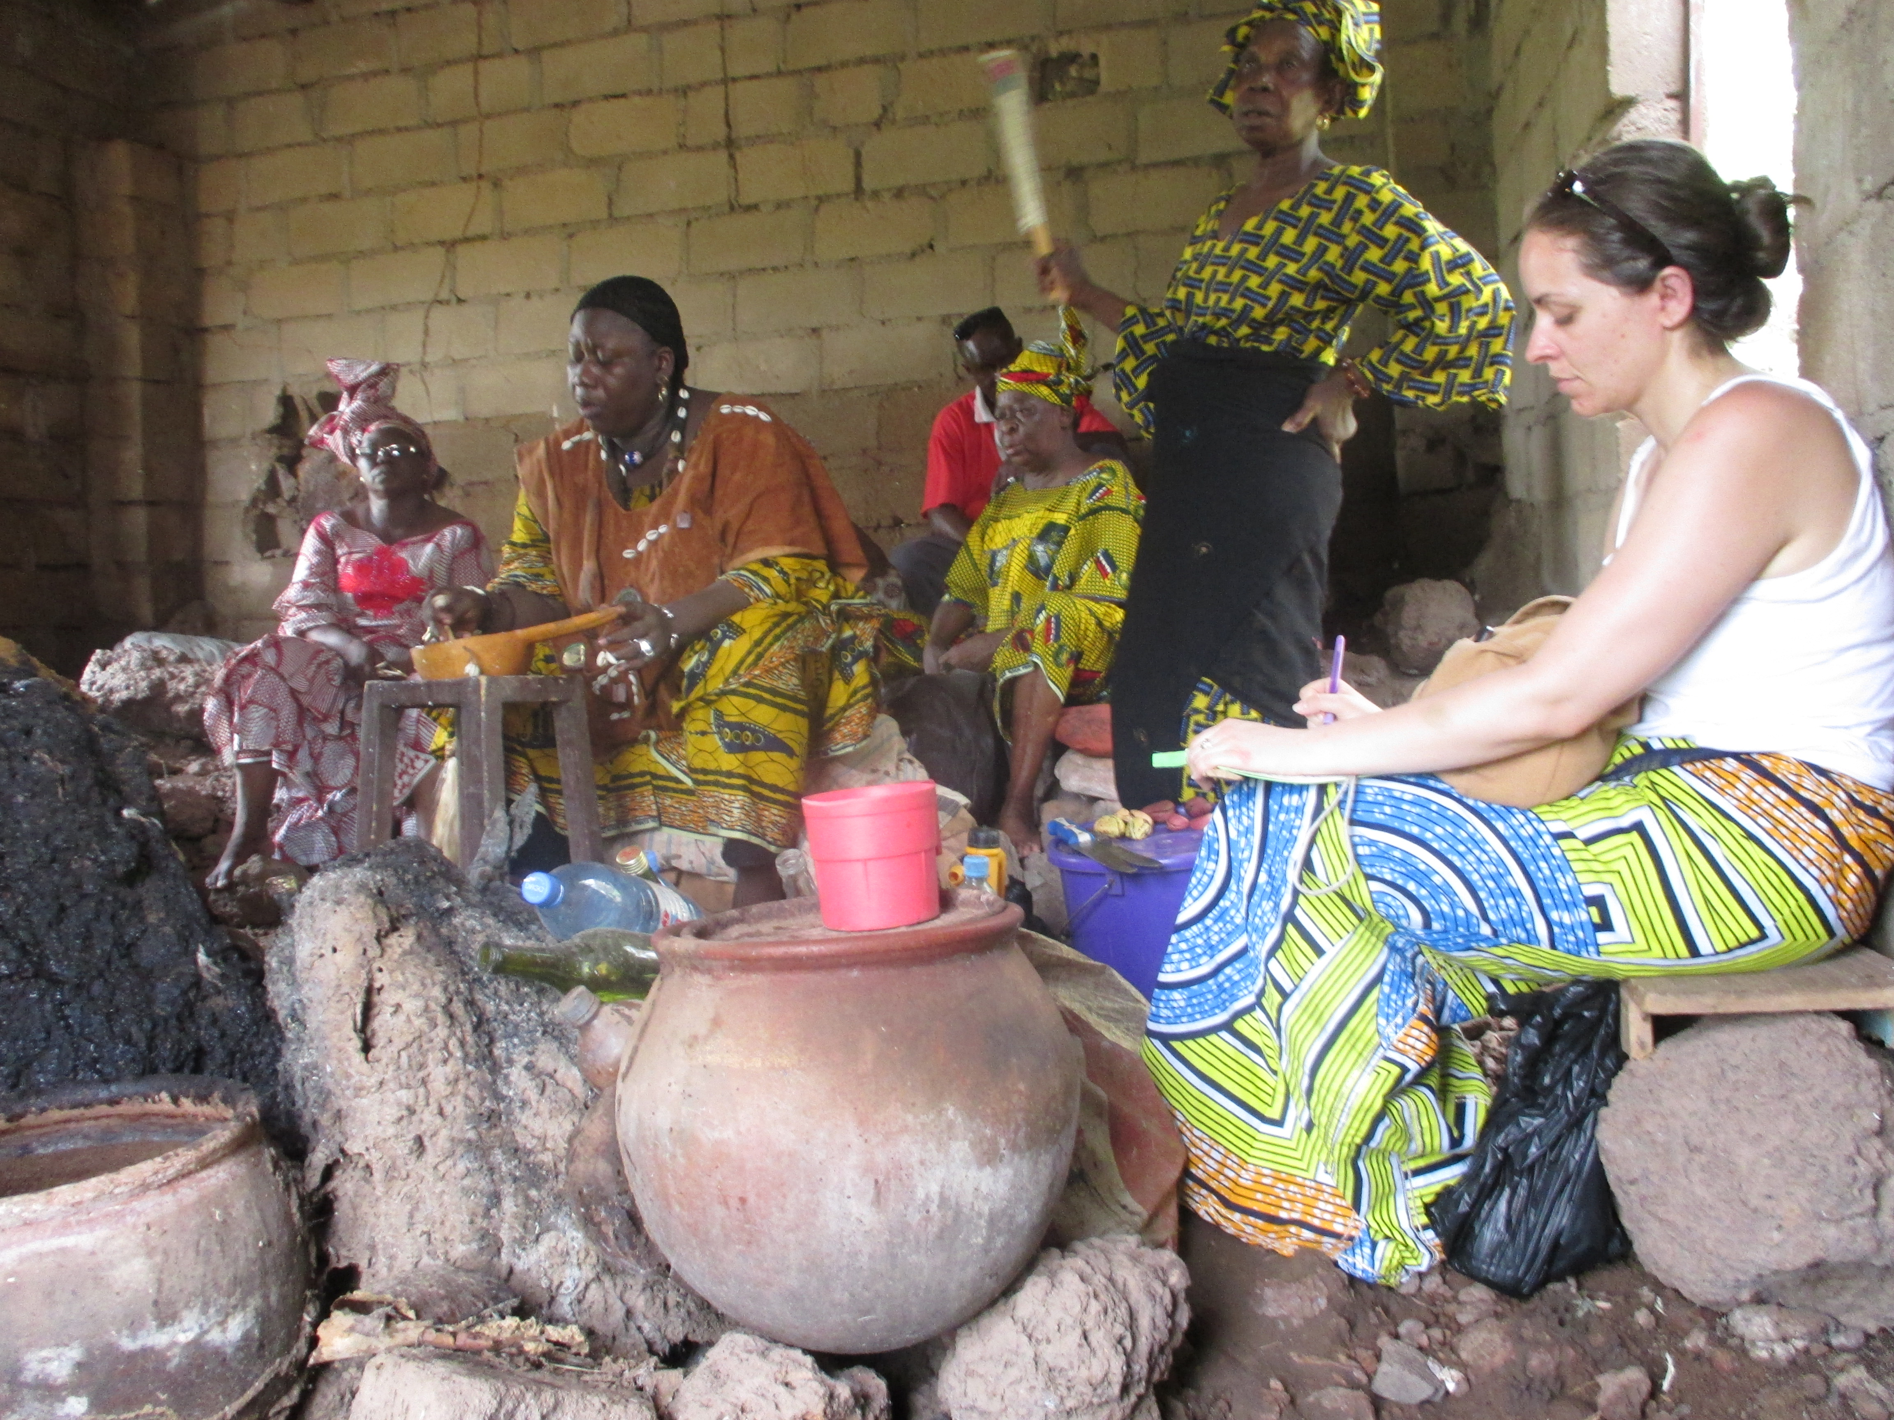
Ethnographic research

Slide 15
Ethnographic research
Ethnographic research is an attempt to obtain a detailed and holistic picture of a particular society, group, institution, setting or situation.
Researcher examines the behavioral patterns and perspectives of participants in their natural settings (e.g., a village, college, office)
Focuses on a particular site or sites that provide the researcher with a context in which to study both the setting and the participants who inhabit it
The participants are observed for extended periods as they take part in naturally occurring activities within the setting
Behaviors can be easily understood by researchers if they are in the “inside” of the research area.
Researchers often become or are a natural part of the research environment.

Slide 16
Example of ethnographic research
Lenski, S. D., Crawford, K, Crumplet, T, & Stallworth, C. (2005). Preparing preservice teachers in a diverse world. Action in Teacher Education, 27 (3), 3-12.
Purpose of the study: Provide a more adequate preparation for working in high-need schools by assisting educators in the development of “habits of mind” that incorporate an understanding and valuing of students’ culture and a recognition of the need to consider those cultures in teaching practices.
Participants: 28 preservice teachers who enrolled in an elementary education program

Slide 17
Additional Examples of ethnographic research
On the Run: Fugitive Life in an American City. Chicago: University of Chicago Press.
Goffman spent 6 years or so immersed in a marginalised black community and members who lived their life on the run from police
Ended up living in the community for the later part of her research.
Goffman was the driver of a car whose passengers were trying to locate and shoot a man who was also a participant in the study.

Slide 18
Case study research

Slide 19
Case study research – focusing on individual cases
Researchers focus on a single cases which may be an individual, a group, an organization or anything else that can be taken together as unit or system. (e.g., a student, a teacher, a group of students in X school, a classroom, a school).
Case study research is appropriate when the researcher wants to answer a descriptive question (e.g., what happened?) or explanatory question (e.g., how or why did something happen?), or simply to explore cases.
Focuses on in-depth understanding by providing thick description of different cases

Slide 20
Example of a Case Study Research
Koerner, M. E., & Abdul-Tawwab, N. (2006). Using community as a resource for teacher education: A case study. Equity & Excellence in Education, 39(1), 37-46.
Purpose of the study: Examine the processes of using a community organization to lead the discussion and obstacles inherent to university settings
Duration and sites: About two years (or four semesters) at a university and a neighboring community

Slide 21
Action research

Slide 22
Action research – focusing on a problem
Action research focuses on addressing a problem and improving the quality of something through an intervention.
It typically is designed and conducted by practitioners who analyze the data to improve their own practice.
Action research can be done by individuals or by teams of colleagues. The team approach is called collaborative inquiry.”

Slide 23
How is Action Research Defined in Education
Action research is a form of investigation designed for use by teachers to attempt to solve problems and improve professional practices in their own classrooms. It involves systematic observations and data collection which can be then used by the practitioner-researcher in reflection, decision-making, and the development of more effective classroom strategies. ( Parsons & Brown, 2002)
Action research is a natural part of teaching. Techers are continually observing students, collecting data, and changing practices to improve students learning and the classroom and school environment. Action research provides a framework that guides the energies of teachers toward a better understanding of why, when, and how students become better learners. (Miller, 2007)

Slide 24
Action Research procedures (McNiff, 2002)
Review your current practice.
Identify an aspect that you wish to improve.
Imagine a way to improve.
Try it out.
Monitor and reflect on what happens.
Modify the plan based on what has been found, what has happened, and continue.
Evaluate the modified action.
Continue until you are satisfied with that aspect of your work (e.g. repeat the cycle).

Slide 25
Example of Action Research
Talandis Jr, G., & Stout, M. (2014). Getting EFL students to speak: an action research approach. Elt Journal, 69(1), 11-25.
Purpose of the study: To find a way to improve students oral activity in class.
Intervention: Implementing an interactive English syllabus

Slide 26
Grounded theory

Slide 27
Grounded theory –Theory from data
is an approach to research with generates theory from data (This approach can be used together with all of the approaches we have discussed thus far)
Used to theorize about a process, action, or interaction.
Rather than going in with a theory, a grounded theory approach seeks to develop a theory for an action or process based on themes that emerge in the data.
Collect data, analyze, collect more data based off or previous data, analyze, collect more data until saturation point (no more new themes are emerging).
The theory is based on the researcher’s interpretation of the data.
The conclusions are suggestive, incomplete, and inconclusive

Slide 28
Examples
What process leads to teachers who are prepared to teach on their first day in a classroom?
What process leads to learners who are demotivated to learn English in high-school?

Slide 29
Identifying patterns within the data

Slide 30
Example of a grounded theory approach
Valmori, L., & De Costa, P. I. (2016). How do foreign language teachers maintain their proficiency? A grounded theory investigation. System, 57, 98-108.
Purpose of the study: Examine how foreign language teachers experience and respond to changes in their foreign language proficiency.
Participants : How nine Italian school foreign language (FL) teachers in two types of high schools (college preparation and vocational schools)
Rationale: A grounded theory approach let issues and possible trajectories for meaningful in-service teachers' professional development practices emerge from the analysis.

Slide 31
Additional video

Slide 32
Choosing an approach
What is the best way to approach your research?

Slide 33
Think…What do I want to do?
I want to investigate a problem and implement a plan to resolve the problem
I want to investigate the issue by living it and being part of the research context
I want collect data from many different sources and develop an explanation from themes in the data
I want to investigate the issue through looking at a special and specific case
I want to investigate the issue by gathering people’s views and opinions
I investigate the issue through people’s stories
Narrative
Phenomenological
Ethnographic
Case Study
Action research
Grounded Theory

Slide 35
Choosing an approach
A group of 5 teachers’ went to Australia for a month to observe and teach English classes. I want to know about their experiences and how it differs from what they experience in the Korean context.
I want to know students daily struggles with English learning.
I want to understand how a different school system works and how it affects teachers work satisfaction.
I want to know how teachers feel about a new educational policy.
My students are not motivated in class and I want to find a better way of teaching to increase their motivation.
I want to know how student’s view a good teacher.
I want to explore how ELT MA programs can be improved in the Korean context.
I want to know about the difficulties teachers have in their first year of teaching.
I want to investigate how bad teachers may have affected students motivation to learn English.

Slide 36
References & Resources
Charmaz, K. (2014). Constructing grounded theory. Thousand Oaks, CA: Sage Publications.
Corbin, J., Strauss, A., & Strauss, A. L. (2014). Basics of qualitative research. Thousand Oaks, CA: Sage Publications.
Creswell, J. W., & Poth, C. N. (2017). Qualitative inquiry and research design: Choosing among five approaches. Thousand Oaks, CA: Sage publications.
Tracy, S. J. (2013). Qualitative research methods. Oxford, UK: Wiley-Blackwell.

Slide 37
Additional References
Denzin, N.K. (1989) Interpretive interactionism. Newbury Park: Sage
Miller, M. (2007). ‘Action Research: Making Sense of Data’, Available at: http://www.coe.fau.edu/sfcel/sensdata.htm (date accessed:15/03/2013).
Ponterotto, J.G. (2006) Brief note on the origins, evolution and meaning of the qualitative research concept ‘thick description’, The Qualitative Report 11(3), 538-54

Slide 38
Appendix a: Steps in qualitative research

