Slide 1
Annotated Bibliography
Tips & Support Tools
Notes:
https://profgwhitehead.weebly.com/tell-3c.html

Slide 2
Materials
https://profgwhitehead.weebly.com/tell-3c.html

Slide 3
The issues
Reputable resources
Narrowing down the literature
APA reference formatting
Reporting weaknesses

Slide 4
Searching the literature

Slide 5
Tips: finding Reputable resources
Google scholar
ResearchGate
OASIS
Start with a search for recent articles (within the last 10 years max)
Look at relevant articles’ references to lead you to other good resources
Make sure your resources are reliable (https://www.scimagojr.com/)
Not reputable: news articles, blogs, Wikipedia, MA theses
Reputable: peer-reviewed journal articles, academic books, PhD theses, conference papers
Notes:
https://oasis-database.org/

Slide 6
Quality sources
Peer-reviewed articles, books, or book chapters
Be careful of predatory publishers (Beall’s list - https://beallslist.net/)
You can check if the journal is of quality here: https://www.scimagojr.com/

Slide 8
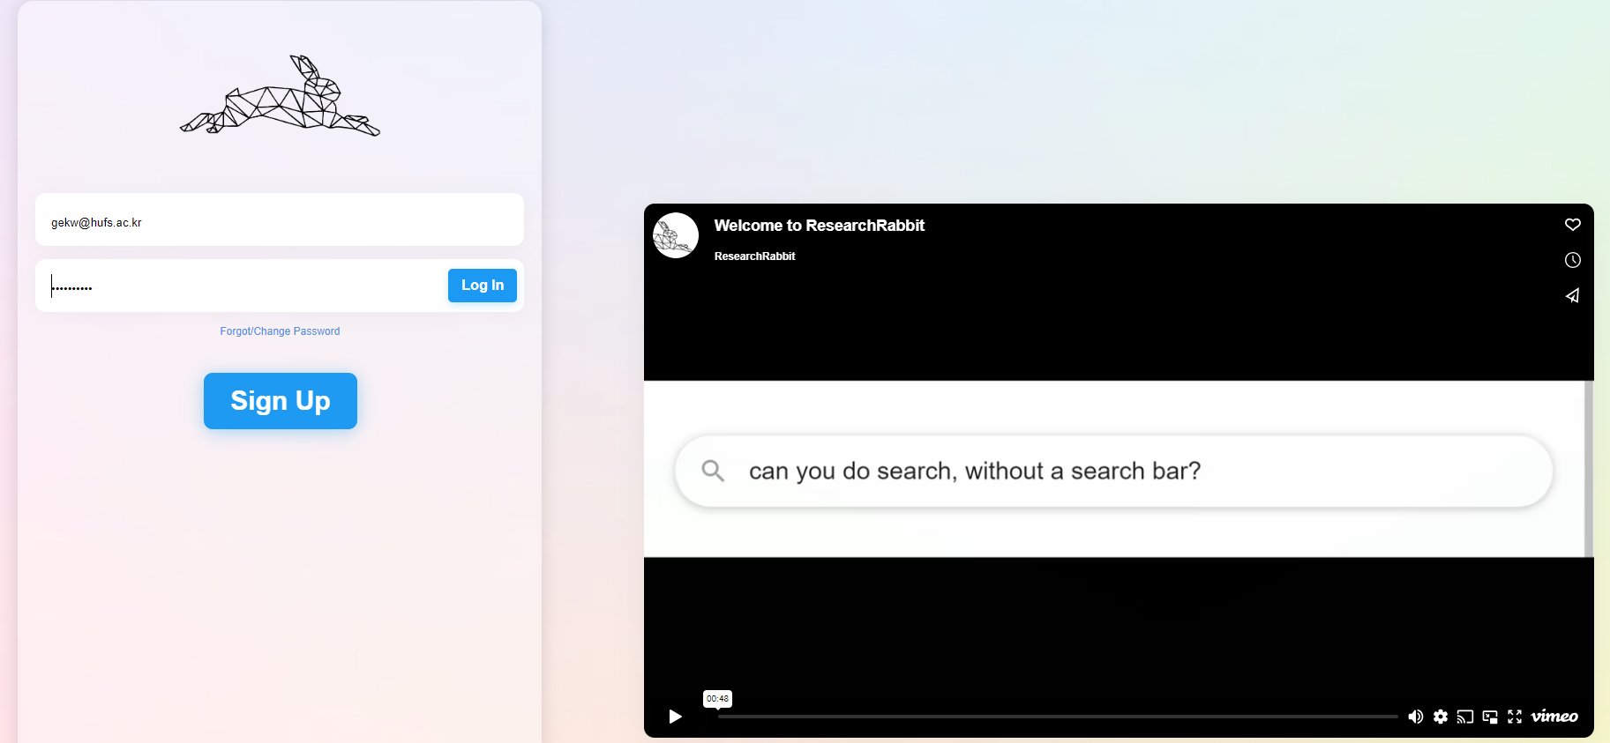
Research rabbit
researchrabbitapp.com
Provides a web of connected literature.
Helps to focus your search

Slide 9
APA formatting

Slide 10
https://owl.purdue.edu/owl/research_and_citation/apa_style/apa_formatting_and_style_guide/general_format.html
Overview of APA formatting
Notes:
https://owl.purdue.edu/owl/research_and_citation/apa_style/apa_formatting_and_style_guide/general_format.html

Slide 11
How to get citation information
https://scholar.google.com
https://www.crossref.org/
Searching other papers reference lists for the APA formatted citation

Slide 12
Reporting a study’s weaknesses

Slide 13
Search the end of the paper
Look for noted limitations that the authors present
Search a .pdf -> CTRL+F – limitations.

Slide 14
Common Limitations/ weaknesses

