Slide 1
Alibi

Slide 2
New words
alibi
interrogate
suspects
fraud
vandalism
theft

Slide 3
Warm up
Have you ever had something stolen from you?
Are you ever worried about someone breaking into where you live?

Slide 4
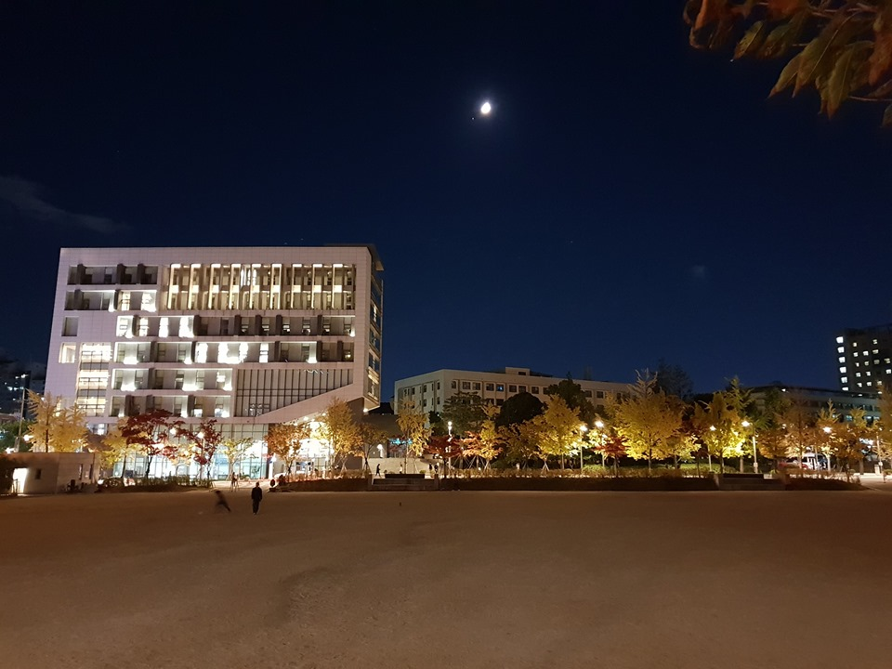

Slide 5
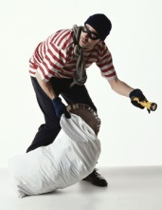
Last night a thief came to the University!!

Slide 6
I have your wallet.

Slide 7
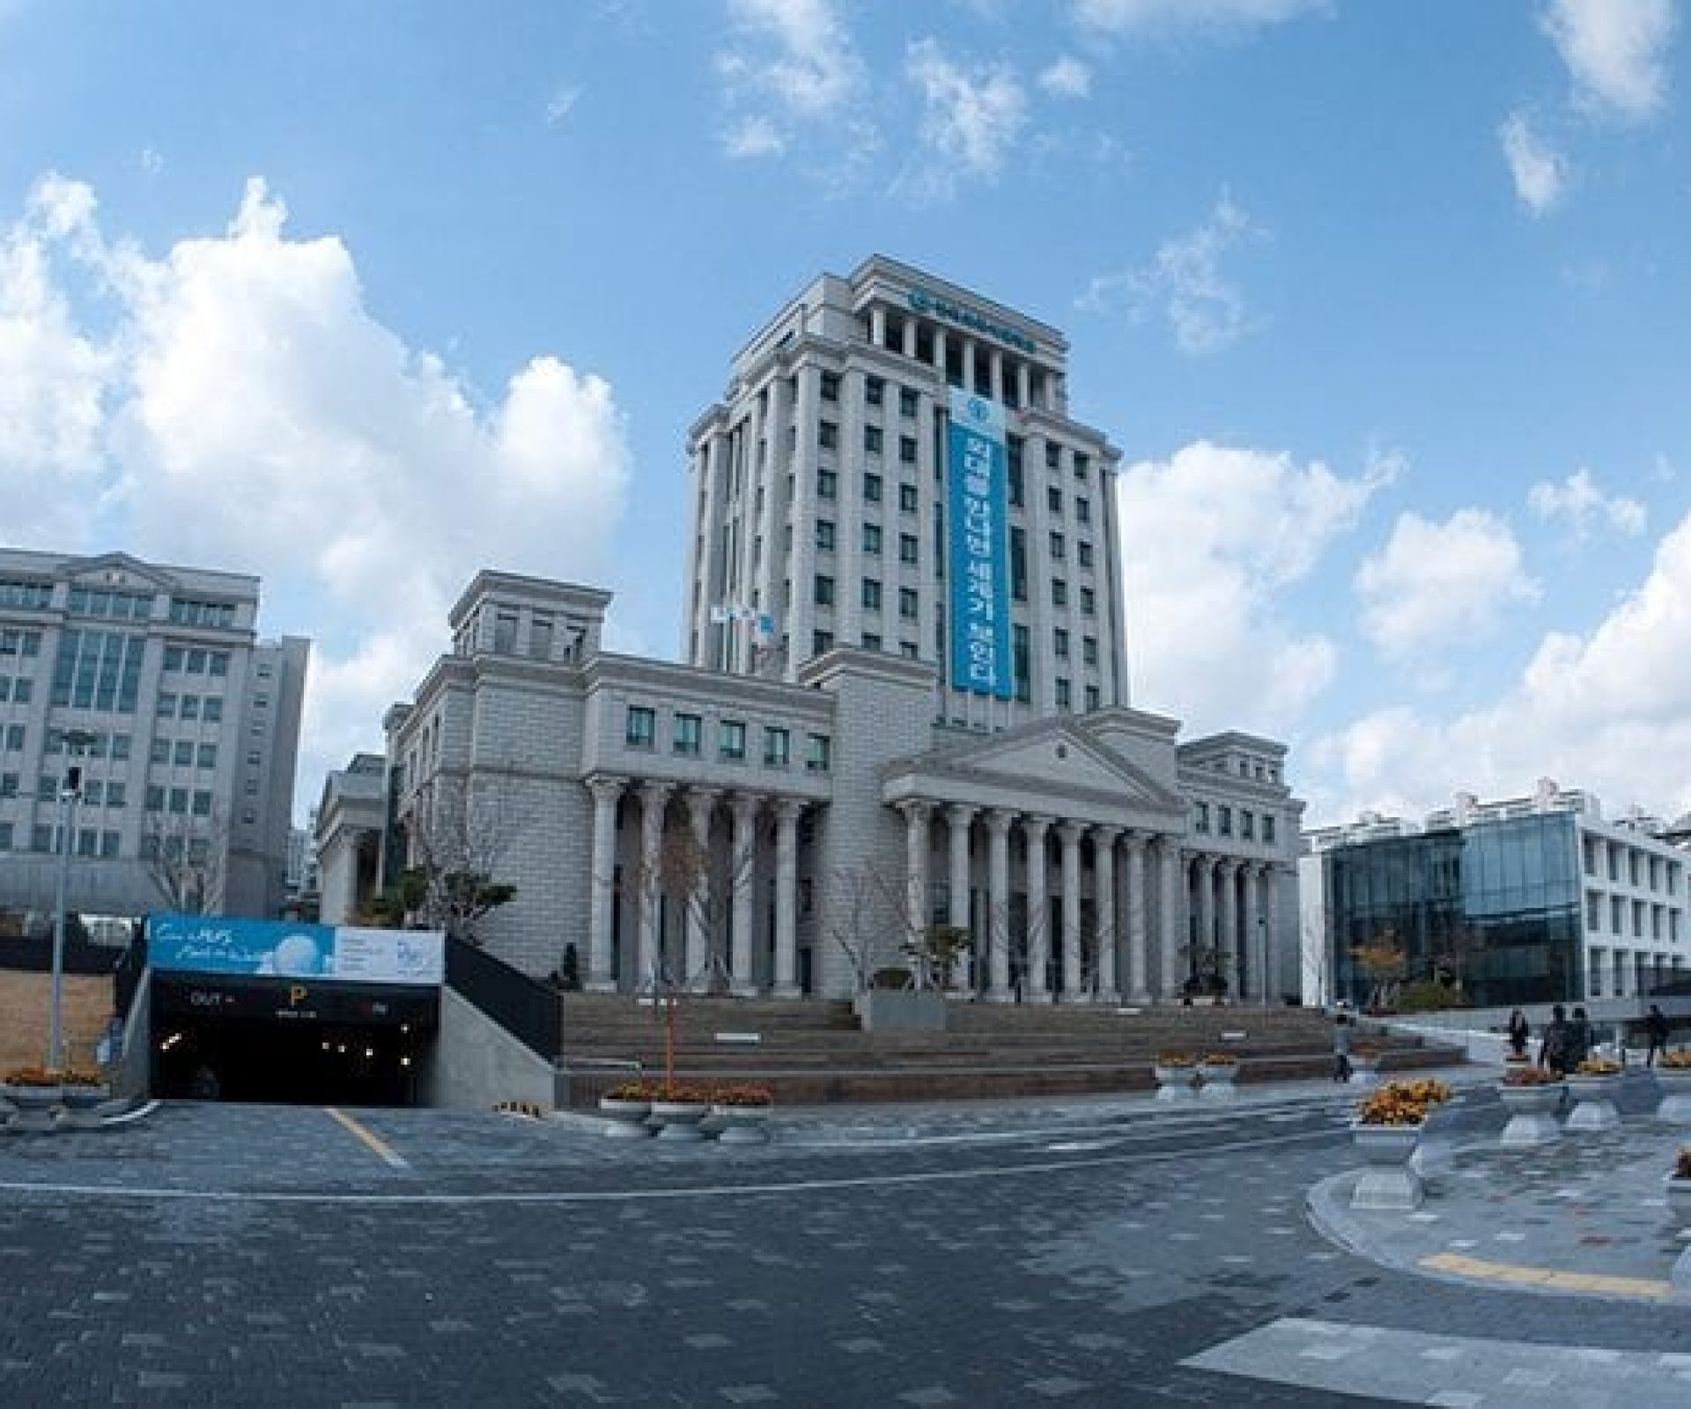
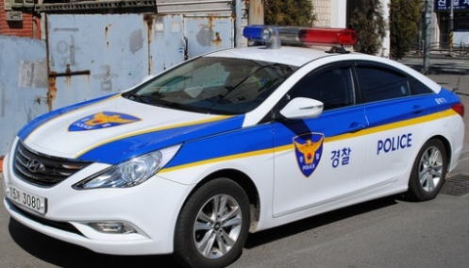
The police came this morning…

Slide 8
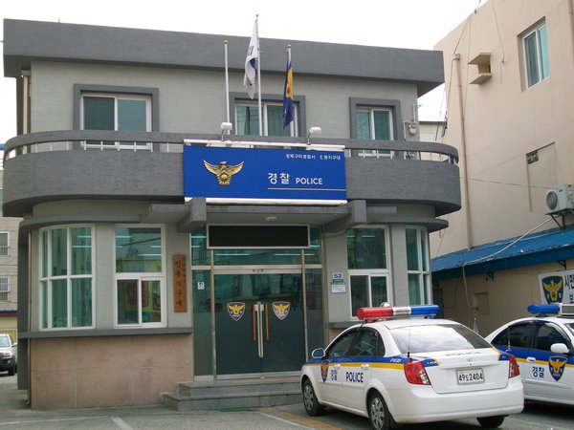
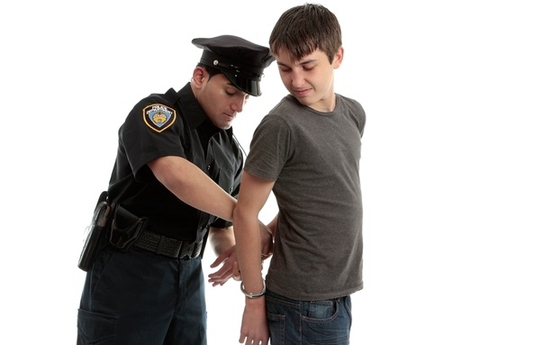
They took the suspects to the police station….

Slide 9
The police know that the crime happened between 5pm and 10pm
The suspects have an alibi…
They say …
5-6pm they were eating dinner together.
6-8pm they were watching a movie.
8-10pm they were at the norebang

Slide 10
alibi
Interrogation questions
5-6 eating dinner together
6-8 watching a movie
8-10 norebang
Where were you ________?
When were you ________?
What color was the________?
Where was the________?
What ________?

Slide 11
The police know that the crime happened between 5pm and 10pm
The suspects have an alibi…
They say …
5-6pm they were bowling.
6-8pm they were in a PC room.
8-10pm they were in the library studying.

Slide 12
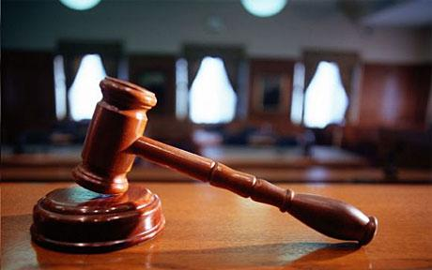
Punishment
What punishment would you give them?

