Slide 1
Advertising
Spending Money

Slide 2
Spending Habits
Do you enjoy shopping?
Do you prefer to use cash or a card when shopping?
What do you enjoy shopping for?
What do you not enjoy shopping for?
Do you shop mostly online or in person?
What is your favorite store to buy clothes at?
What kind of shopper are you?
What do you spend the most money on these days?
What is the most expensive thing you have ever bought?

Slide 3
Discussion
What is the most advertised product in your country?
Tell me about an ad that you remember.
What makes a commercial memorable?

Slide 4
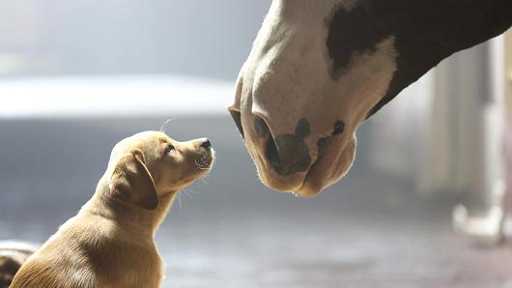
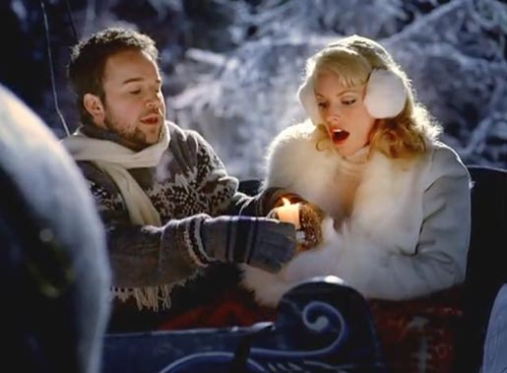
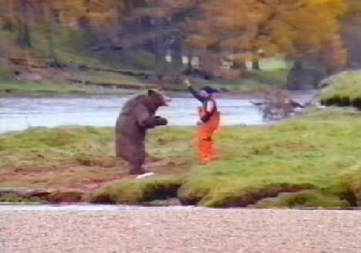
Most Memorable Commercials

Slide 5
What kind of strategies are used to get your attention?
Humour
Celebrities
Emotional appeal
Simple solutions
Sex appeal
Catch phrases
Jingles

Slide 6
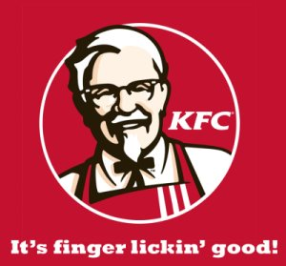
Jingles and Catchphrases

Slide 7
What famous slogans or catchphrases are there in Korea?

Slide 8
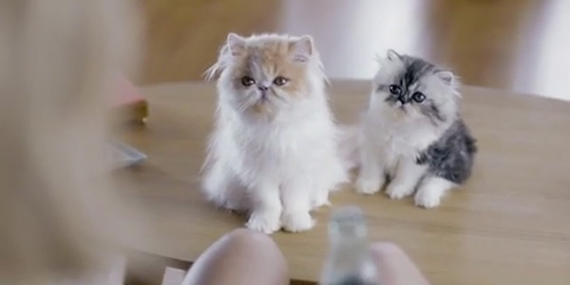
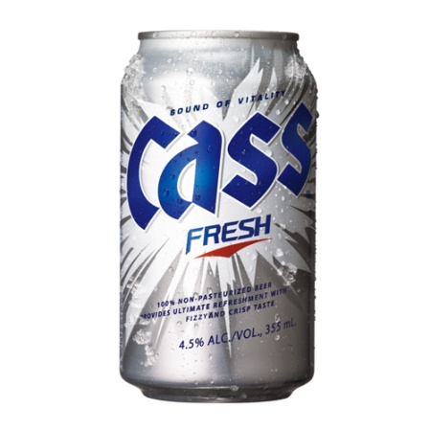
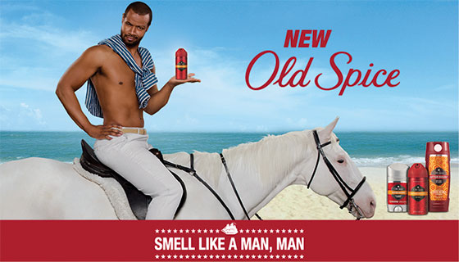
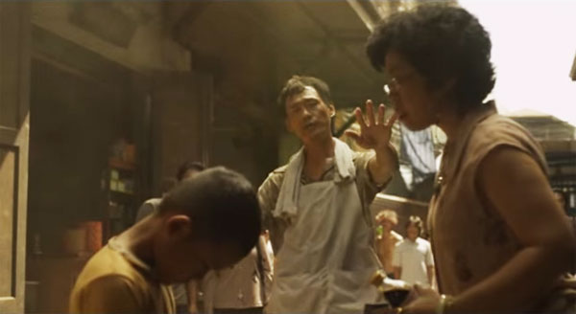
Watch
Consider what strategy is being used in the following commercials.

Slide 9
Advertisement Project
You got a new job on the marketing team!
Page 87
Task 32
Page 78
Task 12

Slide 10
Write down which commercial you liked the best and explain why

