Slide 1
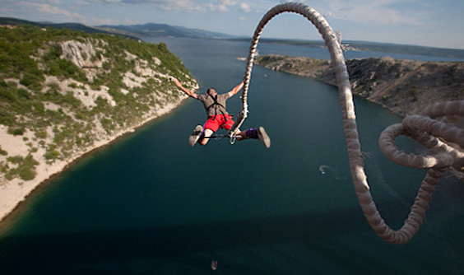
Adventure

Slide 2
Project
You and your friends are starting a new adventure activity company.
Choose what kind of adventure activity your company will provide.
Name your company.
Your job is to get as many customers to sign up as possible.
Think of a way to present your company to attract customers
Think of some deals or discounts that can attract people

