Slide 1
Advanced Communication
Getting Started

Slide 2
Getting Started
When you think of someone with advanced communication skills what comes to your mind?

Slide 3
What is important for advanced communication?
Native-like pronunciation.
Ability to use idioms and slang.
Ability to understand idioms and slang.
Ability to understand native-speakers.
Confidence
6. Knowing a lot about western culture.
7.Knowing how to adapt your speech to your audience.
8.Being careful in your word choices.
9.High level of accuracy when you speak.
10. High level vocabulary

Slide 4
Examining the Native Speaker model
The concept of the native speaker has been around for a long time and is often used as a reference point for teachers and learners of the language (Dewaele, 2017)

Slide 5
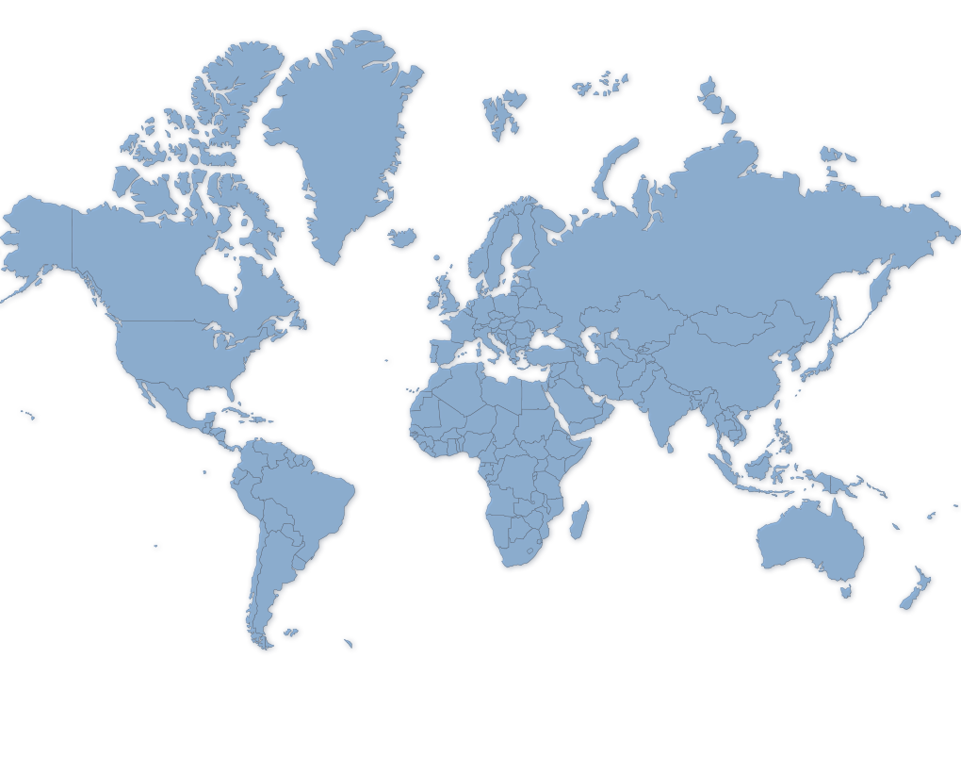
English Speaking Countries
When you think of English speaking countries which countries come to mind?

Slide 6
Opinion
In your opinion which one is the best? Why?

Slide 7
Models
Which standard model is followed in Korea?
Why?

Slide 8
Rate their Communication Skill

Slide 9
Task
Rate the following mystery guests communication ability from 1 – 10 based on your feeling.
Try to explain why you gave them the score you did (especially super low or super high)
Which speakers were easiest for you to understand? Why?

Slide 10
Mystery Guests

Slide 13
The Current Situation
Key points to consider when teaching or learning English

Slide 14
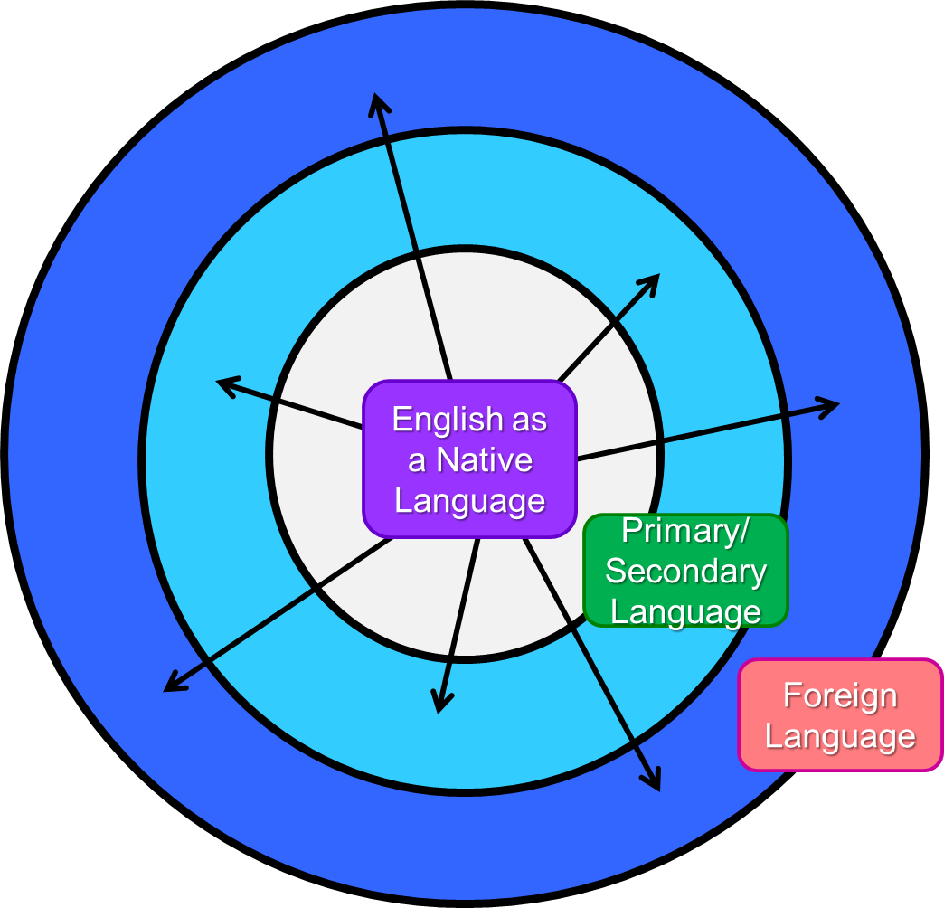
The Spread of English (3 circles)
Inner Circle
Outer Circle
Kachru, 2006
Expanding Circle

Slide 15
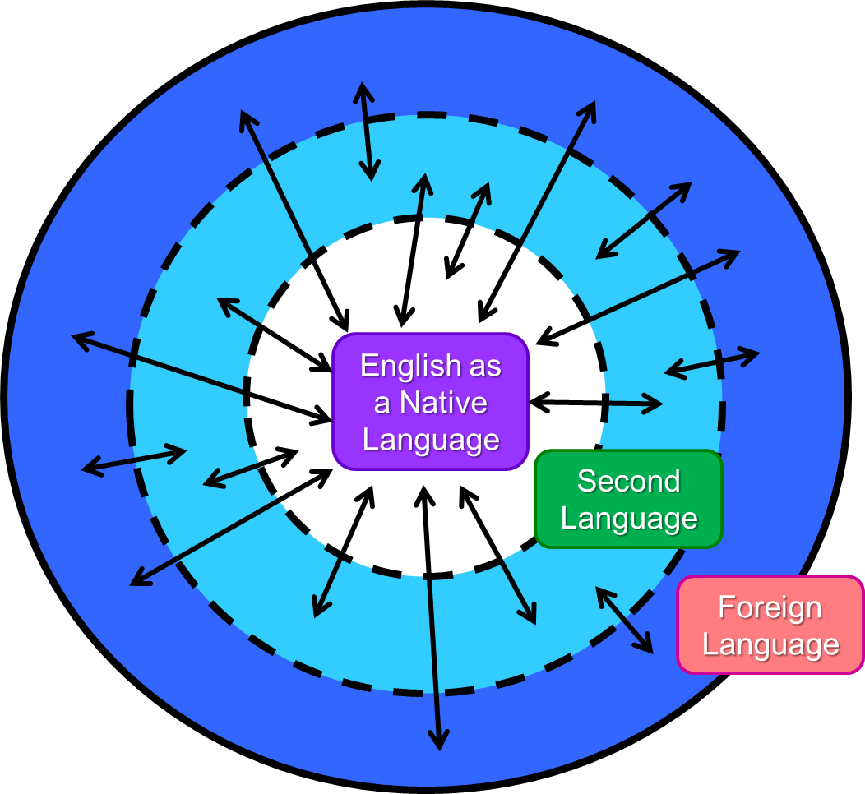
The Current Situation

Slide 16
Regional Varieties
English Ice Cream

Slide 17
Current facts
There are now many more non-native speakers of English than native speakers ( 5 to 1)
Five times more people are learning English in China than there are people in England
The English language is changing especially in international contexts
Both native and non-native speakers can be fluent in the language
Native can have great difficulty in non-native settings due to their nativeness

Slide 18
English in International Settings

Slide 19
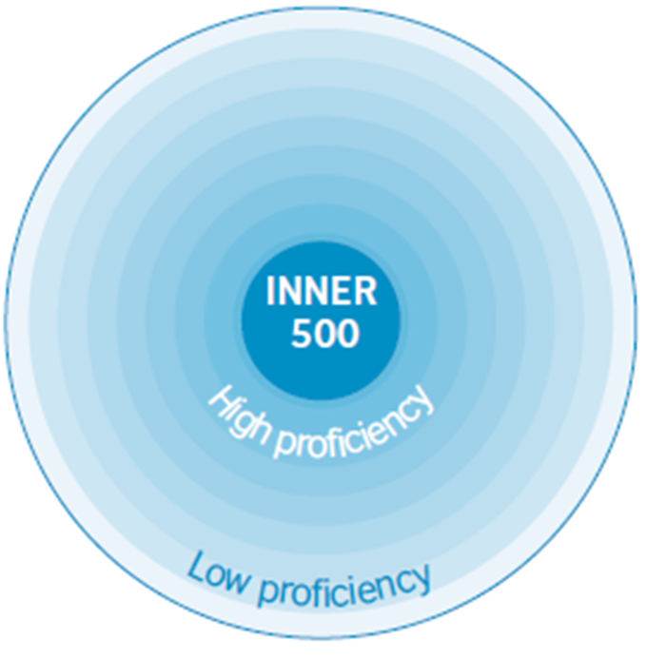
The New Circle
Inclusive
No-mention of Native/ Non-native

Slide 20
Key Points
There are many fluent English speakers, not all are native…
The most important thing is to be comprehensible
Having an accent is not a problem as long as your speech is comprehensible
Native speakers can have troubles in international settings.
Native speakers should try to understand your English just as much as you try to understand theirs.

Slide 21
Key Points
Fostering comprehensible input (how?)
Fostering comprehensible output (how?)

Slide 22
Key Points
Fostering comprehensible output (how?)
Practice, practice, practice
Natural and creative use of language/ not memorized dialogues etc.
Focusing on problems in comprehensibility rather than native-like accuracy
Chunks, Phrases, Vocabulary ( and Word Choice: the more common the better)
Circumlocution
Fostering comprehensible input(how?)
Exposure
Awareness of different speakers of English (linguistically, culturally)
Common Chunks, Phrases, Vocabulary used

Slide 23
Advice for Intercultural Communication
Try to understand the speaker’s background/ point of view
Keep it short and simple
Don’t use idioms, slang or abstract language
Show and demonstrate by using examples ,illustrations, gestures etc.
Monitor face and body language
Pause a lot and check if they understand
Repeat as necessary
Ask for clarity (Don’t jump to your own conclusions)
Notes:
M. Kovyazina Comparative Culturology Lectures, Tyumen State University, 2004-2009

Slide 24
Reflection
What do you need to work on to be increase your communication skills?
How can you help students increase their communication skills?

Slide 25
Comprehensibility

Slide 26
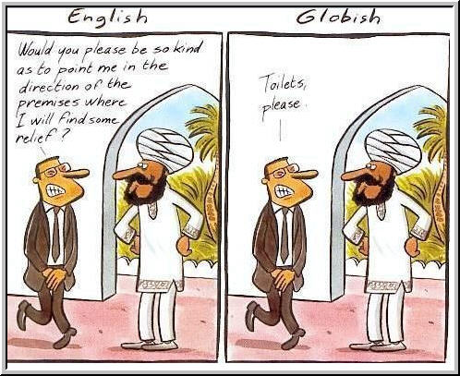

Slide 27
Real life examples
The test was a piece of cake.
I like.. Totally didn’t like the movie.. It was like.. Totally boring.
I met my professor today and I feel that he is overly pedantic and will exasperate the students.

Slide 28
Comprehensibility practice

Slide 29
Describe & Draw

Slide 30
Listen & Write + Jigsaw Reporting

