Slide 1
Academic Reading
Searching for Resources and Creating a Literature Cards

Slide 2
Important Quotes (Whitehead, 2018)
70% of academic writing is _____________.
One cannot write academically if they do not ____ academically.
Good academic readers know what to ______ and how to _______.

Slide 3
Important Quotes (Whitehead, 2018)
70% of academic writing is reading.
One cannot write academically if they do not read academically.
Good academic readers know what to read and how to read.
The more you know about a topic the easier it is to write about it.

Slide 4
Key Points
It is impossible to write about something academically if you do not know well about what you are writing about.
What exactly does the topic entail?
What have other people said about the topic?
What work has been done regarding the topic?
What have others found?
What is the current situation regarding the topic?

Slide 5
Sample: Project-based Learning
How is this topic defined?
What have other people said about the topic?
What is the history of the topic?
What work has been done regarding the topic?
What have others found?
What is the current situation regarding the topic?
How does it relate to your context?

Slide 6
What to read?
Website
Academic journal
Blog
Newspaper
Books
Magazine
Others?

Slide 7
Websites
Must be a professional association with proper credentials i.e. OECD, KICE etc.
However, you can probably find official documents on most sites and it would be better to cite those.
If the cite is not reputable and/or trustworthy, better not to use it

Slide 8
Academic Journals
Peer-reviewed
Indexed (SSCI, Scopus, etc. as these are quality controlled)
Recent (Make sure your articles include recent articles)
Tip* - scimagojr.com
Predatory journal list - https://beallslist.weebly.com/

Slide 9
Blogs
No
But blogs may lead you to good references.

Slide 10
Newspaper/ Online News
May use reported statistics
Make sure these news sources are trustworthy
Make sure that the facts are correct
Better to backcheck the facts and find the original source if possible.

Slide 11
Books
Reputable author
Reputable publisher
(many people pay to have their work published and it is not quality controlled)
Most recent edition if possible

Slide 12
Magazine
Only if it is an academic magazine which is trustworthy and reliable
However, magazines are not usually written for an academic audience and therefore the structure and wording is slightly different.
Use your own discretion.

Slide 13
TIPS: Quality Resources
scholar.google.com
Naver academic
Dbpia
RISS
Narrow your sources down to recent (last 5 years)
Cite older sources if extremely relevant or important historically
Use one good article to lead you to the next (snowballing)
Look at their references

Slide 14
TIPS: More resources
Academia.edu
Researchgate.net
Email the author ☺

Slide 15
Task 1
Find and obtain 3 articles relating to a topic you are interested.
Read through the abstracts and rationale for the study ( Should be in the introduction or end of the literature review)

Slide 16
Creating a literature card

Slide 17
What is a literature card?

Slide 18
What is a literature card?
Document files
Each file is for a different academic topic
It is an organized bank of important information that you read

Slide 19
Why create a lit card?
To keep everything you read organized
So you don’t have to go back to the original articles (if you create a good lit card)

Slide 20
Biesta, G., Priestley, M., & Robinson, S. (2015). The role of beliefs in teacher agency. Teachers and Teaching: theory and practice, 21(6), 624–640.
There is an emerging tendency in curriculum policy in the UK and elsewhere to acknowledge the importance of teachers’ agency – that is, their active contribution to shaping their work and its conditions – for the overall quality of education (see, e.g. Goodson, 2003; Nieveen, 2011; Priestley, 2011). (p.624)
Edwards, A. (2015). Recognising and realising teachers’ professional agency. Teachers and Teaching: theory and practice, 21 (6), 779-784. doi: 10.1080/13540602.2015.1044333
But first, what is agency? By offering different definitions, the papers demonstrate just what a difficult question this is. My favourite explanation of agency is a relatively old one. It was offered by Charles Taylor in a 1997 essay, where he connected agency with both responsibility and self-evaluation, themes which resonate across the current collection of papers. (p.779)

Slide 21
APA Reference in Full
Biesta, G., Priestley, M., & Robinson, S. (2015). The role of beliefs in teacher agency. Teachers and Teaching: theory and practice, 21(6), 624–640.
There is an emerging tendency in curriculum policy in the UK and elsewhere to acknowledge the importance of teachers’ agency – that is, their active contribution to shaping their work and its conditions – for the overall quality of education (see, e.g. Goodson, 2003; Nieveen, 2011; Priestley, 2011). (p.624)
Add the APA references for these as comments.
Add the page # from the original article

Slide 22
Getting Started

Slide 23
APA Referencing
Anderson, N. J. (2009). Leading from behind. In M. A. Christison & D. Murray (Eds.), Leadership in English language education: Theoretical foundations and practical skills for changing times (pp. 110-122). Routledge.
Baecher, L., Knoll, M., & Patti, J. (2013). Addressing English language learners in the school leadership curriculum: Mapping the terrain. Journal of Research on Leadership Education, 8(3), 280–303. doi: 10.1177/1942775113498377
Bass, B. M. (1985). Leadership and performance beyond expectations. Collier Macmillan.
Berg, B. L. (2001). Qualitative research methods for the social sciences (4th ed.). Allyn and Bacon.
Choi, I.C. (2008). The impact of EFL testing on EFL education in Korea. Language Testing. 25(1), 39-62. doi: 10.1177/0265532207083744

Slide 24
Chapter in Edited Volume
Anderson, N. J. (2009). Leading from behind. In M. A. Christison & D. Murray (Eds.), Leadership in English language education: Theoretical foundations and practical skills for changing times (pp. 110-122). Routledge.

Slide 25
Journal Article
Baecher, L., Knoll, M., & Patti, J. (2013). Addressing English language learners in the school leadership curriculum: Mapping the terrain. Journal of Research on Leadership Education, 8(3), 280–303. doi: 10.1177/1942775113498377
Choi, I.C. (2008). The impact of EFL testing on EFL education in Korea. Language Testing. 25(1), 39-62. doi: 10.1177/0265532207083744

Slide 26
Books
Bass, B. M. (1985). Leadership and performance beyond expectations. Collier Macmillan.
Berg, B. L. (2001). Qualitative research methods for the social sciences (4th ed.). Allyn and Bacon.

Slide 27
Additional Referencing
https://owl.english.purdue.edu/owl/resource/560/01

Slide 28
Tips
Google Scholar ”
Be careful though – sometimes missing info or wrong format
www.crossref.org
Look the reference up in other papers (links on google scholar etc.)

Slide 29
TASK: Create a lit. card for your topic
Use the three articles you have already obtained and find at least 3 more ( total 6) to use for your literature card.
Make sure these sources are reputable and of relevance to what you are writing about
Create a Lit. card for your topic from those sources

Slide 30
Steps
Title your file with the main topic of the sources (i.e. CLT lit card, Noticing hypothesis lit card, Testing washback lit card)
Create headings using APA format of your references (https://owl.english.purdue.edu/owl/resource/560/01)
While reading the sources copy and paste important information into the heading
Remember to put the page # for each entry
Focus only on key points
Abstract
Literature review
Summary of the study that they did (can be found in the Abstract)
Summary of the findings
It’s like highlighting!

Slide 31
Reality
Please note that most 6000 word academic papers have 20 to 30 references.
MA thesis may be around 30-50 (For your reference, mine had 63).

Slide 32
Timeline
Use the rest of this class to start creating your literature card (minimum of 6 entries)
Your lit card assignment is due 2 weeks from now

Slide 33
Guided Reading
Who did the study?
Why did they do the study? What gap were they trying to fill?
Who were the participants? How many?
How did they collect data (interviews, observations, survey etc.)?
What did they find?
What do they suggest now?

Slide 34
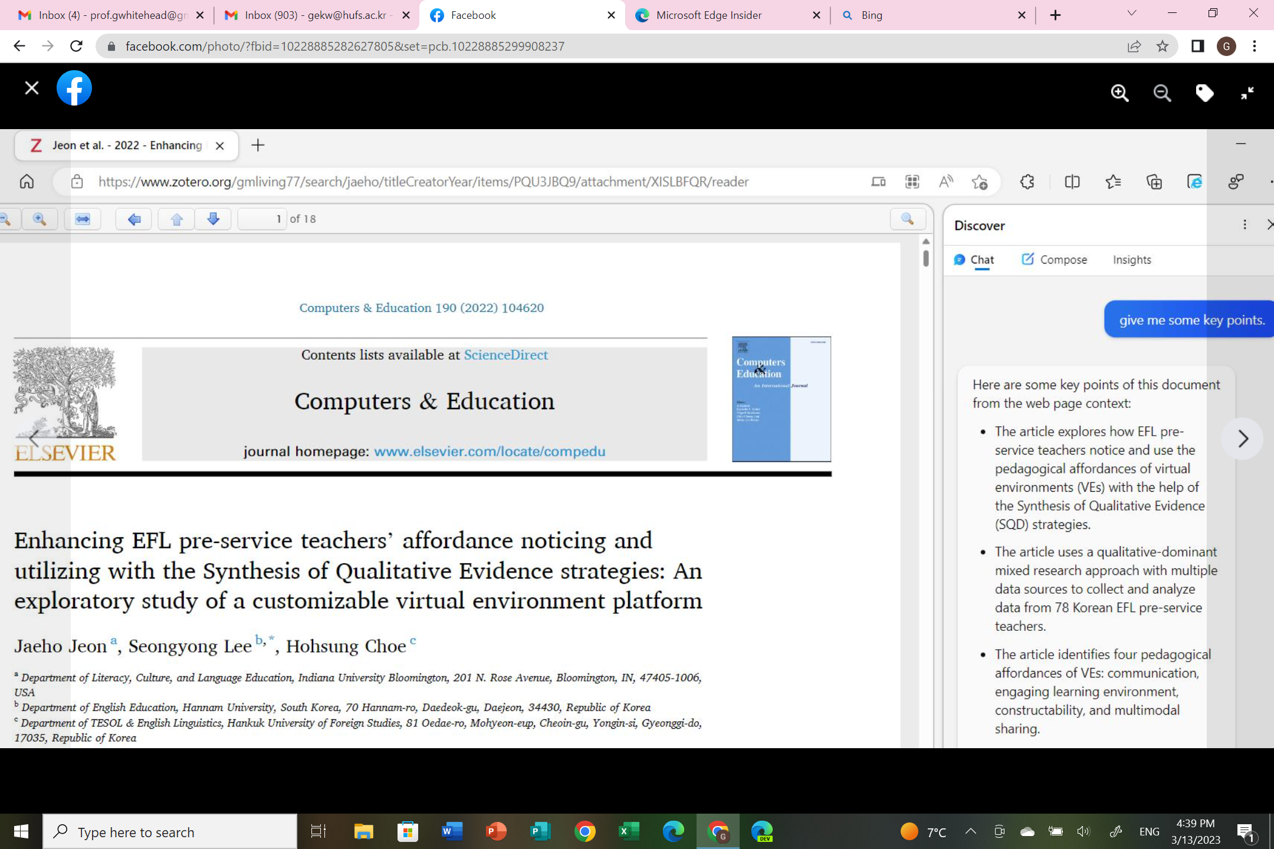
The new Bing + Microsoft Edge Dev.

Slide 35
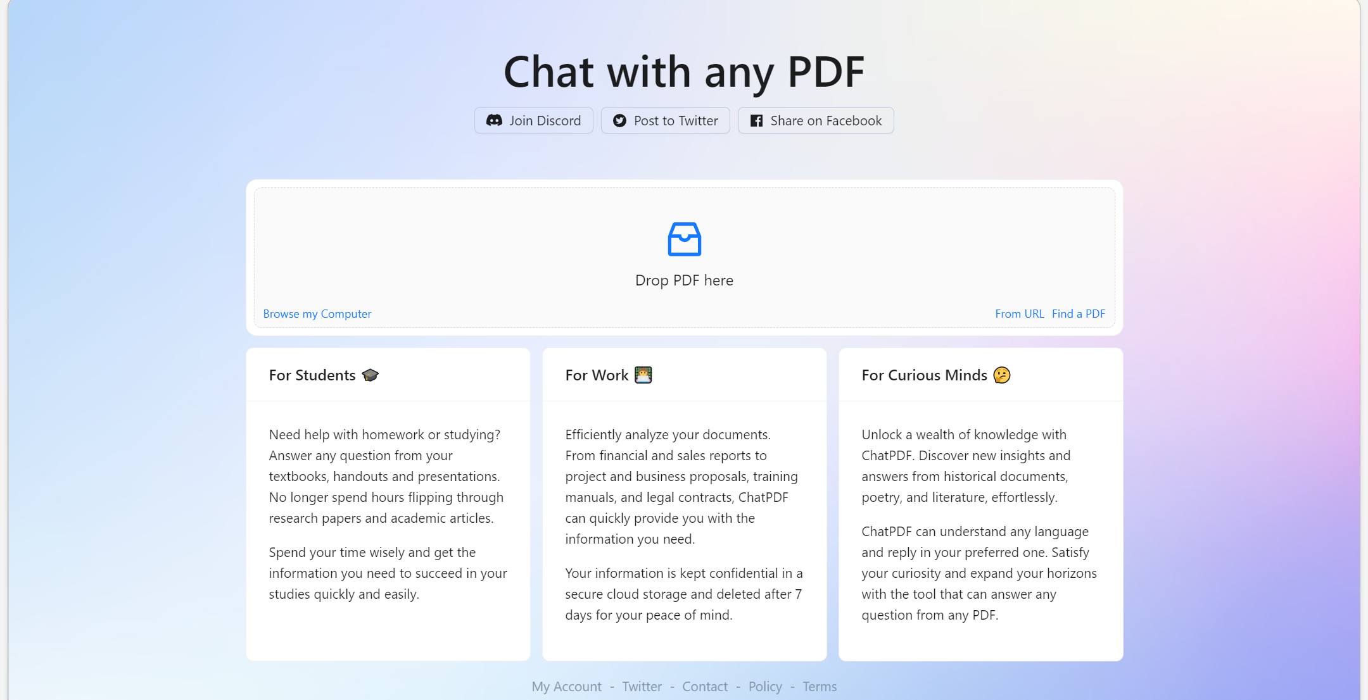
https://www.chatpdf.com/

Slide 36
Extra Task
Read the following article that is available on my website:
Writing a scientific article: A step-by-step guide for beginners

