Slide 1
Academic Presentations
Proposals, Posters and stuff

Slide 2
Professional organizations
Korean Association of Teacher of English (KATE) (www.kate.or.kr)
KATE is the largest ELT organisation here in Korea
Most conference participants are Korean professors and teachers.
KOTESOL (www.kotesol.org)
Monthly workshops in various regional chapters (good place to start)
Pedagogy focused more than research
National conference and International conference
A lot of Non-Korean teachers of English attend
Applied Linguistics Association of Korea (ALAK) (https://alak.jams.or.kr)
ALAK is more research focused.
Yearly international conference yearly.
Mixture of participants but more people with research interests

Slide 3
Common Types of presentations
Workshops
Lectures
Research presentation
Poster presentation
Panel presentation

Slide 4
Why do people present?
Some ways that people end up doing an academic presentation:
They are asked do present by someone
They want to present something
They are required to present something to fulfil your duties ( work, school)
They are forced to present something ( by a teacher, professor, administrator etc.)
Reality
At some point in this field you will do a presentation of some sort.

Slide 5
Good things happen by presenting
Networking
Advertising
May get a free trip ☺
Good for your CV
Will help with job hunting

Slide 6
Preparing for a presentation
Proposal
Abstract
Materials
Powerpoint, Prezi, etc.
Videos
Handouts
Poster

Slide 7
Proposal, abstract, and short bio
The proposal and abstract are often include in the same file
Bio may be included as well or sent separately at a later date

Slide 8
Poster presentation
Going through the steps

Slide 9
TASk: Poster presentation
You are going to create proposal for a poster presentation
You are going to create a poster for the presentation
This can be on the topic you are doing for your project or thesis
It can also be a new topic if you like
You are going to present your poster at a presentation fair
People will walk around and visit your poster and you have to give a short presentation the content when they visit you.

Slide 10
Overview: The proposal vs. The abstract
The Abstract is seen by potential attendees and is meant to attract them. It is often printed in the conference book for them to refer to.
The Proposal is your outline, or description, of your session that the proposal readers use to evaluate your session for inclusion in the conference schedule. Your Proposal is never seen by conference attendees.

Slide 11
The proposal

Slide 12
Good proposals
Clearly written
Have clear objectives
Are relevant, relatable, and interesting to the intended audience
Have a catchy, professional title

Slide 13
Reasons for rejection
Adds nothing new to the field
Outdated content/ topic
Out of the scope of the conference theme
The proposal is poorly written
Unclear
Not proofread
The reviewer didn’t understand it… or just didn’t like it…

Slide 14
TITLEs
Storytelling in Elementary School English Classrooms
Tell Me a Story! Approaches to Storytelling for Young Learners
Willingness to Speak: The Obstacles Students face
Why won’t you speak? Korean high-school students and their willingness to speak English
Teacher I can’t! Looking at factors affecting Korean high-school students’ willingness to speak in English

Slide 15
Make it better
Drama Based Instruction and its Contributions to L2 development
Examining the Pros and Cons of English Only Classrooms
Parents and their Affect on Language Teachers

Slide 16
Sample proposal template

Slide 19
The abstract

Slide 20
Abstract – a 200 - 500 word summary
Is a clear and concise summary of your entire presentation
Captures the attention of the reader
Names the potential target audience
Previews the content and what the attendee can learn
DO NOT include lengthy background information
There is no need to include references here.
Do not be too wordy.

Slide 21
samples
High-stakes Testing Washback
Washback from high-stakes testing has been an important topic of discussion in the Korean context since the introduction of University entrance testing in the1950s. In regards to the education of English in the country, high-stakes testing objective have controlled what is taught and learned in classrooms for decades. Teachers report being unable to teach the way they want to because they have to cater to the needs and expectations of students, parents and other stakeholders who only care about obtaining a high score on the exam. Although this problem has been going on for a long time, nothing has been done to resolve it. The same problem continues to persist with not end in site.

Slide 22
Samples
My Life Depends on It! Addressing the washback of High-stakes English Testing in South Korea
This presentation looks at the impact of high-stakes testing on English teaching and learning over the past 50 years. Attendees will guided through the major issues that have arisen as a result of high-stakes testing washback and introduced to the obstacles that English teachers face as a result at present day. Future directions will be discussed which aim to provide attendees with possible paths that can minimize the negative washback on them for the time-being. Through this presentation attendees will gain a deeper understanding of the high-stakes testing system and its influences on English language education in South Korea, as well as an increased awareness on how to deal with the negative washback at the practitioner level.

Slide 23
Samples
Motivated learners: A focus on the teacher
A common difficulty that teachers often face on a daily basis is dealing with learners who lack motivation; students that just don’t want to be there and have no interest in learning whatsoever. These students often do not see the point or purpose of learning English and therefore often reject it altogether. Various motivational theories have taken aim at the learner and have failed to account for the crucial role that the teacher plays in the entire equation. This workshop aims to discuss some of the key characteristics of a teacher that can either directly promote or destroy student motivation in the classroom. By guiding attendees through a series of reflective thinking activities they will be able to evaluate their own characteristics, pinpoint possible issues and create an action plan that can contribute towards long-term motivation in their learners.

Slide 24
Source for Conference Abstracts
Conference books (ALAK, KOTESOL, KATE)
www.tesol.org
KOTESOL monthly workshops

Slide 25
Biographical Information

Slide 26
What is biographical information
A paragraph of 100 words or less that describes who you are professionally
Let’s readers or attendees know about you
Attracts them to your work

Slide 27
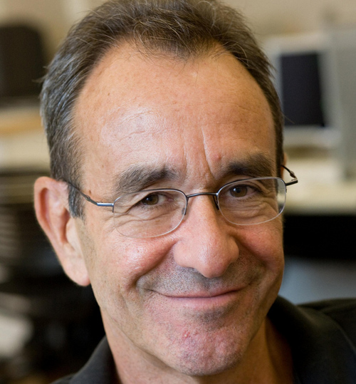
Sample Bios
Scott Thornbury teaches on the MA TESOL program at The New School in New York. His previous experience includes teaching and training in Egypt, UK, Spain, and in his native New Zealand. He has written extensively on areas of language and methodology for Cambridge University Press. He is currently the series editor of the Cambridge Handbooks for Language Teachers.

Slide 28
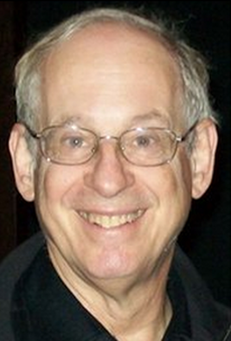
Dr. Stephen Krashen, Professor Emeritus of USC (University of Southern California) has published more than 300 papers as a linguistic researcher. He is most famously known for his Theory of SLA, which includes 5 hypotheses: Acquisition-Learning Hypothesis, the Input Hypothesis, Monitor Theory, the Affective Filter, and the Natural Order Hypothesis. Dr. Krashen is a strong proponent of bilingual education, and has written several papers on the topic. He believes that the mastery of second language greatly augments future cognitive development.

Slide 29
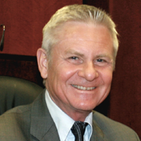
David Nunan, Ph.D., is Vice-President for Academic Affairs and Dean of the Graduate School of Education at Anaheim University. He is a past President of TESOL International Association (2000-01) and the world's leading textbook series author. Dr. Nunan is a world-renowned linguist and best-selling author of English Language Teaching textbooks. David Nunan has been involved in the teaching of graduate programs for such prestigious institutions as the University of Hong Kong, Columbia University, the University of Hawaii, Monterey Institute for International Studies, and many more. In 2002, Dr. Nunan received a congressional citation from the United States House of Representatives for his services to English language education through his pioneering work in online education at Anaheim University.

Slide 30
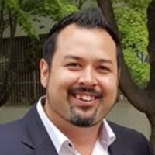
George E.K. Whitehead is assistant professor at the International Graduate School of English, South Korea. His previous experience includes language teaching and language teacher education in Canada, Japan, and South Korea. George’s research interests include the contextualization of language teacher education, second language teacher assessment, critical L2 pedagogy, language teacher leadership, and language teacher conceptual change. His published work has appeared in journals such as RELC, Asian EFL Journal, and System.

Slide 31
Biographical Information
Biographical information: not more than 70 words, should be written in Times Roman 12, single space in *.*.doc format
Biographical information framework:
1. who you are and your position (work or student)
… is a graduate student in the ____ program at the International Graduate School of English
What have you done (work, presentations, publications?)
… has worked as a ……
… has presented at…
… has published …. In…
What are your academic interests?
… research interests include….

