Slide 1
Academic Presentations
Proposals, Posters and stuff

Slide 2
Professional organizations
Korean Association of Teacher of English (KATE) (www.kate.or.kr)
KATE is the largest ELT organisation here in Korea
Most conference participants are Korean professors and teachers.
KOTESOL (www.kotesol.org)
Monthly workshops in various regional chapters (good place to start)
Pedagogy focused more than research
National conference and International conference
A lot of Non-Korean teachers of English attend
Applied Linguistics Association of Korea (ALAK) (https://alak.jams.or.kr)
ALAK is more research focused.
Yearly international conference yearly.
Mixture of participants but more people with research interests

Slide 3
Common Types of presentations
Workshops
Lectures
Research presentation
Poster presentation
Panel presentation

Slide 4
Why do people present?
Some ways that people end up doing an academic presentation:
They are asked do present by someone
They want to present something
They are required to present something to fulfil your duties ( work, school)
They are forced to present something ( by a teacher, professor, administrator etc.)
Reality
At some point in this field you will do a presentation of some sort.

Slide 5
Good things happen by presenting
Networking
Advertising
May get a free trip ☺
Good for your CV
Will help with job hunting

Slide 6
Preparing for a presentation
Proposal
Abstract
Materials
Powerpoint, Prezi, etc.
Videos
Handouts
Poster

Slide 7
Proposal, abstract, and short bio
The proposal and abstract are often include in the same file
Bio may be included as well or sent separately at a later date

Slide 8
Poster presentation
Going through the steps

Slide 9
TASk: Poster presentation
You are going to create proposal for a poster presentation
You are going to create a poster for the presentation
This can be on the topic you are doing for your project or thesis
It can also be a new topic if you like
You are going to present your poster at a presentation fair
People will walk around and visit your poster and you have to give a short presentation the content when they visit you.

Slide 10
Overview: The proposal vs. The abstract
The Abstract is seen by potential attendees and is meant to attract them. It is often printed in the conference book for them to refer to.
The Proposal is your outline, or description, of your session that the proposal readers use to evaluate your session for inclusion in the conference schedule. Your Proposal is never seen by conference attendees.

Slide 11
The proposal

Slide 12
What does it include
An abstract
A short description of your presentation (usually 200-300 words)
Your Bio
A short description of yourself (Usually 100-150 words)

Slide 13
Good proposals
Clearly written
Have clear objectives
Are relevant, relatable, and interesting to the intended audience
Have a catchy, professional title

Slide 14
Reasons for rejection
Adds nothing new to the field
Outdated content/ topic
Out of the scope of the conference theme
The proposal is poorly written
Unclear
Not proofread
The reviewer didn’t understand it… or just didn’t like it…

Slide 15
Biographical Information

Slide 16
What is biographical information
A paragraph of 100 words or less that describes who you are professionally
Let’s readers or attendees know about you
Attracts them to your work

Slide 17
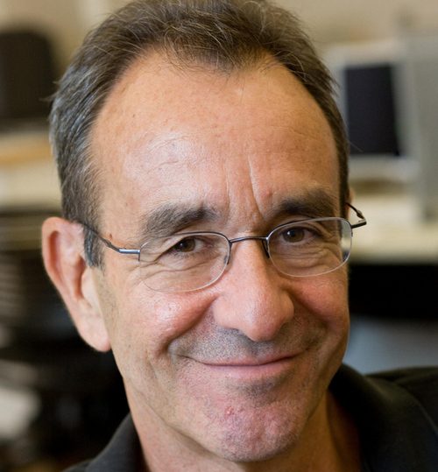
Sample Bios
Scott Thornbury teaches on the MA TESOL program at The New School in New York. His previous experience includes teaching and training in Egypt, UK, Spain, and in his native New Zealand. He has written extensively on areas of language and methodology for Cambridge University Press. He is currently the series editor of the Cambridge Handbooks for Language Teachers.

Slide 18
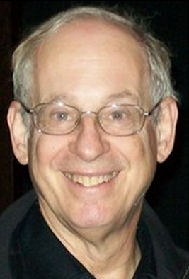
Dr. Stephen Krashen, Professor Emeritus of USC (University of Southern California) has published more than 300 papers as a linguistic researcher. He is most famously known for his Theory of SLA, which includes 5 hypotheses: Acquisition-Learning Hypothesis, the Input Hypothesis, Monitor Theory, the Affective Filter, and the Natural Order Hypothesis. Dr. Krashen is a strong proponent of bilingual education, and has written several papers on the topic. He believes that the mastery of second language greatly augments future cognitive development.

Slide 19
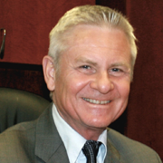
David Nunan, Ph.D., is Vice-President for Academic Affairs and Dean of the Graduate School of Education at Anaheim University. He is a past President of TESOL International Association (2000-01) and the world's leading textbook series author. Dr. Nunan is a world-renowned linguist and best-selling author of English Language Teaching textbooks. David Nunan has been involved in the teaching of graduate programs for such prestigious institutions as the University of Hong Kong, Columbia University, the University of Hawaii, Monterey Institute for International Studies, and many more. In 2002, Dr. Nunan received a congressional citation from the United States House of Representatives for his services to English language education through his pioneering work in online education at Anaheim University.

Slide 20
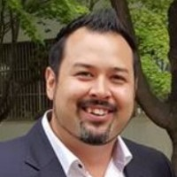
Dr. George E. K. Whitehead currently works as an assistant professor in the Graduate School of TESOL at Hankuk University of Foreign Studies. Over the past 20 years, Dr. Whitehead has held professional positions in Canada, Japan, and Korea as a language instructor, curriculum developer, teacher-educator, assistant professor, and director of university TESOL programs. His main research interests include language teacher education and development, language teacher leadership, critical second language pedagogy, and the development of context-specific language teaching and learning practices. His published work has appeared in various top journals in the field such as TESOL Quarterly, Modern Language Journal, Language Teaching Research, and System.

Slide 21
Biographical Information
Biographical information: not more than 100 words, should be written in Times Roman 12, single space in *.*.doc format
Biographical information framework:
1. who you are and your position (work or student)
… is an M.A. graduate student in the ___(English Language Teaching/ Materials Development & Technology)__Department at Hankuk University of Foreign Studies, Graduate School of TESOL.
What have you done (work, presentations, publications?)
… has worked as a ……
… has presented at…
… has published …. In…
What are your academic interests?
… research interests include….

Slide 22
The abstract

Slide 23
Abstract – a 200 - 500 word summary
Is a clear and concise summary of your entire presentation
Captures the attention of the reader
Names the potential target audience
Previews the content and what the attendee can learn
DO NOT include lengthy background information
There is no need to include references here.
Do not be too wordy.

Slide 24
Samples
“My Life Depends on It…” Addressing the washback of High-stakes English Testing in South Korea
This poster presentation presents the impact of high-stakes testing on English teaching and learning over the past 50 years. This poster guides attendees through the major issues that have arisen as a result of high-stakes testing washback and introduces the obstacles that English teachers face as a result at present day. Future directions are provided which aim to suggest possible paths that can minimize the negative washback on them for the time-being. Through this poster presentation attendees will gain a deeper understanding of the high-stakes testing system and its influences on English language education in South Korea, as well as an increased awareness on how to deal with the negative washback at the practitioner level.

Slide 25
EMART: Creating Music Videos through the integration of English, Music, and Art
In this workshop, attendees will be guided through a lesson which incorporates elements of language, music, and art to create a simple and attractive music video. During this workshop, attendees will participate in the lesson as learners, and will also be debriefed about the pedagogy and supporting theory so that they can experience how it works from both the inside and out. Attendees will also be introduced to simple procedures and technological tools to create music videos or slide shows quickly and easily without needing video editing software. Through this workshop, attendees will develop their abilities to use simple software to create teaching materials, and gain familiarity and understanding with a new, simple, fun special lesson for their learners which can be used when the situation permits.

Slide 26
Young English language learners: Key considerations for their optimal development in the South Korean setting
Young English language learners (YELLs)­—those before the age of 10— are developing in many ways (e.g., physically, emotionally, socially, cognitively, and linguistically) at a rather rapid rate. In the field of English language education, there has been a large amount of discussion about when children should begin learning a second language, how they should learn a second language (e.g., studying at home with parents, studying abroad, sending them to a private English academy) and how to tell whether the education they are receiving is helping or hindering their overall development of the language. This workshop will guide attendees through a series of key considerations in approaching YELLs’ English language development in South Korea. Throughout the workshop, attendees will be placed into breakout rooms to share their thoughts and opinions on various key questions related to YELLs’ development. Attendees will also apply what they have learned through situational application tasks in which they are placed in a position in which they must give advice to a friend, colleague, or parent based on the key considerations covered in this workshop. Through this workshop, attendees will increase their knowledge and understanding of how to approach YELLs and foster their ability to knowledgeably advise others on key factors they need to consider when they approach the development of YELLs.

Slide 27
What do they need to succeed? Examining language teachers’ core competencies at the local level in South Korea
One of the key issues in language teacher education has been, and continues to be, understanding what teachers need to learn and develop in order to succeed in their profession. To date, most research in this area has been conducted in native-speaking ESL countries and has led to ‘golden global standards’ (see Canagarajah, 2005) which fail to take into account the situated and dynamic nature of teaching and the contextually specific competencies teachers require. In this presentation I discuss the first stage of a two-stage doctoral research project which examined Korean in-service secondary school English teachers’ core competencies. Data were collected from 15 in-service teachers and 15 teacher educators through one-on-one semi-structured interviews as well as recorded video observations of 10 of the in-service teacher participants. I first discuss the findings of this stage of the study under the major core competency themes that emerged: Pedagogical competencies, Self competencies, and Administrative competencies, and present the full descriptive profile which includes the specific knowledge, skills, and abilities that fell under each of these major categories. I then conclude with outlining the implications of these findings on a global scale and suggest important directions for future research in this area.

Slide 28
Source for Conference Abstracts
Conference books (ALAK, KOTESOL, KATE)
www.tesol.org
KOTESOL monthly workshops

