Slide 1
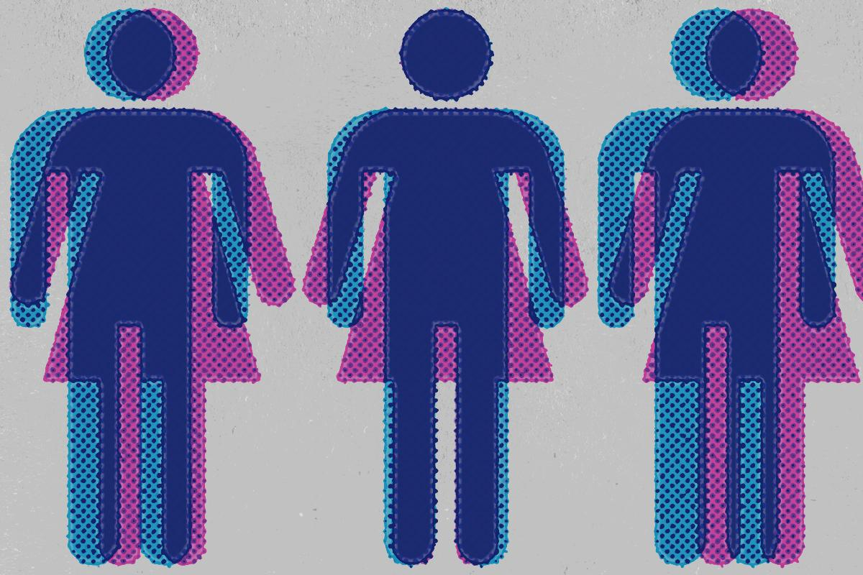
A Women’s Place

Slide 2
Discussion
When you were young did your mother work outside of the home?
What things did you expect your mother to do and what things did you expect your father to do?

Slide 3
Gender Roles
Women’s roles in the past vs. now
Why have things changed?

Slide 4
Gender Stereotypes
Men are good at…
Women are good at…
Men are better than women at these jobs…..
Women are better then men at these jobs….
Men and women are relatively equal at these jobs…

