Slide 1
A Guided Analysis of Effective Language Teaching
George E.K. Whitehead

Slide 2
Today’s Class Purpose: to stimulate critical reflection of your teaching practices
Introduction to key points in effective language teaching
DECA Framework for observing lessons
Video observation and feedback
Discussion and reflection

Slide 3
Key Points In Effective Language Teaching
Also…
BAD

Slide 4
When you think of ineffective language teachers what comes to your mind?

Slide 5
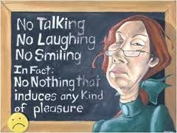
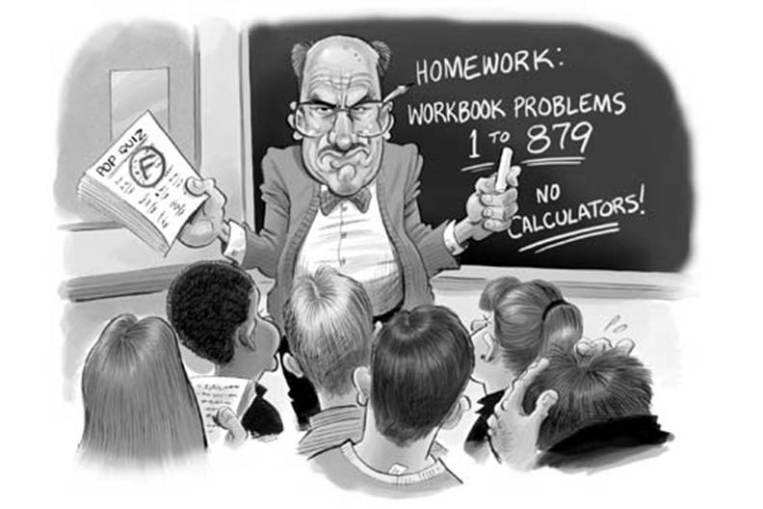
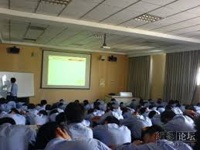
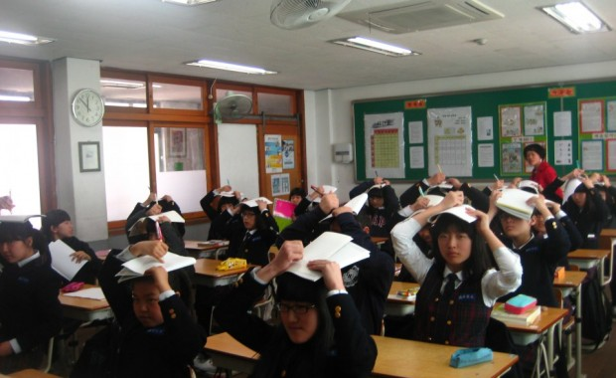
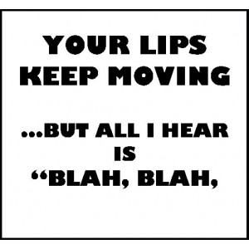
Ineffective language teachers

Slide 6
When you think of effective language teachers what comes to your mind?

Slide 7
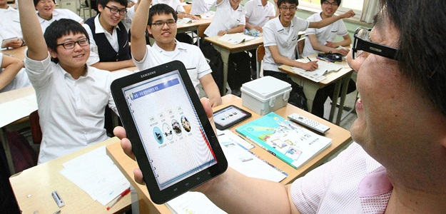
Effective language teachers

Slide 8
What are the characteristics of effective language teachers?

Slide 9
No Secret Recipe
There is no “secret recipe” for being an effective teacher. (Coombe, 2014)
Different teachers have different styles that work for them.
Using quality ingredients will help you create your own effective recipe.

Slide 10
Background
Observation of over 3000 teachers of English in various contexts.
Emergent qualities and characteristics shared amongst teachers who were most effective.
Effective = The teacher positively contributed to a context in which language learning and development can occur.

Slide 11
Characteristics of Effective Teachers
Delivery
Environment
Content
Attitude

Slide 12
Delivery
Does the teacher’s delivery style engage and excite the learners?
Does the teacher maximize student participation/ involvement in the lesson?
Does the teacher monitor the participation and involvement in classroom activities/ tasks?
BONUS POINT: Does the teacher participate in activities with learners?
Does the teacher speak at the level of students’ comprehension?
Does the teacher deliver the lesson in a way that is easy to understand?
Is the teacher’s delivery flexible? Does it cater to the moment to moment needs of the learners and classroom situation?
Is the teacher’s delivery interactive?
Does the teacher’s delivery focus on quality or quantity?

Slide 13
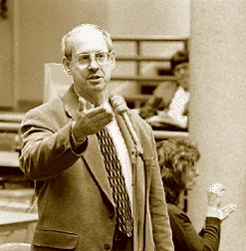
Environment
blockage can be reduced by sparking interest, providing low-anxiety environments, and increasing the learner's self-esteem.
Affective Filter Hypothesis
certain emotions, such as anxiety, self-doubt, and boredom interfere with the process of acquiring a second language
(Krashen, 1982)

Slide 14
Environment
Is the classroom a positive/ happy/ motivational setting?
Is the environment low-risk and supportive for learners?
Does the classroom setup facilitate interaction?
Does the environment support peer scaffolding opportunities?
Does the classroom setup allow for the teacher to monitor all students?
Is the environment decorated in a way that supports students’ development?
Does the environment reflect strong rapport and comfort between the teacher and students?
Does the environment reflect strong rapport and comfort between students?

Slide 15
Content
Is the content difficulty appropriate for the students’ level?
Does the content relate to the students’ age, interests, and experiences?
Is it engaging/ exciting/ compelling to the learners?
Is the lesson content clear and well organized?
Is the content of the lesson accurate?
Is the content of the lesson visually appealing?
Do the visuals being used assist understanding (i.e. pictures are clear, have a direct link to supporting understanding)?
Are videos being used relevant to the lesson, and not too long (be careful of the zombie effect!)?

Slide 16
Attitude
Does the teacher appear passionate, positive, and motivated?
Does the teacher appear to genuinely care about the learners?
Does the teacher have a flexible and friendly attitude towards students?
Does the teacher have a positive, can do it, attitude overall?
Does it appear to be genuine or robotic?
Does the teacher encourage learners rather than discourage/ force?
Is the teachers’ attitude a good model for students to follow?
Does the teacher seem approachable?
Is the teachers’ attitude respectful of students?
Does the teacher appear to be confident?

Slide 17
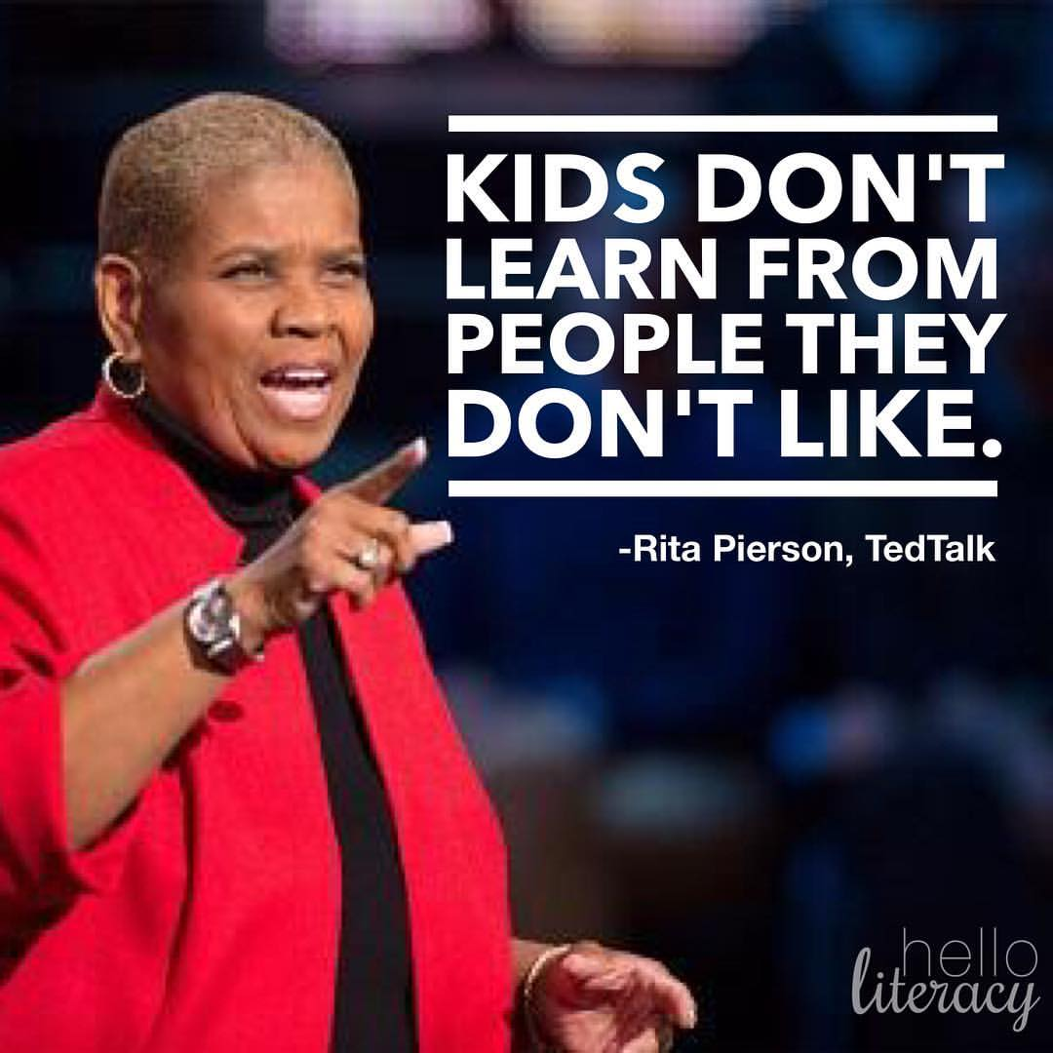
BONUS- General Likeability
Sanders, T. (2005). The likeability factor: How to boost your L-factor & achieve your life's dreams. New York: Crown.

Slide 18
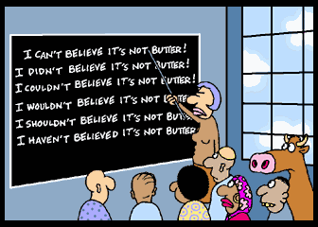
Video Observations

Slide 19
Things I hope to see in your lessons…
When presenting lesson aims, present them in a way that students can understand.
Today we are going to (do, learn about, discuss)…
By the end of today’s lesson I hope you will (be able to understand x better, know more about x etc.)

Slide 20
Things I hope to see in your lessons…
When using visual aids
Make sure visual aids are relevant and clearly connected to the language or meaning you are trying to facilitate.
Video clips for lead-in 60-90 seconds is usually sufficient.

Slide 21
Things I hope to see in your lessons…
Teacher talk
Mixture of English and Korean is fine.
Important that when using English you adapting your speech to meet students level of comprehension.
Be careful of asking ‘Do you understand?, Got it? Can you do that? Right?
Be careful of asking ‘ Was if fun? Was if funny? Did you enjoy?

Slide 22
Things I hope to see in your lessons…
A positive attitude.
Delivering the lesson in a way that engages learners ( and does not bore them).
An environment where students feel comfortable (but not too comfortable).
Contextualizing what students are learning to things that they can relate to.

Slide 23
Reflection Time
Take a moment to reflect on your own Delivery, Environment, Content, and Attitude …
Based on today’s workshop, are there any areas you think you could improve?
How could you go about doing this?

Slide 24
Thank you
Email: prof.gwhitehead@gmail.com
URL: profgwhitehead.weebly.com
Facebook: https://www.facebook.com/groups/gifle/

Slide 25
References
Coombe, C. (2014). 10 Characteristics of Highly Effective EF/SL Teachers. Perspectives TESOL Arabia, 22(2), pp.6-12.
Krashen, S. (1982). Principles and practice in second language acquisition(Vol. 2). Pergamon: Oxford.
Pierson, R. (2013). Every child needs a champion [Video file]. Retrieved from https://www.ted.com/talks/rita_pierson_every_kid_needs_a_champion
Sanders, T. (2005). The likeability factor: How to boost your L-factor & achieve your life's dreams. New York: Crown.

